Slide 1

Investigation of Wattpad stories
Rupali Mayekar
David Richter
Luke Pharr
Andrea Karaffa
UTDataJan Tues/Thurs: Team 3

Slide 2

"Wattpad takes everything you love about storytelling, and turns it into a social, on-the-go experience. The result is a one-of-a-kind adventure in creation and discovery of stories. Today, the global Wattpad community is made up of more than 65 million people. We’re proudly based in Toronto, Canada, but Wattpad stories transcend borders, interests, and language.“
https://www.wattpad.com/about/
Notes:
Andrea – it’s like Soundcloud for stories

Slide 3
Background
Hypothesis
Motivation
Summary & Outcome
Wattpad is a good source to explore the increasing trend of creating and consuming stories on-the-go.
Desire to understand the users—readers and writers—and Wattpad’s global footprint.
The dataset available from the Wattpad API does not represent historical usage of the app. User data was not available, so research questions focused on story data.
Notes:
Andrea
Define the core message or hypothesis of your project.
Describe the questions you asked, and why you asked them
Describe whether you were able to answer these questions to your satisfication, and briefly summarize your findings
-WattPad is an application improving accessibility to publishing and reading stories on the go, but the API is still under development and is not reflective of the actual app usage yet.

Slide 4
Questions & Data
Research Questions | Data Required
What is the average popularity by read count, vote count, comment count? | Story ID, Read Count, Vote Count, Comment Count
What are the most popular categories? | Story ID, Vote Count, Read Count, Comment Count, Categories, Tags
How many stories are published annually? | Story Id, Created Date
What is the average time to complete a story? | Story ID, Created Date, Modify Date
What is the average number of chapters in a story? | Story ID, Number of Parts
Does story length correlate to number of readers? | Story ID, Read Count, Number of Parts
Does the sentiment analysis provide a link to the story tags? | Story ID, description, tags
Average popularity by story rating? | Story ID, rating
What are the most popular languages? | Story ID, language
All data acquired from api.wattpad.com
Notes:
We set out to answer 9 questions related to stories, languages and categories.

Slide 5
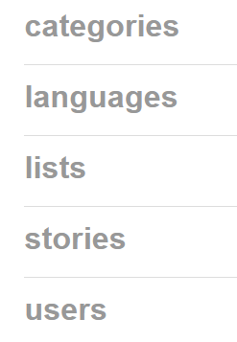
The Process: API Query to Analysis
3. Pulling Data into Data Frame
2. Connect to the API
1. Document Research Questions
6. Export to CSV
5. Remove unwanted data
4. Run script daily, merge and remove duplicates**
Create plots / Standard formats
Adjust API query / Research questions
Wattpad API’s used:
** Process Step Added to Address the following difficulties:
Quantity of data records lower than expected Data changed daily
Notes:
David -
Describe the exploration and cleanup process
Discuss insights you had while exploring the data that you didn't anticipate
Discuss any problems that arose after exploring the data, and how you resolved them
Present and discuss interesting figures developed during exploration, ideally with the help of Jupyter Notebook

Slide 6
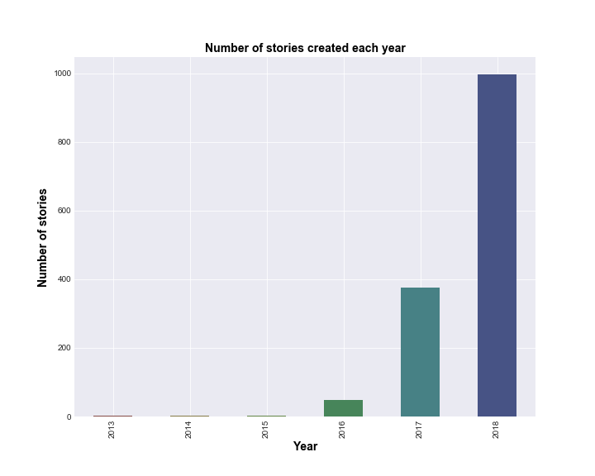
Story Trends
167
19
Avg number of chapters in a story
59,780
Avg number of words in a story
Avg days to complete story post
Most numerous stories occur in the year 2018, increasing annually
Dataset analyzed is pulling from most recent records and does not provide good historical trending
Notes:
Andrea

Slide 7
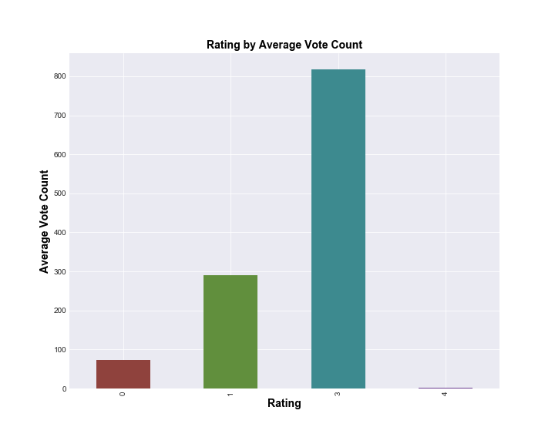
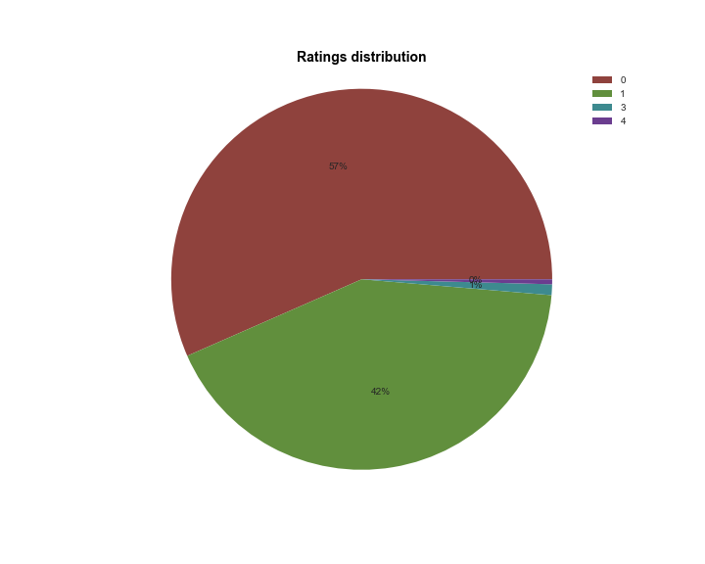
Story Ratings
Ratings related to story popularity
?
99% of stories have ratings of 0 or 1
Stories in the dataset are more recent, and require more time to receive votes
OR
Stories in the dataset are just not very good
Notes:
Andrea

Slide 8
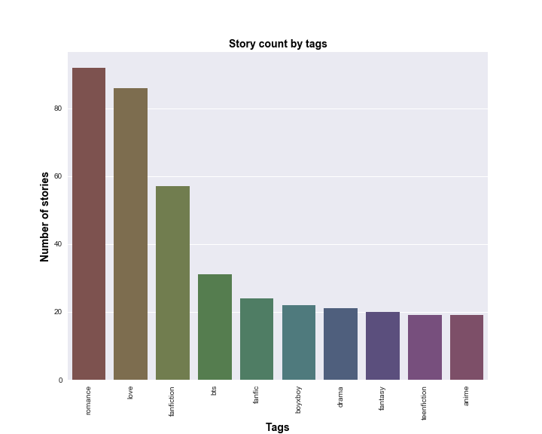
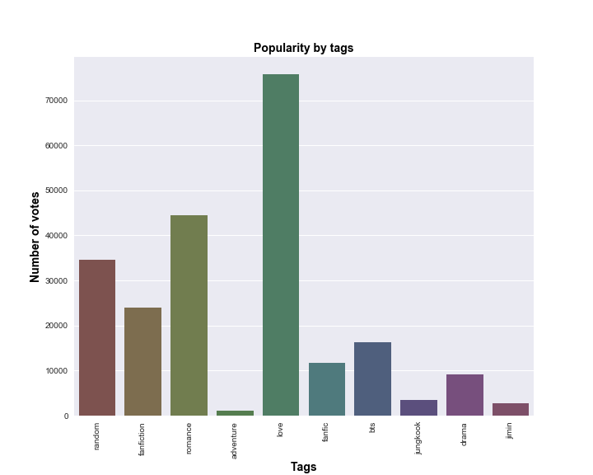
Story Tags
Wattpad writers and users like Love, Romance Fanfiction
(Love, romance, fanfiction are most applied tags, and tagged to stories with highest number of votes)
Notes:
Rupali

Slide 9
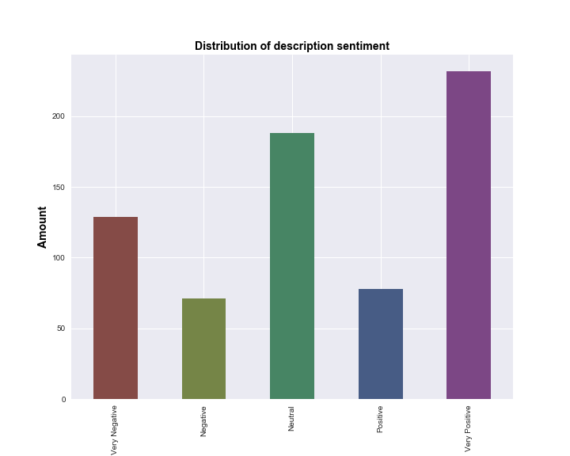
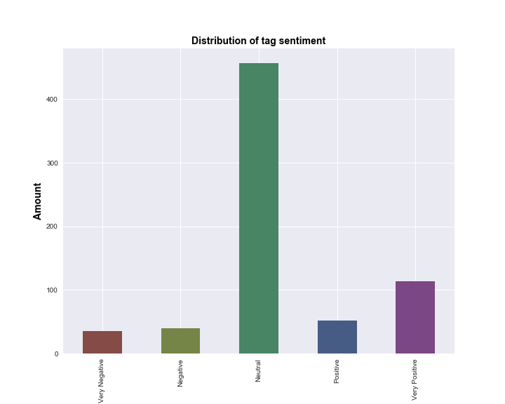
Tag and Description Sentiment
Combining average tag sentiments results in neutral sentiment
Sentiment between story tags and description is not consistent
Description sentiment is likely more representative of the story because the averaged tag sentiment causes multiple sentiments to be averaged out
Notes:
Luke

Slide 10
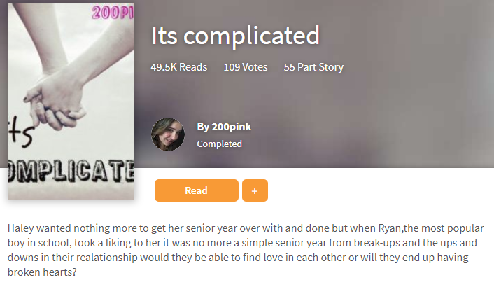
Discussion
Lessons Learned
Commit and push OFTEN Test data set early Commit to a topic not an API
General Themes
Romance, love and fanfiction are well received themes on Wattpad More recent stories have lower ratings Combining compound sentiment of individual story tags neutralizes sentiment
Notes:
Andrea
Discuss your findings. Did you find what you expected to find? If not, why not? What inferences or general conclusions can you draw from your analysis?

Slide 11
Conclusion
Difficulties
API not well documented, difficulty with pagination, API call queries
Unanswered questions
Number of users globally and locally?
If We Had More Time…
Datasets do not appear to represent app as a whole
Which markets and languages are most widely read?
Analyze individual story parts
Query API daily and continue to build existing dataset
Research better sources to understand mobile reader trends
Utilize other NLP tools to see if they yield different results
Notes:
Andrea

Slide 12
Q & A

