Slide 1

GURUKUL (E-learning Platform)
Internal Guide : Professor Ashwini Kshatriya
External Guide : Pallav Mamtora
Project developer : Vasava Vishwanath
Roll number : 22-CS-018

Slide 2

Company Profile
Company Name : Techmicra IT Solutions
About :
Techmicra IT Solutions company formed in 2013 based in Ahmedabad (Gujarat) Techmicra's brought together shrewd innovations comprise of reserved gadgets and activities refined over our broad experience to offer various results that guarantee unwavering quality consumption control and business refinement.
The company started with web development and design solutions during its inception phase and now has more than 25 departments like CRM development, Branding solutions, ERP implementation solutions, database administration & development, business intelligence and data analytics and more.
Address :
Office No. 408, 4th Floor, Ashwamegh Elegance III, Nr. CN Vidhyalay, opp. SBI Zonal office, Ambawadi, Ahmedabad, Gujarat 380015
Contact :
Email : pallav@techmicra.in
Phone : +91 9727835207

Slide 3
Project introduction
The Gurukul E-Learning Website is a role-based digital learning platform designed to provide a structured and centralized environment for online education. The system connects administrators, teachers, and students through clearly defined workflows that support course creation, content management, learning activities, assessments, and certification processes. Its primary goal is to modernize the educational experience by transforming traditional teaching methods into a digital ecosystem where academic content can be created, reviewed, published, and monitored efficiently while maintaining quality standards and organized system management.
Within the platform, administrators manage overall operations such as reviewing courses, publishing approved content, monitoring certificates, and analyzing platform performance through dashboards.
Teachers contribute by creating courses, adding modules and lessons, preparing quizzes and assignments, and submitting content for approval, ensuring a structured academic flow.
Students engage with the system by browsing courses, learning lessons, completing quizzes and assignments, tracking progress, and downloading certificates upon successful completion. Together, these interconnected workflows create a complete learning lifecycle that demonstrates a practical and scalable e-learning solution for modern educational environments.

Slide 4
System Requirements & Gatherings
The Gurukul E-Learning platform has 3 entities Admin, teacher and student.
ADMIN :
→ Admin can securely log into the system using authorized credentials.
→ Admin can access the Admin Dashboard to manage overall platform operations.
→ Admin can view and manage all registered users within the system.
→ Admin can review submitted courses before approval.
→ Admin can publish approved courses and make them available to students.
→ Admin can monitor issued certificates and completion records.
→ Admin can access platform analytics to track performance and activity.

Slide 5
System Requirements & Gatherings
TEACHER :
→ Teacher can securely log into the system with assigned credentials.
→ Teacher can access the Teacher Dashboard to manage teaching activities.
→ Teacher can create a new course with required details and structure(paid and free.
→ Teacher can add modules to organize course content logically.
→ Teacher can add lessons inside modules for structured learning delivery.
→ Teacher can create quizzes to evaluate student understanding.
→ Teacher can create assignments for practical assessment.
→ Teacher can submit the completed course for administrative review and approval.
→ Teacher can grade student submissions and provide evaluation feedback.

Slide 6
System Requirements & Gatherings
STUDENT :
→ Student can securely log into the platform using registered credentials.
→ Student can access the Student Dashboard to manage learning activities.
→ Student can browse available courses published on the platform.
→ Student can open the curriculum to view course structure and modules.
→ Student can learn lessons through provided educational content.
→ Student can mark lessons as completed to update progress tracking.
→ Student can attempt quizzes associated with the course.
→ Student can submit assignments for evaluation.
→ Student can track overall learning progress within the dashboard.
→ Student can download certificates after successful course completion.
→ Student can enroll in paid courses.

Slide 7










Tools and Technologies
Frontend :
Backend :
Database :
Presentation :
IDE :
React.js
MS PowerPoint
Vs code
Node.js
CSS3
Express.js
Backend API testing :
Documentation :
Vite
Postman
MS Word

Slide 8
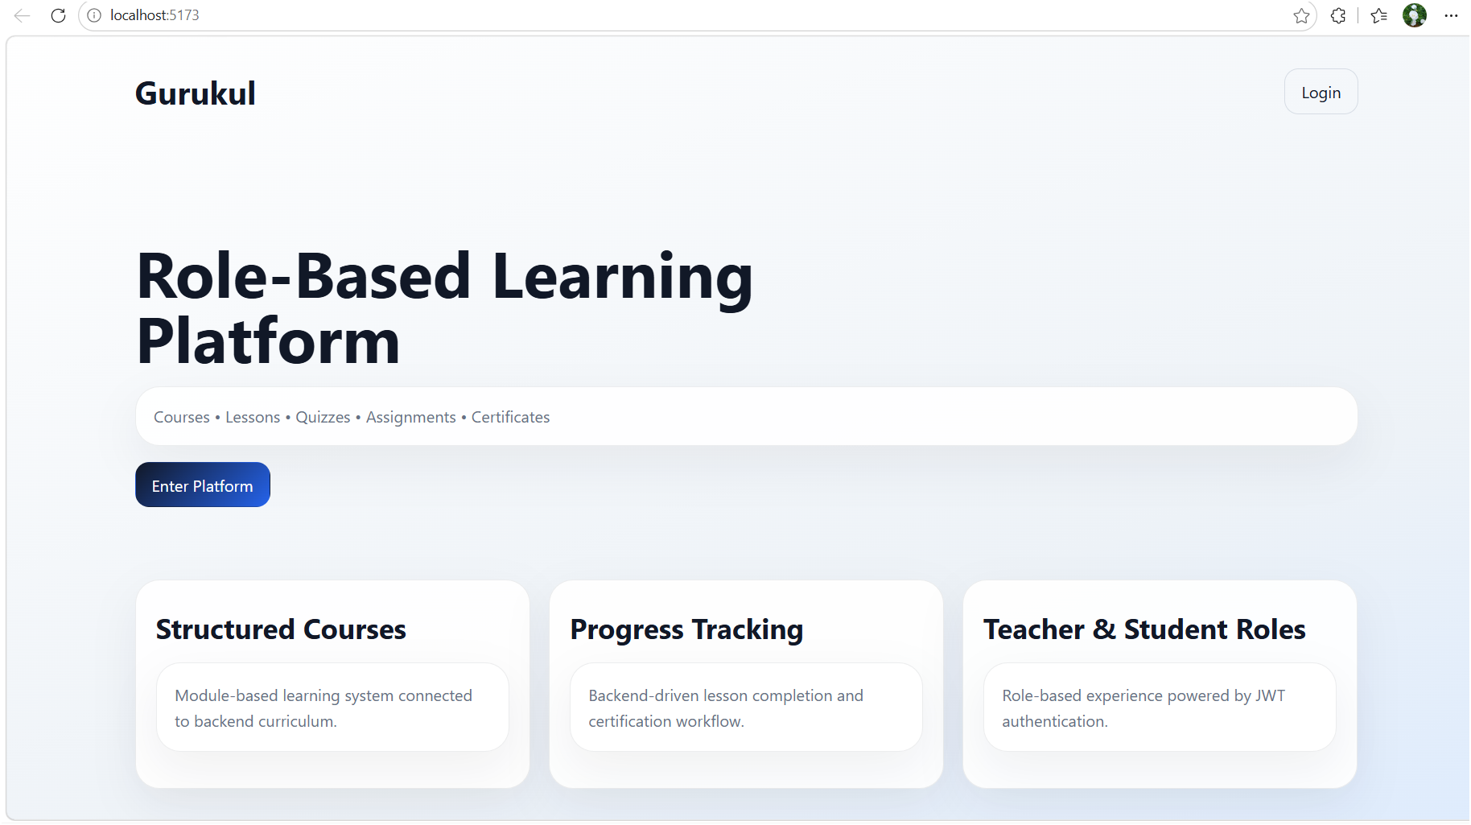
Landing Page

Slide 9
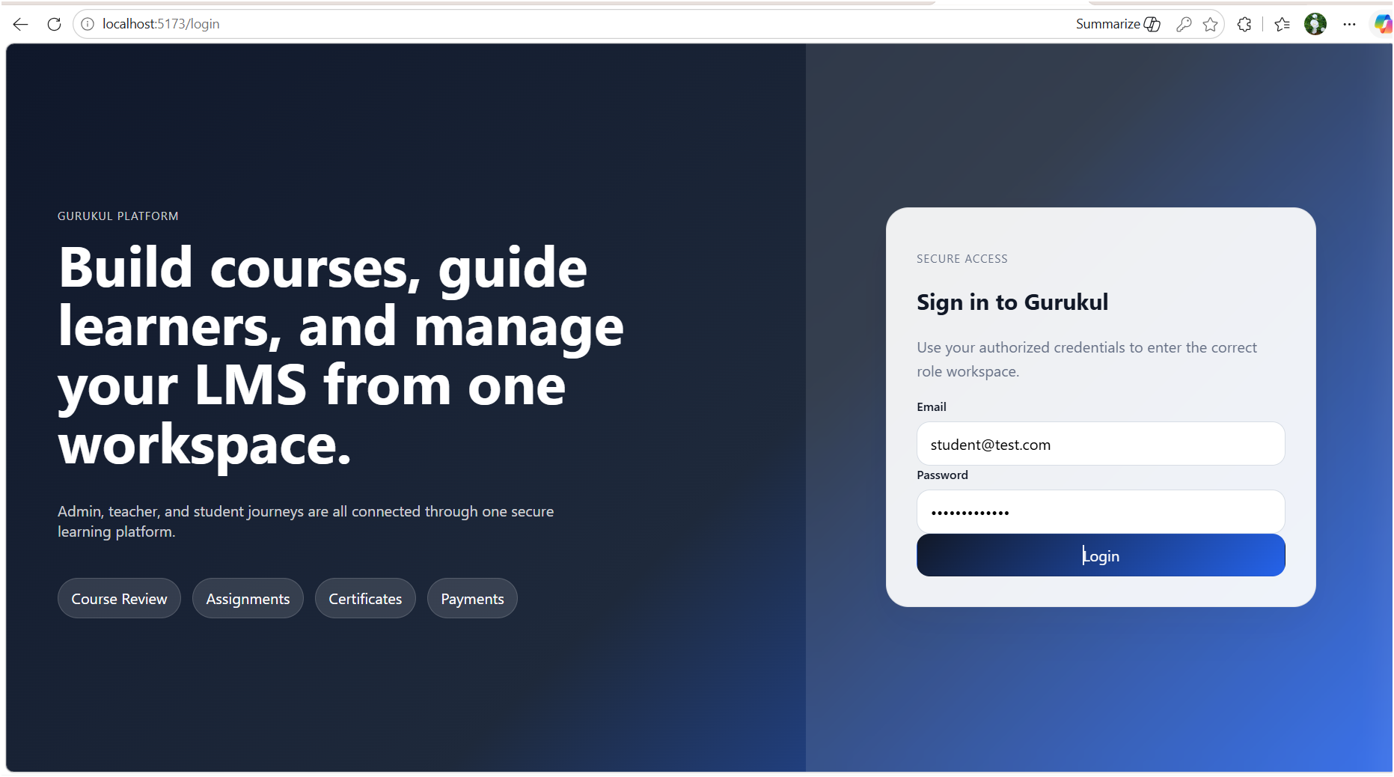
Login Page

Slide 10
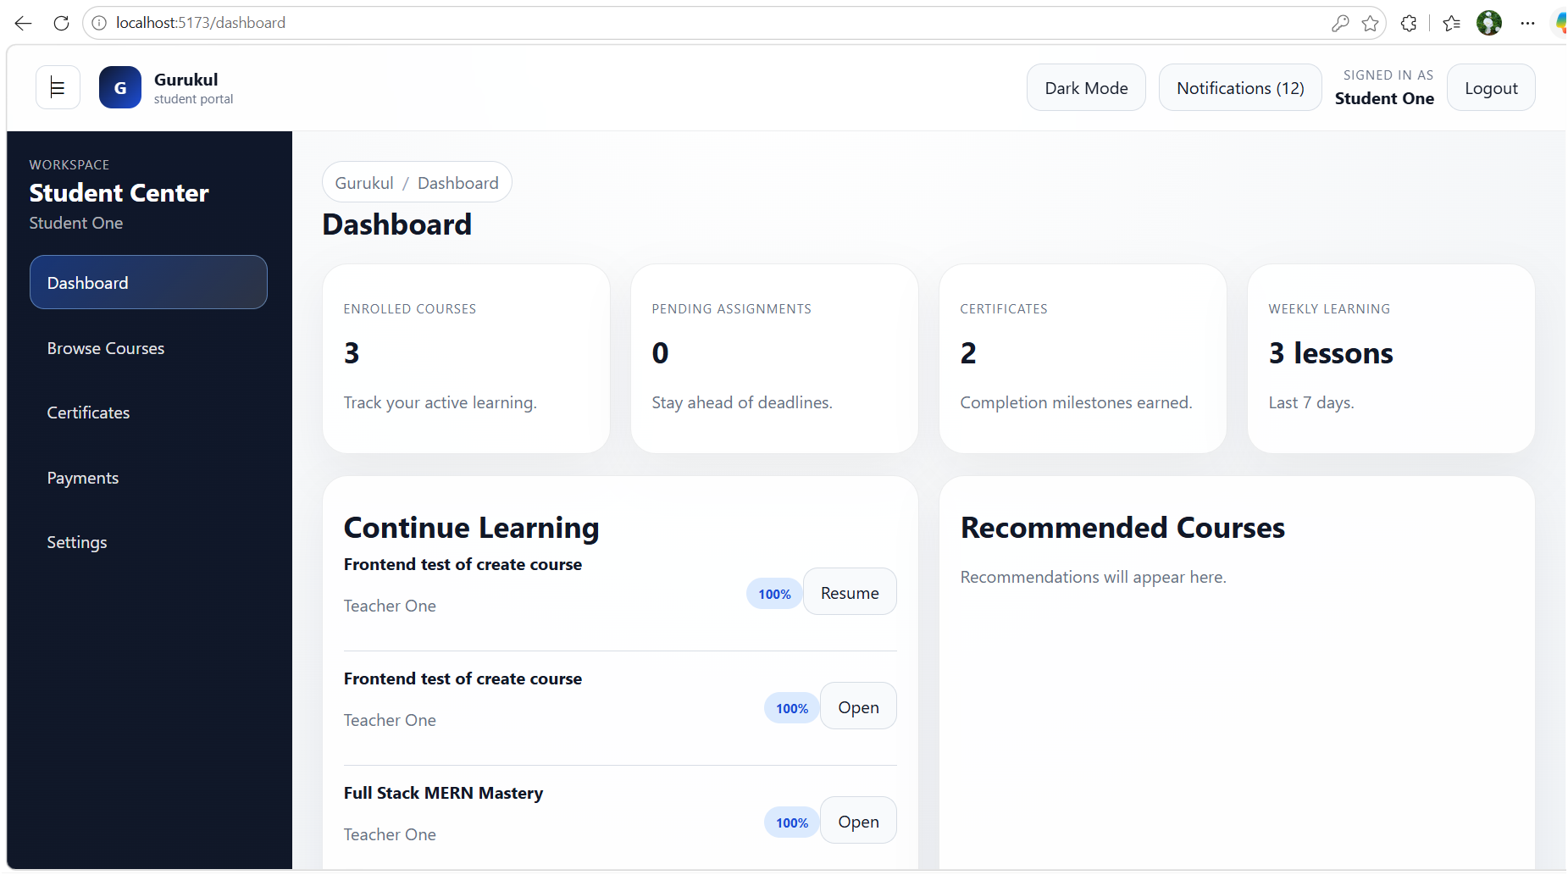
Student Pages

Slide 11
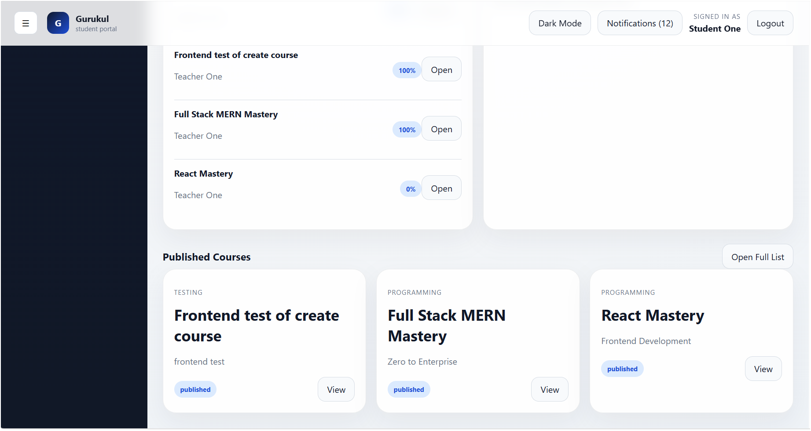
Student Pages

Slide 12
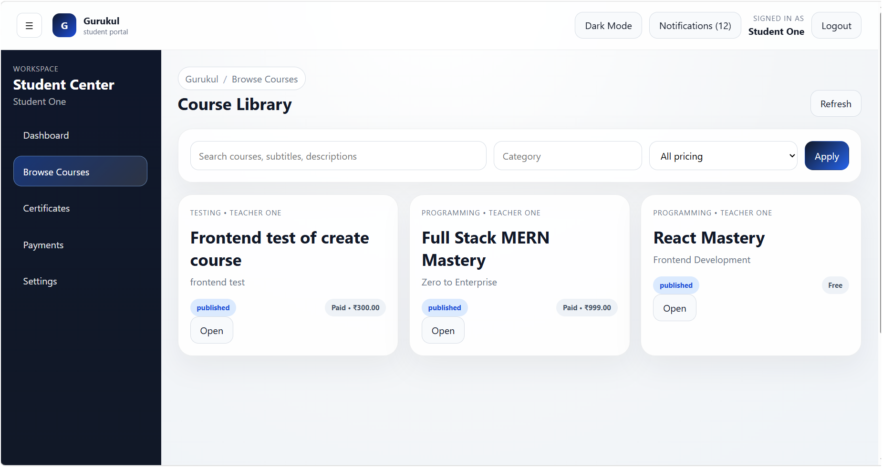
Student Pages

Slide 13
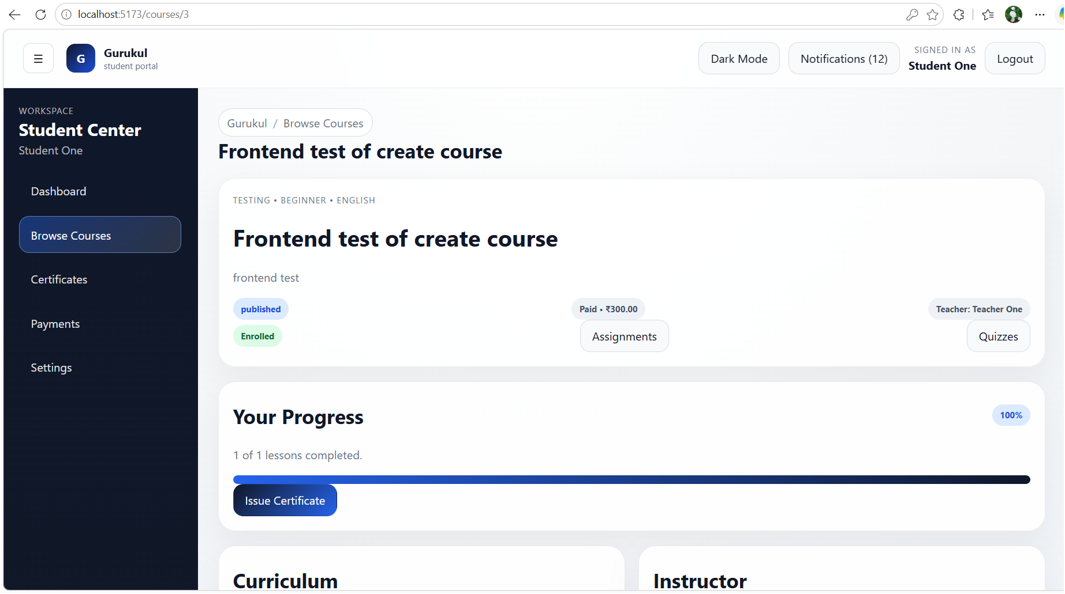
Student Pages

Slide 14
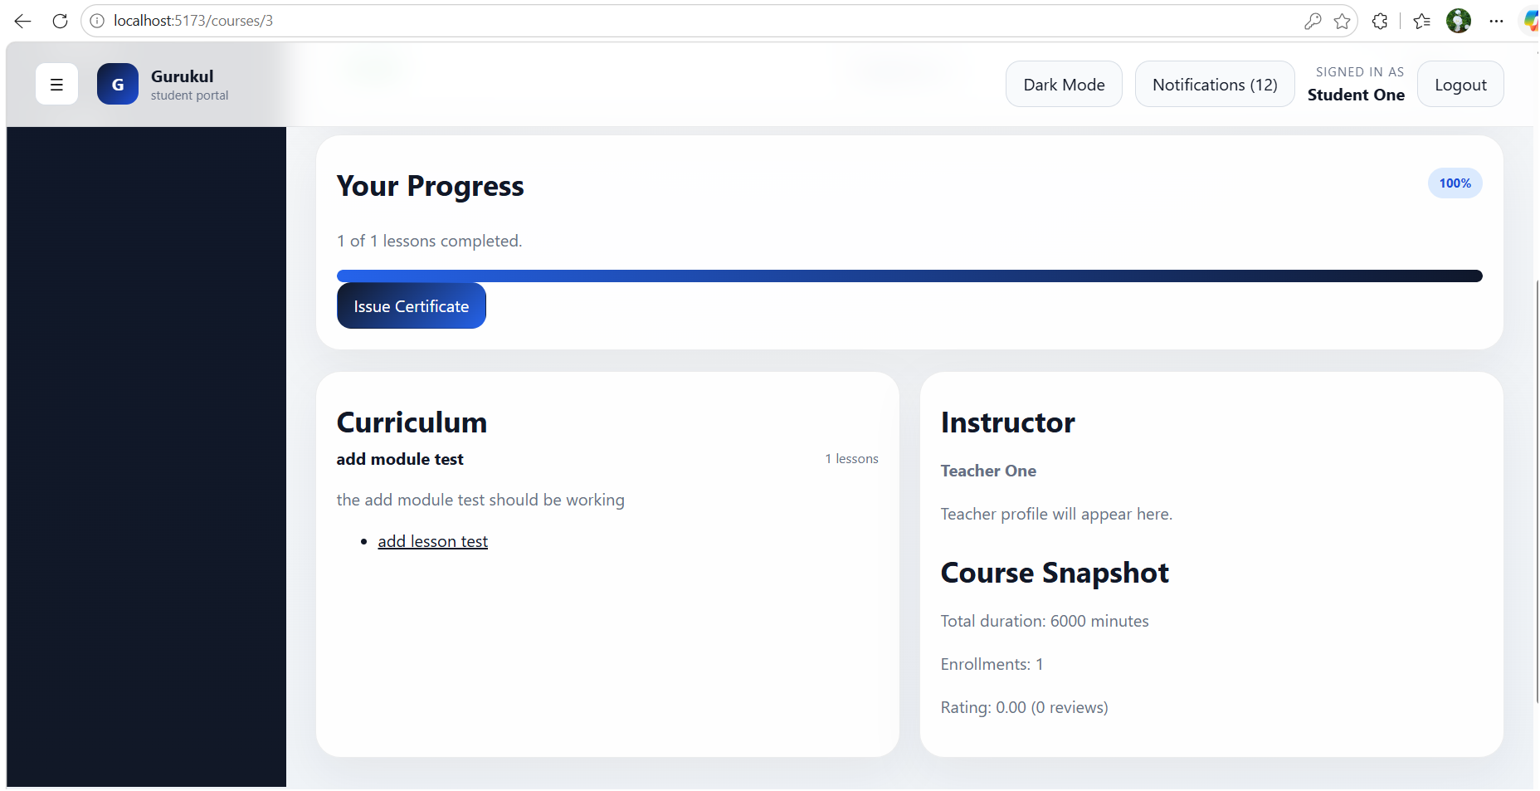
Student Pages

Slide 15
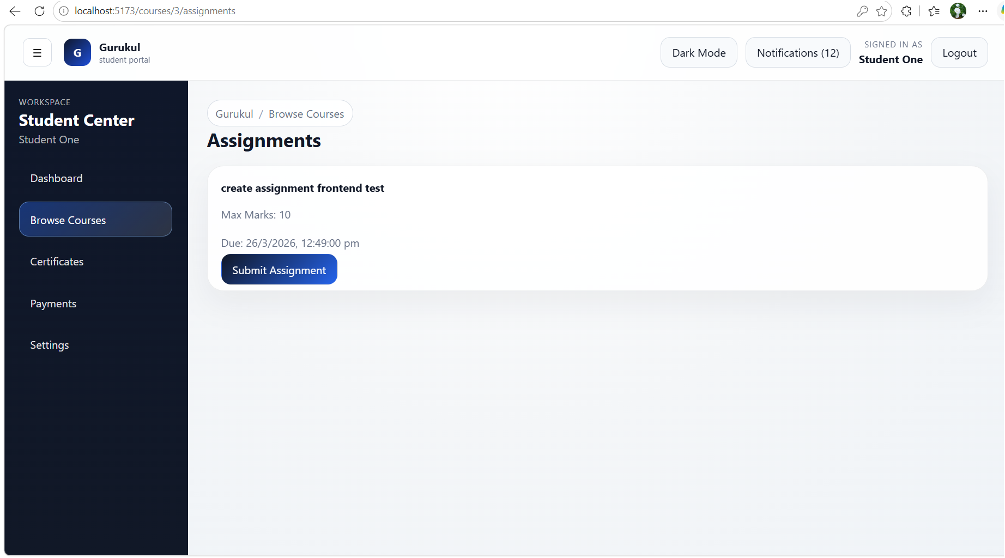
Student Pages

Slide 16
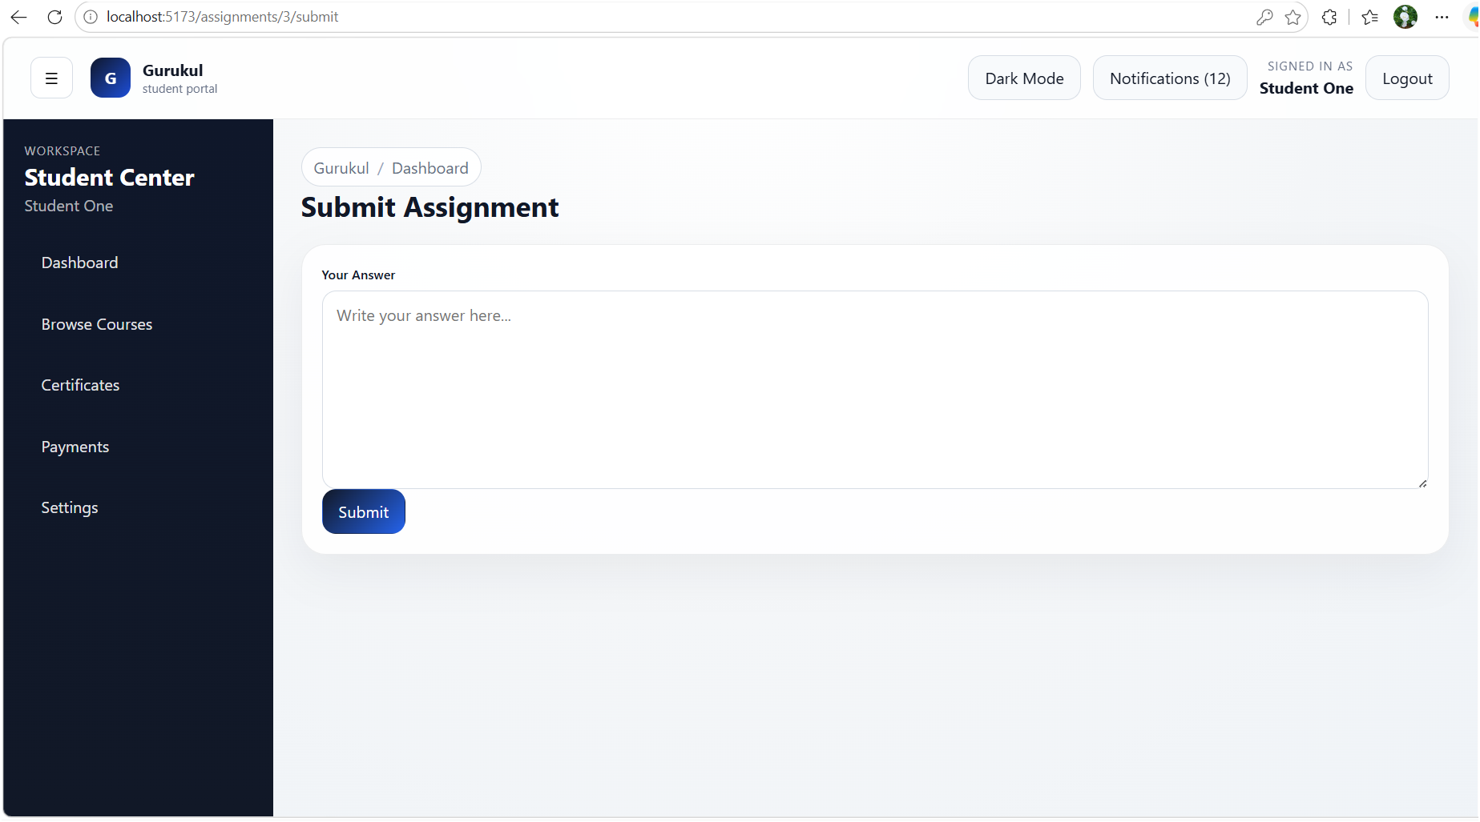
Student Pages

Slide 17
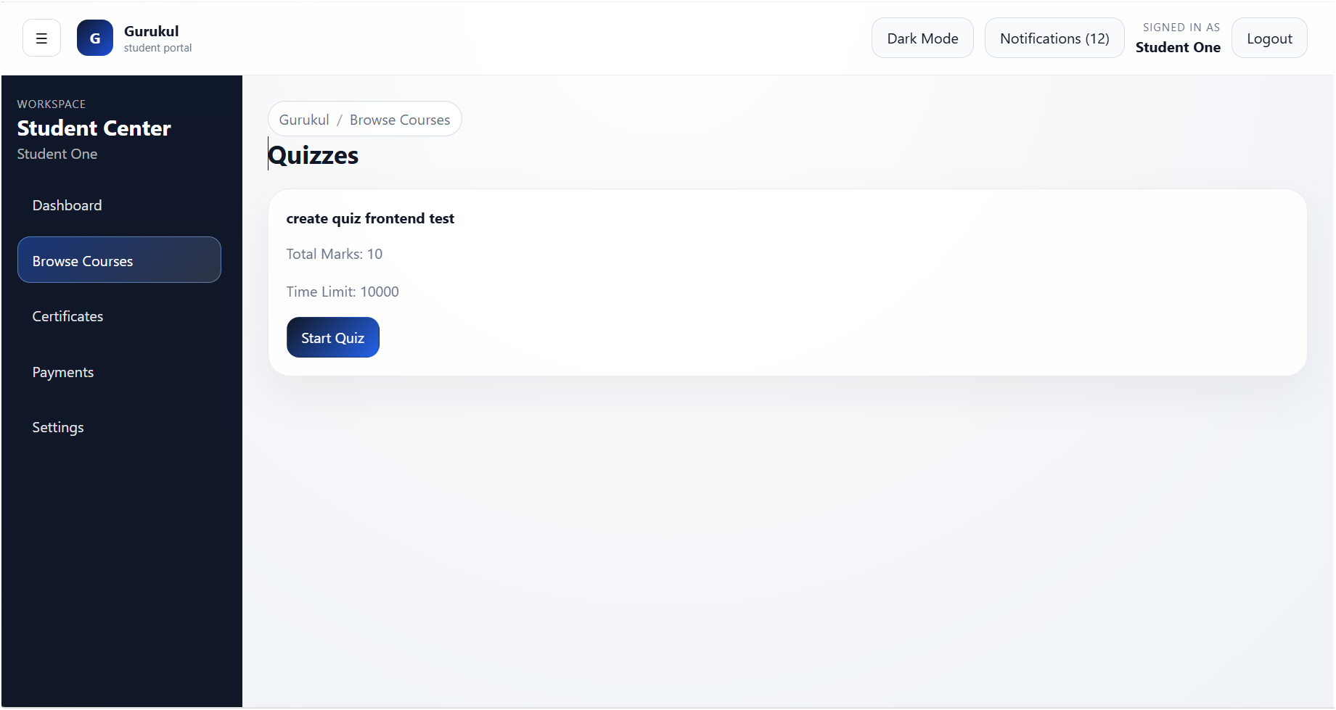
Student Pages

Slide 18
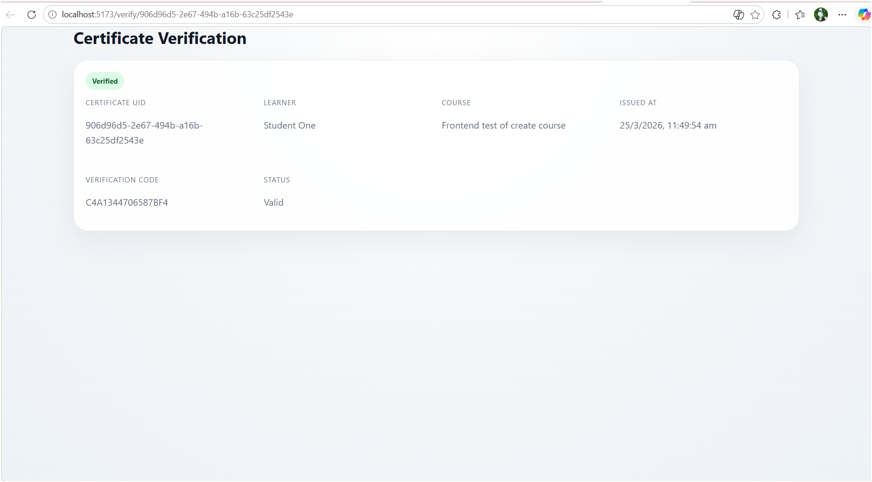
Student Pages

Slide 19
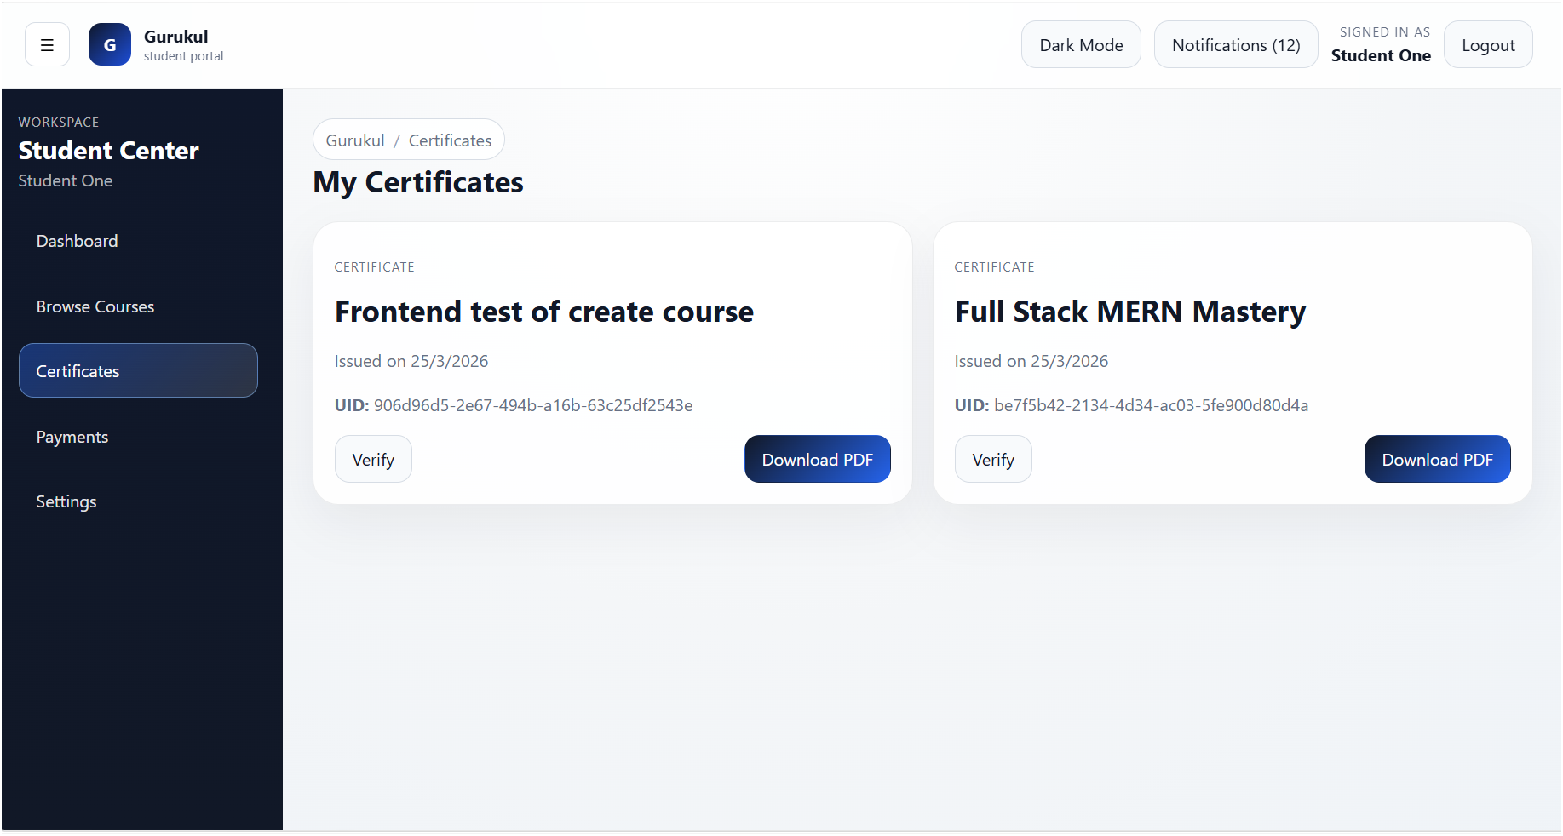
Student Pages

Slide 20
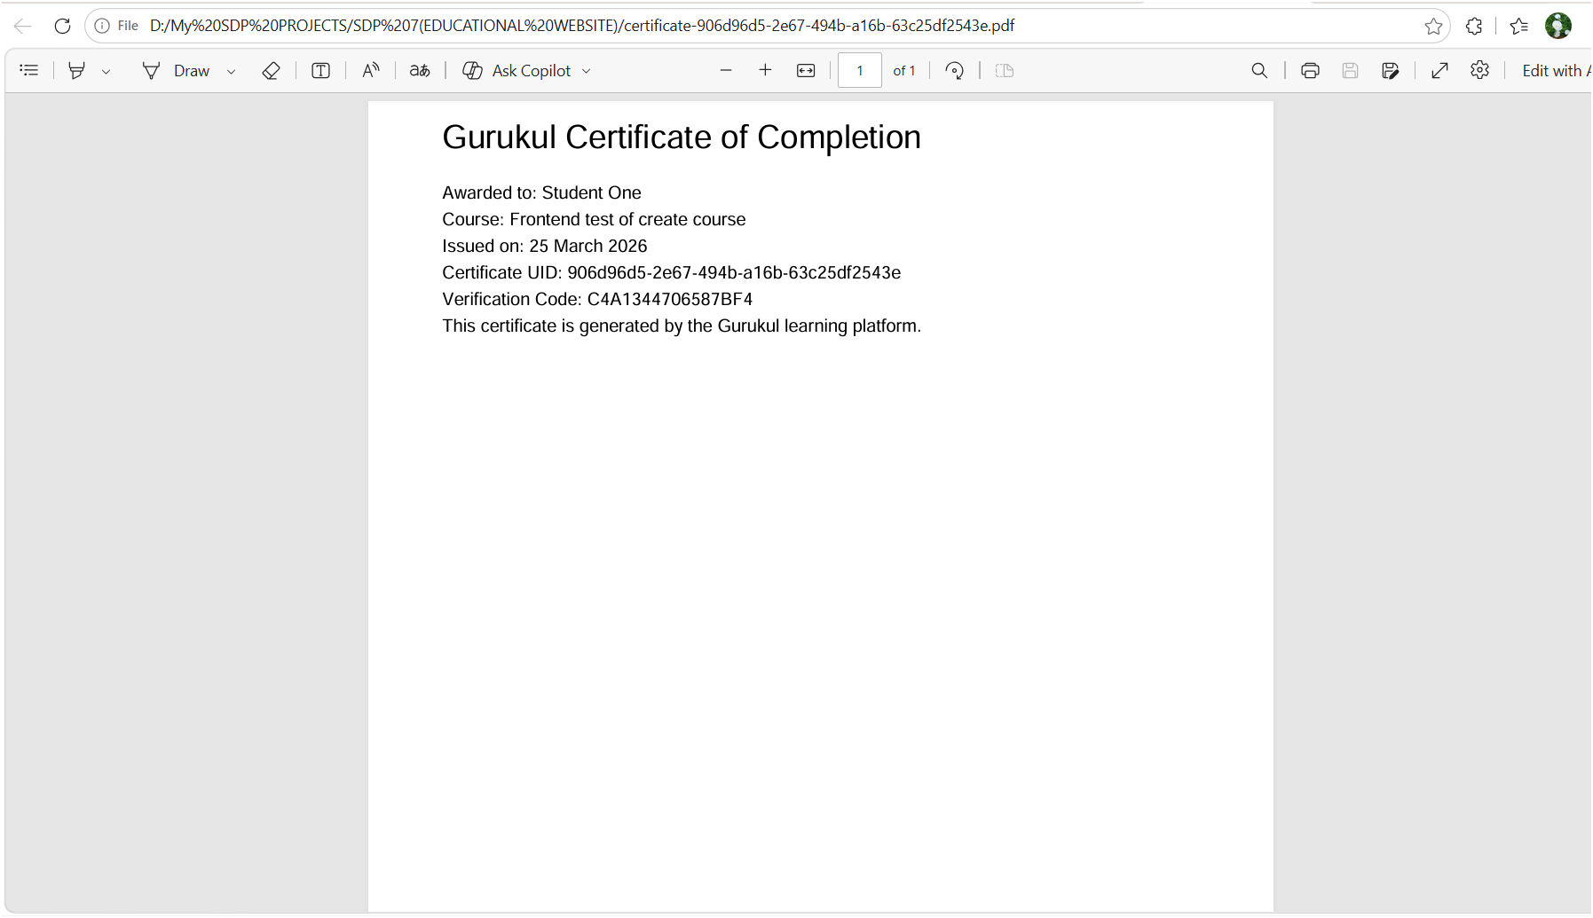
Student Pages

Slide 21
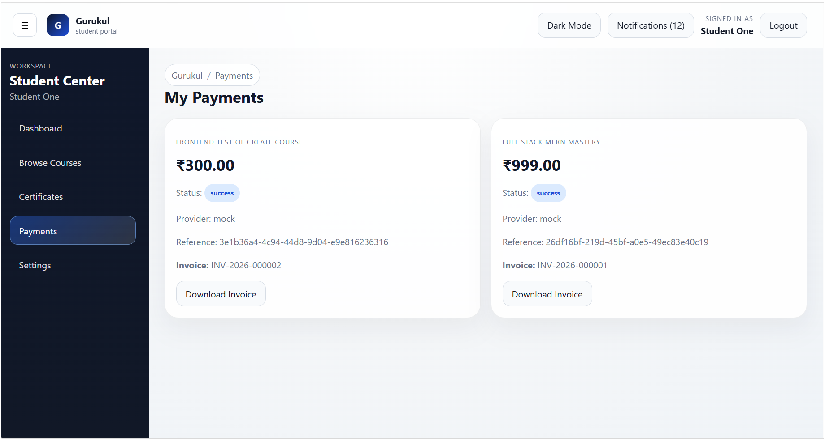
Student Pages

Slide 22
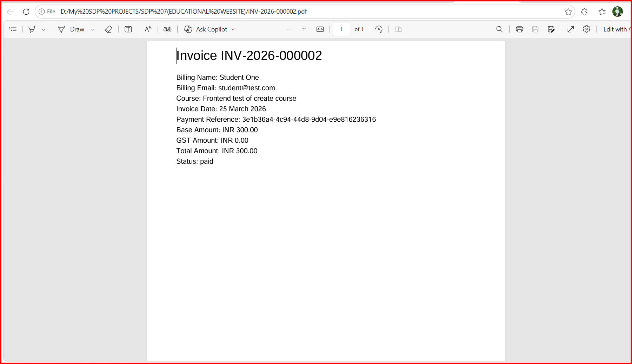
Student Pages

Slide 23
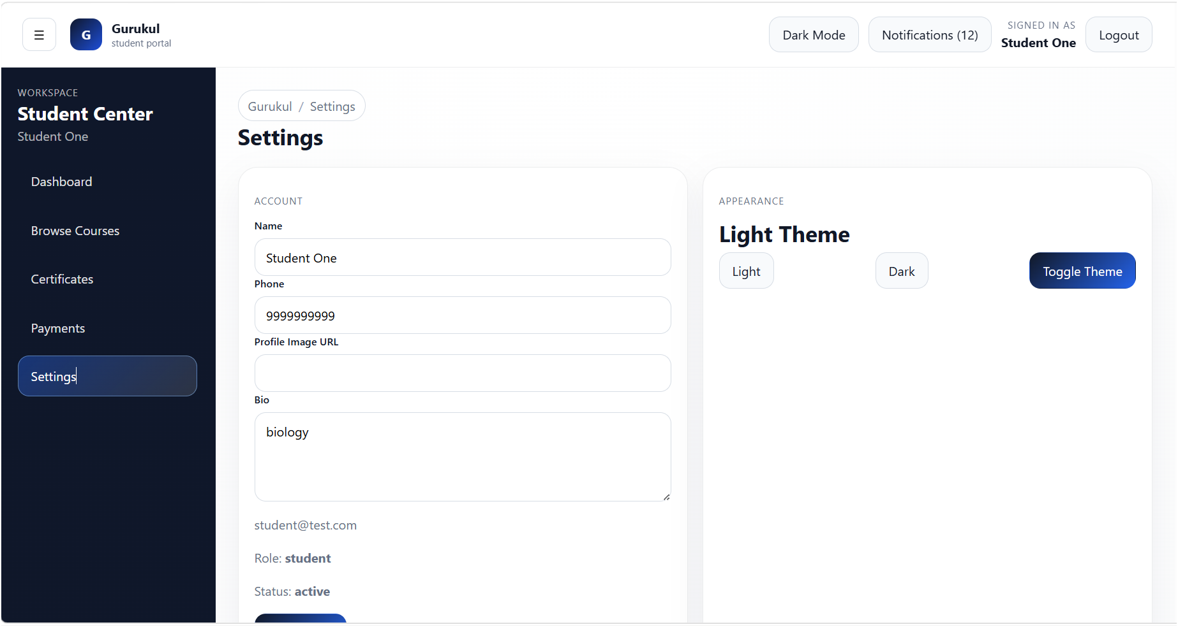
Student Pages

Slide 24
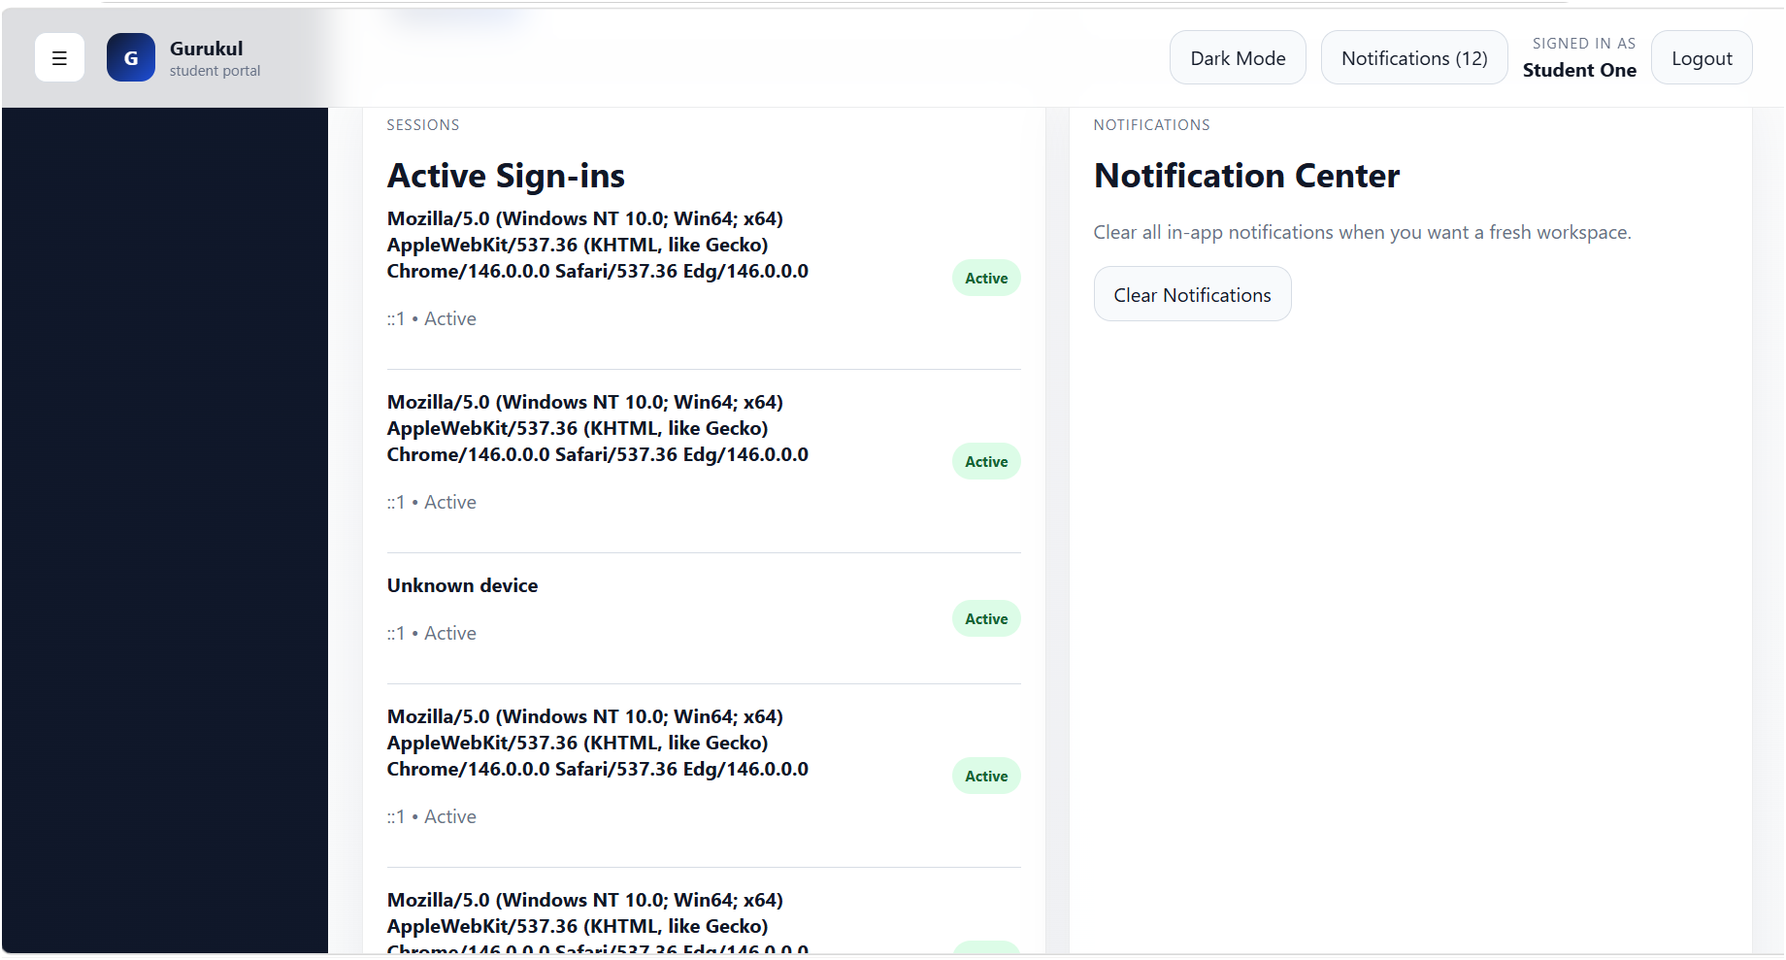
Student Pages

Slide 25
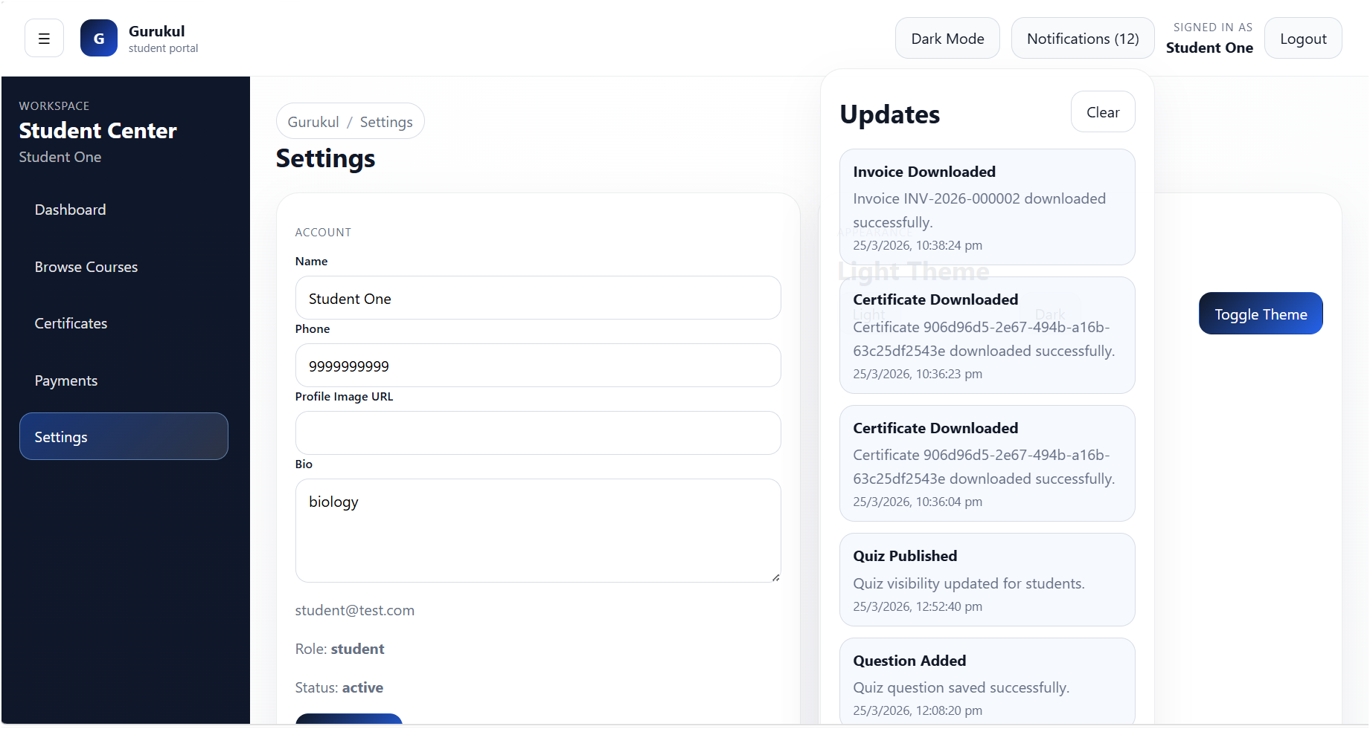
Student Pages

Slide 26
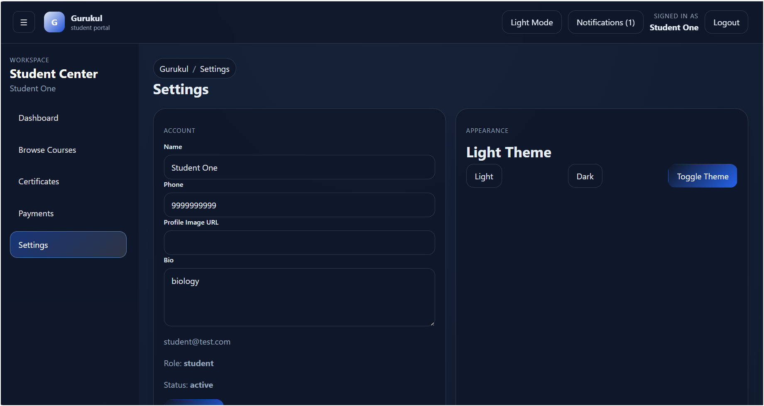
Student Pages

Slide 27
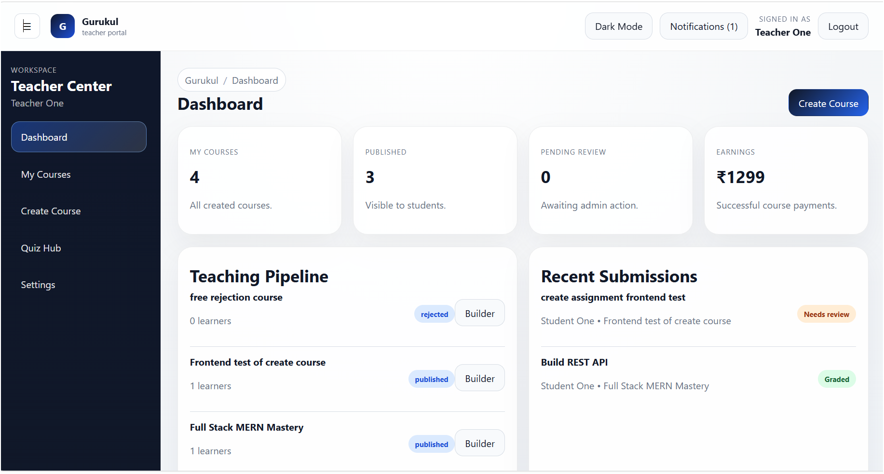
Teacher Pages

Slide 28
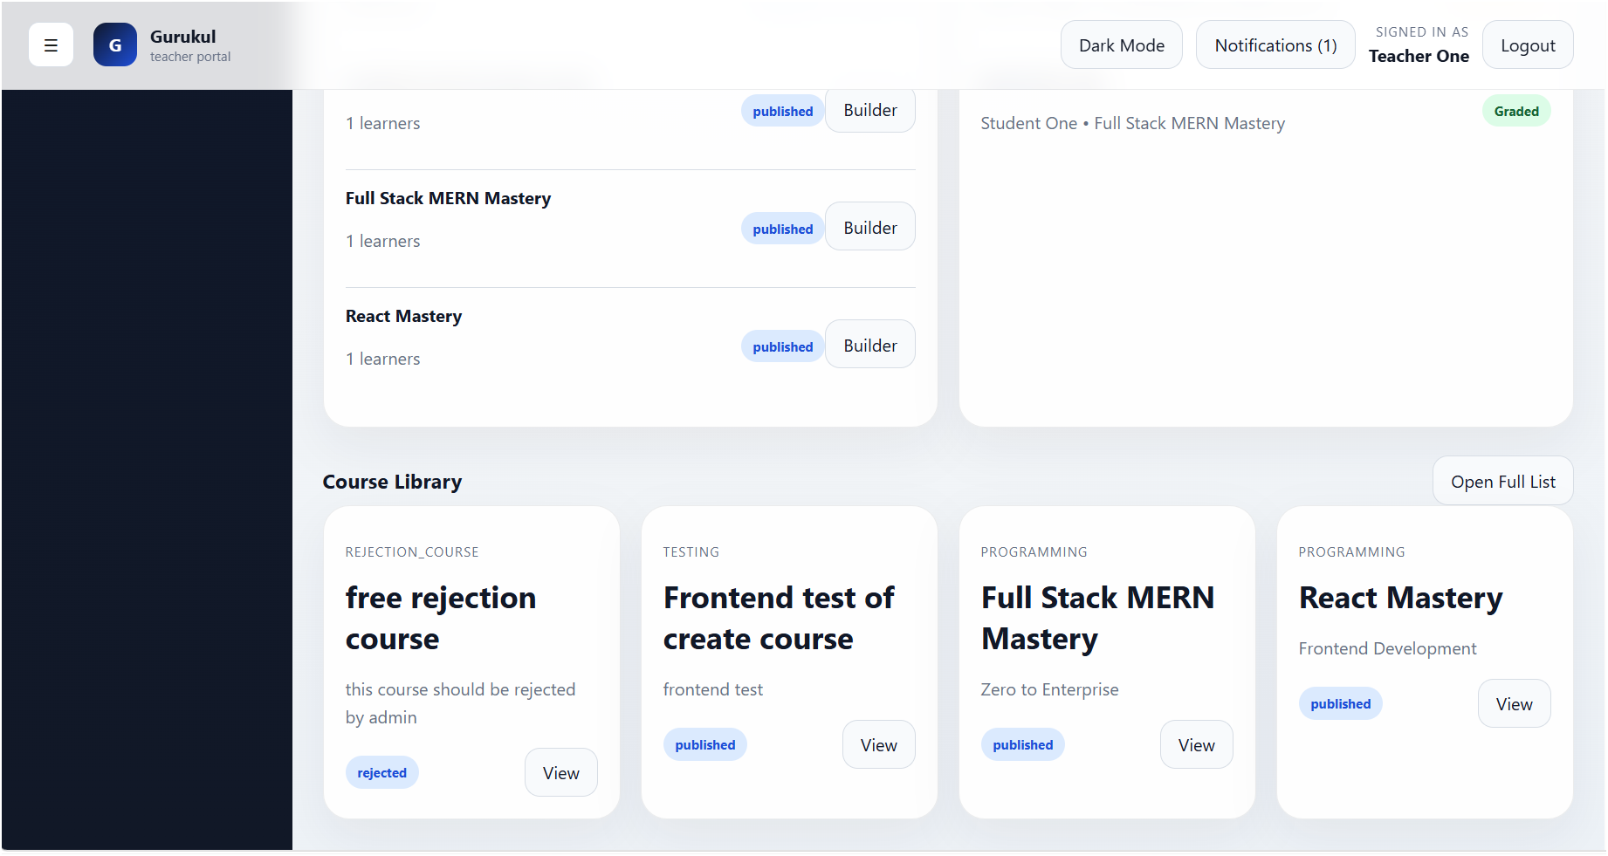
Teacher Pages

Slide 29
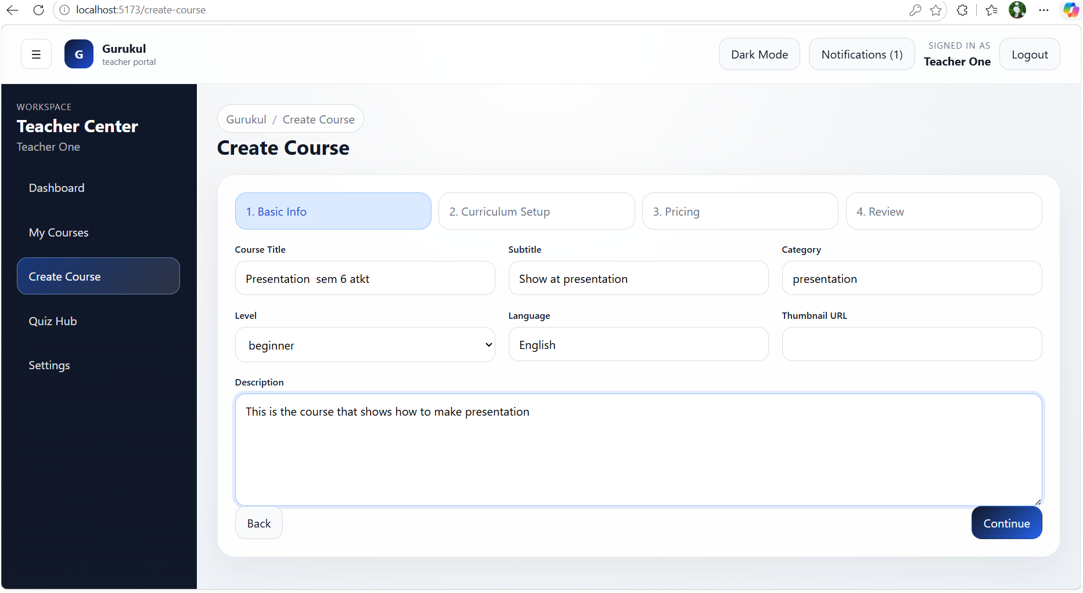
Teacher Pages

Slide 30
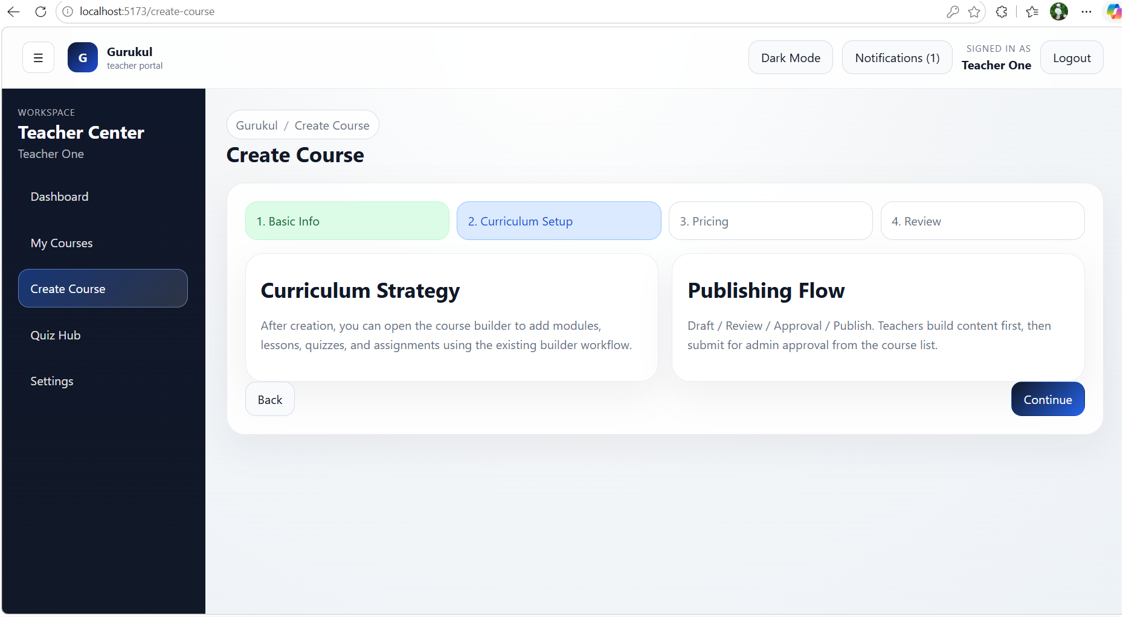
Teacher Pages

Slide 31
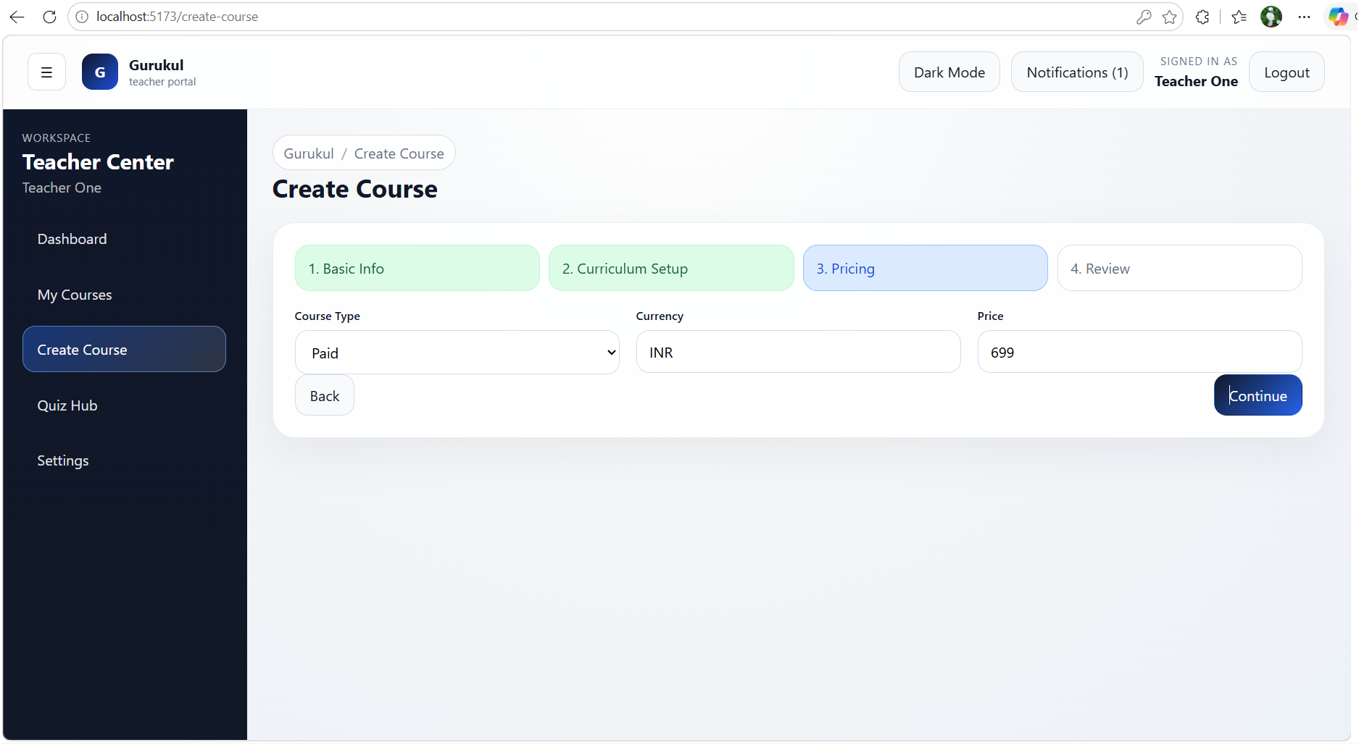
Teacher Pages

Slide 32
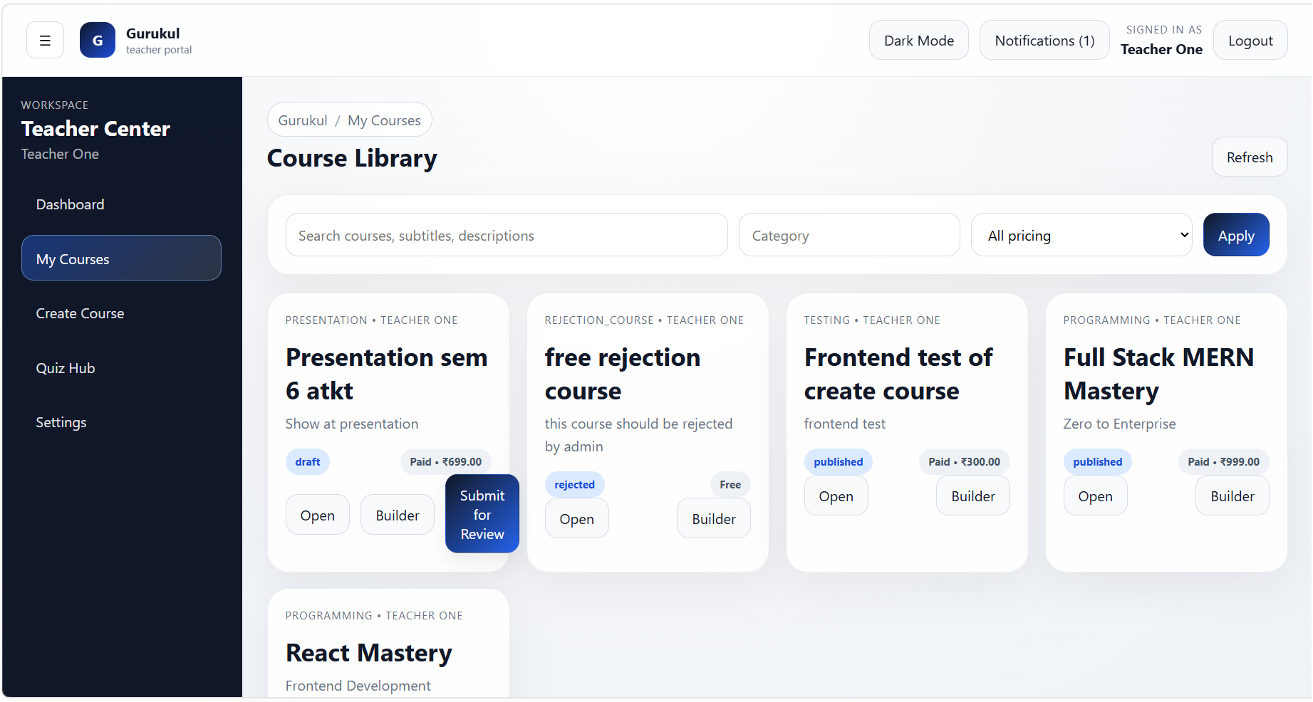
Teacher Pages

Slide 33
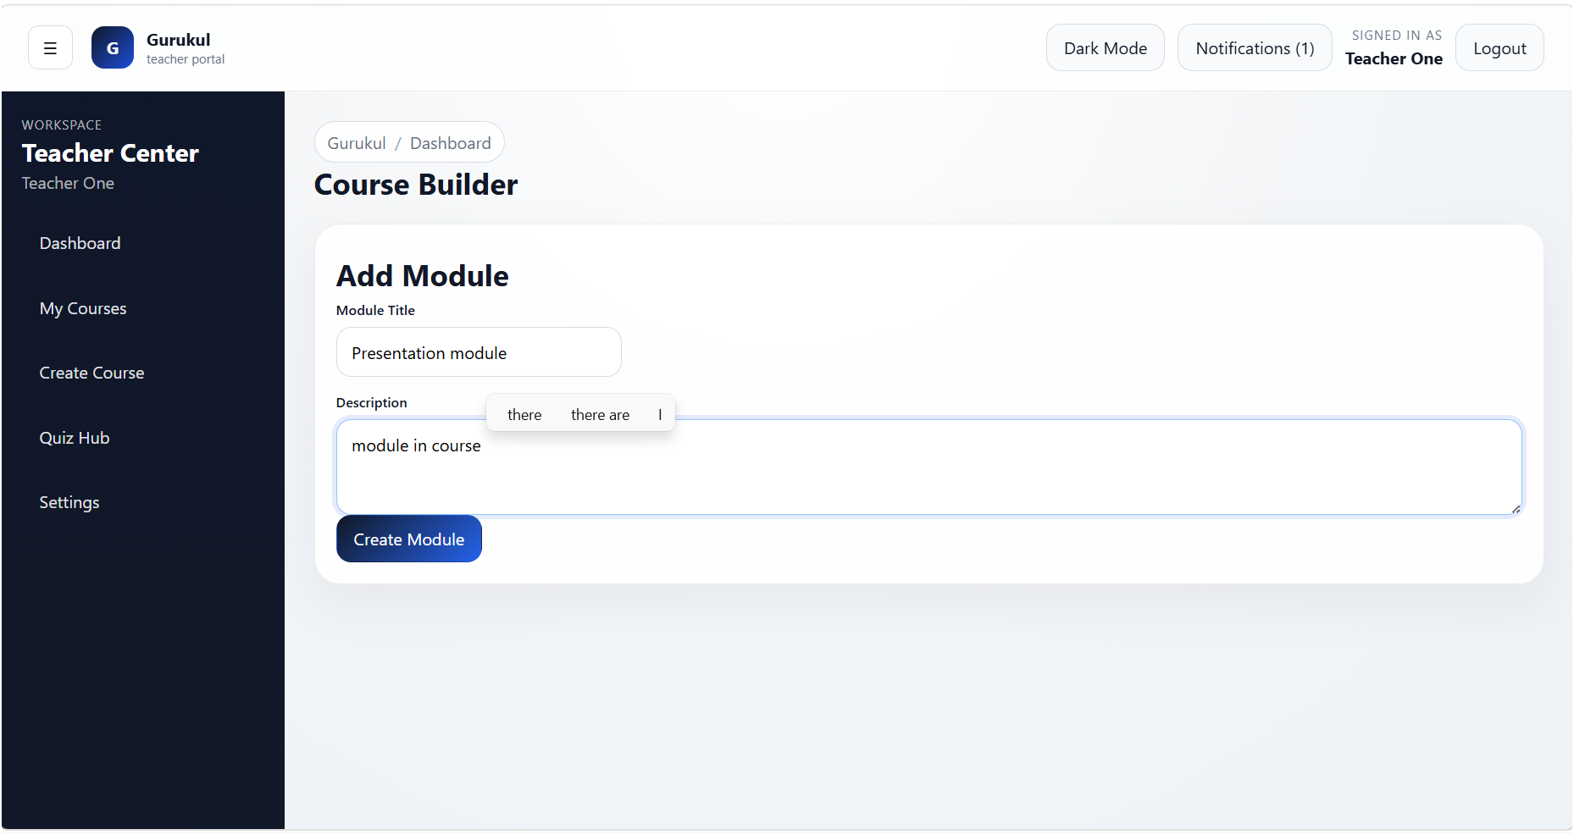
Teacher Pages

Slide 34
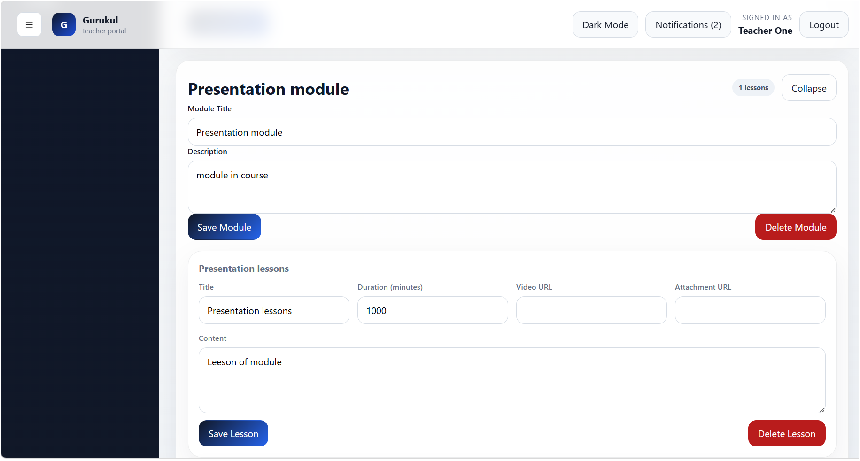
Teacher Pages

Slide 35
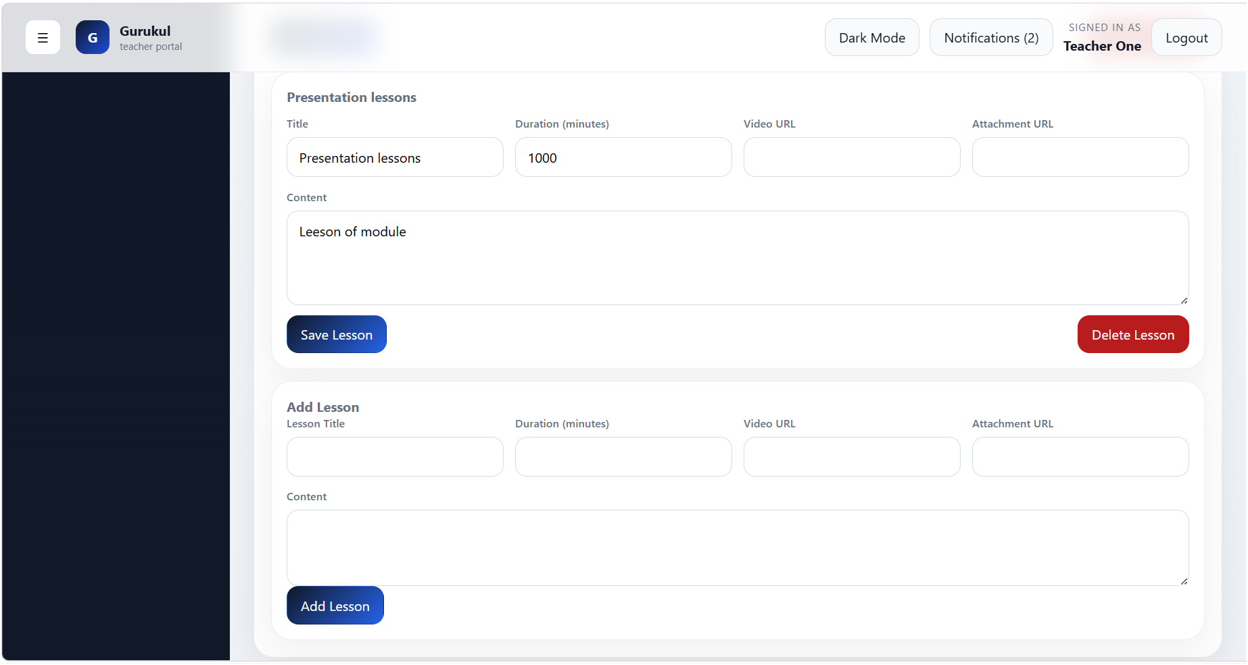
Teacher Pages

Slide 36
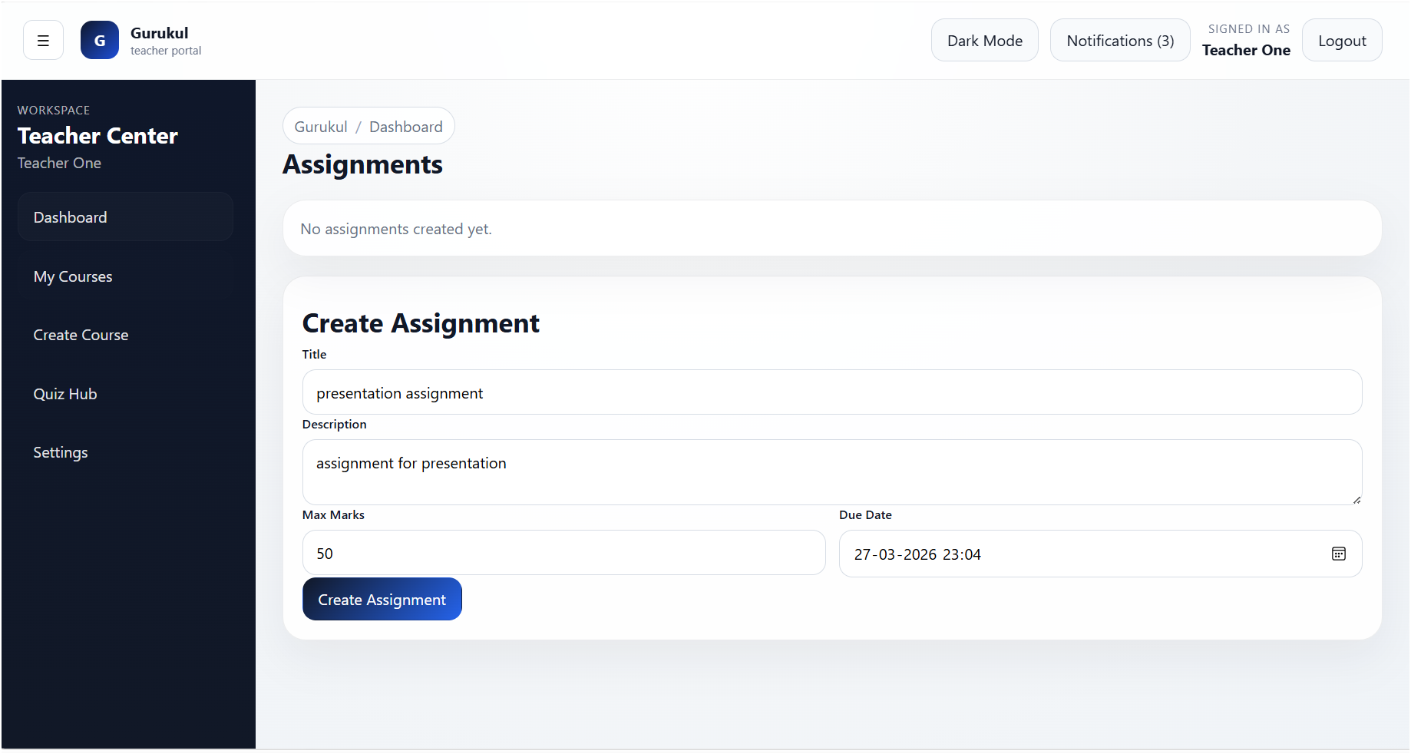
Teacher Pages

Slide 37
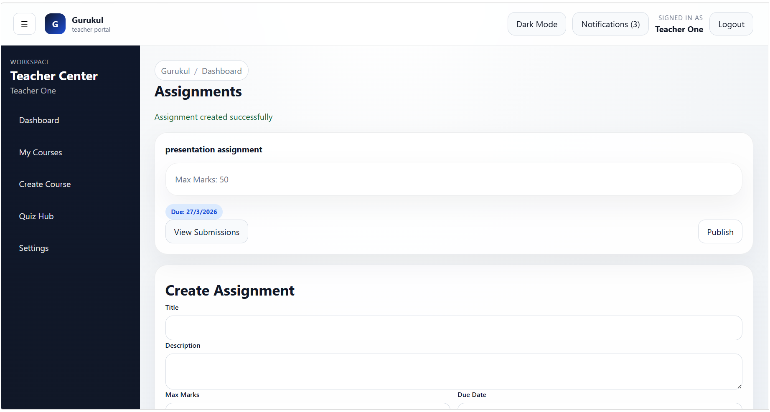
Teacher Pages

Slide 38
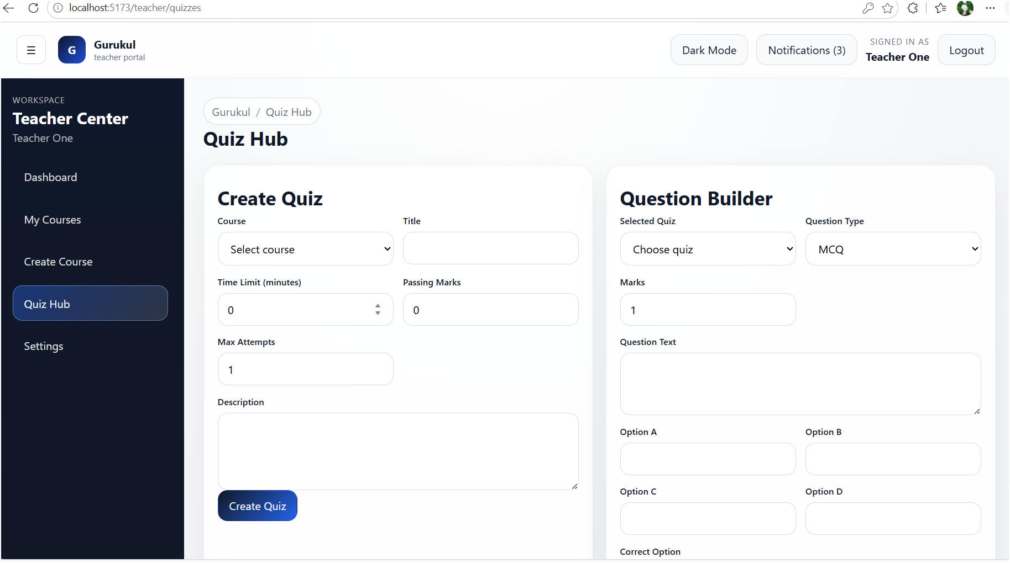
Teacher Pages

Slide 39
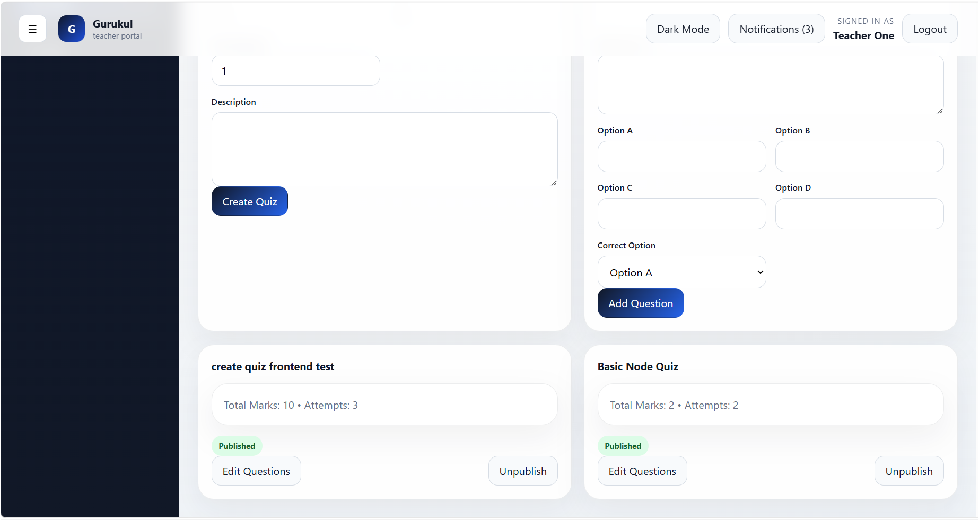
Teacher Pages

Slide 40

Teacher Pages

Slide 41
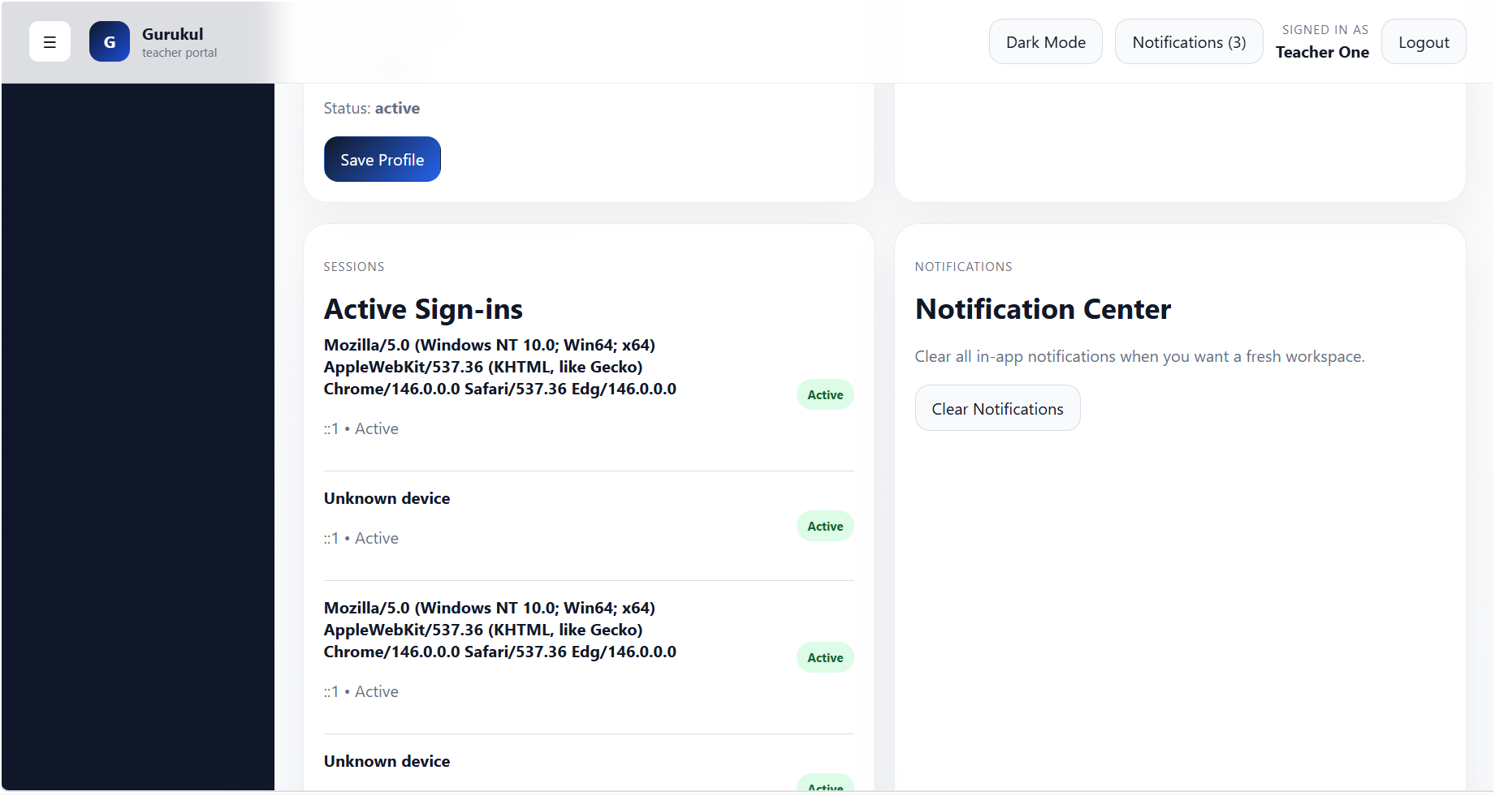
Teacher Pages

Slide 42
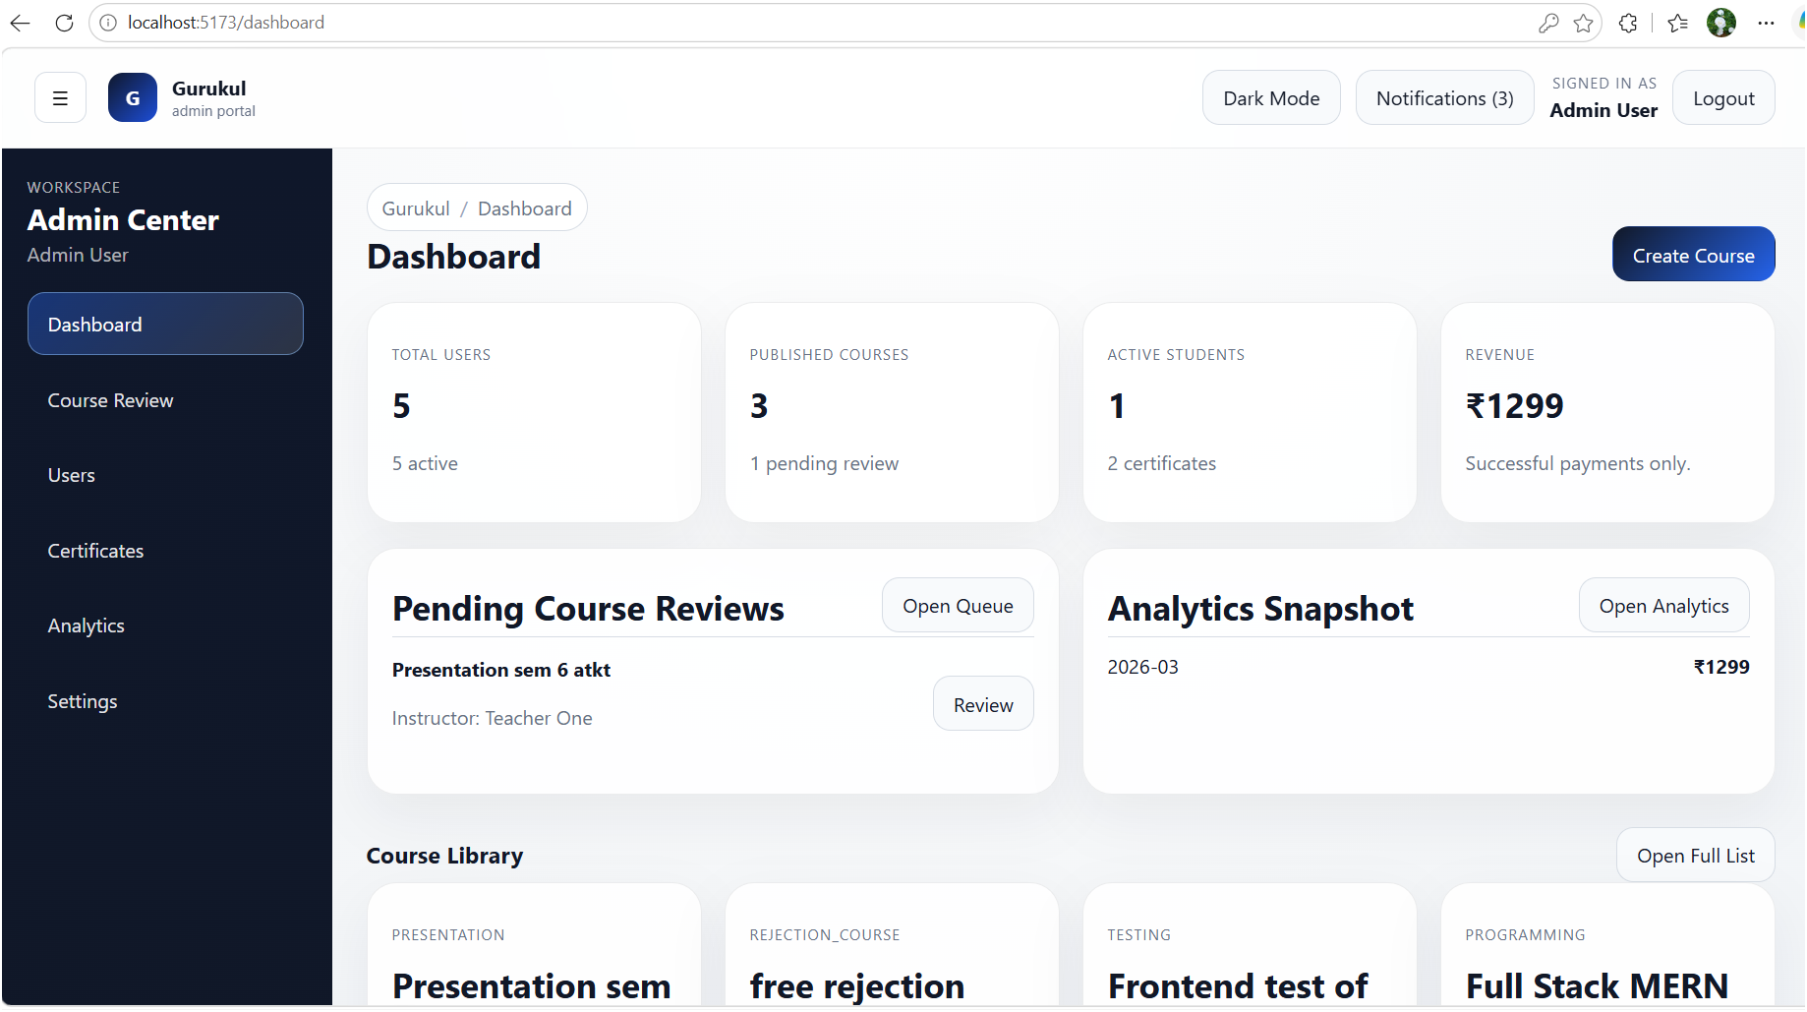
Admin Pages

Slide 43
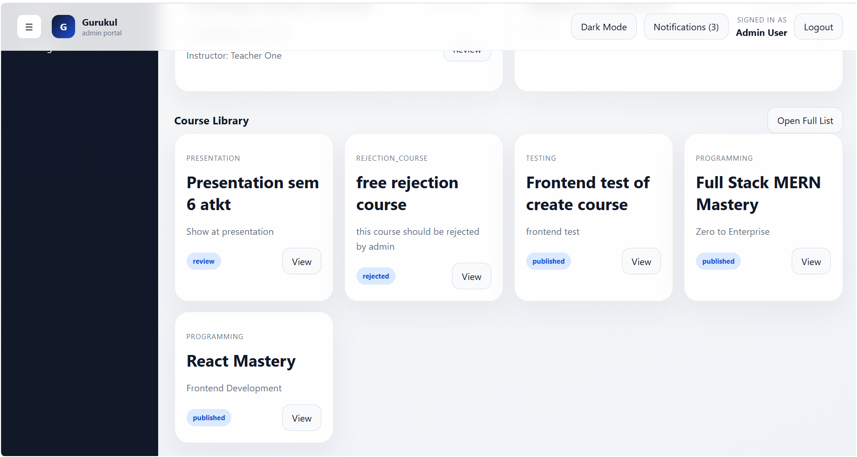
Admin Pages

Slide 44
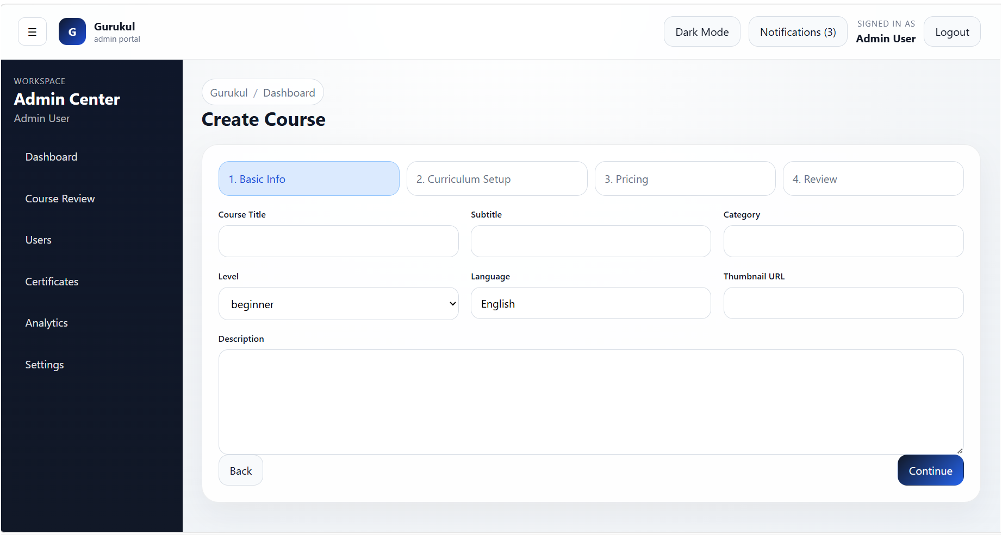
Admin Pages

Slide 45
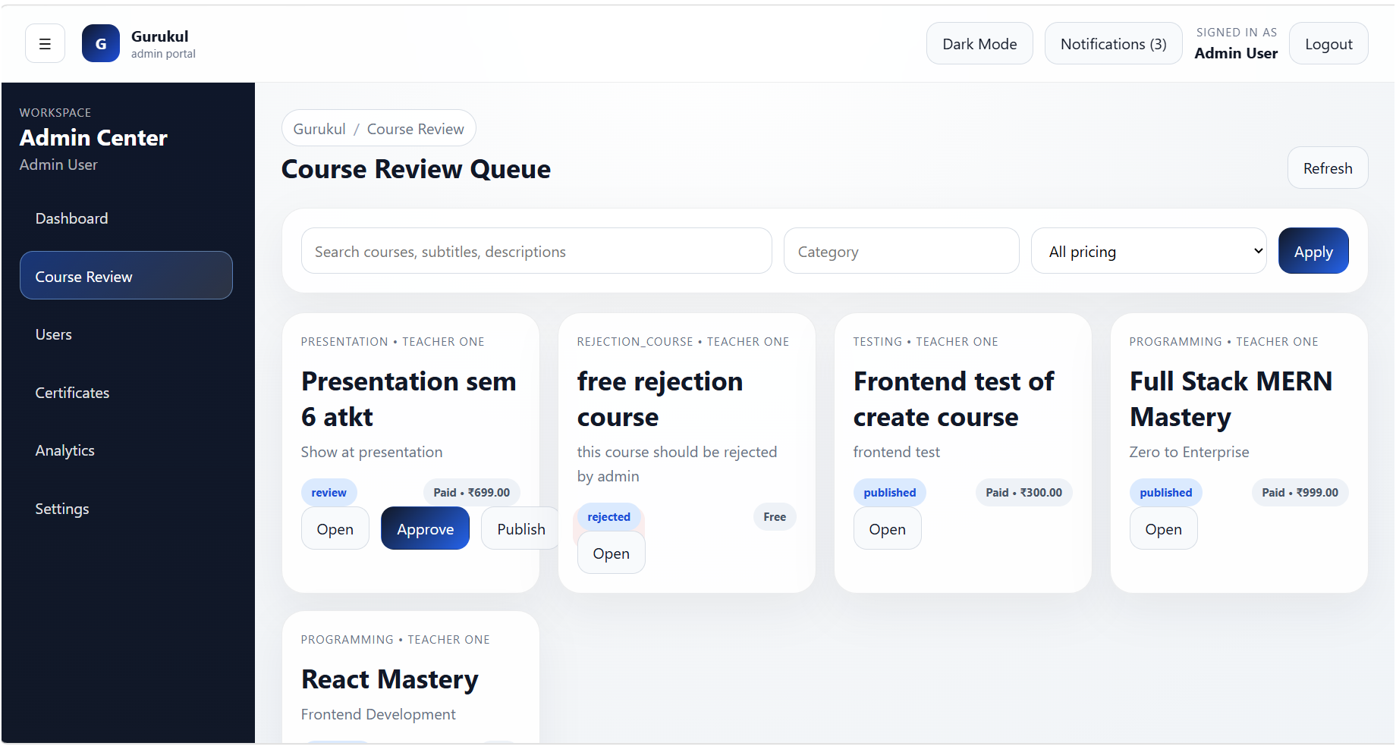
Admin Pages

Slide 46
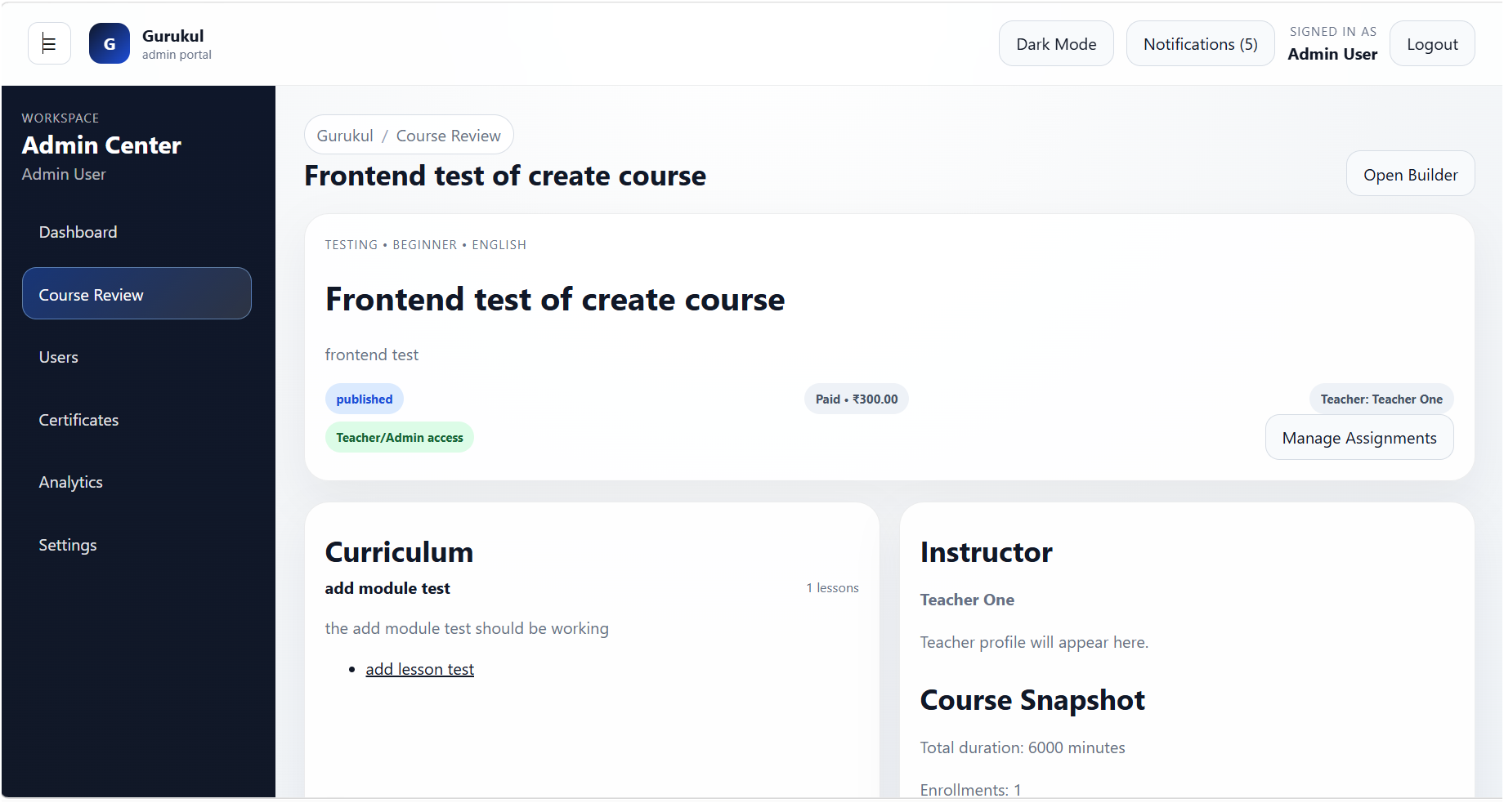
Admin Pages

Slide 47
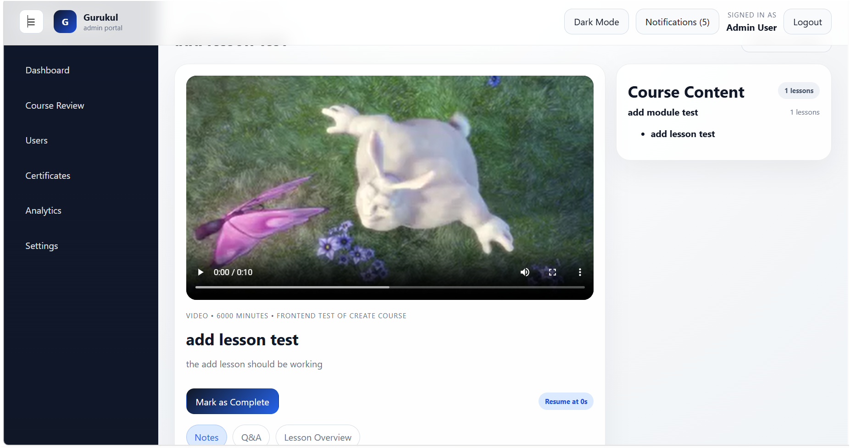
Admin Pages

Slide 48
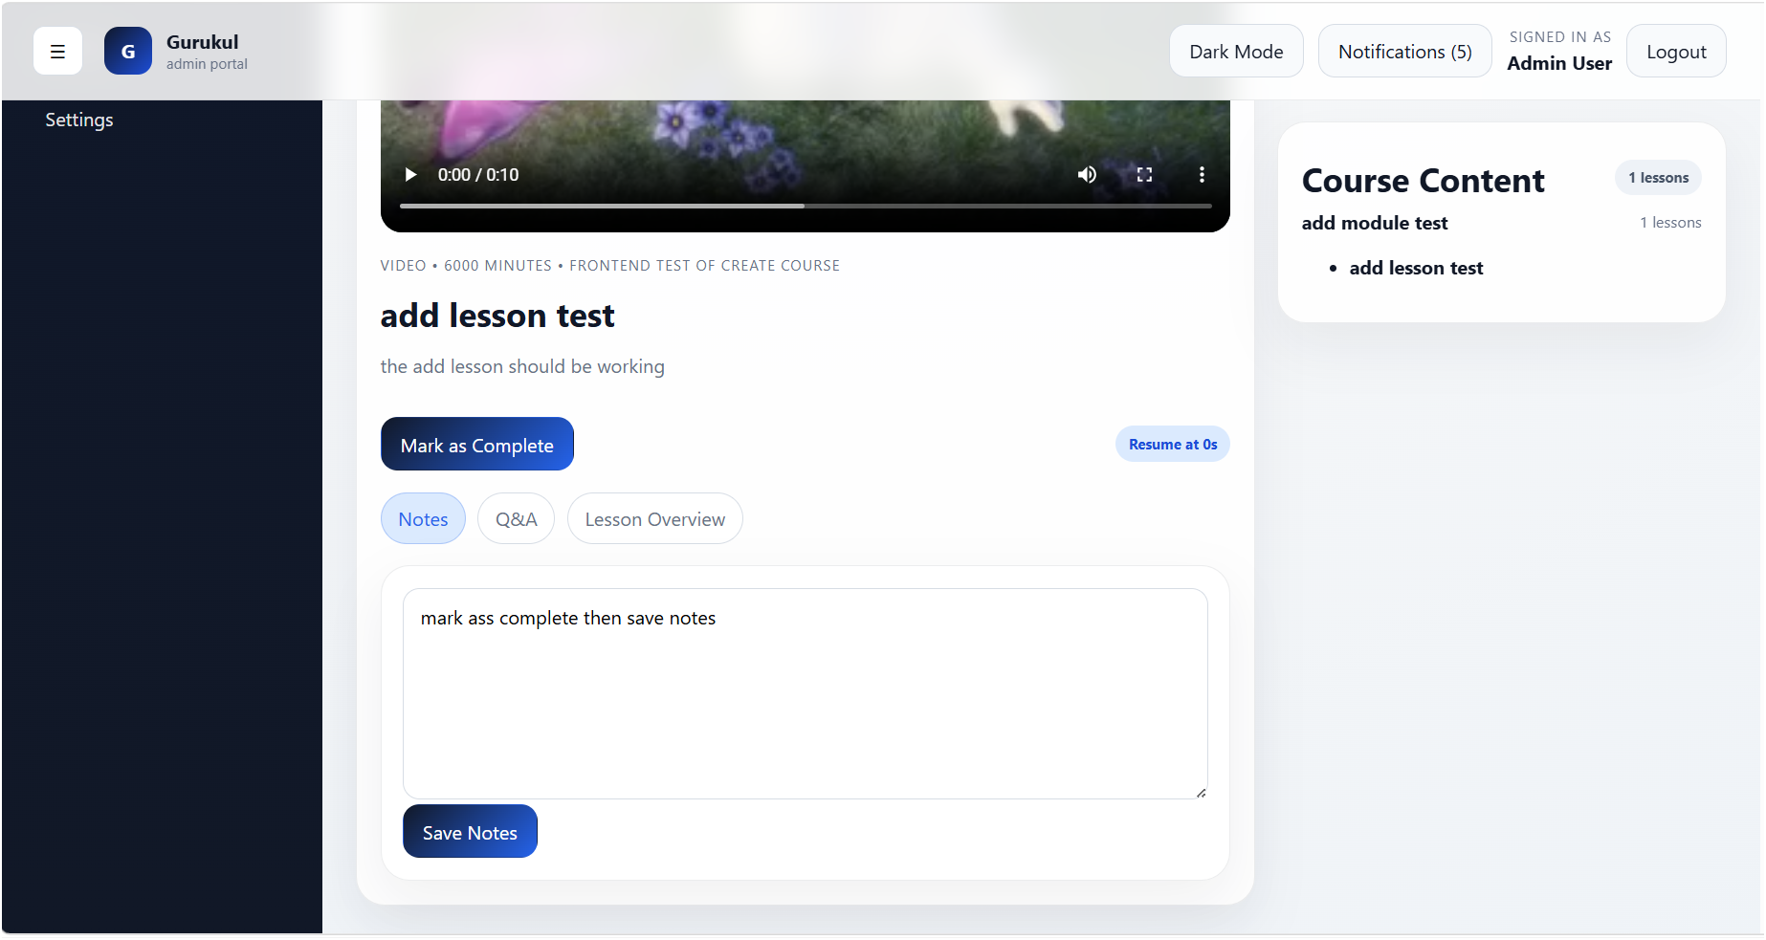
Admin Pages

Slide 49
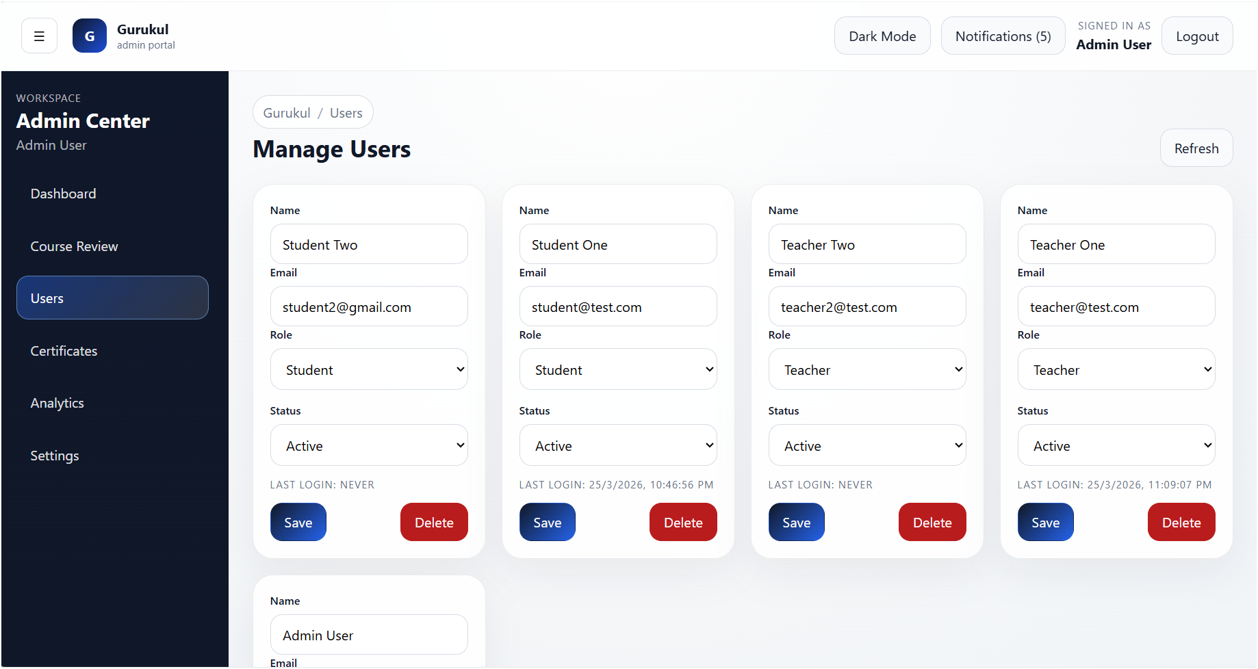
Admin Pages

Slide 50
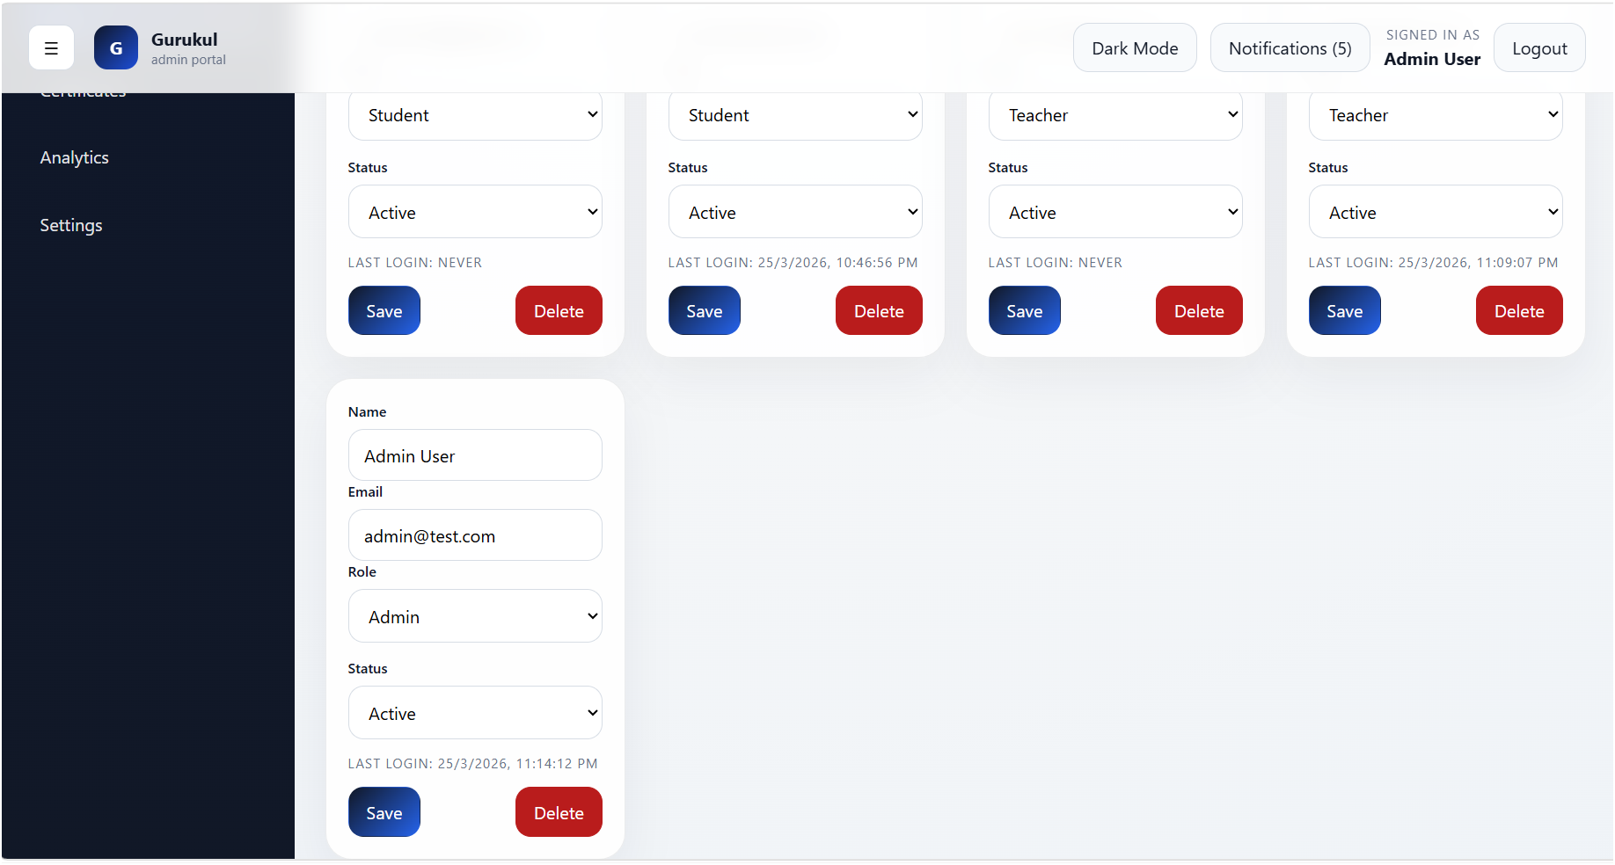
Admin Pages

Slide 51
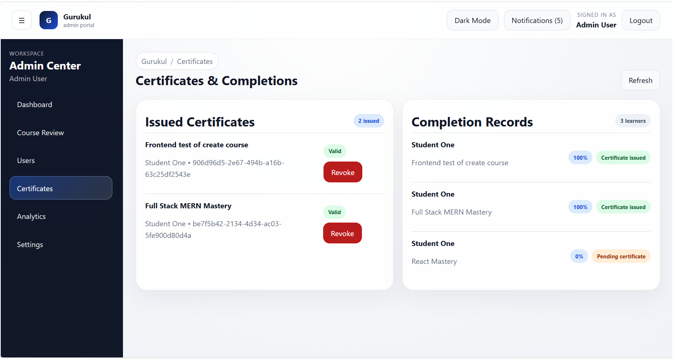
Admin Pages

Slide 52
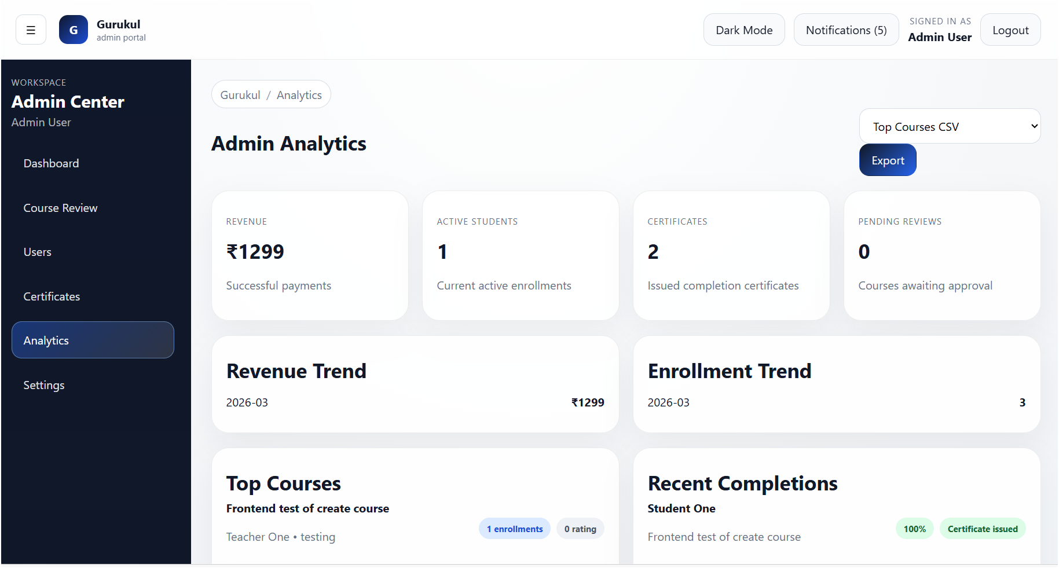
Admin Pages

Slide 53
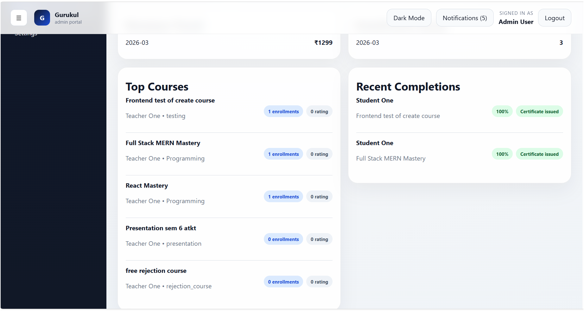
Admin Pages

Slide 54
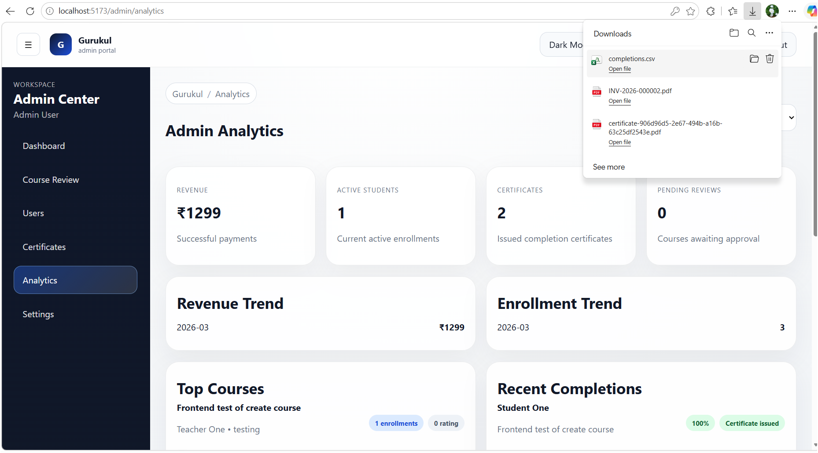
Admin Pages

Slide 55
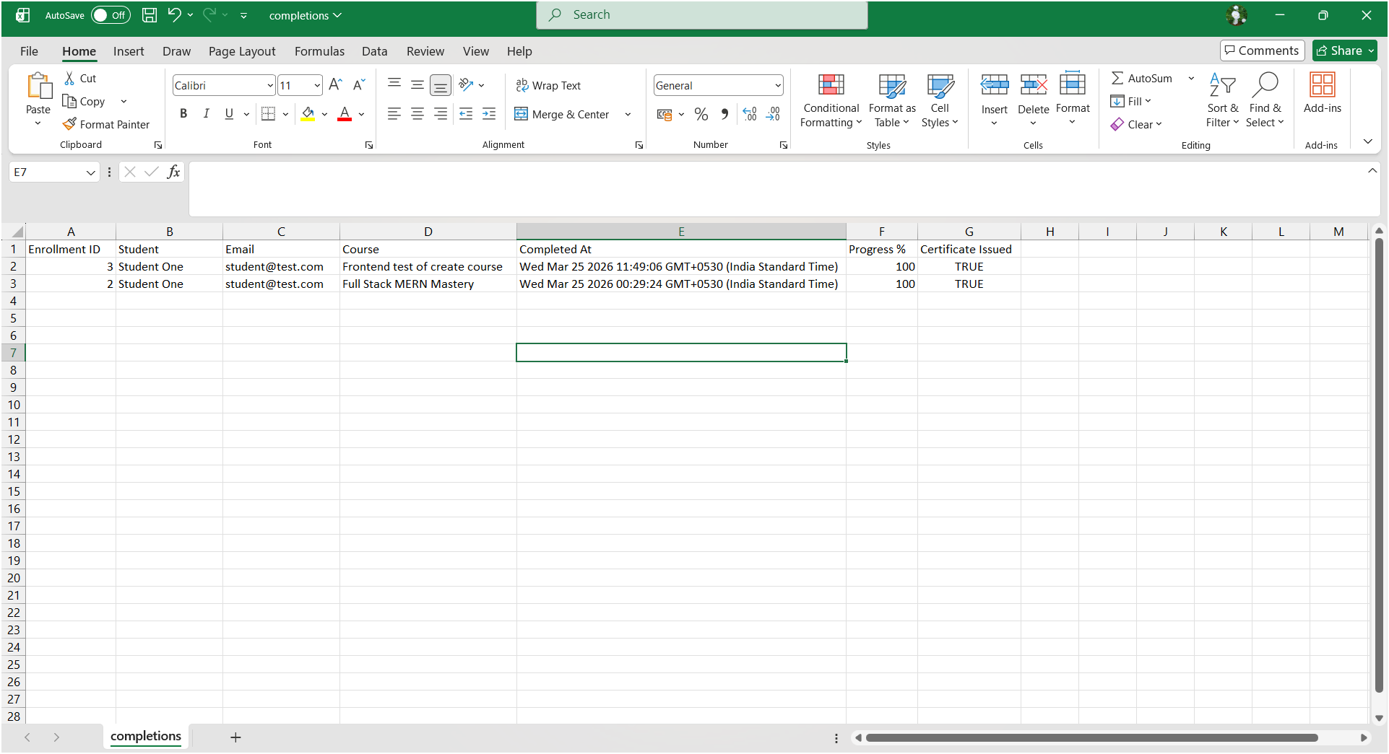
Admin Pages

Slide 56
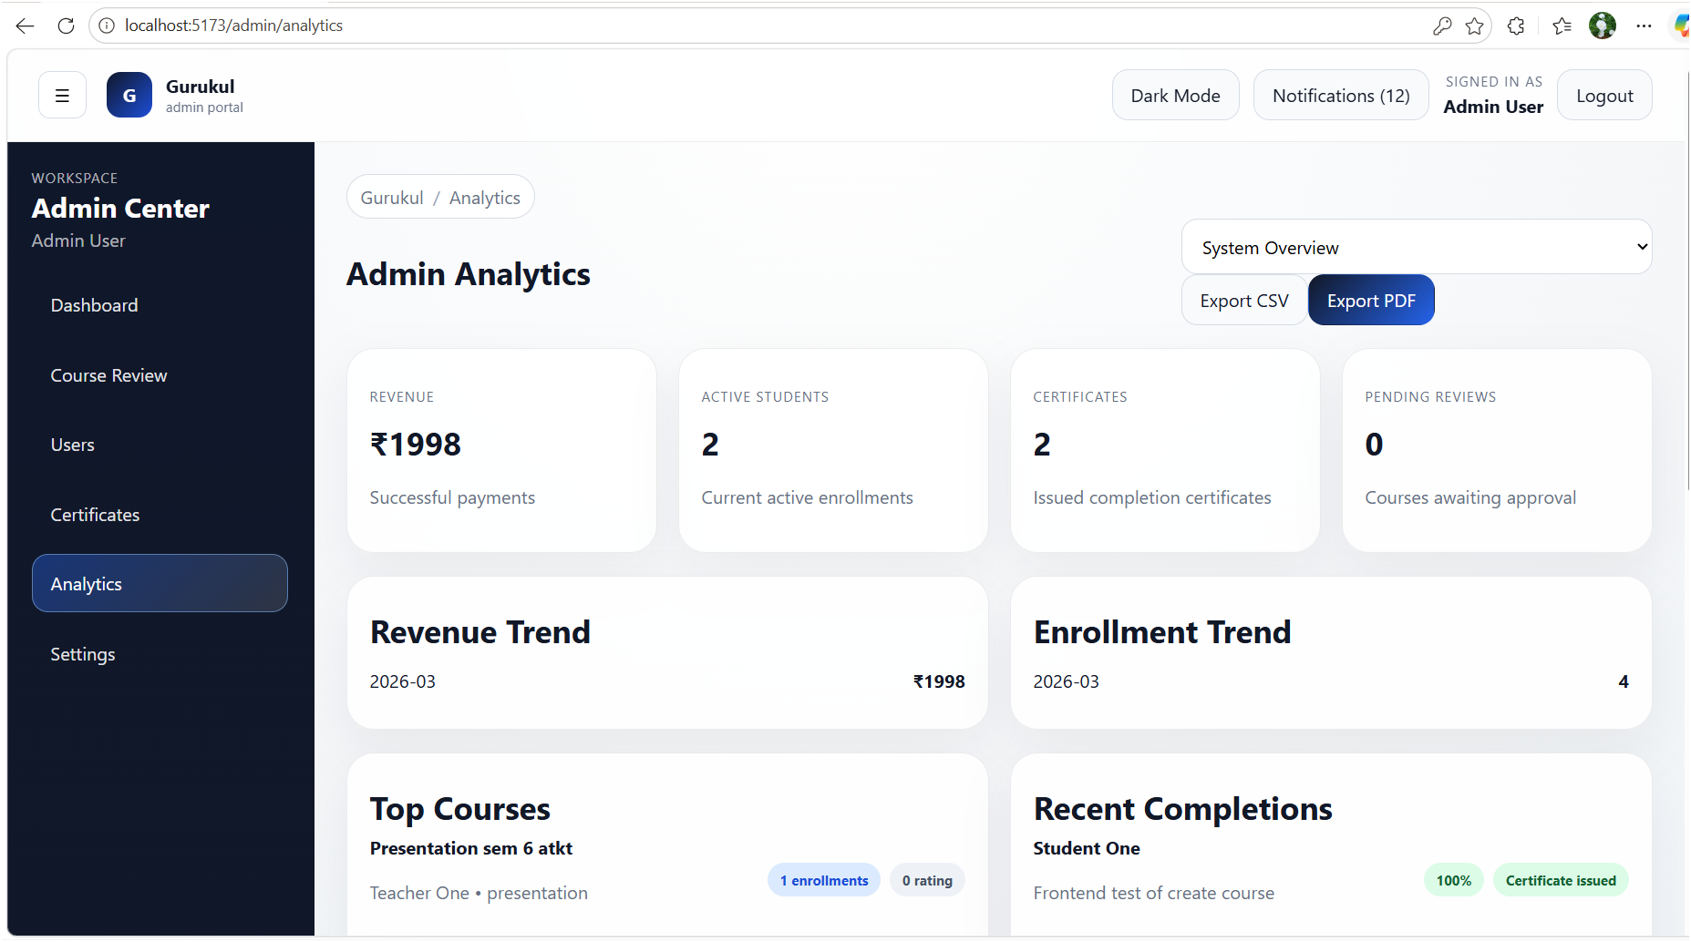
Admin Pages

Slide 57
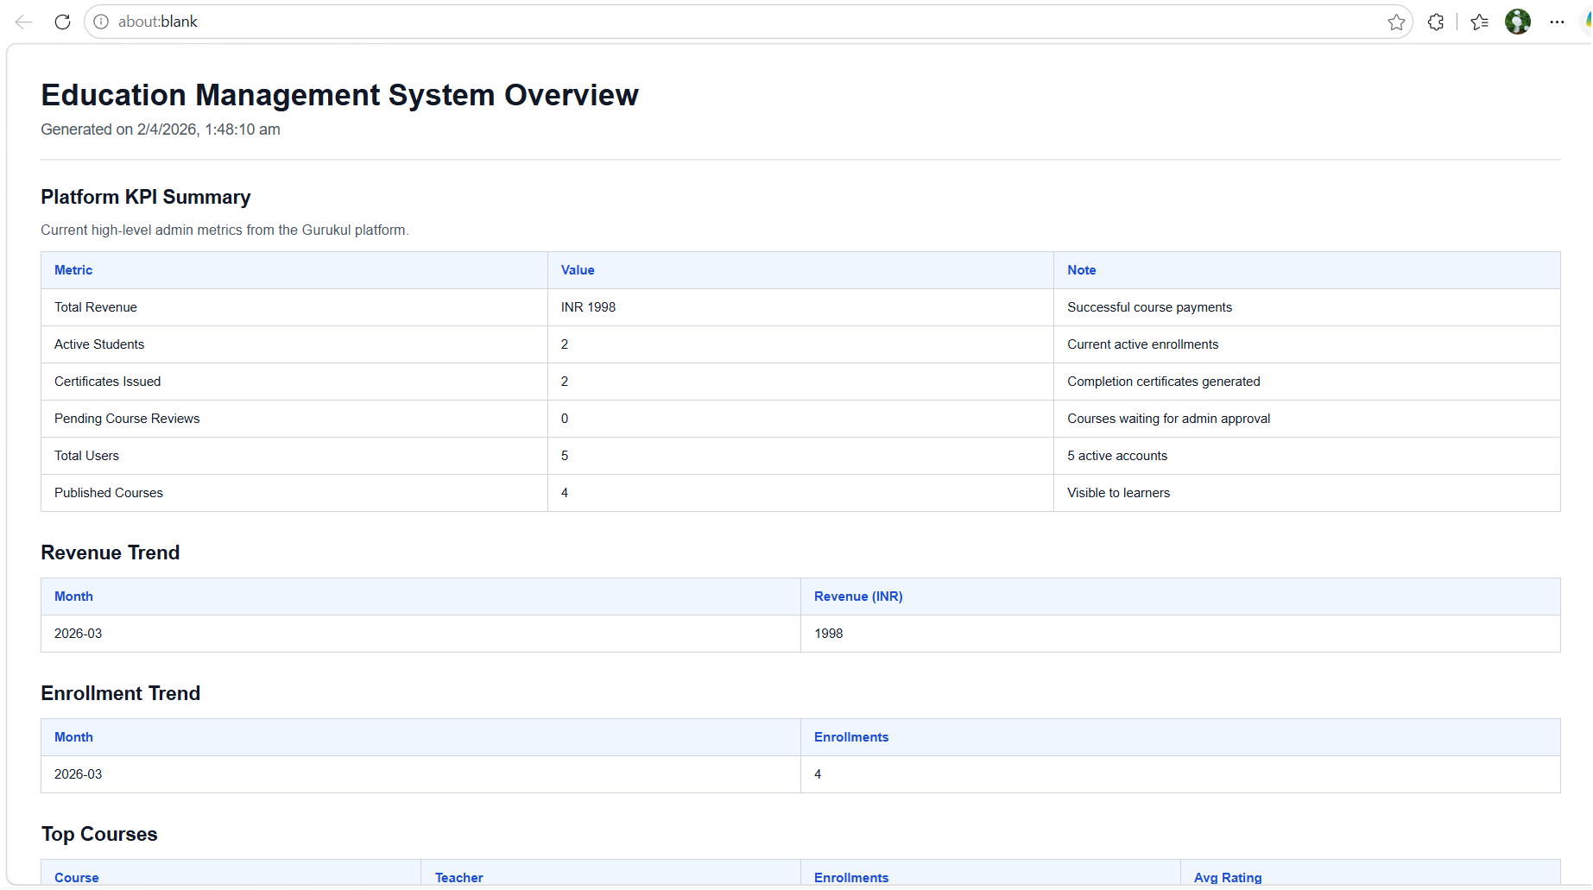
Admin Pages

Slide 58
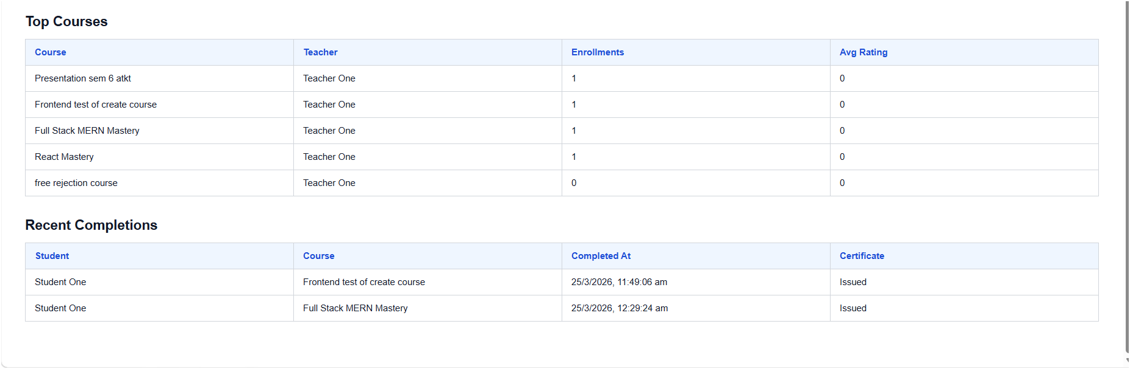
Admin Pages

Slide 59

Admin Pages

Slide 60

Admin Pages

Slide 61

Thank you

