Slide 1

NON-CUSTODIAL GROUP SETTLEMENT
SplitLane
Exact USDC shares, paid directly to the recipient.
Base Sepolia + Ethereum Sepolia | Attestcoin proof lane on Creditcoin CC3
Notes:
[Sources]
- README.md (project scope and chain support, accessed 2026-08-12)
- docs/architecture.md (system design, accessed 2026-08-12)

Slide 2
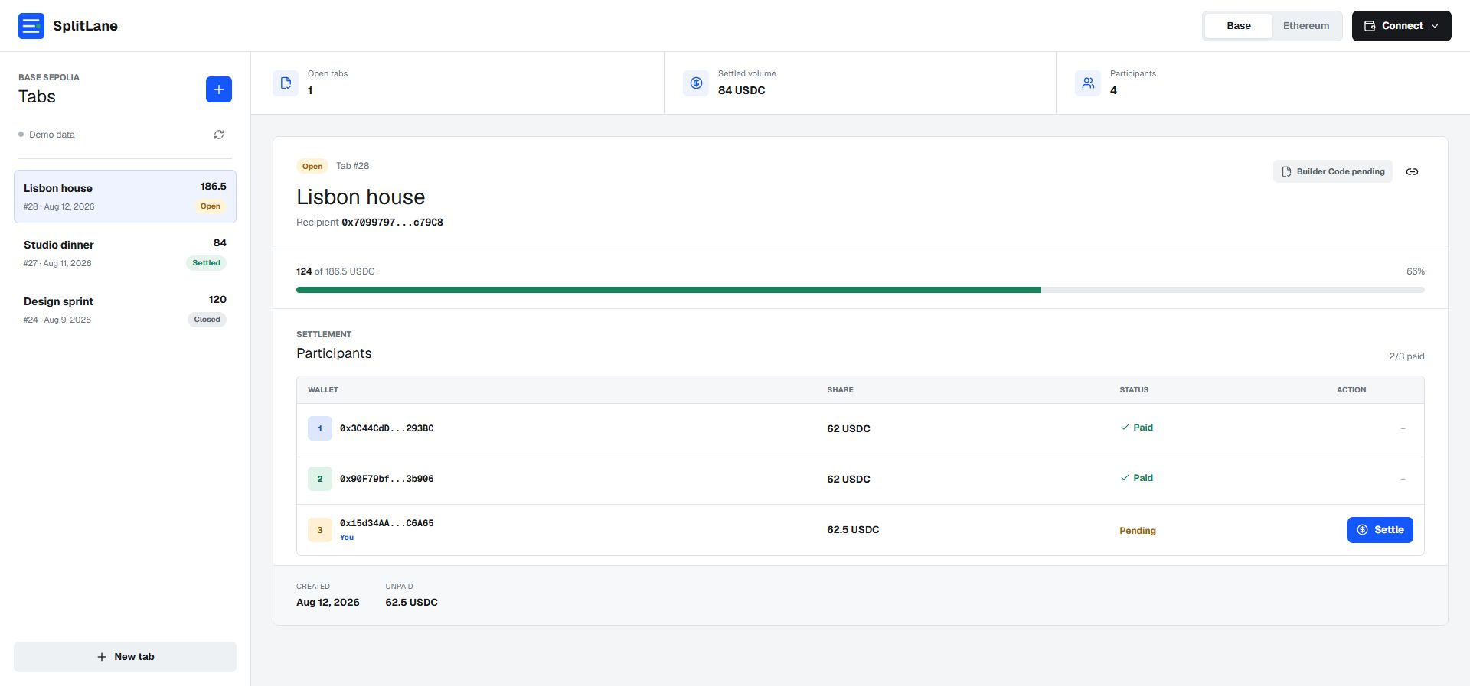
Group expenses need coordination, not custody
Shared bills create three recurring problems:
1. One person fronts the full amount.
2. Participants lose track of exact shares.
3. Pooled wallets add avoidable trust and withdrawal risk.
SplitLane records the obligation and lets every participant settle their own share.
02
Notes:
[Sources]
- README.md (problem and solution statement, accessed 2026-08-12)
- docs/assets/splitlane-dashboard.png (local product screenshot captured 2026-08-12)

Slide 3
A tab moves from agreement to direct settlement
CREATE
SETTLE
PROVE
Recipient defines the tab
Each participant pays
Receipt evidence is verified
Title, metadata hash, participants and exact USDC shares are recorded onchain.
USDC moves from that participant directly to the recipient after approval.
Ethereum Sepolia receipts can enter the Attestcoin proof lane on CC3.
03
Notes:
[Sources]
- docs/demo-script.md (demo flow, accessed 2026-08-12)
- contracts/src/SplitLane.sol (settlement behavior, accessed 2026-08-12)

Slide 4
Two chains share one narrow contract surface
Web dashboard
SplitLane contract
Next.js + wagmi/viem
Base Account wallet connection
Shareable chain-aware tab URLs
Immutable tab records
Exact participant shares
Direct USDC transferFrom settlement
Base Sepolia lane
Ethereum + Attestcoin lane
Official Circle USDC
Builder Code attribution support
Base explorer transaction links
Ethereum Sepolia receipt inspection
Proof construction and verification
Creditcoin CC3 BlockProver
04
Notes:
[Sources]
- docs/architecture.md (component and chain boundaries, accessed 2026-08-12)
- apps/web/src/lib/chains.ts (chain configuration, accessed 2026-08-12)
- packages/attestcoin/src/workflow.ts (proof workflow, accessed 2026-08-12)

Slide 5
The security model removes pooled-fund failure modes
The contract records obligations. It does not become a bank account.
✓
No pooled custody
✓
No privileged withdrawal
Payment remains participant-initiated. The contract has no owner, upgrade, admin withdrawal, recovery, or native-currency path.
✓
No recipient self-share
✓
Reentrancy protection
✓
Exact fixed shares
Threat model and invariant tests are included in the repository.
05
Notes:
[Sources]
- docs/threat-model.md (trust boundaries and mitigations, accessed 2026-08-12)
- contracts/src/SplitLane.sol (privilege and transfer paths, accessed 2026-08-12)

Slide 6
Attestcoin is a deliberate Ethereum-only proof lane
Chain separation is enforced in code so the demo never overstates what is proven.
Ethereum Sepolia
Base Sepolia
Accepted source chain
Receipt inspected
Proof built
BlockProver verification supported
Settlement supported
Builder Code attribution supported
Attestcoin proof requests rejected
Proof evidence is emitted only after source transaction inspection and verification steps complete.
06
Notes:
[Sources]
- packages/attestcoin/README.md (supported lane and commands, accessed 2026-08-12)
- packages/attestcoin/src/constants.ts (source-chain constraint, accessed 2026-08-12)
- packages/attestcoin/test/workflow.test.ts (rejection and evidence tests, accessed 2026-08-12)

Slide 7
DELIVERY STATUS
Built, tested,
ready for public testnet evidence
13 web tests | 15 Attestcoin tests | 30 Foundry tests
Public repository, live URLs and deployment hashes are added after release.
Notes:
[Sources]
- package.json (verification commands, accessed 2026-08-12)
- Local verification record: web 13/13, Attestcoin 15/15, Foundry 30/30 (2026-08-12)

