Slide 1


PHISHING
DETECTION PROGRESS
Data Science Project
Instructor: Reda ALHAJJ
HAMZA BENMILOUD
Liwa Belghith

Slide 2

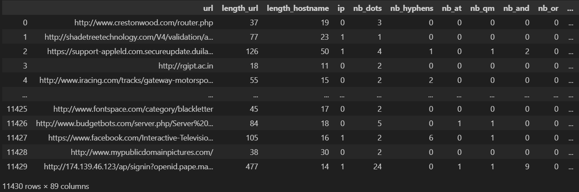
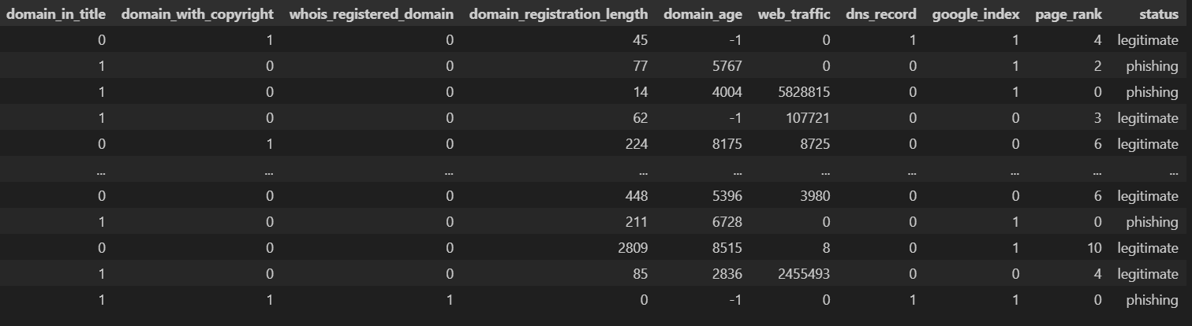
Dataset Review

Slide 3
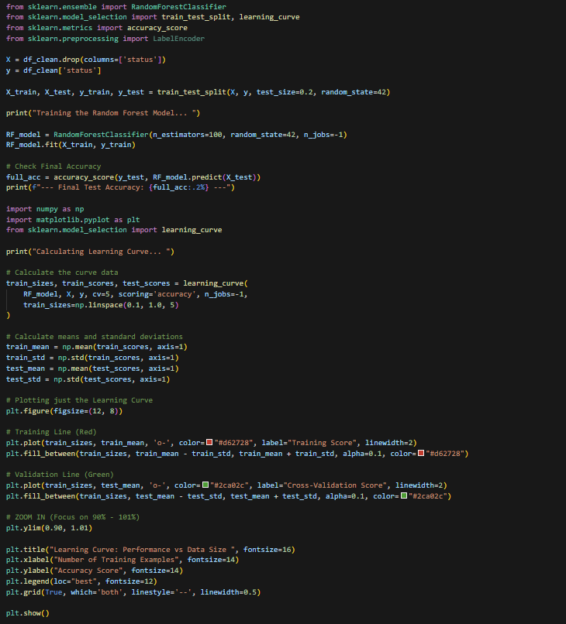







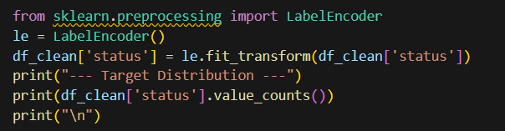
What is already done :
Discovering , cleaning and analyzing dataset .
Training base model (Decision Tree) on dataset features.
Using Advance Models(Random Forest, XGBoost).
Analyzing and plotting results .
Comparing the Three Results From each Model.

Slide 4
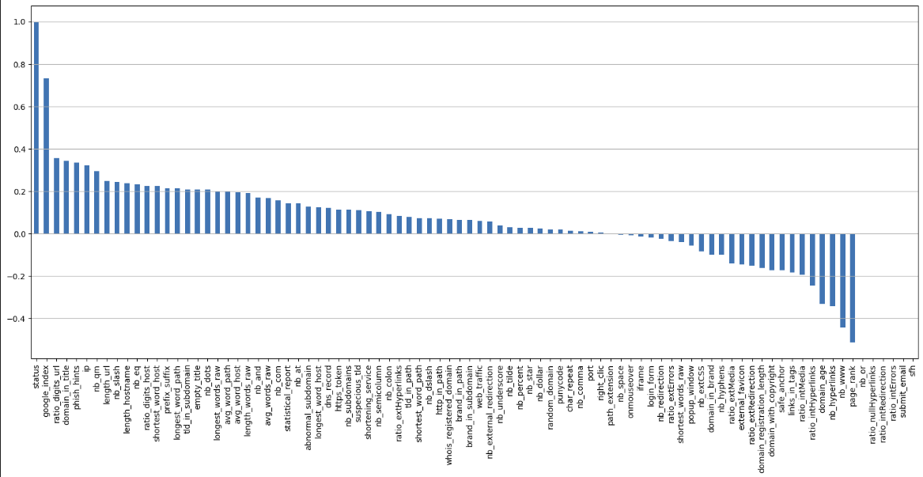
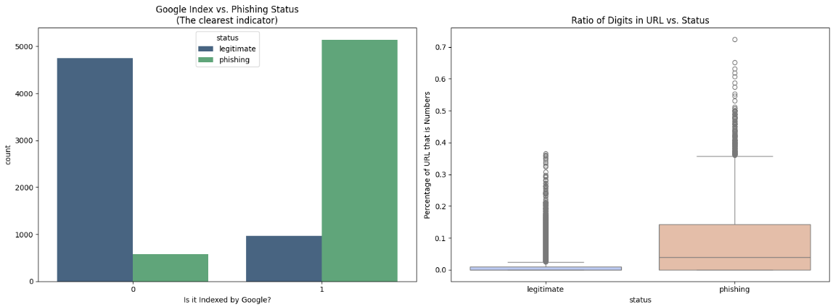
What is already done :

Slide 5
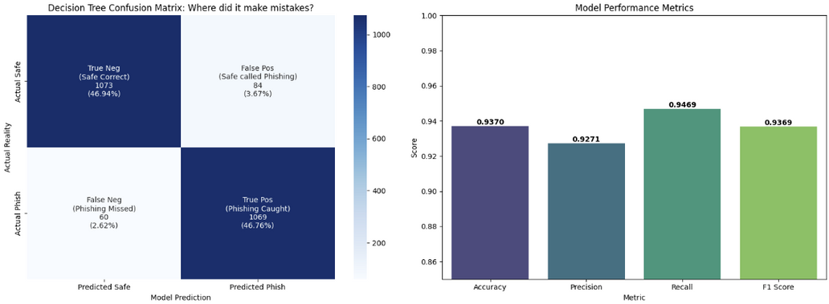
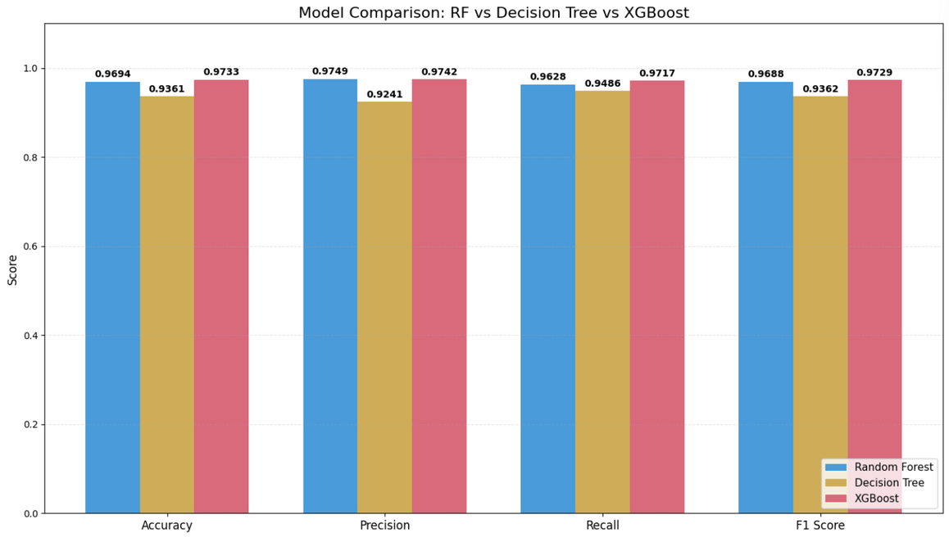
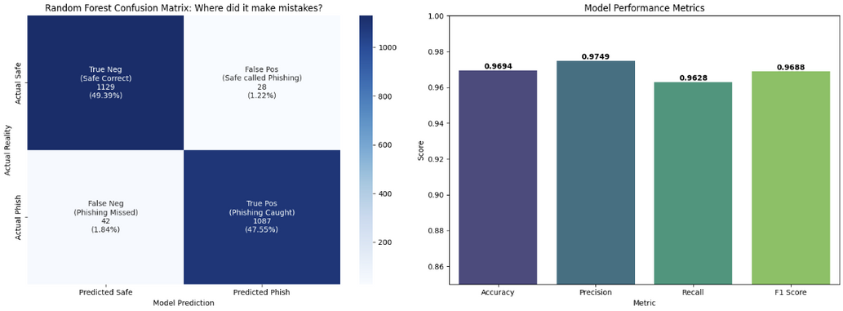
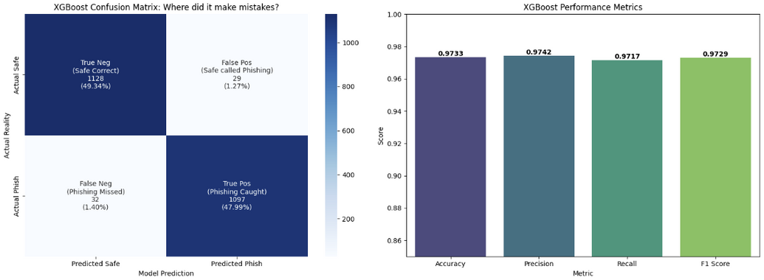
What is already done :
XGBoost outperformed all other models, achieving the highest accuracy of 97.33% and a superior F1-score compared to the Random Forest and Decision Tree. This demonstrates that gradient boosting offers the most robust generalization for our dataset, minimizing errors more effectively than single-tree or bagging methods.

Slide 6
Challenged faced and solutions :
Challenge | Solution
Data Analysis Paralysis | We developed a structured EDA approach
Understanding Model Training | We started with the simplest model and less features
Interpreting and Comparing Results | We used a normalized bar chart to compare all models across the four key metrics
Model testing | We need to develop a script first that can extract features from URL

Slide 7
Plan and timeline :
WEEK 10
WEEK 12
Develop and train Email Phishing Detection module
Build a simple web demo interface.
WEEK 9
WEEK 11
WEEK 13
Finalize URL-based model & begin email data collection
Integrate URL and Email modules into a unified system.
Final testing and preparation of final report/presentation.

Slide 8
Liwa Belghith
Hamza Benmiloud
Task One
Task One
Model Training
Data Preprocessing
Train and optimize machine learning models to classify URLs as phishing or legitimate.
Clean the raw dataset by handling missing values, removing duplicates, and formatting data for analysis.
Task Two
Task Two
Results Visualization
Feature Engineering
Create clear charts and graphs to communicate model performance effectively.
Analyze meaningful features from URLs to improve model detection capabilities.
Task Three
Task Three
Model Evaluation
Demo App Development
Comparing test trained models using metrics like Precision, Recall, and F1-Score to select the best-performing one.
Build a user-friendly web application to demonstrate the phishing detection system in action.

Slide 9
Changes from original proposal :
Change: Expanding from URL-only detection to a comprehensive Email Phishing Detection system.
Phishing attacks are most commonly delivered via email. Detecting malicious intent from the entire email (sender, subject, body text) is a more realistic and valuable security tool.
This allows us to incorporate Natural Language Processing (NLP), which was initially out-of-scope, adding significant technical complexity and learning.
Since our core URL model is already performing at a high level, this expansion is a logical and ambitious next step that utilizes our remaining time effectively.

Slide 10

The End
THANK YOU FOR LISTENING
Liwa Belghith
HAMZA BENMILOUD

