Slide 1
College Recruiting Application
Li Wang
CIS 598
Spring 2019

Slide 2



Goal
Android Application: Student
Slide
Provides the introduction of the company
Form
Enter the students’ contact information
Confirm the information
Combination
Android Application: Administrator
Signup with secure number
Add the university name, image, and professional types
Select the schools and professional type
A table that lists the students’ information
View, add, and delete information
add comment
Store the information on local device
Export the information in a common delimited file

Slide 3

Requirements
Simple and intuitive user interface based upon good design principles
Works well with Sqlite 3
Ability to export student information in comma delimited file

Slide 4
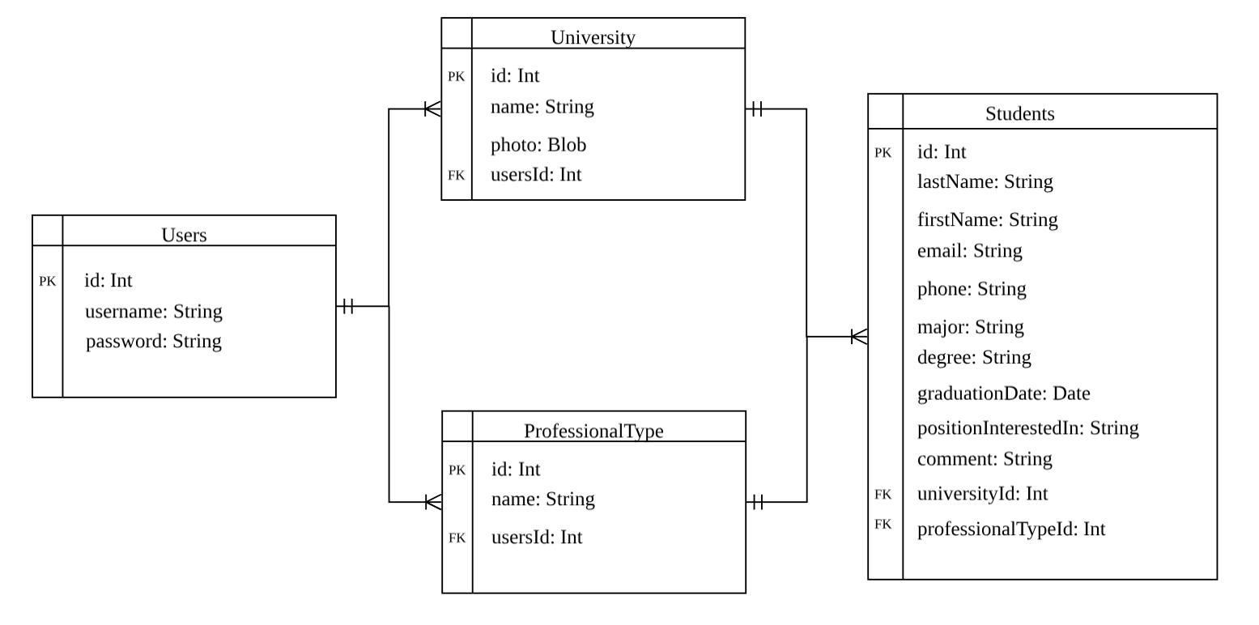
Database Structure

Slide 5



Tools and Data Source
Android Application
Android Studio
SQLite 3
Data Sources
Commerce Bank

Slide 6
Question?

