Slide 1
Audio Signals Captured by Laser Doppler Vibrometer
Weihong Li, Zhigang Zhu
Visual Computing Lab
Department of Computer Science
The City College of New York
Notes:
My topic of today’s talk is “…”
My name is “”, I’m working with Prof. Zhu on this research project sponsored by the Air Force Research Laboratory.
We are from Video computing lab in CS department.

Slide 2
Outline
Introduction of LDV
The Components of Audio Detection
Audio Signal Enhancement
  Volume Scaling
  Filters Design
Experiment Design and Data Collection
Conclusion and Future Work
Notes:
Here is the outline of my talk:
First, I’ll introduce the modules and principles of the LDV, laser doppler Vibrometer.
Then, I’ll talk about the 3 components for detecting audio.
After that, I’ll go though some audio signal processing techniques.
Followed by experiment design and data collection.
Finally, conclusion and future work.

Slide 3
Outline
Introduction of LDV
The Components of Audio Detection
Audio Signal Enhancement
  Volume Scaling
  Filters Design
Experiment Design and Data Collection
Conclusion and Future Work
Notes:
Let’s first take a look at the LDV.

Slide 4
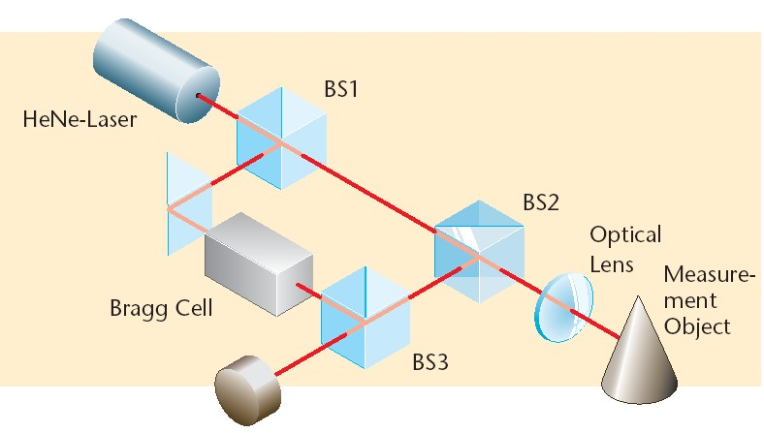
The Modules of LDV
Notes:
Here is the modules of LDV.
HeNe-Laser generator, which produces the HeNe-Laser with wavelength of about 633nm.
Beam-splitter is used to split the laser beam.
The Bragg cell is used to identify the sign of the moving object’s velocity. it is an acousto-optic modulator to shift the light frequency by 40 MHz,

Slide 5
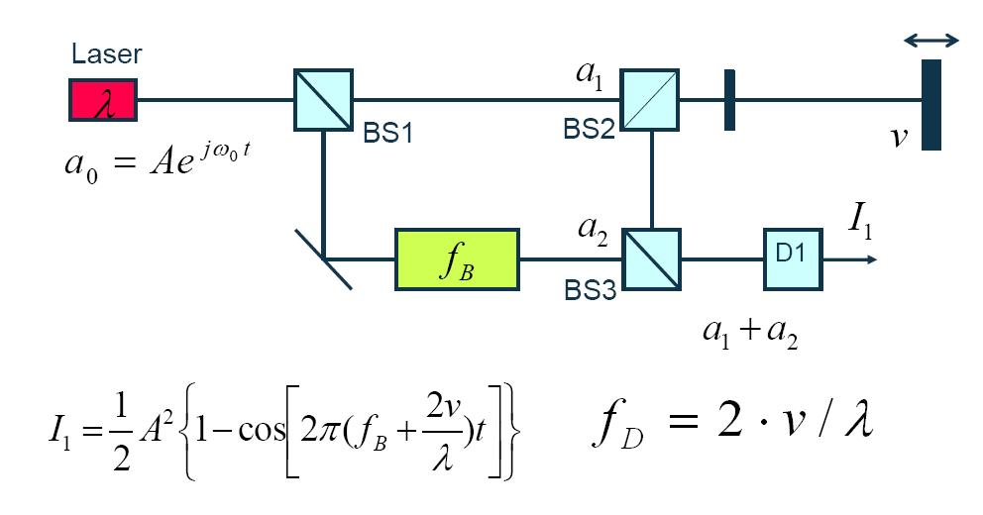
Heterodyning Interferometer
Notes:
Basically, Laser Doppler vibrometers (LDVs) work according to the principles of laser interferometry. In this figure of the Heterodyning interferometer, a coherent laser beam is divided into object and reference beams by a beam splitter BS1. The object beam strikes a point on the moving (vibrating) object and light reflected from that point travels back to beam splitter BS2 and mixes (interferes) with the reference beam at beam splitter BS3. If the object is moving (vibrating), this mixing process produces an intensity fluctuation in the light according to this formula.
Whenever the object has moved by half the wavelength, the intensity has gone through a complete dark-bright-dark cycle. A detector converts this signal to a voltage fluctuation. The Doppler frequency f_{D} of this sinusoidal cycle is proportional to the velocity v of the object according to the formula
Let’s talke a look at a real product of LDV device.

Slide 6
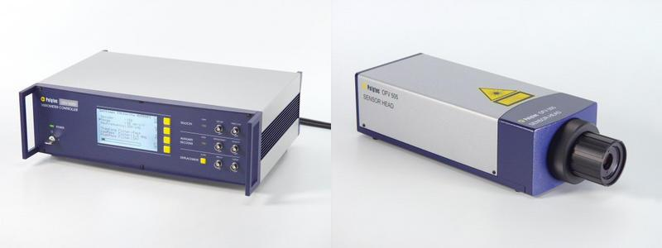
The LDV from PolyTech™
The Controller
The Laser Head
Notes:
This product consists of Laser head and the controller. All the LDV modules we just saw reside in the laser head. The laser head will send the received signals to the controller. The controller is responsible for configuration and signal processing.

Slide 7
Outline
Introduction of LDV
The Components of Audio Detection
Audio Signal Enhancement
  Volume Scaling
  Filters Design
Experiment Design and Data Collection
Conclusion and Future Work

Slide 8
The Components for Audio Detection
LDV Equipment
  Controller
  Laser Head
Audio Card
  Creative™ Audigy2 ZS
Softwares
  LDVProject Java Program
  Creative MediaSource Player
Notes:
There are 3 main components for audio detection: First one is the LDV equipment as we’ve already seen. The 2nd one is the Audio card. This card is responsible for receiving the digital format signal from the output of the Controller. Here, the digital format is S/P-DIF: Sony-Philips digital interface format.
We bought a low-cost creative Audigy2 ZS audio card. This card have a optical S/P-DIF port and can save the digital signal from the controller into several standard audio file, like mp3, wav file by using the Create MediaSource Player coming up with the audio card.
Then, the digital sample data then can be fed into the software for signal processing.

Slide 9
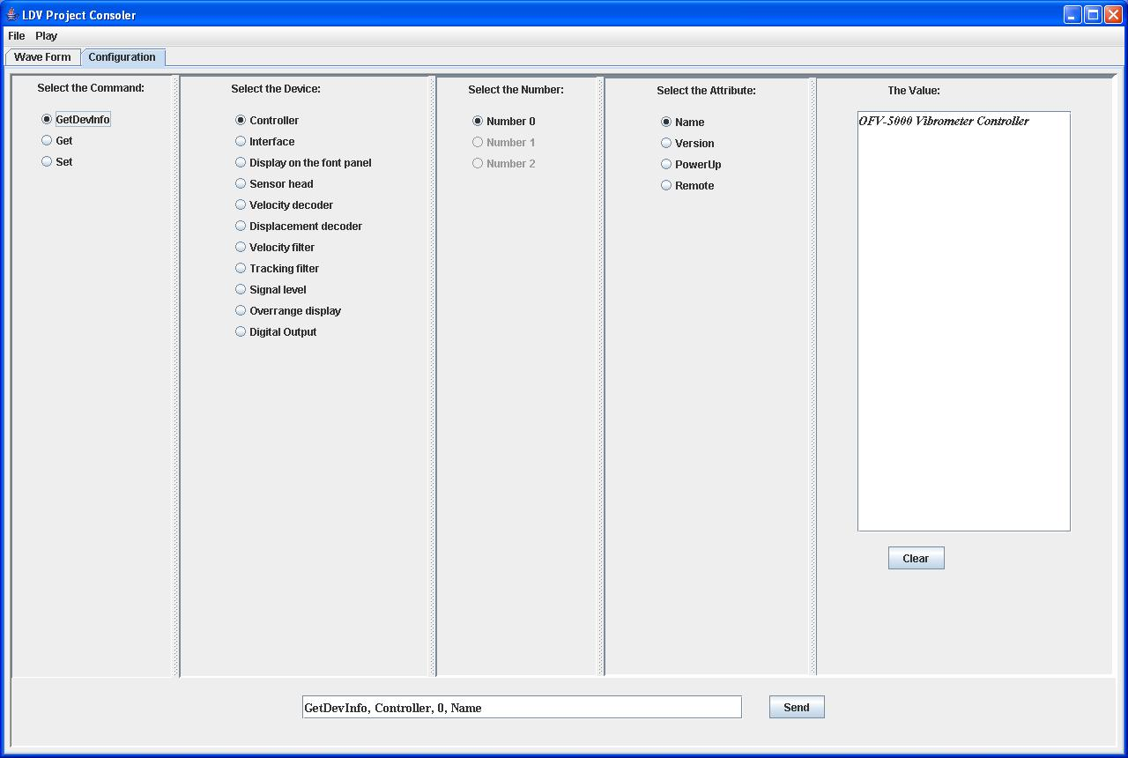
LDV Configuration Module
Notes:
Here is our software, consisting of 2 pars.
This is the first part of our software: Configuration Module. It is used to send commands to the controller to configure and monitor the device status via a RS-232 Serial communication port.

Slide 10
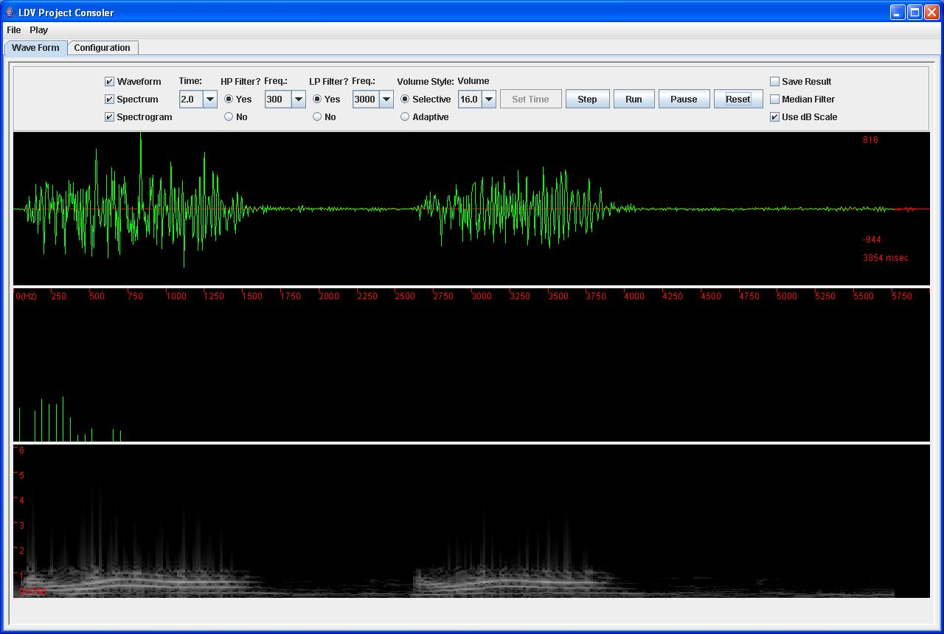
Signal Processing Module
Notes:
This is the main module of our system: Signal processing module.
It includes all the filters. I’ll show you a demonstration later.

Slide 11
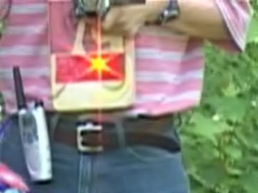

An example of detected Audio
30-meter listening
Notes:
Prof. Zhu talked nearby a building pillar. Actually, it is NAC building.
The distance between the pillar and the sensor head is about 10 meters away.
Let’s hear the audio captured by the LDV.
We can find that the signal not so good, and could be enhanced by using DSP techniques.

Slide 12
Outline
Introduction of LDV
The Components of Audio Detection
Audio Signal Enhancement
  Volume Scaling
  Filters Design
Experiment Design and Data Collection
Conclusion and Future Work

Slide 13
Audio Signal Enhancement
Volume Scaling
  Adaptive volume
  Selective volume
Filters Design
  Gaussian bandpass filter
  Median filter
Notes:
In our software, the audio enhancement mainly focused on 2 parts:
Volume scaling and filter Design.
Including adaptive, selective scaling, GBPF and Median filter.
I’ll mainly discuss Gaussian filter today.

Slide 14
Outline
Introduction of LDV
The Components of Audio Detection
Audio Signal Enhancement
  Volume Scaling
  Filters Design
Experiment Design and Data Collection
Conclusion and Future Work

Slide 15
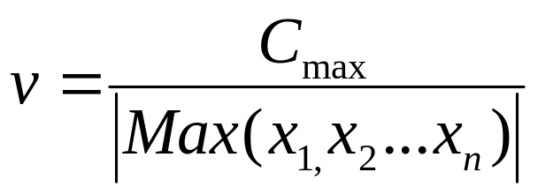
Volume Scaling
Constant Factor Scaling Volume:
  Multiple the sample data by a constant value, e.g., 8, 16, 32, etc.
Adaptive Volume:
  For each frame, get the adaptive scale factor by:
Notes:
The useful original signal obtained from the S/P-DIF output of the controller is a velocity signal. When treated as the voice signal, the volume is too small to be heard by human ears.
Cmax is the maximum constant value of the volume (defined as the largest short integer, i.e., 32767)
And X1,X2,…Xn are sample data in one speech frame (e.g. n = 1024 samples).
The scaled sample data stream, vX1, vX2,…vXn , will then be played via a speaker so that a suitable level of voice will be heard.
The advantage of this approach is that we can hear a smoother voice than that of the adaptive method. However, the adaptive method will always give a suitable volume for any kind of the sampled data stream.

Slide 16
Outline
Introduction of LDV
The Components of Audio Detection
Audio Signal Enhancement
  Volume Scaling
  Filters Design
Experiment Design and Data Collection
Conclusion and Future Work

Slide 17
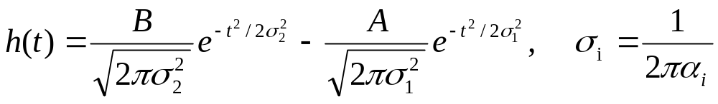
Gaussian Bandpass Filter
For Gaussian Bandpass filter:
The impulse response of this filter is:
Notes:
We can produce the Gaussian bandpass transfer function by expressing it as the difference of two Gaussians of different widths, that is different variances.
Notice that the broader Gaussian in the frequency domain (Figure 10) creates a narrower Gaussian in the time domain (Figure 11),
and vice versa
We want to reduce the signal magnitude outside the frequency range of human voices, i.e., below s₁= 300 Hz and above s₂ = 3K Hz.
The high frequency reduction is mainly controlled by the width of the first (the broader) Gaussian function i.e., α2, and the low frequency reduction is mainly controlled by the width of the second Gaussian function, i.e., α1.

Slide 18
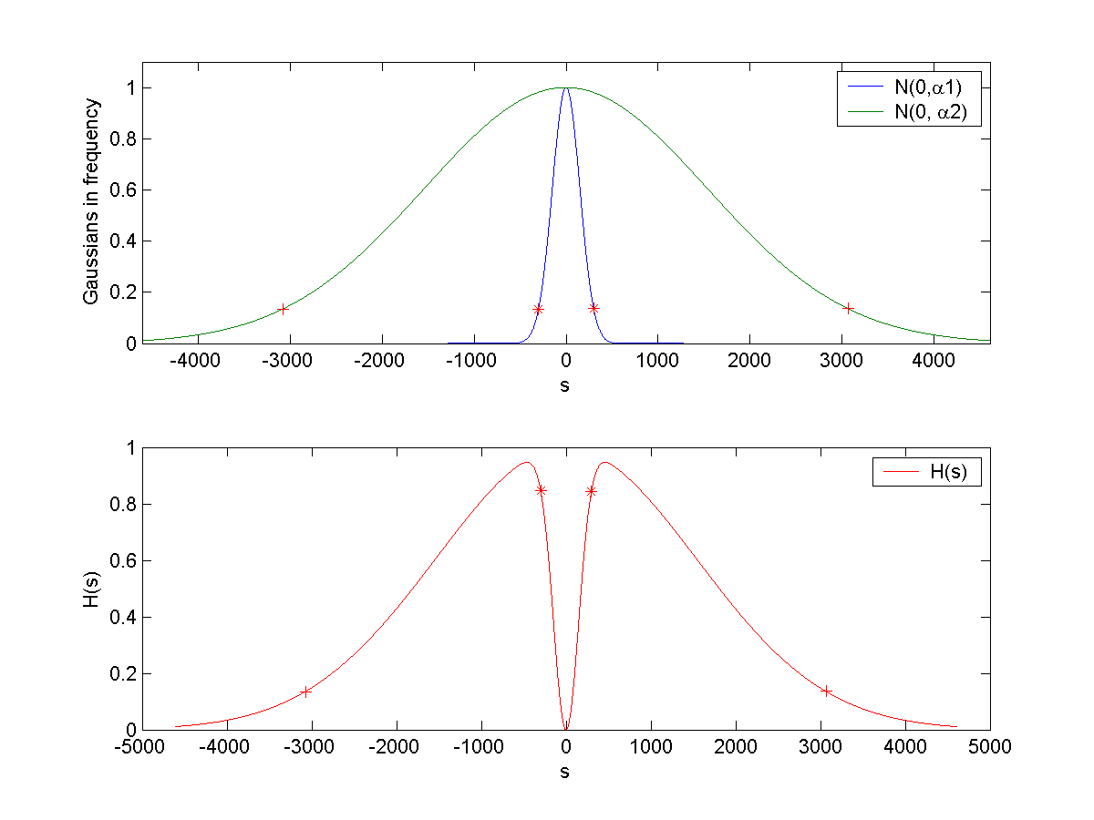
GBPF (1)
The Gaussian Bandpass Filter:
Notes:
We want to reduce the signal magnitude outside the frequency range of human voices, i.e., below s₁= 300 Hz and above s₂ = 3K Hz.
The high frequency reduction is mainly controlled by the width of the first (the broader) Gaussian function in Eq. (3), i.e., α₂, and the low frequency reduction is mainly controlled by the width of the second Gaussian function, i.e., α₁.

Slide 19
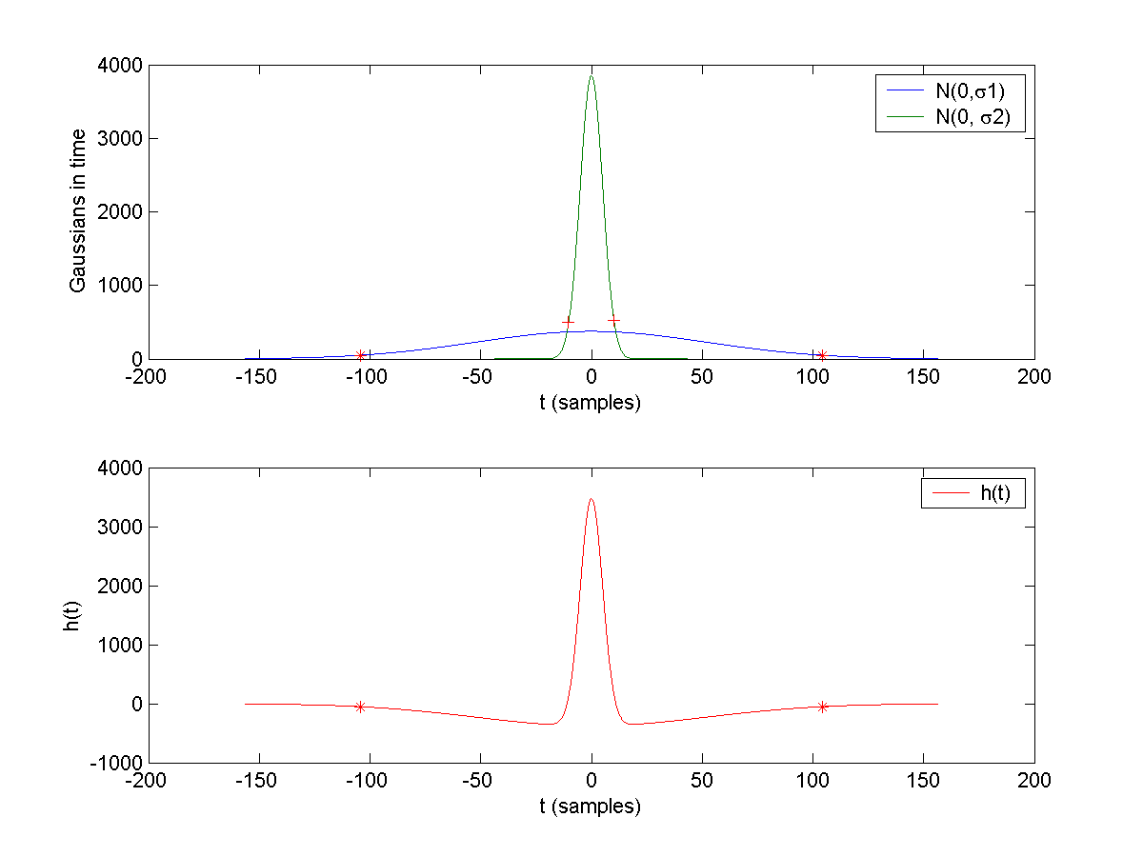
GBPF (2)
The Impulse Response:
Notes:
In practice, we process the waveform directly in the time domain, i.e., by convolving the waveform with the impulse response in (2) equation
This leads to a real-time algorithm for LDV voice signal enhancement. For doing this, we need to calculate the variances of the two Gaussian functions in the time domain.

Slide 20
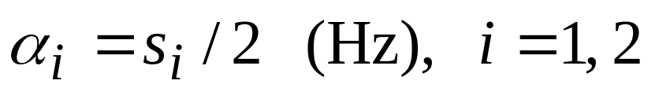
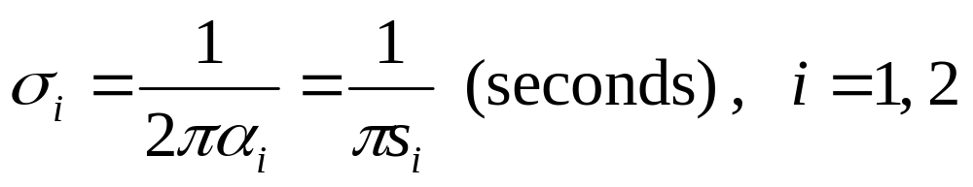
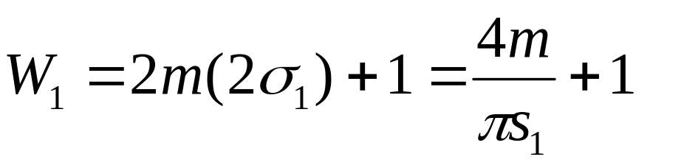
Window Size of GBPF
Drops significantly when |s_{i}| > 2α_{i}, (i=1, 2)
So we have
The window size is
Notes:
Since the Gaussian function drops significantly when |s_{i}| > 2α_{i}, (i=1, 2), as shown by a pair of ‘*’s and a pair of ‘+’s in previews slide , we obtain the widths of the two Gaussian functions in the frequency domain as:
For digital signals, we need to determine the size of the convolution kernel. Since the narrower Gaussian (with width α₁) in the frequency domain creates a broader Gaussian (with width σ₁) in the time domain, we use σ₁ to estimate the appropriate window size of the convolution. Again, we truncate the impulse function when we have t > 2σ₁. Therefore, the size of the Gaussian bandpass filter is calculated by the formula :
where m is the sampling rate of the digital signal. Typically, we use m = 48 K samples/second with the S/P-DIF format.

Slide 21
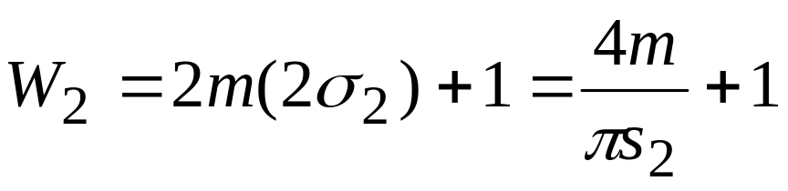
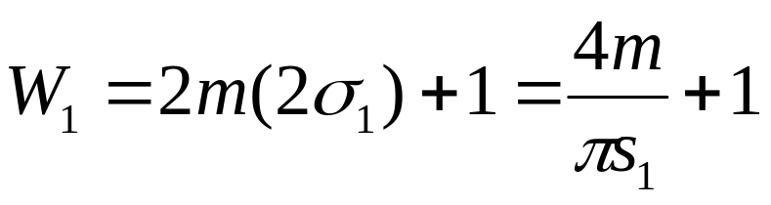
Example of Window Size
GHPF Window Size (efficient):
  When m=48k, s₂=3kHz, W₂ = 21
GLPF Window Size:
  When m=48k, s₁=300Hz, W₁ = 210

Slide 22
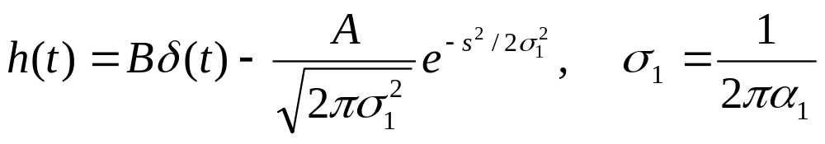
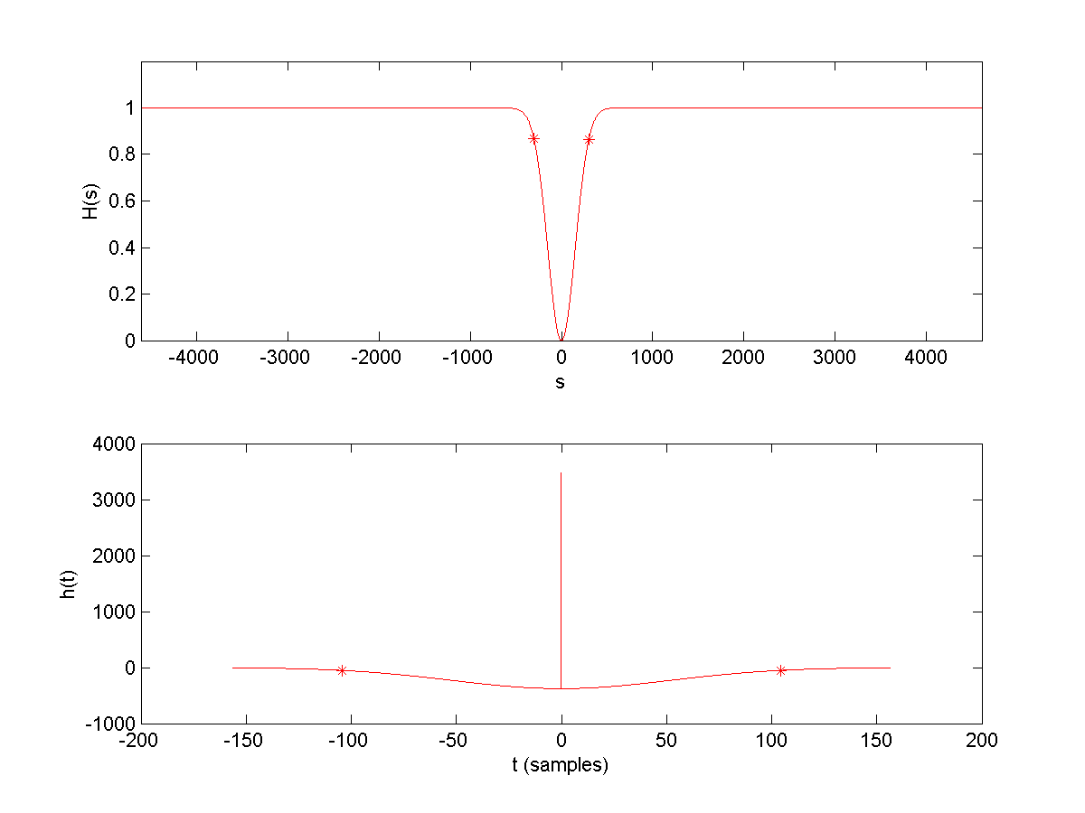
Special Case: GHPF
Gaussian Highpass filter
Notes:
Some time, we want to keep all high freq. Then, the bandpass filter changed to high pass filter.

Slide 23
Outline
Introduction of LDV
The Components of Audio Detection
Audio Signal Enhancement
  Volume Scaling
  Filters Design
Experiment Design and Data Collection
Conclusion and Future Work

Slide 24
Experiment Design and
Data Collection
Long Range LDV listening
  From 30 to 300 meters (100 – 1000 ft)
Listening through walls/doors/windows
Talking inside a car
  Front door, w/o engine on, w/o tapes
Type of surfaces: traffic sign, lamp post, etc.
Surface directions

Slide 25
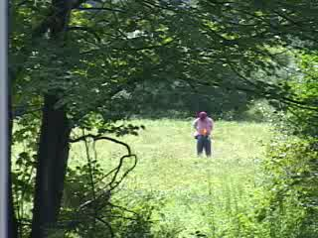
Long Range Listening
30-meter listening
260-meter listening
Notes:
Let’s take a look at the long distance experiments first.
The experiment setup is like this: Prof. Zhu held a metal cake box pasted with a retro-tape, the laser is shot on the tape.
While the professor was talking, the vibration of the cake box is detected by the LDV.
Professor also used a hand-held camcorder to record the original sound and video.
The walkie talkie is used to communicate each other.

Slide 26
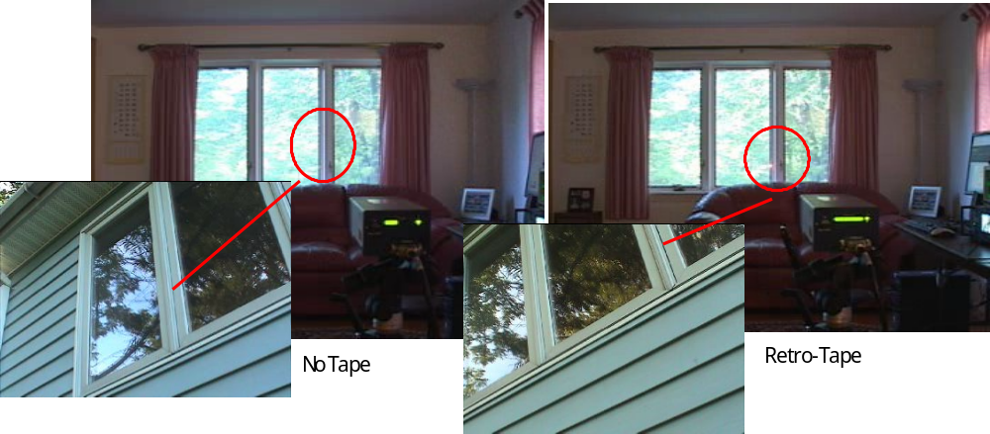
Listening Around House
Notes:
Here is the LDV sensor head.

Slide 27
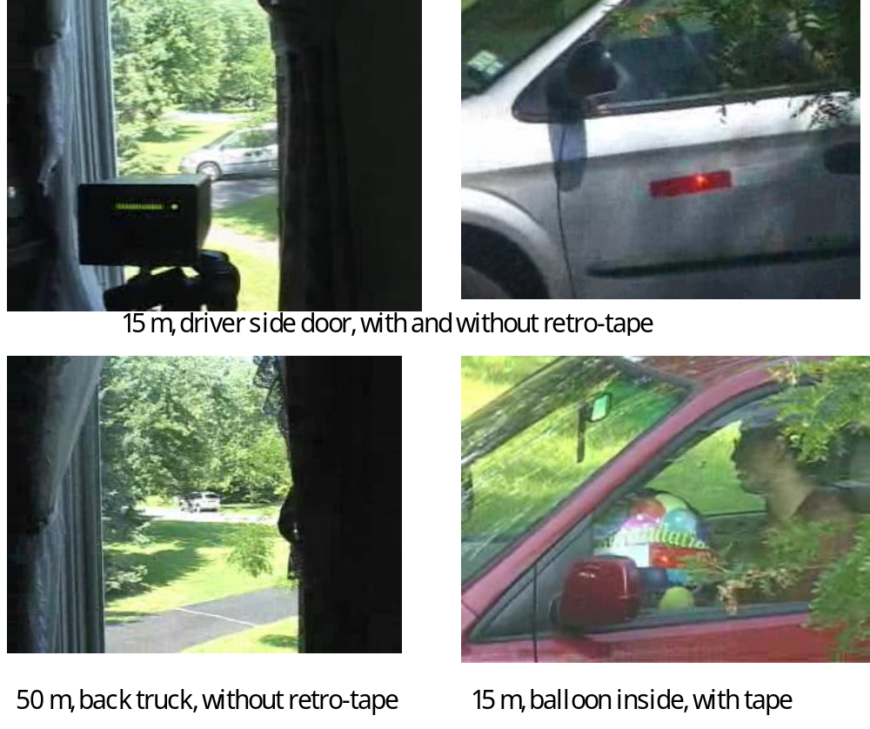
Inside A Car
Notes:
All kinds of cars, balloon in the car.

Slide 28
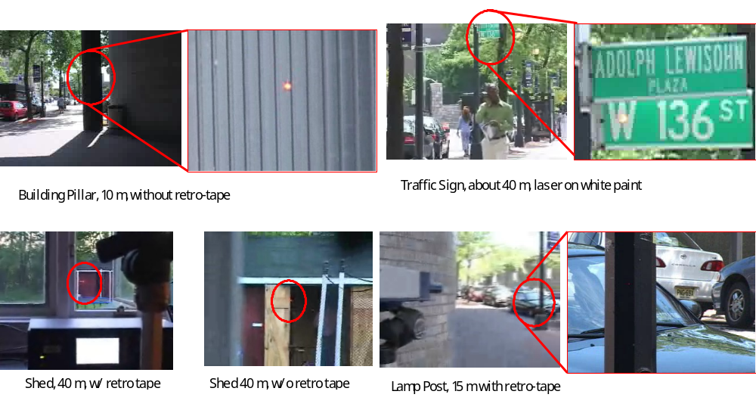
Surface Types
Voice
Notes:
Building pillar, traffic sign, shed, lamp post, etc.
It turns out all the surface and objects reflect the sound itself.

Slide 29
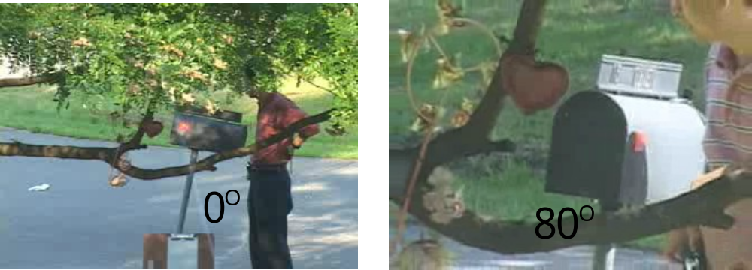
Surface Directions
Notes:
experiment of LDV voice detection through a normal mailbox with retro-tape treatment. The voice signals are still intelligible even when the angle between the surface normal and the laser beam is as large as 80 degrees.

Slide 30
Outline
Introduction of LDV
The Components of Audio Detection
Audio Signal Enhancement
  Volume Scaling
  Filters Design
Experiment Design and Data Collection
Conclusion and Future Work

Slide 31
Discussion and Conclusion
The principle and properties of LDV
  Non-contact, remote, high-resolution
Audio enhancement techniques
  Gaussian bandpass filter, adaptive volume
LDV is good for voice detection
  With retro-reflective tape treatment
  Under certain distance
Notes:
We have found that the vibration of the objects caused by the voice energy reflects the voice itself.

Slide 32
Future Works
Real time capture and synthetic techniques.
  Save/Playback the processed signal on the fly.
Automatic object tracking using computer vision techniques
  Introduce EO/IR camera into LDV system.
Advanced signal processing algorithms
Apply speech recognition algorithms
Notes:
Right now, we first record the signal data into mp3 or wav file by using the Create MediaSource Player. And then this files are fed into our software.
Tracking people and clandestine listening for defense purpose..
Use more advanced Signal processing to enhance the audio data.

