Slide 1
Remote Voice Acquisition and Enhancement Via Laser Doppler Vibrometer (LDV)
Weihong Li and Prof. Zhigang Zhu
Computer Science Department
Graduate Center
The City University of New York
Notes:
Today I will be talking about one of my research topics, which is …
My name is “”, I’m working with Prof. Zhu on this research project.
This research is supported by Air Force Research Laboratory (AFRL) and CUNY. We are collaborating with researchers from other universities, like UIUC.

Slide 2
Outline
Introduction of LDV
Signal Processing Module
Audio Signal Enhancement
  Volume Scaling
  Gaussian bandpass filter
  Wiener filter
Summary
Notes:
Here is the outline of my talk:
First, I’ll briefly introduce the modules and principles of the LDV, laser doppler Vibrometer.
Then, I’ll show you our signal processing software.
After that, I’ll go though some audio signal enhancement techniques based on the characteristics of the signal captured by LDV. These include …
Finally, I’ll conclude my talk.

Slide 3
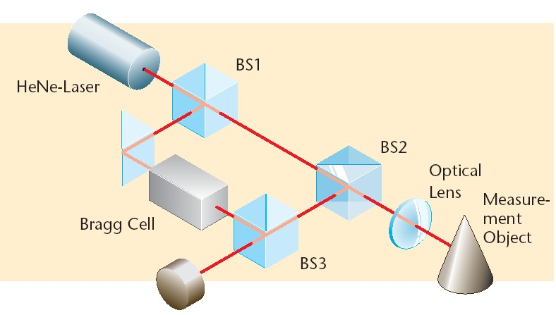
The Modules of LDV
Notes:
Here is the modules of LDV.
HeNe-Laser generator produces a red HeNe Laser with wavelength of about 633nm.
Then, this laser beam is divided into object and reference beams by a beam splitter BS1. The object beam strikes a point on the moving (vibrating) object and light reflected from that point travels back to beam splitter BS2 and mixes (interferes) with the reference beam at beam splitter BS3. If the object is moving (vibrating), this mixing process will produce an intensity fluctuation in the light. A detector converts this intensity fluctuation into a voltage fluctuation. (Whenever the object has moved by half of the wavelength, which is 317 nm in the case of HeNe laser, the intensity has gone through a complete dark-bright-dark cycle. )
The Bragg cell is used to determine the sign of the moving object’s velocity.

Slide 4
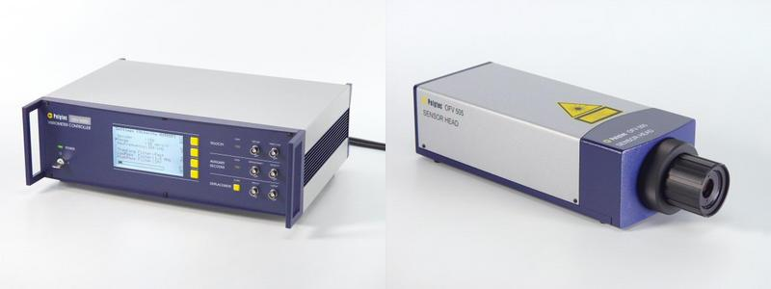
The LDV from PolyTech™
The Controller
The Laser Head
Notes:
We purchase a LDV from PolyTech company. This product consists of Laser head and the controller. All the LDV modules we just saw reside in the laser head. The laser head will send the detected voltage signals to the controller. The controller is responsible for configuration and signal processing.
How to detect voice:
To detect voice, we can choose a object close to the source of the voice and shoot the laser beam on this object to detect the vibration caused by the voice energy.

Slide 5
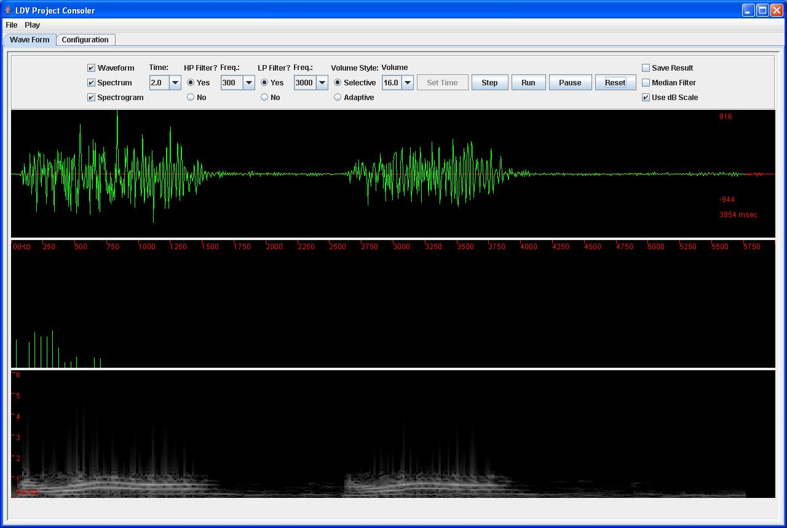
Signal Processing Module
Notes:
We developed a Signal processing module for enhancing the audio signal.
It includes all the filters, which can be applied to the signals on the fly.
The first window is used to display the wave form. 2nd one is the STFT of the current frame, which is indicated by a red portion of the waveform. 3rd one the spectrogram of signal in the first window.

Slide 6
Audio Signal Enhancement
Volume Scaling
  Adaptive volume
  Selective volume
Filters Design
  Gaussian bandpass filter
  Wiener filter
Notes:
In our software, the audio enhancement mainly focused on 2 parts:
Volume scaling and filter Design. Let’s first take a look at the volume scaling (>>)

Slide 7
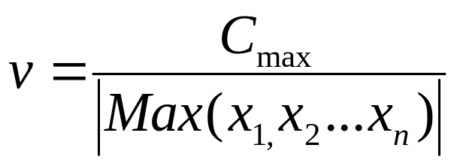
Volume Scaling
Constant Factor Scaling Volume:
  Multiple the sample data by a constant value, e.g., 8, 16, 32, etc.
Adaptive Volume:
  For each frame, get the adaptive scale factor by:
Notes:
Due to the changes of speech loudness, and also the changes of distances between the human speakers to the target,
the volumes of the voice signals may change dramatically.
We have applied two strategies for scaling volume.
Adaptive: first get a scale factor, then, multiple the sample data with this factor.

Slide 8
Gaussian Bandpass Filter
Low frequency noise:
  Motor engine
  Air Conditioner
High frequency noise
  Laser speckle patterns
  Occlusion of the laser beam
Voice frequency range: 300Hz – 3kHz
Notes:
Unfortunately, the audio signal captured by LDV consists a lot of noise energy.
The low frequency noise energy is introduced by machines nearby the detected object …
The high frequency noise energy is …
On the other hand, the inherent “speckle pattern” problem [3, 6] on a normal “rough” surface

Slide 9
Wiener Filter
Reduce noise energy falling inside the voice frequency range
Optimal filtering in the sense of Minimum Mean Squared Error (MMSE)
The noise energy is assumed to be the low energy part (20%) of this signal.
Notes:
The degraded speech can be modeled as the summation of a clean speech signal and additive noise which is illustrated as
The noise part is assumed to be the low-energy part (20%) of this signal. Then the noise power spectrum is estimated using the noise part of this signal. The optimal filter is therefore updated based on this new noise estimation.

Slide 10
Summary
The principle and properties of LDV
  Non-contact, remote, high-resolution
Audio enhancement techniques
  Bandpass/wiener filter, adaptive volume
Better voice detection
  With retro-reflective tape treatment
  Within certain distance (<1000ft)
Notes:
We have found that the vibration of the objects caused by the voice energy reflects the voice itself. And LDV is a Non-contact, …., and can be used to detect this vibration.
We have proposed a hybrid enhancement approach, which combines the Gaussian bandpass and Wiener filtering, followed by the adaptive volume scaling, to improve the intelligible of the detected LDV audio signals.
LDV could provide better voice detection …

Slide 11
Grants and Publications
Grants:
  Air Force Research Laboratory (AFRL), Grant No. F33615-03-1-6383
  PSC-CUNY
  CUNY Equipment Grant
Publications:
  ICPR 2006
  ICME 2006
  CVPR Workshop on OTCBVS 2005
  CUNY Technical Report (TR-2005006)
Notes:
We have found that the vibration of the objects caused by the voice energy reflects the voice itself.
We have proposed a hybrid enhancement approach, which combines the Gaussian bandpass and Wiener filtering, followed by the adaptive volume scaling, to improve the intelligible of the detected LDV audio signals.

Slide 12
Thank You

