Slide 1
CLASSROOM MULTIMEDIA INTEGRATION FOR ADVANCED
E-PRESENTATIONS
Weihong Li, Hao Tang, Chad McKittrick and Zhigang Zhu
Visual Computing Lab
Computer Science Department
Graduate Center
The City University of New York
Notes:
Today I will be talking about “…”
This work is done by me, weihong Li, Mr. Hao tang and Dr. Zhigang Zhu.
We are from Visual Computing Lab at CUNY

Slide 2
Outline
Background and Motivation
System Overview and Components
Media Integration Algorithms
  Slide & Video Registration
  Video & Whiteboard Registration
  Slide & Whiteboard Integration (Results)
Discussion and Future Work
Notes:
Here is the outline of my talk:
First, I will briefly introduce the background and motivation for our system.
Then, I will show you our system overview and the components.
After this, we will go through the hybrid media integration algorithms, which include slide and video registration, video and white board registration and slide and white board integration.
And finally, I will conclude my talk

Slide 3
Background
Record and playback based e-lecture system
  Georgia Tech – Classroom 2000
  CMU – Just-In-Time system
  UMass – RIPPLES/MANIC
Smarter presentation
  Automated keystone correction
  Projector array alignment
More automated, flexible and interactive systems are needed
Notes:
Our project is an application of computer vision techniques in the distance and electronic education system, that is e-learning system.
The first generation e-learning systems mainly adopted a “record-and-playback” approach.
Including classroom 2000 project conducted in Georgia Tech.
Just-In-Time System from CMU and
Ripples/Manic project in Umass at Amherst.
Another related work is smarter presentation. The techniques include automated keystone correction for projector and projector array alignment.
However, The new generation e-learning system should be more automated, flexible and interactive to both instructor and students.

Slide 4
Motivation
Rich information in multimedia materials
  Need to be captured
  Need to be organized
Powerpoint slides combined with whiteboard
  A better way to present a lecture
  Deliver effective e-lectures
Leverage computer vision techniques
  Assist instructor for presentations
  Organize materials for students
Notes:
Our project is motivated by the following considerations.
Multimedia materials from classrooms are rich sources of information, which need to be captured and organized
2. A PowerPoint slide presentation combined with a whiteboard handwriting capture system
can provide a better means to present a lecture and later can be delivered more effectively for off-campus students.
[3]The last and most important, we want to leverage the computer vision techniques in classroom scenario to both assist instructor for giving a better presentation and to organize the materials for students effectively.

Slide 5
System Overview
Intelligent Classroom Assistants
Instructor Assistants
Feature Extraction
Data Fusion for
Event Recognition
Media Capturing and Processing
Speaker Contour
Equipments Movement
Camera
Video
Adaptive
Background
Difference Image
Projection Blocking
Speech Energy
Speaking too fast
Mic.
Audio
Particle Filter for Speaker Tracking
Speech Rate
Speaking too low
STFT for Audio signal processing
Mimio
Writing
Student Assistants
Handwriting
Recognition
Projector
Slides
Multimedia Integration
Multimedia Presentation
PPT Slides Capturing
Media Integration
Active
Objects
Multimedia Synchronization
Customized Presentation
Notes:
Our system is multi-modal based system; the input data include video, audio, handwriting image and ppt slide image.
Data from each modality is pre-processed in the media capturing and processing module by a single or couple of sub-modules. For example, both adaptive background and particle filtering based speaker tracking sub-models take the video as their input. And the audio data is processed by a stft sub-module. The handwriting is recognized by a handwriting recognition sub-module based on OCR techniques.
Our intelligent classroom assistants consists of two parts. The first part is Instructor Assistants, which is mainly focused on assisting a instructor for presentation by using activities recognition approaches. For example, we will extract some video and audio features, like the speaker contour and speech energy to infer some events and activities in a classroom, such as a instructor is speaking too fast or speaking too low or might be blocking the projection area too long for students.
The other part of the intelligent classroom assistants is student assistants, which is mainly focused on media integration and presentation. For example, in our presentation system, we want to present the multimedia information to the students in such a way that when they have a question, they could easily obtain the answer by just clicking on corresponding active objects, which could be an instructor object, generated by speaker tracking, or a word object, generated by OCR techniques.
In this paper, we’ll focus on the media integration sub-module.

Slide 6

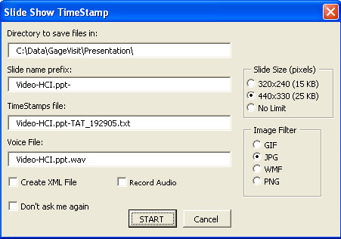

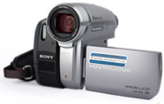
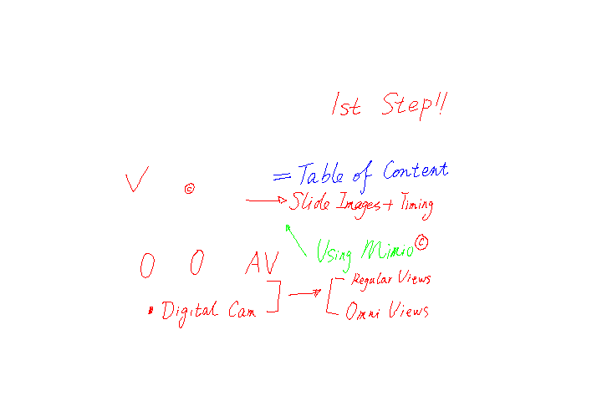
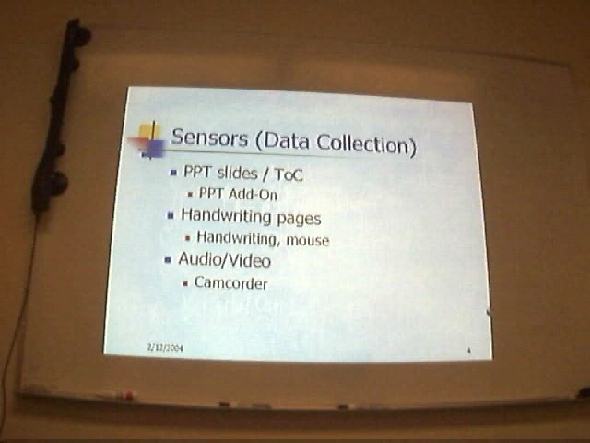
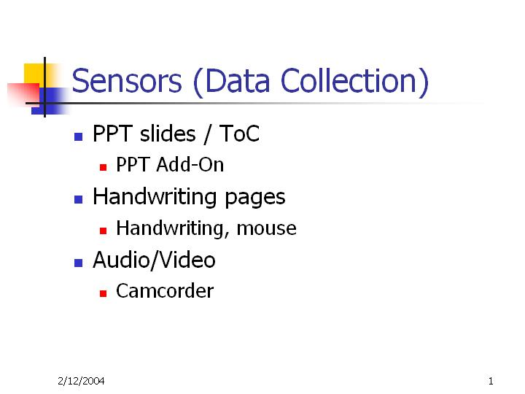
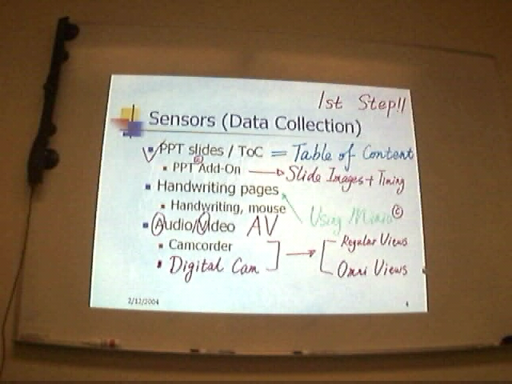
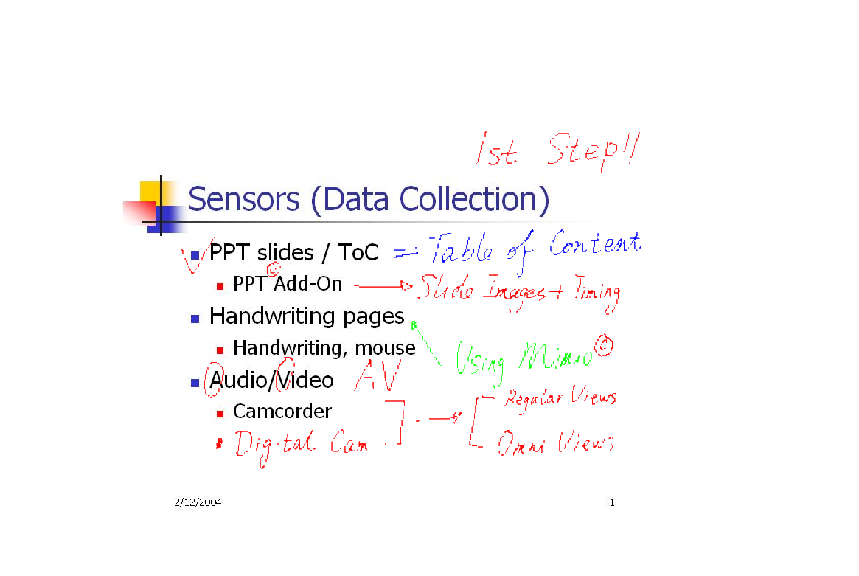
Handwriting pages
video
PPT slides
V1
S
H
V2
combined
Notes:
Let’s take a look at the media capturing and integration. As I said,
We used a Mimio Virtual Ink digital whiteboard system to capture a instructor’s handwriting on the whiteboard and saved it as an image.
The Powerpoint slide capturer was modified from the Berkeley PPT recording Add-In to save the ppt slides into JPEG image format.
Projector and Camera are widely used in classroom. Here, we also use them for integration because the Mimio handwriting image and PPT slides image do not share the same materials.
By combining these information together, we can obtain the handwriting and ppt slide integrated image.

Slide 7
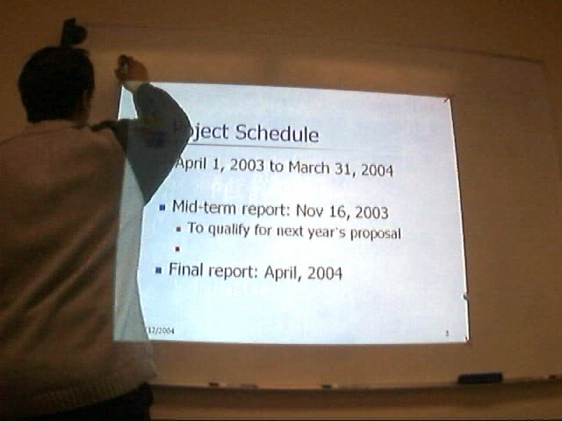
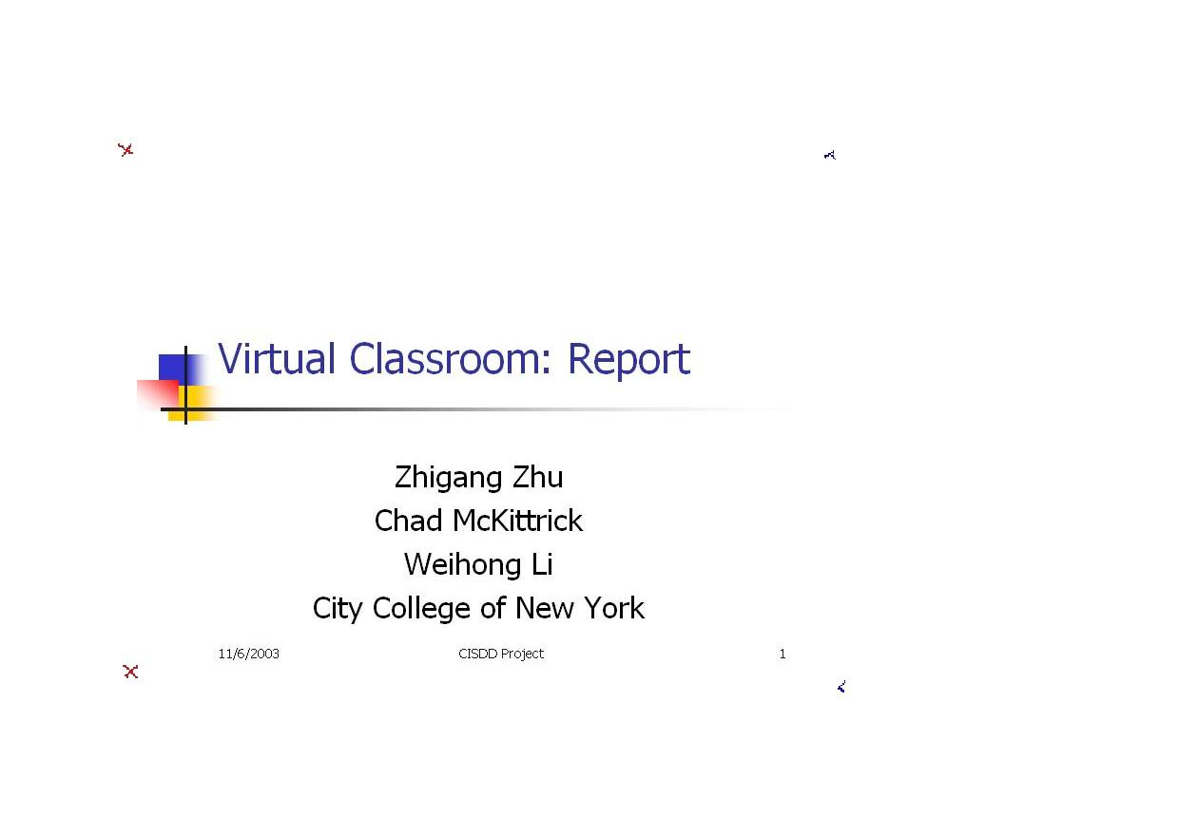
A Simple Approach
Mark four corners to register slide and mimio handwriting …
Notes:
Certainly, we could apply a simple approach which does not need the camera at all to align these two images:
The method is to let the instructor mark the 4 corners of the projection area.
Then, we can extract corners to get the projective transformation matrix. After this, aligning the ppt slide image with its corresponding mimio handwriting image is just a trivial work.

Slide 8
Drawbacks of the Approach
Need Dynamic registration of PPT@ Slide & Mimio page because
  Hard to mark in some cases
    due to self-occlusion and height
  Instructor may forget to do it
  Devices may not be kept stationary
    Camera, projector, Mimio capture bar
Goal:
  Completely automatic and “mind-free” approach
Notes:
However, this simple approach is a static method and has a bunch of drawbacks…..
Our goal is to propose a completely automatic and “mind-free” dynamic registration approach to solve all these issues.

Slide 9
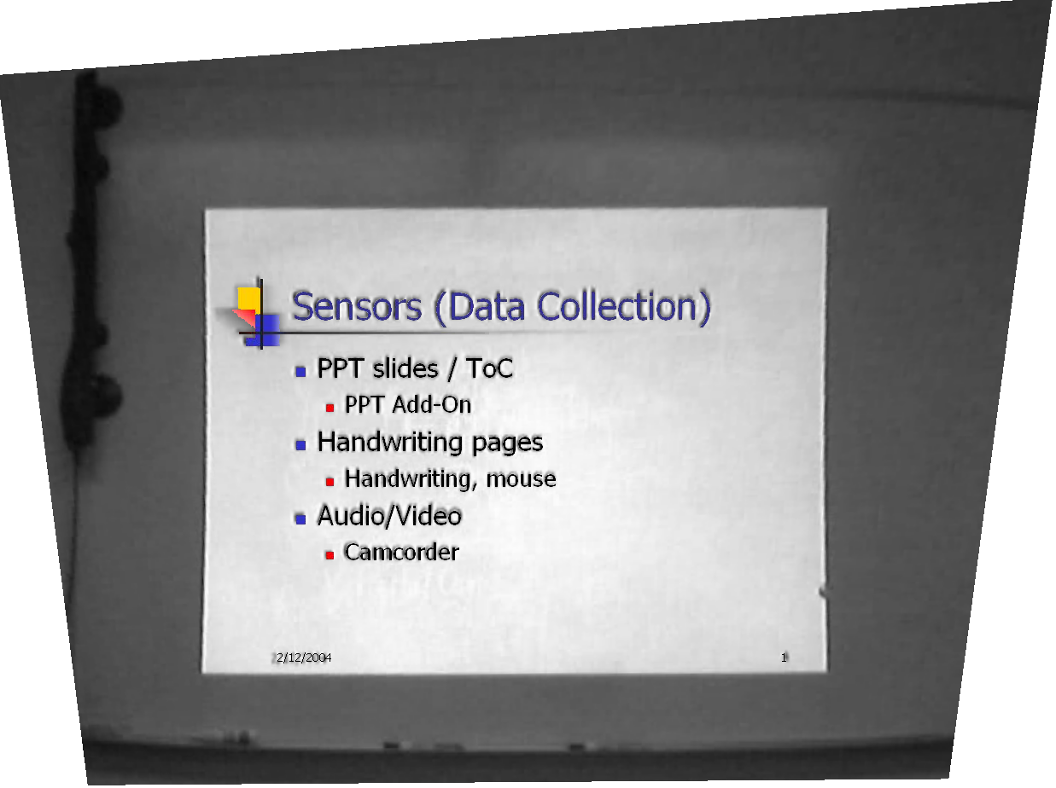
Slide and Video Registration
Distortion Removal
Feature Extraction
Image Transformation
Notes:
First step is to register slide and video. [*****] The intuition behind this work is to superimpose the slide onto the projection area of the video frame, and transform the combined image such that the rectified view of the ppt slide remains.

Slide 10
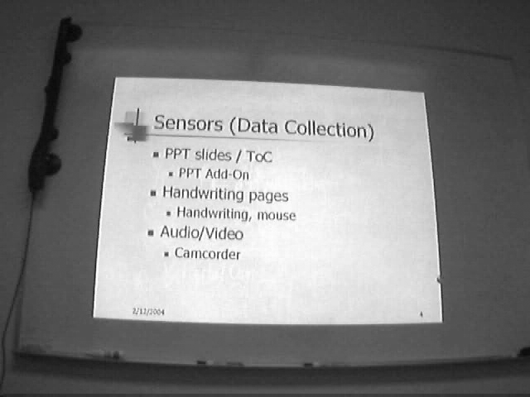
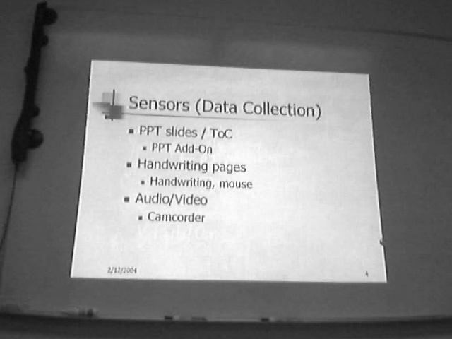
Slide and Video Registration
Step 1: Radial Distortion Removal
Radial Removal: Zhang, PAMI 2000
Notes:
Because some video images have radial distortion as well as perspective distortion, as a pre-process step, we need to remove the radial distortion.
We applied the calibration method proposed by Dr. Zhang to remove the radial distortion.
We can see that in the right image the distortion on the projection boundary has been removed.

Slide 11
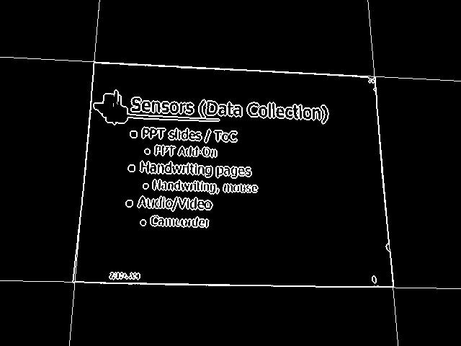
Slide and Video Registration
Step 2: Feature Extraction
Notes:
And then, we want to obtain the 4 corner coordinates of the projection area. Because the projection area is usually significantly brighter than other areas, we can first obtain the edge image and then apply the Hough transform to extract the four boundary lines to get the four corners.

Slide 12
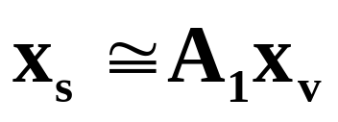
Slide and Video Registration
Step 3: Image Transformation
Mapping between slide and video: homography
Notes:
After that, we can transform the extracted projection area in the video frame to a rectified view and register the video frame with the ppt slide.
This figure shows the video and powerpoint slide alignment result by using projective transformation matrix A1.
The video frame is transformed to the PPT slide coordinates so that the orthogonal view of the PPT slide remains.

Slide 13
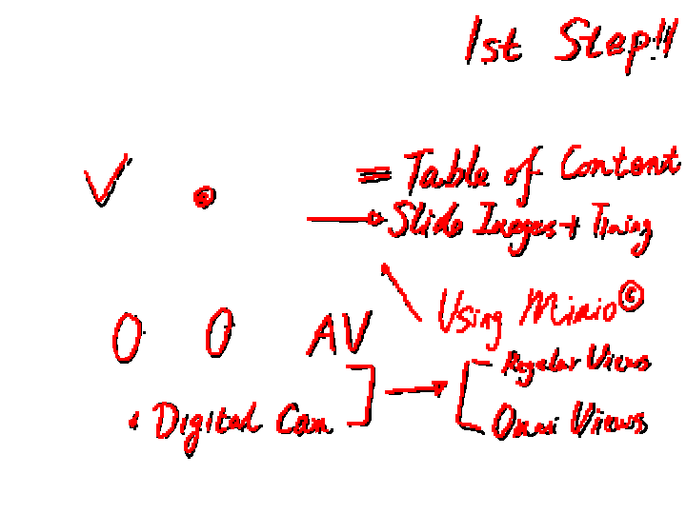
Video and Board Registration a two stage algorithm
(1) Initial Matching
  handwriting extraction
  Translation via centroid
  Scaling via polar profiles
(2) Fine Registration
  connected components
  content-based matching
  Projective transformation
Notes:
As a matter of fact, the registration of the whiteboard handwriting image with video frame is more challenging because the camera cannot “see” the invisible frame boundary of the whiteboard image. [*****] The intuition behind this work is to match the handwriting contents from both images. The mimio image has already contains the clear handwriting contents, the same handwriting contents from video frames can be obtained by image subtraction. Therefore, we can match them up.
We proposed a coarse-to-fine algorithm to do this job, and let’s first take a look at the initial matching.

Slide 14
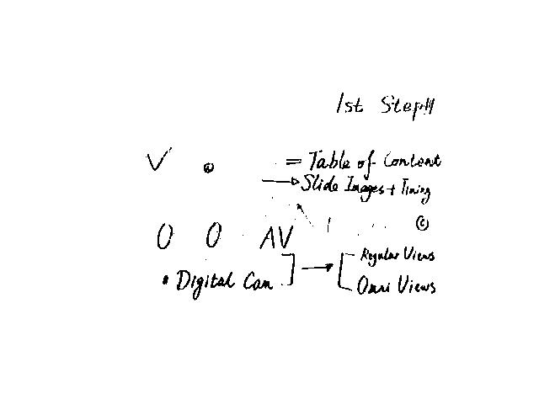
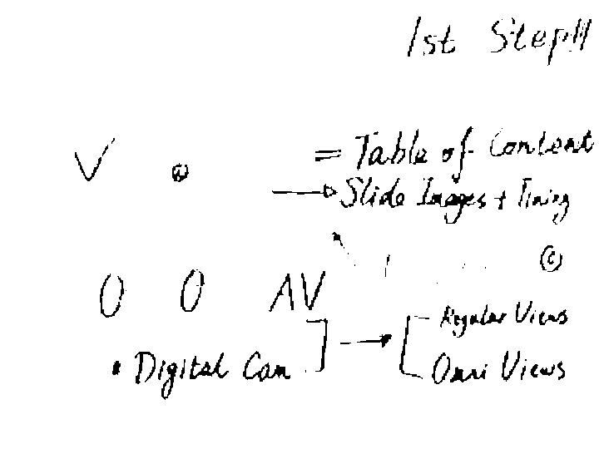
Video and Board Registration handwriting extraction
Notes:
To get the handwriting contents of video frames, we subtract the video frame with PPT projection only from video frame with both PPT projection and Mimio handwriting. After that, we apply the video to slide projective mapping matrix A1 to rectify the handwriting image

Slide 15
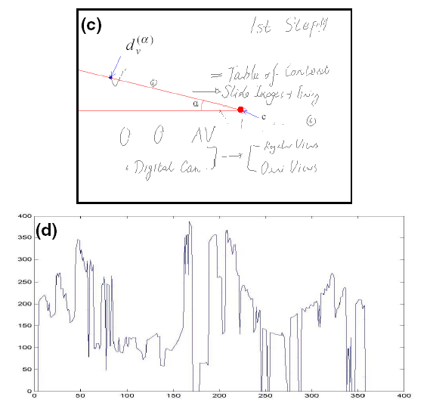
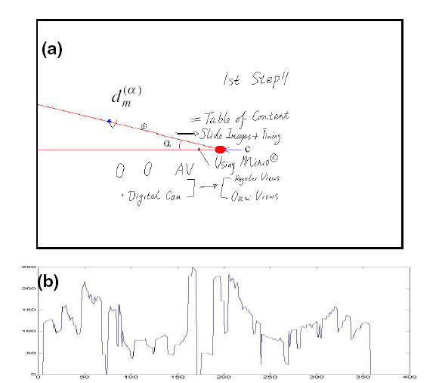
Video and Board Registration translation and scaling
Translation from centroids
Scale from polar profiles
Notes:
To initially match the two images, we need to know the translation and scale factor.
To get the translation, we calculate centroids for both images, which are indicated by the red dots, the difference of the two centroids will give us the translation of this two images.
To determine the scale factor, we generate a centroid-centered polar profile for both images by measuring the distances between the outmost stroke point and the centroid in all directions . The scale factor is given by the ratio of the area under the polar profile of both images.
Please note, here, We don’t need to worry about the rotation since both the Mimio and video handwritings are almost orthogonal view. If not, we could get the rotation by matching up the two profiles.

Slide 16
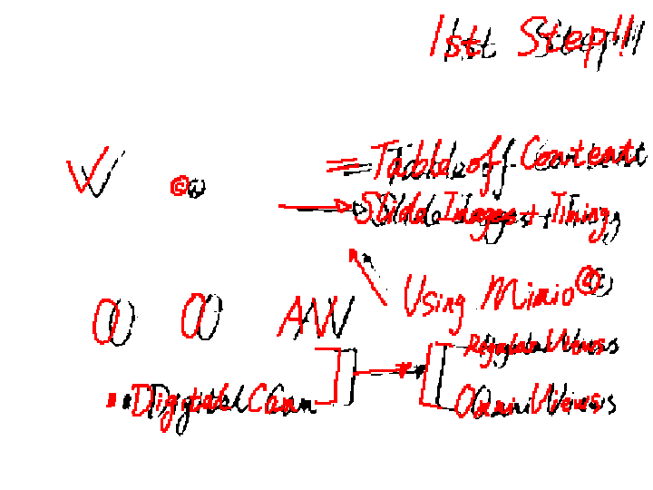
Video and Board Registration initial match result
Notes:
After image translation and scaling, the two images are roughly aligned.
We can see that the initial matching result provides a good starting point for fine registration.

Slide 17
Video and Board Registration a two stage algorithm
(1) Initial Matching
  handwriting extraction
  Translation via centroid
  Scaling via polar profiles
(2) Fine Registration
  connected components
  content-based matching
  Projective transformation
Notes:
The fine registration is based on the initial matching.

Slide 18
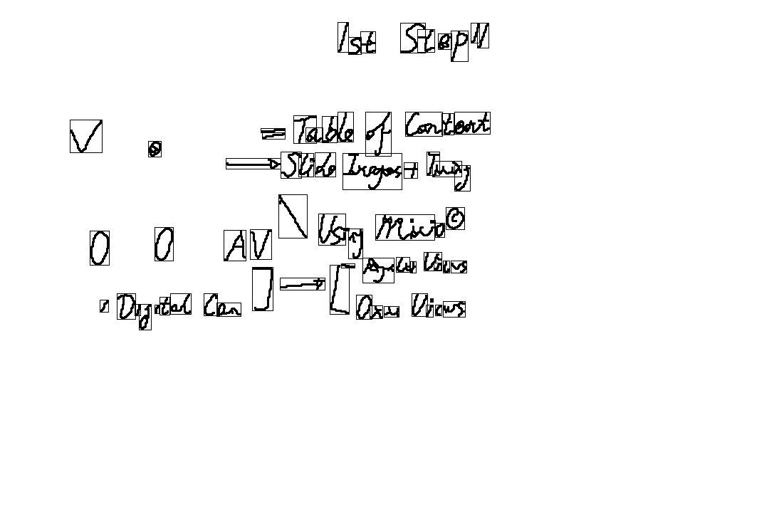
Video and Board Registration connected component (CC) extraction
Notes:
We first extract the the connected components from Mimio image, which are indicated by the bounding rectangle boxes.

Slide 19
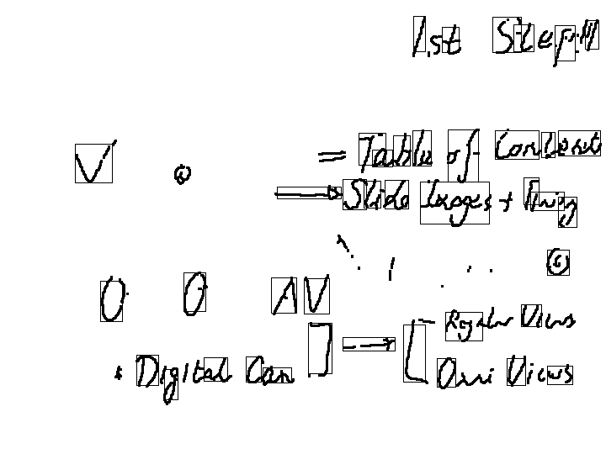
Video and Board Registration content-based matching
Select large CCs in Mimio as templates
Matching in video using normalized cross-correlation.
Notes:
Then, we select those connected components with large size as templates for a robust matching, followed by a content-based matching using normalized cross-correlation criteria.

Slide 20
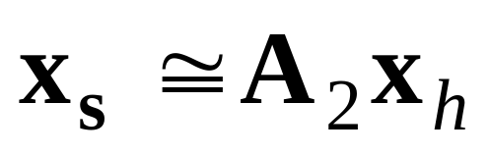
Video and Board Registration projective transformation
Transformation:
Notes:
Finally, we used least square method to calculate the final 3x3 planar projective transformation matrix by choosing those matches whose normalized cross-correlation values are larger than a threshold.
Here, the final projective transformation matrix A2 is used to transform the mimio image to the powerpoint slide image.

Slide 21
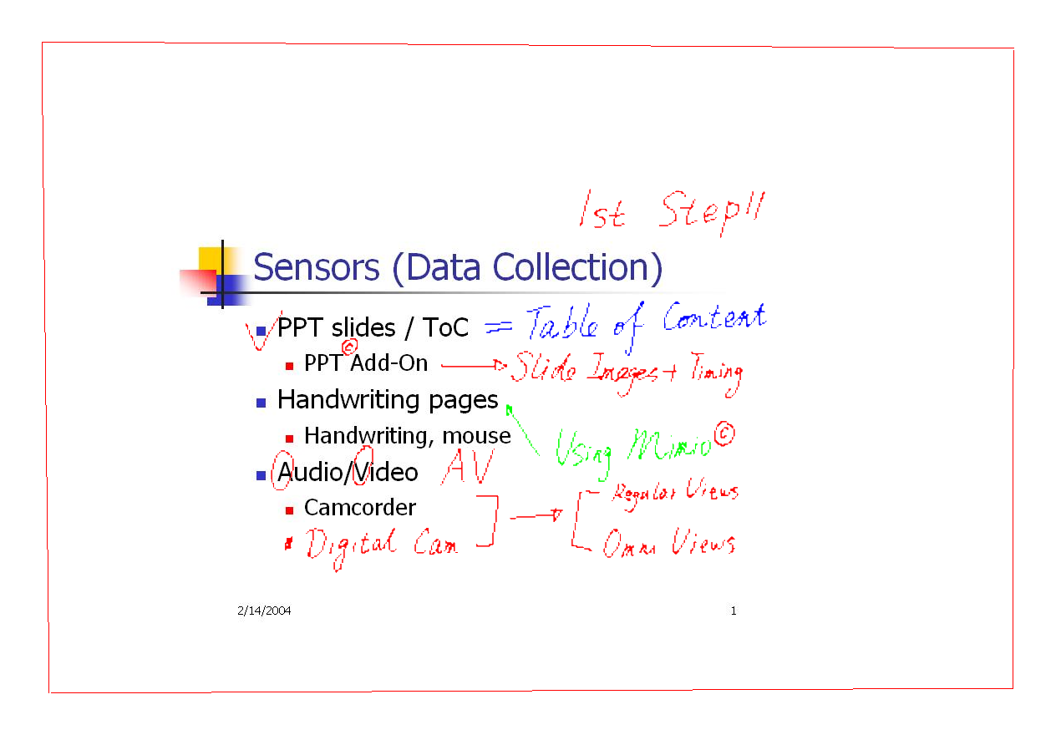

Slide-Board Integration
Notes:
We can see from the close-up that the two circles are perfectly registered from mimio image to Powerpoint slide.

Slide 22
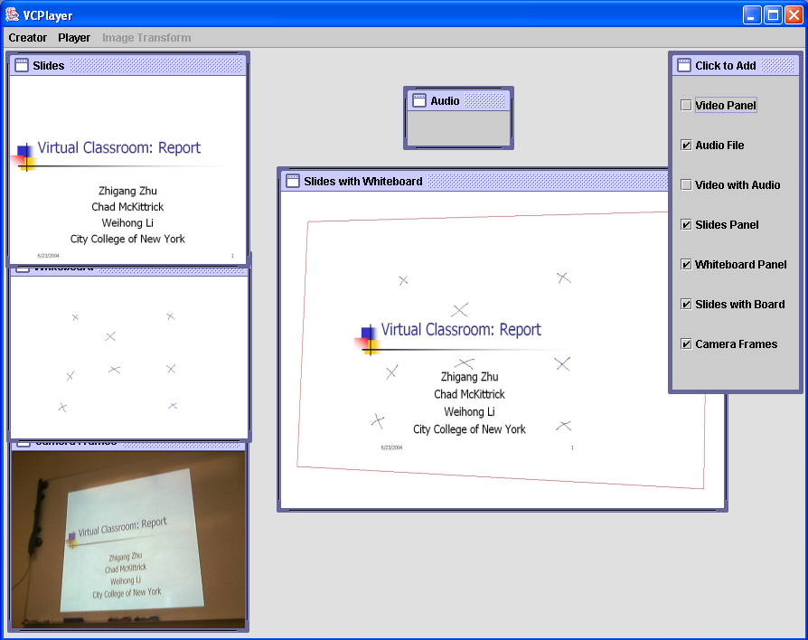
Notes:
Now, it’s show time. Let me give you a demonstration of our Virtualized Classroom interface.
Our interface is implemented in Java. Right now, it has 2 parts: the creator and the player.
Basically, the creator allows the users to configure what they want for the presentation and the player just playback the presentation as the users have customized.
The user can create a new configuration by choosing the “new” in the Creator menu, the system will popup a
Window asking the user to select the multimedia sources.
We can save the configuration as a “.vcp” file.
Also, the user can open a saved configuration file and configure it again.
After create the .vcp configuration file, we can open it for playing by choosing “open” under player menu.
It will take some time for the Interface to load and transform the specified multimedia materials, including the ppt slides, the whiteboard pages and the combination of ppt slides and mimio handwriting pages, and the camera frames.
After loading, we can see there are some control toolbar for playing, stopping, pausing, go to next slide, go to previous slide. Also, we can right click the mouse to popup a menu list. And select any slide you want to review.
Its very convenient for the users.

Slide 23


Sponsors
NSF Computing Research Infrastructure (CRI)
CCNY Center of Perceptual Robotics, Intelligent Sensors and Machines (PRISM)
The CUNY Institution for Software Design and Development (CISDD)
Thank you!

