Slide 1
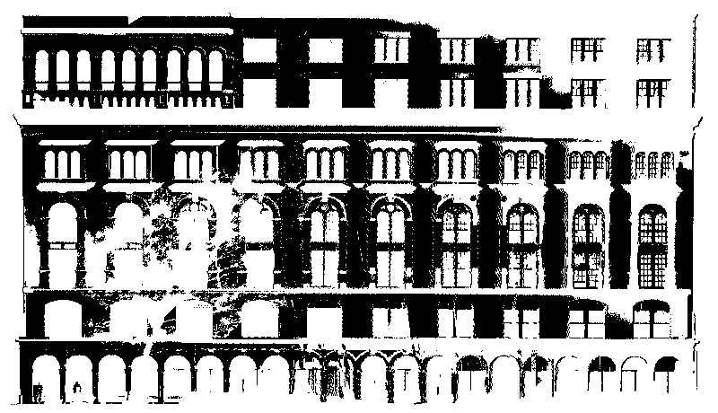
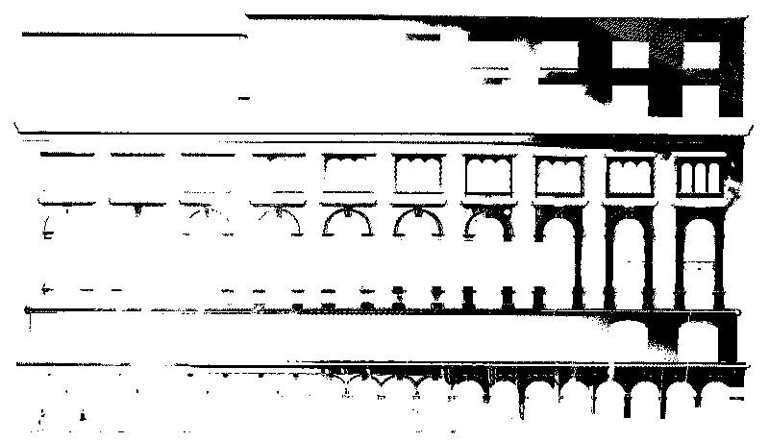
Dataset Segmentation
Approaches on Data Segmentation
  Edge based methods
  Region grow based methods
Separators Based Segmentation
  Salient features
  Real dataset
Notes:
Modeling a building point clouds as a whole structure simultaneously is difficult
due to the natural complexity of buildings. To simplify this problem, We utilize
the divide and conquer strategy to segment the point clouds into simpler ones.
Methods for 3D point cloud data segmentation are mainly
edge based and region grow based.
We proposed an efficient segmentation approach for buildings based on
the observation that different parts of a building are usually separated by
salient features, such as walls, ledgers etc.
These “separators” provide clues for dataset segmentation.
For example, the ledger in bottom left separate the dataset into roof & body parts.
Also, the roof are divided by these walls into different sections.
We compute these dark region using kernel based connected-component method.

Slide 2
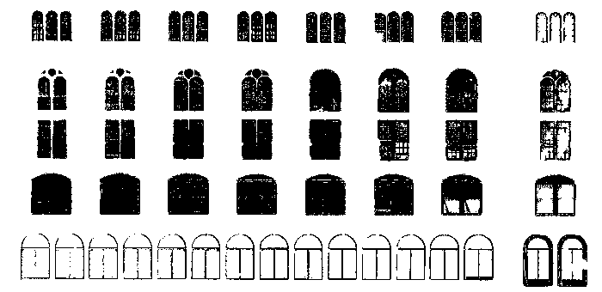
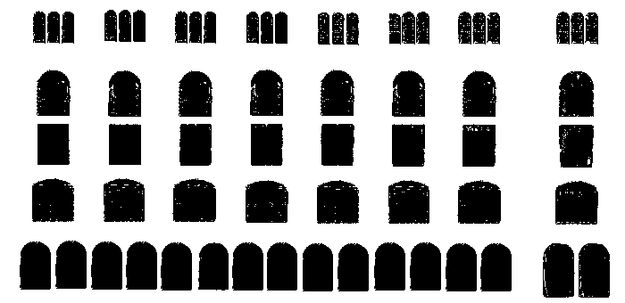
Window and Door Detection
Window and Door Computation
  For images (Lee et al. CVPR04) and for PCDs (Pu et al. ISPRS07)
  Compute the depth and locations of windows
Notes:
Unfortunately, for real dataset, the window images computed are not that perfect for processing.
For example, the left window image is extracted from a real dataset. As we can see, holes are existed here and there. For this case, some manual work are involved to improve the image for computing. The improved image is shown in the right.

Slide 3
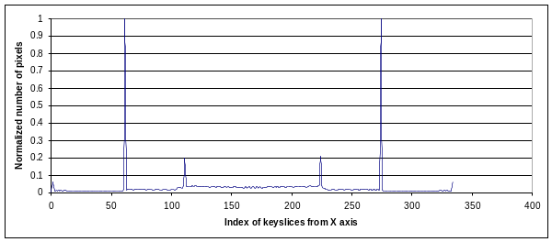
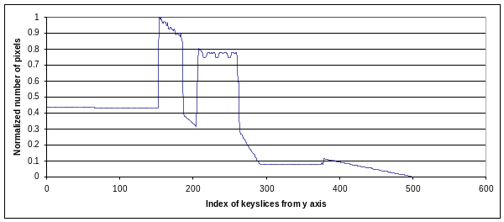
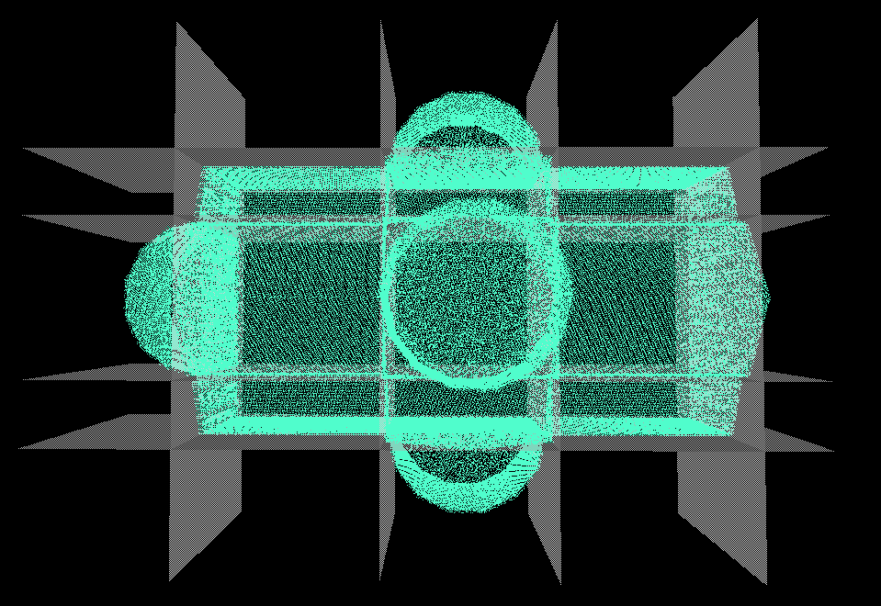
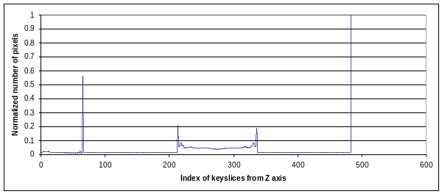
Dataset Segmentation
Approaches on Data Segmentation
  Edge based methods
  Region grow based methods
Separators Based Segmentation
  Salient features
  Locating separators based on
  data point distribution of 2D slices
Notes:
To detect these separators, we examine the data point distribution of 2D slices
extracted from all major planes as shown in the right image.
From top to bottom, these 3 charts depict the data point distribution of 2D slices
extracted from X, Y and Z axes.
The horizontal axis is the index of the 2D slices for X, Y and Z axes.
The vertical axis is the normalized number of pixels, which ranges from 0 to 1.
We identify the separators as the indices of the slices
that coincide with the local maxima and inflection points in the data point distribution.
This figure shows the detected separators marked with gray planes
in the snapshot of the point clouds.
The 4 separators detected in top chart are shown in top-down direction.
The 4 separators detected in bottom chart are shown in left-right direction.

