Slide 1
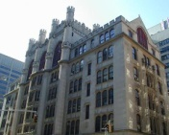
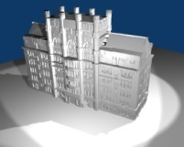
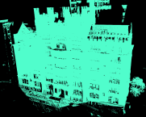
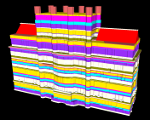
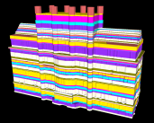
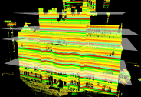
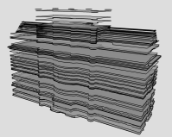

Input scene
Output model
Data
acquisition
Rendering
Point cloud
Tapered faces
Slab
partitioning
Taper
detection
Volumetric slabs
Extruded keyslices
Extrusion
Slab
projection
2D Slice
Keyslices
Keyslice detection /
Boundary vectorization

