Slide 1
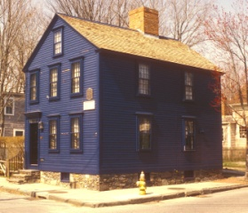
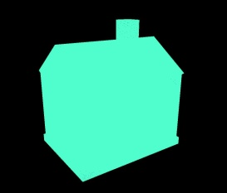
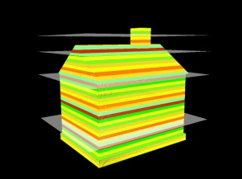

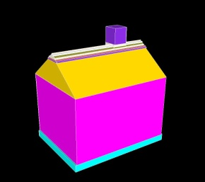
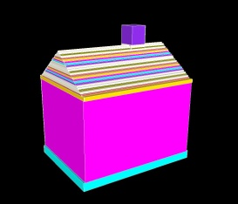
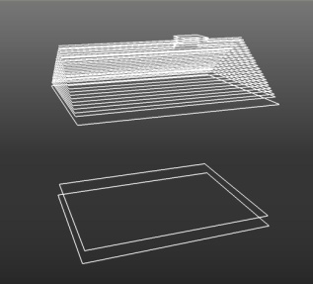
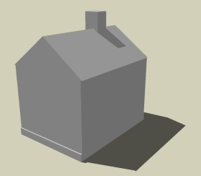
Data
acquisition
Slab
partitioning
Slab
projection
Input scene
Point cloud
Volumetric slabs
2D Slice
Keyslice detection /
Boundary vectorization
Rendering
Taper
detection
Extrusion
Output model
Tapered faces
Extruded keyslices
Keyslices

