Slide 1
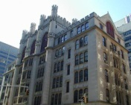
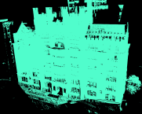
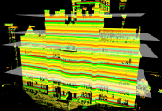

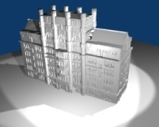
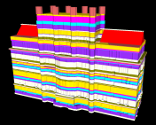
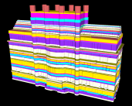
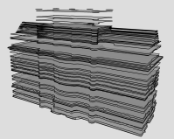
Model Analysis
Data
acquisition
Slab
partitioning
Slab
projection
Volumetric slabs
2D Slice
Input scene
Point cloud
Keyslice detection /
Boundary vectorization
Rendering
Taper
detection
Extrusion
Output model
Tapered faces
Extruded keyslices
Keyslices
Model Reconstruction

