Slide 1
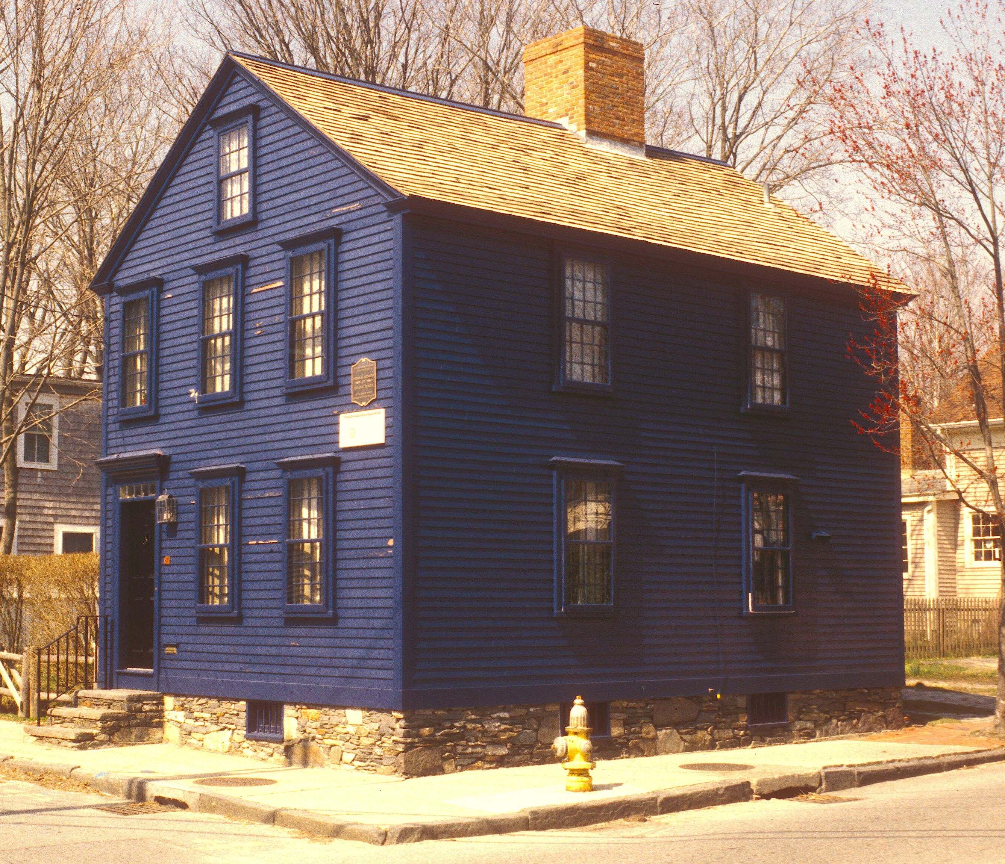
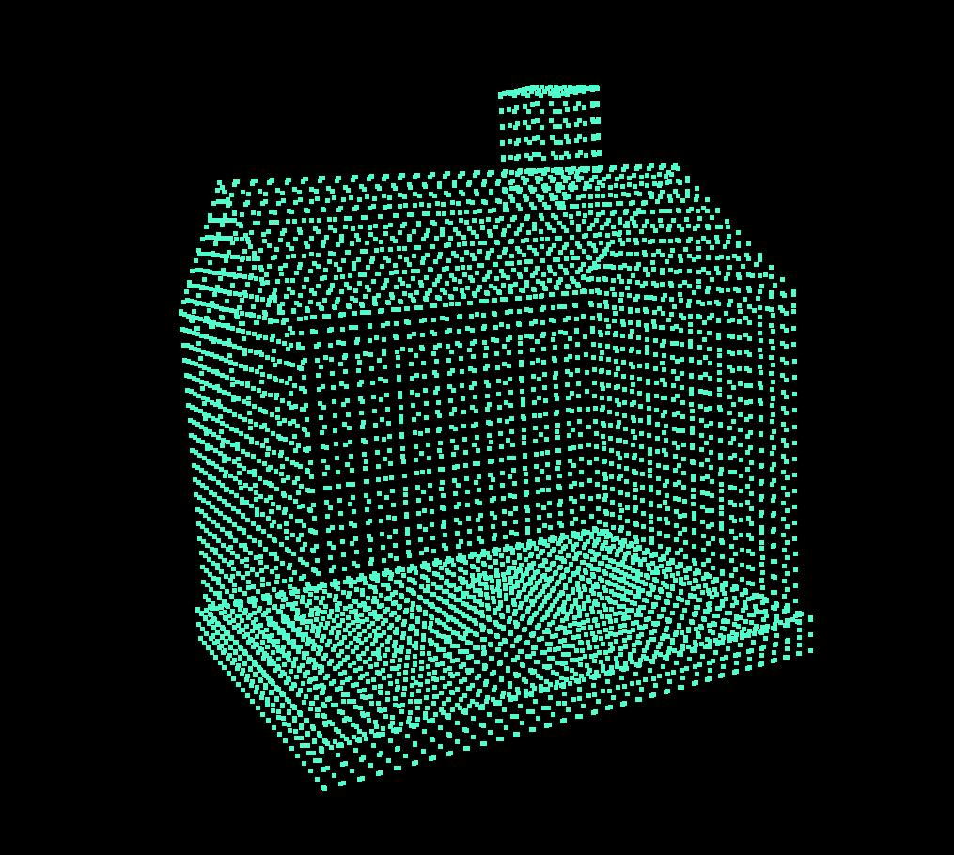
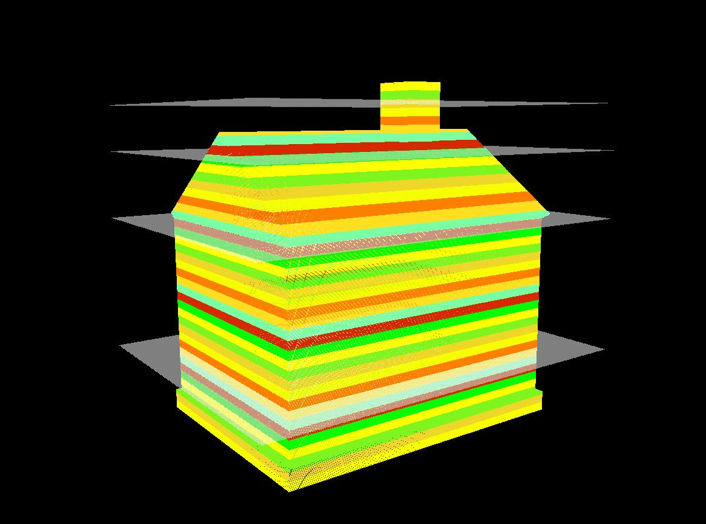

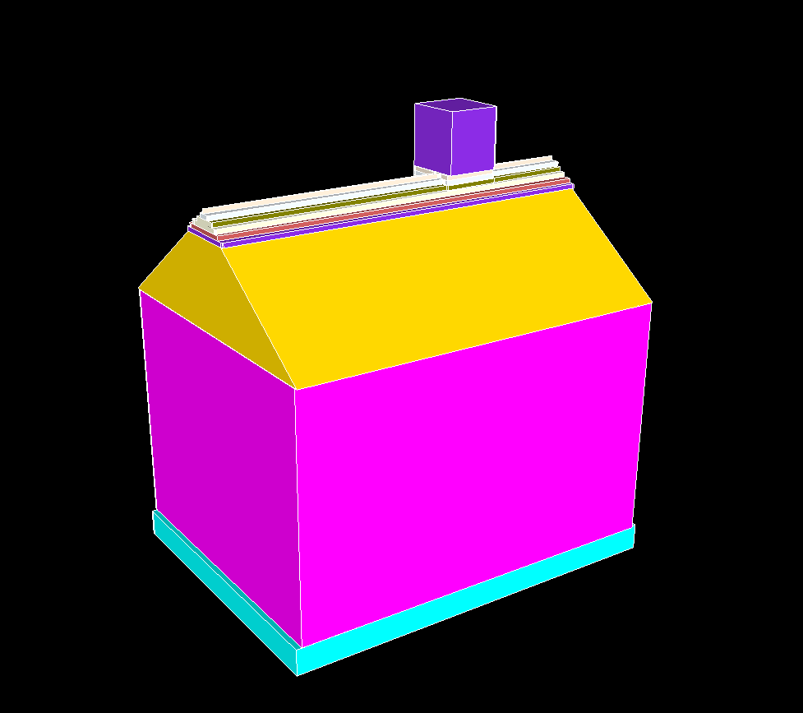
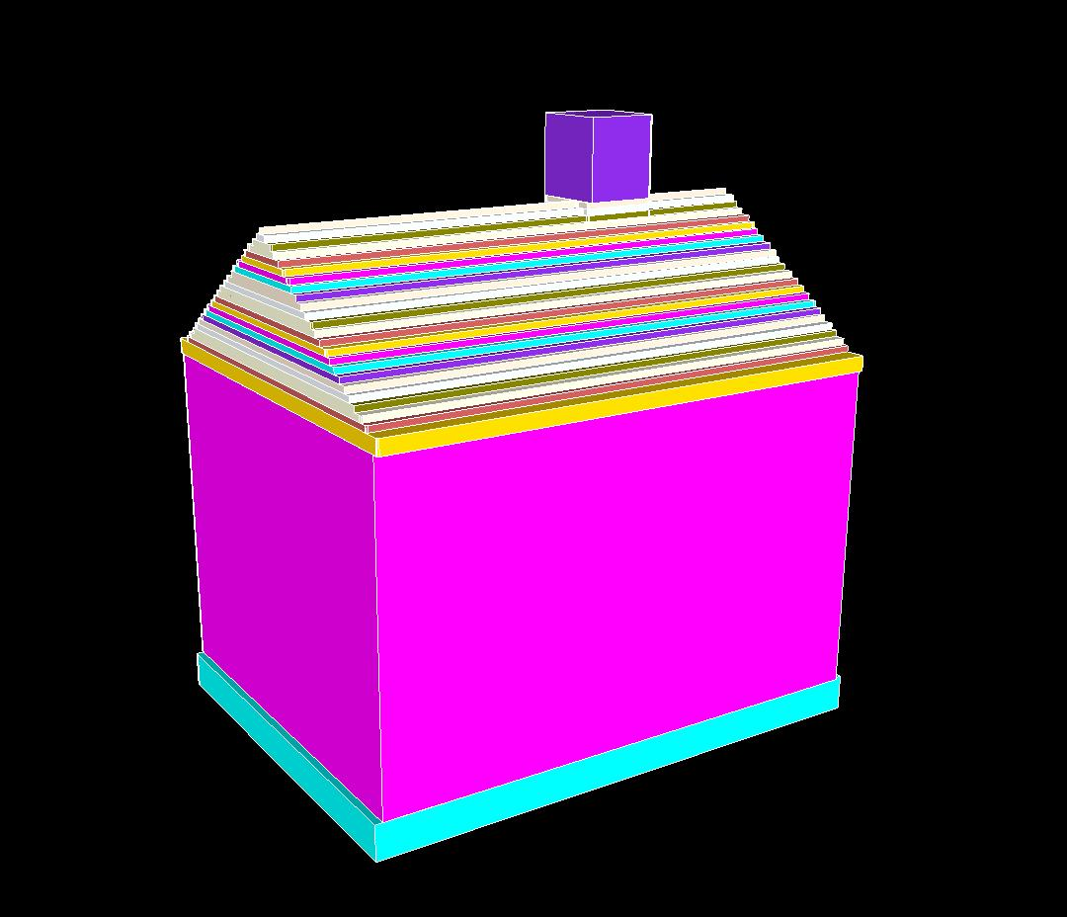
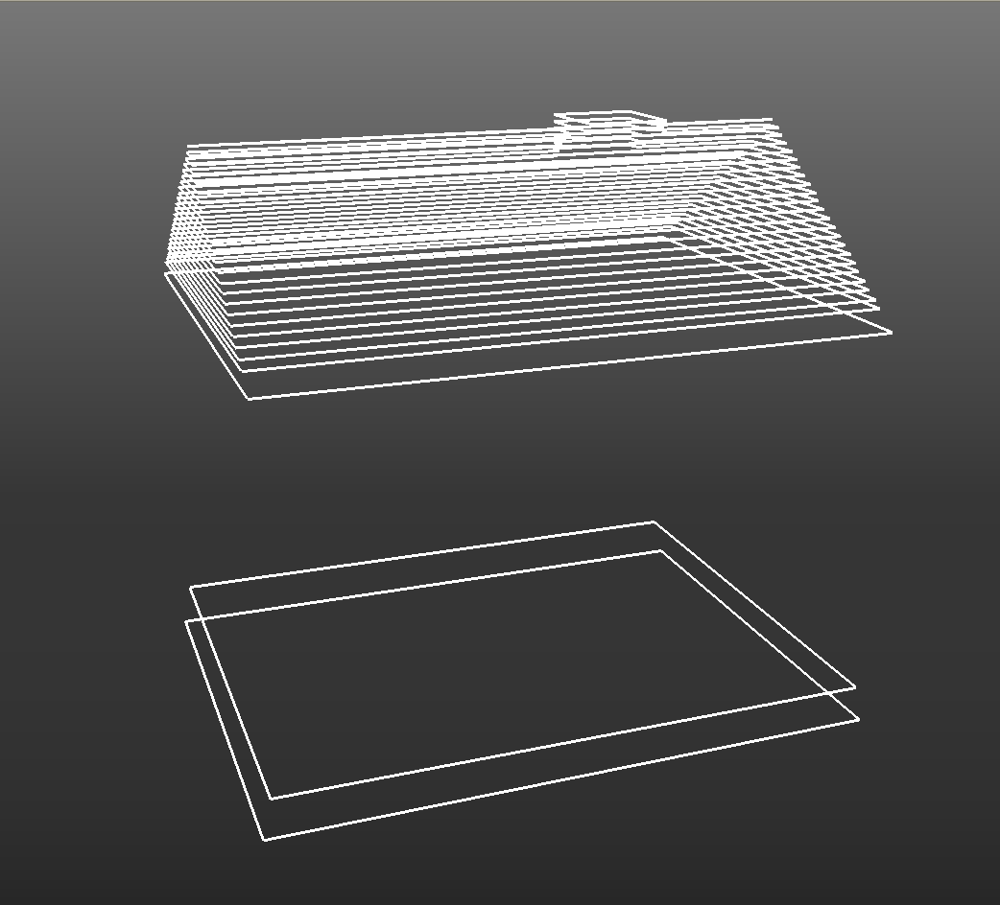
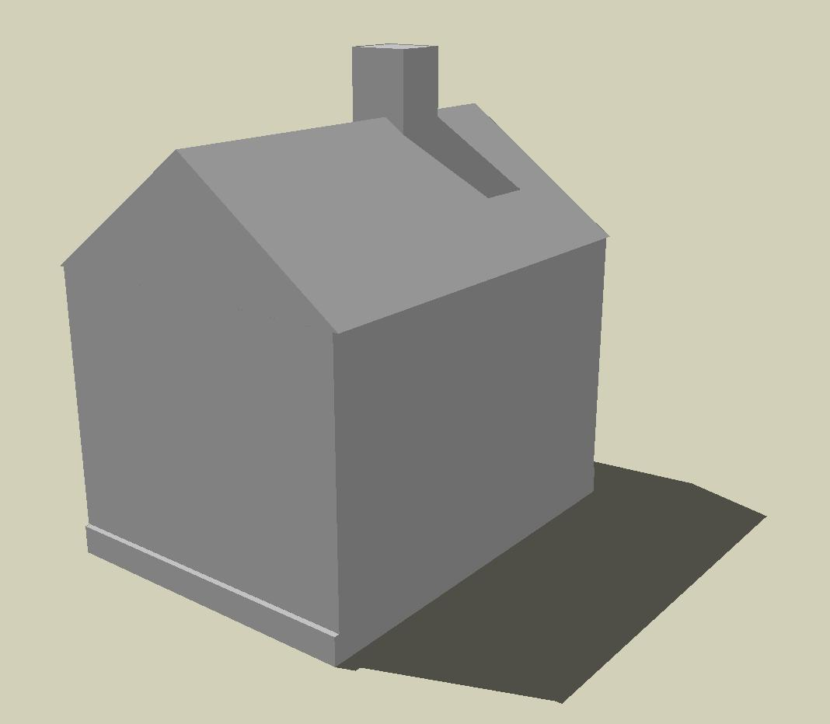
Data
acquisition
Slab
partitioning
Slab
projection
Input scene
Point cloud
Volumetric slabs
2D Slice
Keyslice detection /
Boundary vectorization
Rendering
Taper
detection
Extrusion
Output model
Tapered faces
Extruded keyslices
Keyslices
Notes:
Volumetric slabs: using the command Project.exe -j -O "-p input_path -P output_path -t 6 -m 50 -d 1 -s 4“
Keyslices: model_display.rb without pushpull operation. update window->style.
Extruded keyslices: using colors in model_display.rb.
Tapered faces: update the colors array to make the corresponding colors the same.
Output model: window->style + window->shadow

