Slide 1
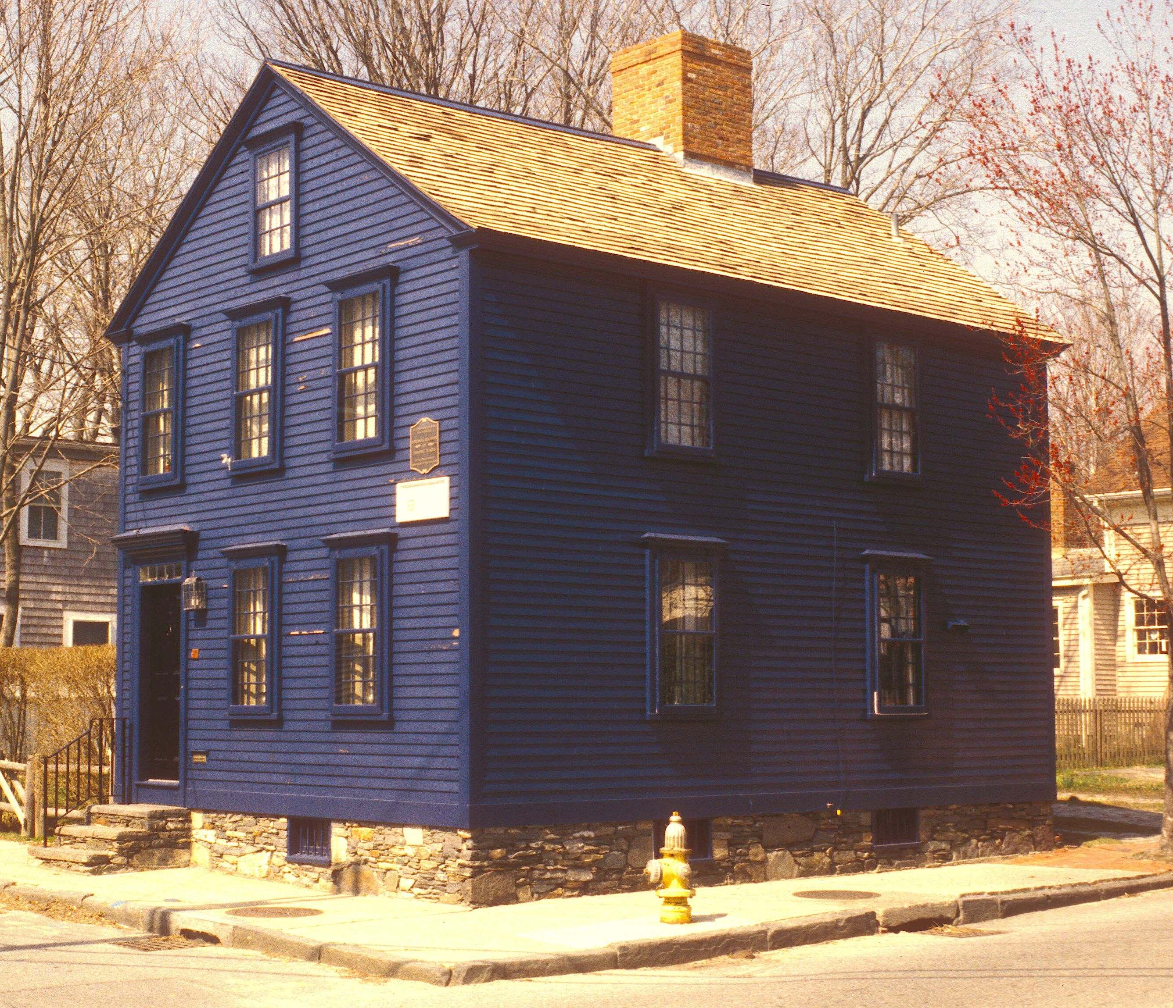
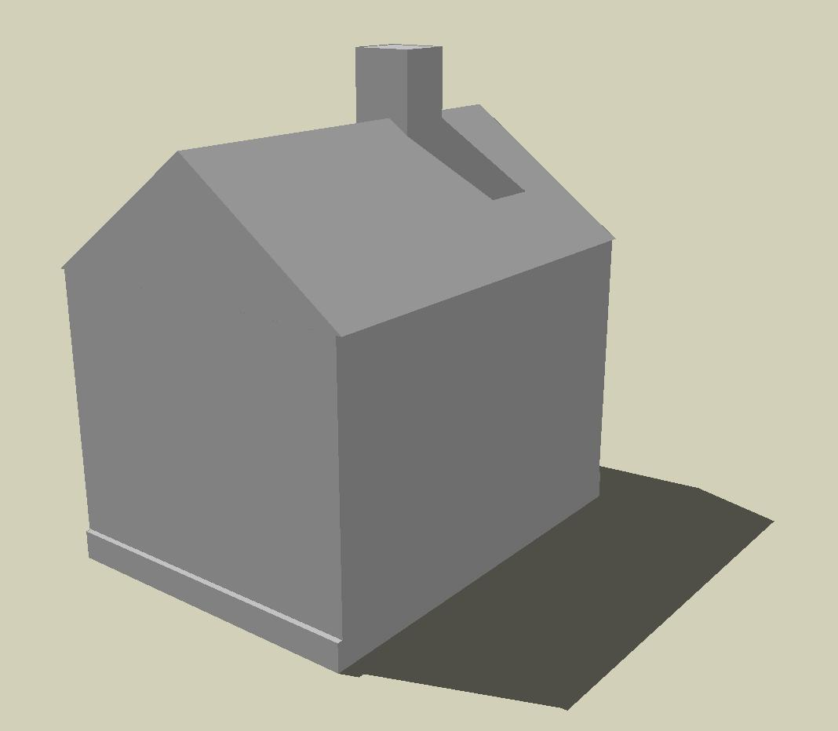
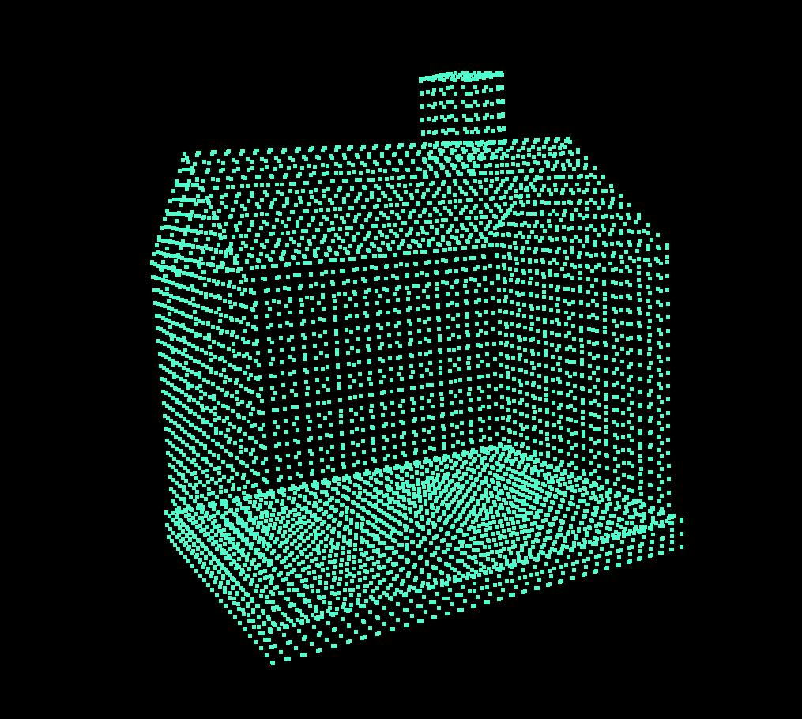
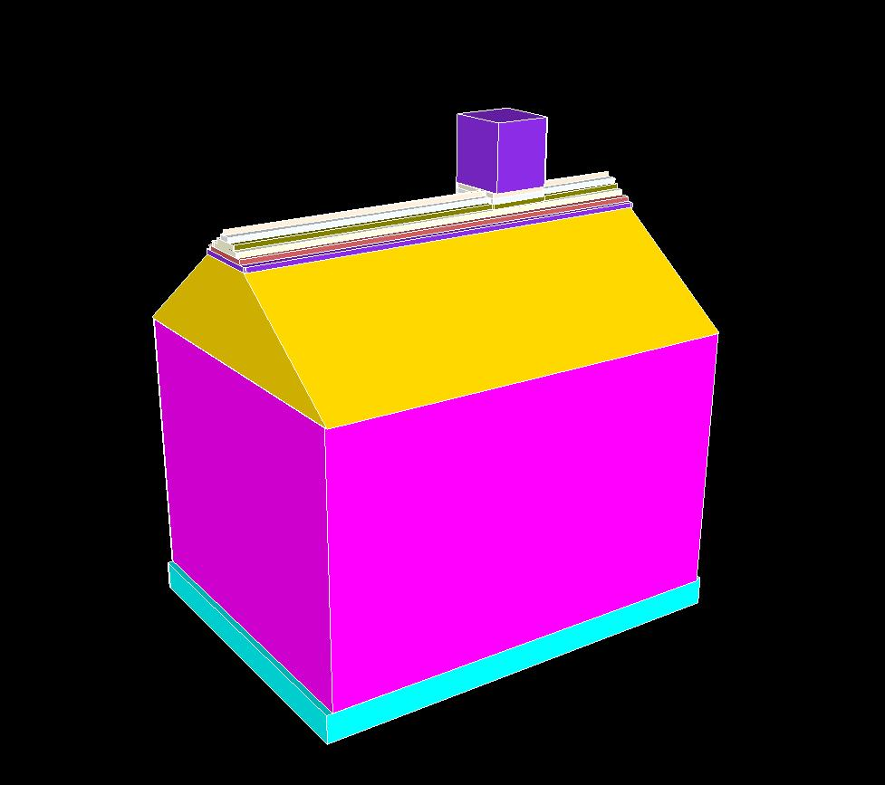
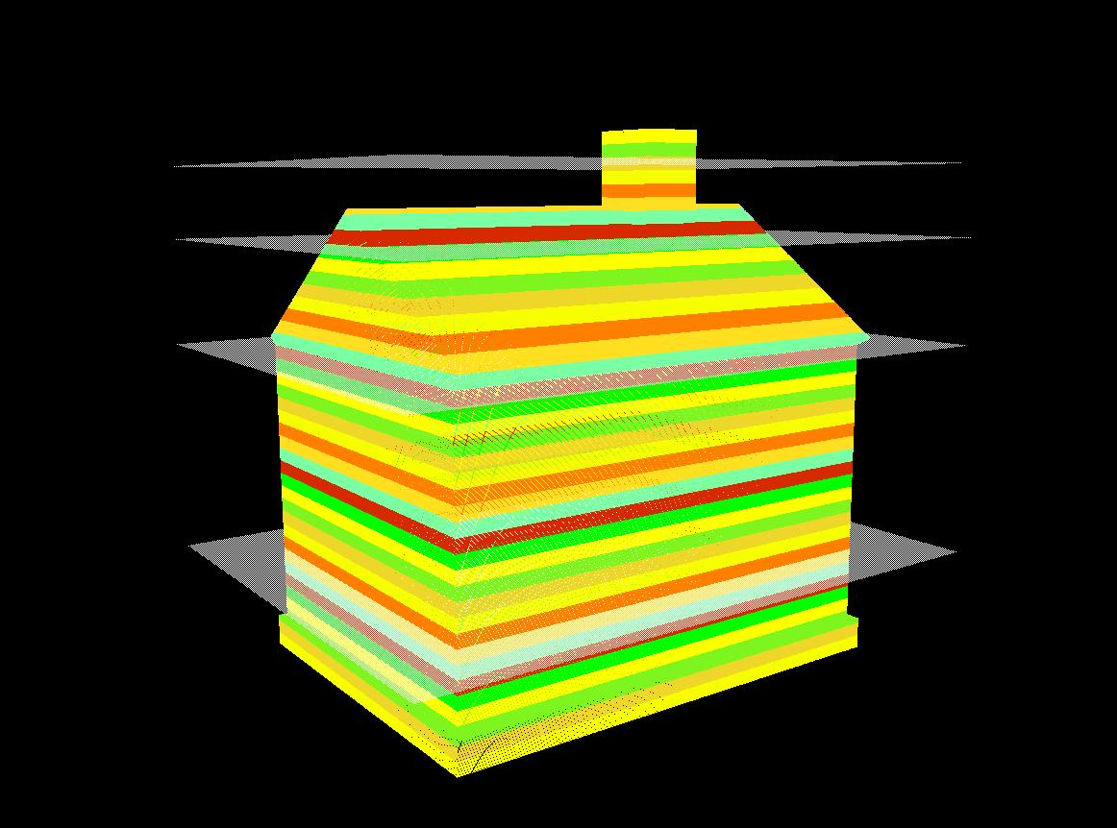
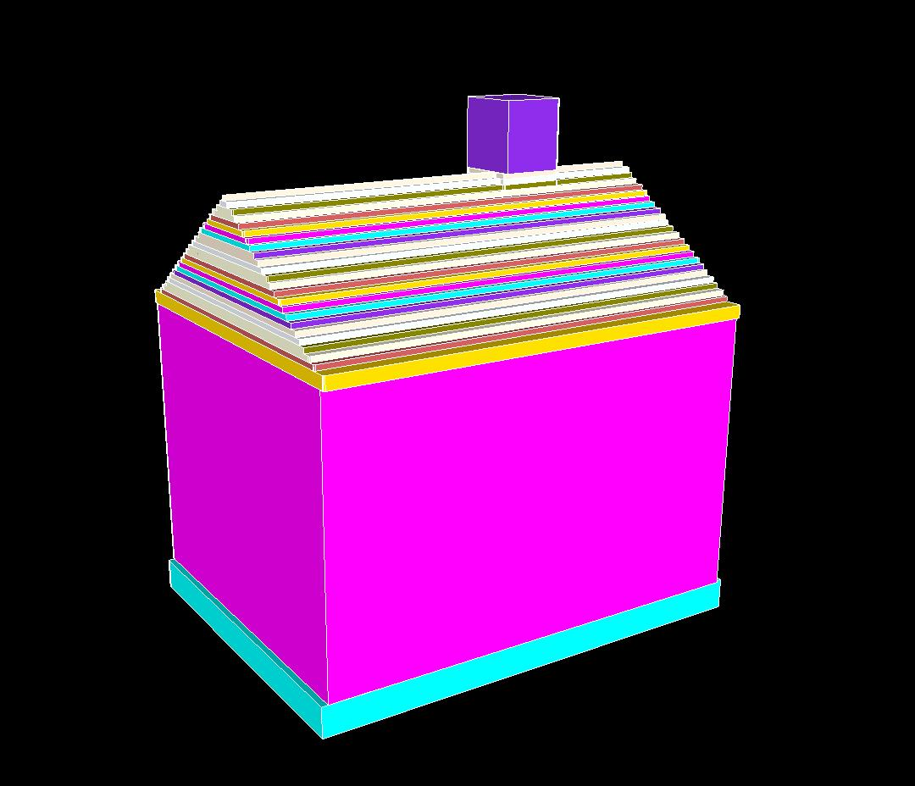

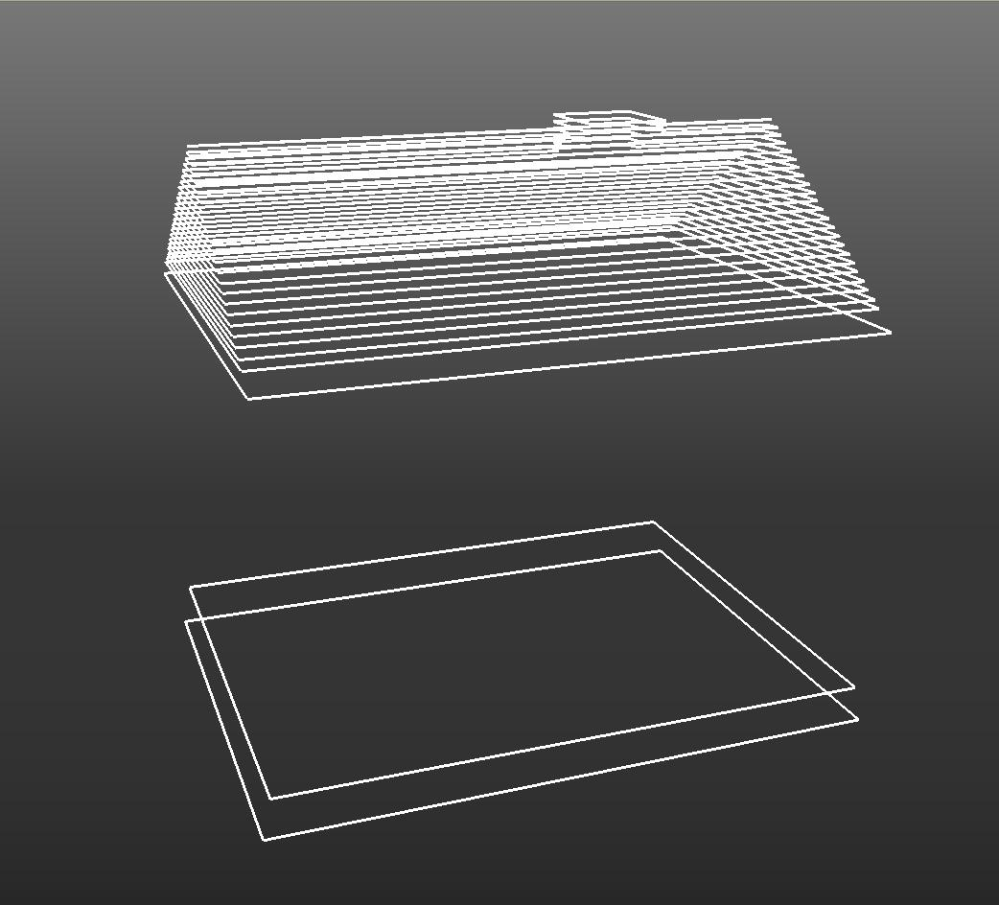
Output model
Data
acquisition
Rendering
Point cloud
Tapered model
Slab
partitioning
Taper
detection
Volumetric slabs
Extruded model
Slab
projection
Extrusion
2D Slice
Keyslices
Keyslice detection /
Boundary vectorization
Notes:
Volumetric slabs: using the command Project.exe -j -O "-p input_path -P output_path -t 6 -m 50 -d 1 -s 4“
Keyslices: model_display.rb without pushpull operation. update window->style (generic CAD + edge profile).
Extruded keyslices: using colors in model_display.rb.
Tapered faces: update the colors array to make the corresponding colors the same.
Output model: window->style + window->shadow

