Slide 1

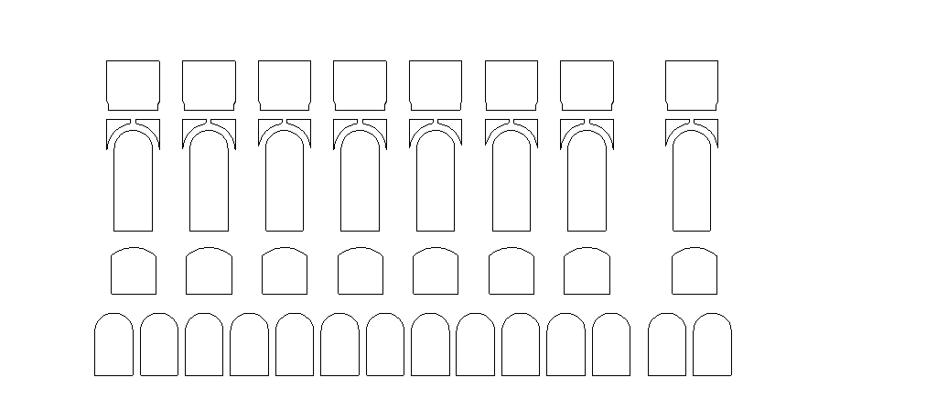

(a)
(b)
(c)

