Slide 1
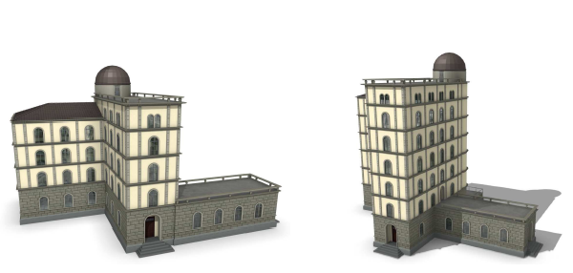
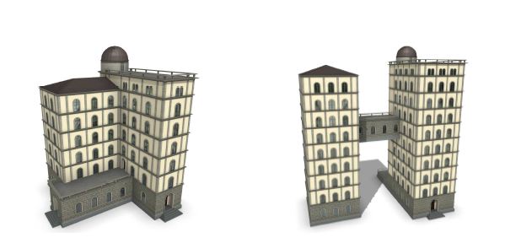
Related Work
Procedural modeling of buildings (SIGGRAPH 06)
Virtualized buildings generated from randomized parameters
Not suitable for creating existing buildings.
Notes:
Let me introduce some related work.
First of all, the PMB work published at xxx 2006. As you can see, all these urban building models are generated using the so-called shape grammar.
The strength of this method is that it can generate numerous buildings using the randomly generated grammar quickly and buteafully.
However, these buildings are virtual ones, which means their methods is not suitable for modeling existing buildings. This is more related to computer graphics techniques.

Slide 2
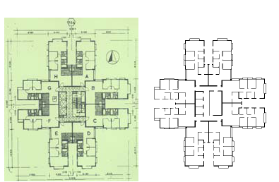
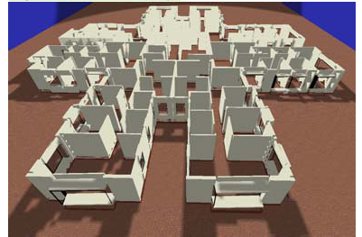
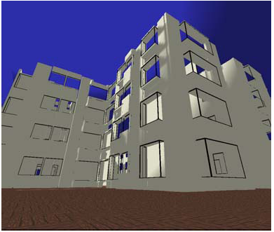
Related Work (cont.)
3D building reconstruction from 2D floorplan image (PVMV 05)
Not applicable when the 2D floorplan image is not available
Notes:
In this work, Or et al tried to model the existinig buildings with the help of its 2D floorplan images.
They first extract the floorplan image from the specification, and then reconstrcut the building accordingly.
However, for most of the case, the 2D floorplans are not available and their method could not be applied in those scenarios.

Slide 3
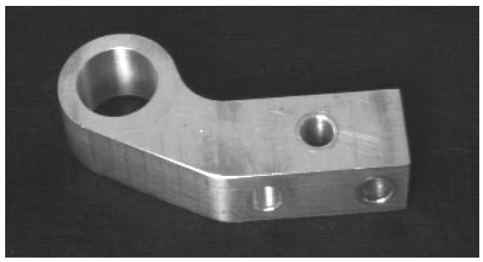
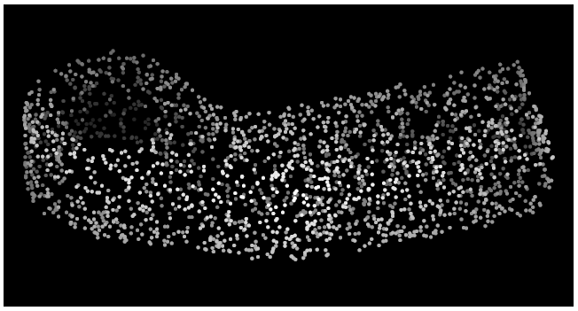
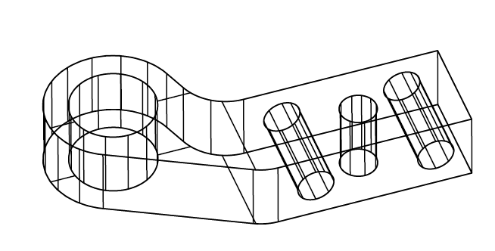
Related Work (cont.)
Mechanical parts inference from range data (T-RA 99)
Incorporates the a priori knowledge about the structures, such as holes, bosses and grooves.
The input is required to be high SNR and applicable only to small scale dataset
Notes:
The most related work is the reverse engineering. Here, basically, the mechanical parts are scanned and the range data is shown on the top right.
They have pre-defined all the possible mechanical Geometry shapes, such as holes, grooves, brute-force
Works on small-scale data set, espeically
The purpose? There are very limited geometry shapes, and user is required to choose some primitive shapes.
Not applicable to large scale dataset

Slide 4
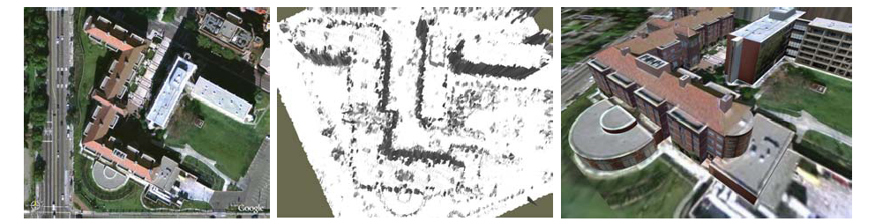
Related Work (cont.)
Aerial image (LiDAR data) based reconstruction.
Limited 3D model and low-resolution
Not applicable for interior view modeling

Slide 6
Pre-processing
3D Data
Loading
2D Slices Extraction
Noise Removal
Missing Data Recovery
Lightweight 3D Reconstruction
Extrusion Detection
Boundary Vectorization
Tapered Structure Detection
Post-processing
Model Generation
Model Visualization
Notes:
Boundary Vectorization

Slide 8
Pivot Direction
(a)
(b)

Slide 9
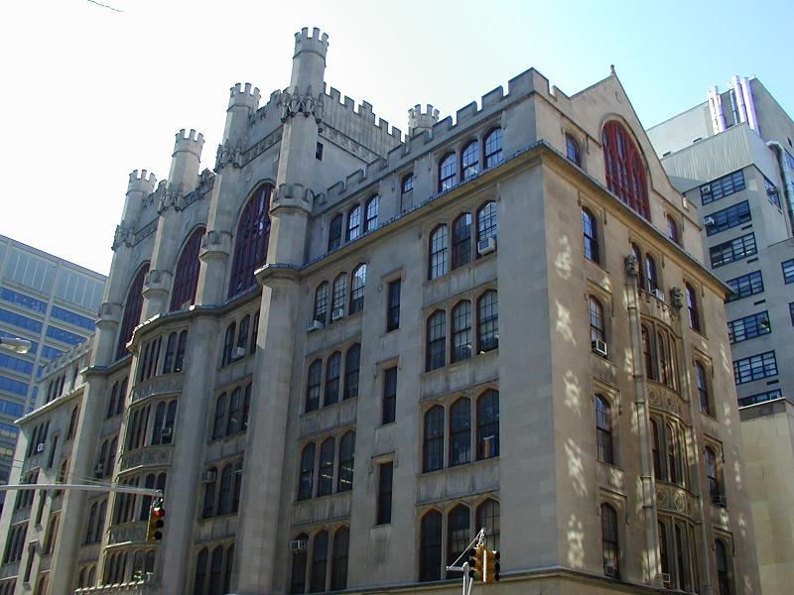

Slide 10
