Slide 1
Lightweight 3D Reconstruction of
Urban Buildings From Range Data
Weihong Li
Advisor: Professor George Wolberg
Committee:
Professor Zhigang Zhu
Professor Ioannis Stamos
Notes:
Thank you for coming. Today I will be talking about my thesis proposal, which is “…”.
My advisor is …
Prof Zhu and Prof Stamos are on my committee.
The situation is 3D modeling of range data is computational expensive. Though state-of-the-art techniques can model the
3D point data precisely, they are not scalable. In other words, they’re suffering from large-scale datasets, such as memory blowup issue, time consuming issue, etc.
In this work, we are trying to address this problem by proposing a lightweight 3D reconstruction strategy on range data of urban buildings.

Slide 2
Outline
Introduction
Methodologies
  3D point cloud preprocessing
  Lightweight 3D reconstruction
  Model generation
Preliminary Results
Tasks and Timeline
Notes:
Here is the outline of my talk:
First, I will give an brief introduction on the background and motivation for this research. Then, I will talk about the meth we proposed, which consists of three stages.
After that, I will show you some preliminary results, and finally I will talk about the ongoing tasks as well as the timeline for the dissertation defense.

Slide 3
Outline
Introduction
Methodologies
  3D point cloud preprocessing
  Lightweight 3D reconstruction
  Model generation
Preliminary Results
Tasks and Timeline
Notes:
First, introduction…

Slide 4
Introduction
Background
  Massive point clouds by laser range scanners present challenges to efficient modeling, visualization and storage.
  State-of-the-art techniques are not scalable on large datasets
  Lack of techniques for web-based applications
Motivation
  Simplicity of Google SketchUp push-pull operations
  Lightweight techniques to tackle the scalability issue
  Automatic 3D model generation for web-based applications
Notes:
Laser range scanners are widely used to accurately measure the 3D information about scenes. However, how to process the massive point clouds collected by these devices is a big challenge. State-of-the-art modeling on 3D data directly is computational expensive and is not scalable on large-scale dataset.
Because of this, they are not suitable for web-based applications, such as GE, MVR, etc.
Our work is motivated by the simplicity of the push-pull operation in Google SU. Essentially, this operation implies a priori knowledge about the buildings, which is that buildings can be modeled based on two basic operation, extrusion and taper to the cross-sectional contours. Another motivation is to solve the memory blow-up issue by avoiding expensive direct computation on 3D point cloud data.We hope to address the automatic 3D model generation issue for web-based applications.

Slide 5
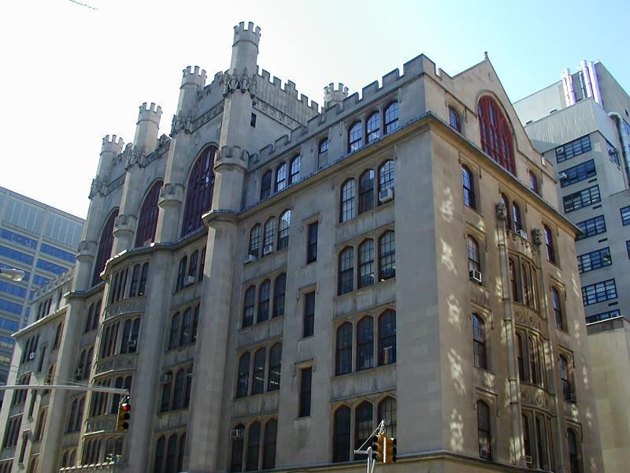
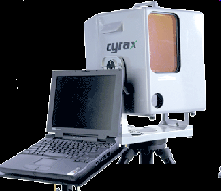
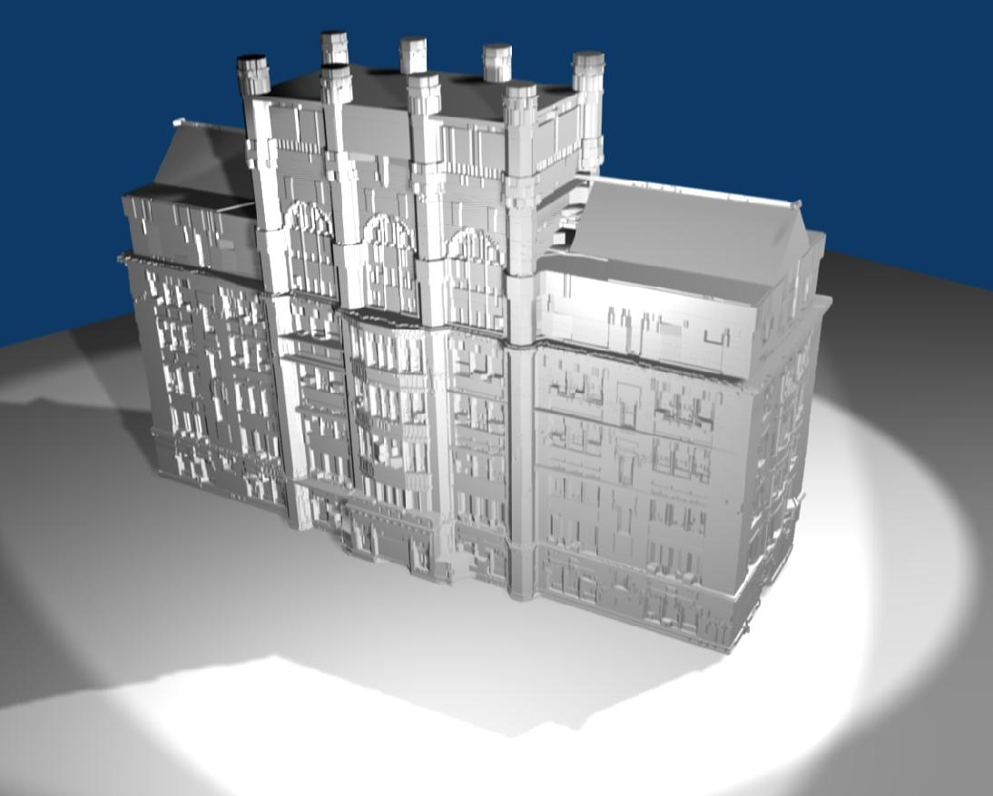
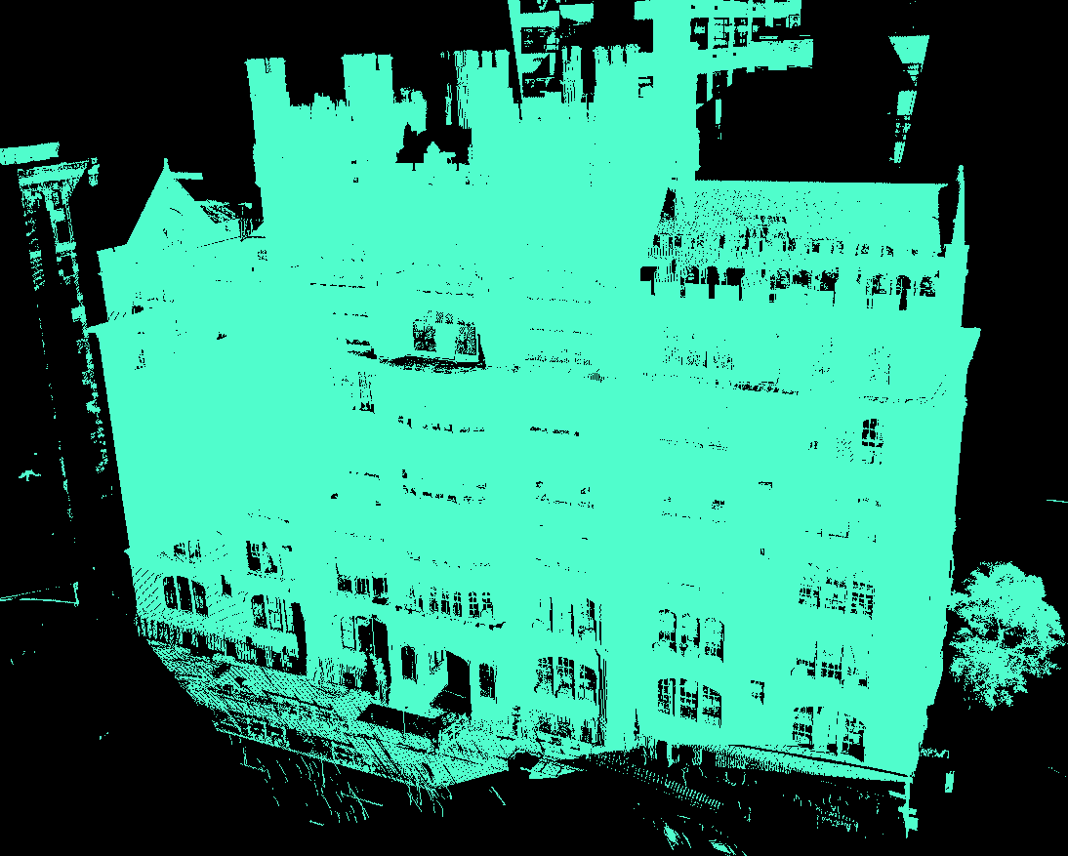
Notes:
Here is a big picture of our work.
The [Leica Cyrax 2500] laser-range scanner sweeps an eye-safe laser beam across the building to collect 3D depth points. To obtain the 3D depth points for the whole building, multiple scans are required at different locations to cover all the façade of the building.
Prof Stamos and his students have registered and rectified multiple scans of buildings. This is a snapshot of the registered 3D point cloud, which consists of 14 scans totaling 14 million points.
To store this huge amount of data, it requires about 700 MB on space.
Our proposed approach takes this registered and rectified 3D point cloud data as input, and reconstruct the 3D model in a lightweight manner. Here is a snapshot of our reconstructed model. As a matter of fact, the space needed to store this high-resolution model is only about 300kb. So the compression rate is more than two thousand. Not to mention the low-resolution model, which only needs about 20 KB on space.

Slide 6
Contributions
Lightweight 3D Reconstruction
  Incorporate a priori knowledge to reconstruction
  Convert 3D problem to 2D lightweight image processing
  Scalability on large-scale datasets
Cost-Effective Geometry Compression
  Suitable for storage and visualization
  Applications in architecture, urban design, virtual city touring, and online gaming
Produce Wide Spectrum of Resolutions
  Easily adjusted to different applications
  Outperforms state-of-the-art approximation approaches
Notes:
Here are the three aspects of our contributions: 1. we proposed a LW 3D model reconstruction of urban buildings by combining a priori knowledge and lightweight 2D IP techniques, which is scalable on large-scale dataset.
Second, the output offers cost-effective Geometry compression on range data. This boosts the 3D model based web-based application since it require much less storage space and can be visualized quickly. Because of these, the proposed approach may be applied to a lot of applications, including architecture, urban design, VCT and online gaming, etc.
And finally, our proposed method can generate multiple resolutions of the reconstructed model easily. For the low resolution model, it outperforms the state-of-the-art model approximation approach, Such as qslim, which was proposed by Michael Garland for his PhD work at CMU.

Slide 7
Related Work
Procedural Modeling of Urban Buildings
  Computer Graphics synthesis
Reverse Engineering
  Small-scale dataset with high SNR
Medical Image Processing
  Statistical inference from histologic images
Model Approximation
  Work on reconstructed 3D model data
Notes:
Here, Let me quickly go through some related work.
Procedural modeling techniques can create a huge number of buildings and streets quickly and beautifully. However, it is a computer graphics synthesis technique and is not able to model any existing buildings.
Reverse engineering techniques can only deal with small-scale, high SNR dataset.
MIP techniques can deal with low SNR dataset, but the statistical inference on which they based are usually time consuming.
Some model approximation tools, such as qslim, they only work with 3D model data, instead of range data.

Slide 8
Outline
Introduction
Methodologies
  3D point cloud preprocessing
  Lightweight 3D reconstruction
  Model generation
Preliminary Results
Tasks and Timeline
Notes:
Ok, now let me show you the methodologies we are using to achieve these goals.

Slide 9
Overview
Preprocessing
3D Data
Loading
2D Slice Extraction
Noise Removal
Missing Data Recovery
Lightweight 3D Reconstruction
Extrusion Detection
Boundary Vectorization
Tapered Structure Detection
Postprocessing
Model Generation
Model Visualization
Notes:
Here is the overview of our proposed algorithm.
The preprossing stage is to load the 3D data point, extract 2D slices from it. And then enhance these 2D slices by noise removal and missing data recovery for further process.
The 2nd stage is key stage for LW 3D reconstruction. It includes Extrusion and Taper structure detection and boundary vectorization.
The post-processing stage is for mode generation and visualization.
Let’s take a look at details on each modules

Slide 10




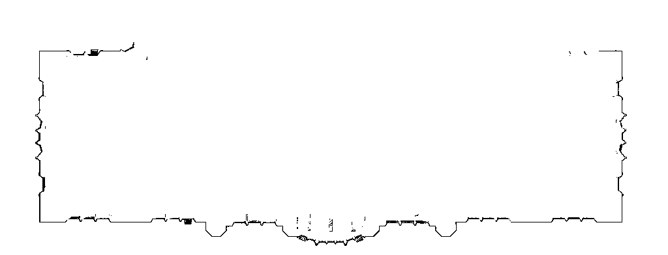
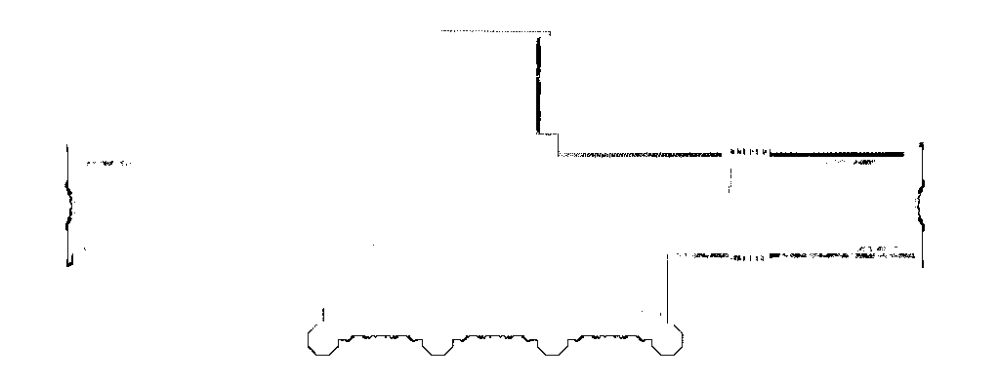
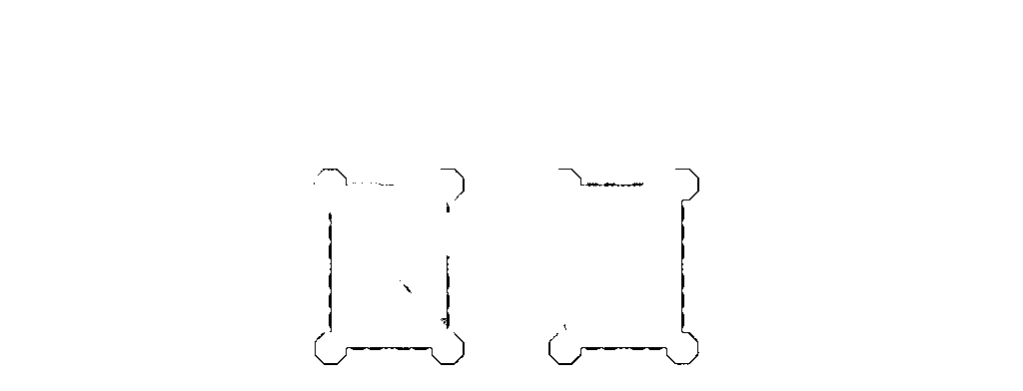
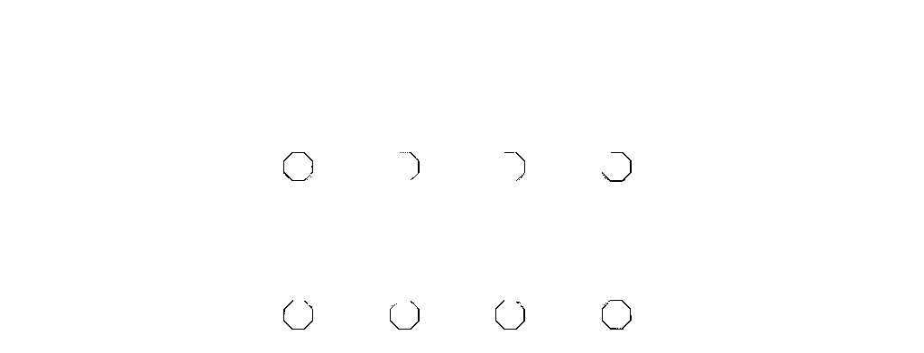
3D Data Preprocessing (1)
Slice Extraction
  Two ways for extraction
Notes:
The motivation of doing slice extraction is to convert 3D model reconstruction problem into lightweight 2D IP problem.
Basically, to extract slices is to project a slab of 3D data onto a 2D image as you can see from the animation.
Depend on how to choose the height of slab, \delta, the extraction can be divided into two ways. If \delta is allowed to be a dynamic value, then we might choose large delta in parts of the structure that are similar. And low values in regions that contain finer details. This requires analysis on the 3D point cloud data. If \delta is set to be constant, then we can generate 2D cross-sectional image slices from equal-size slabs. Then, we will work on 2D slices to infer the similar structures. To avoid direct computation on 3D data, we are adapting the 2nd way for extraction.
Here are the sample slices extracted horizontally along the Y axis. These are from the bottom part of the building, This is the roof part of the building, which contains tapered structure. These are the top structure of the building.

Slide 11
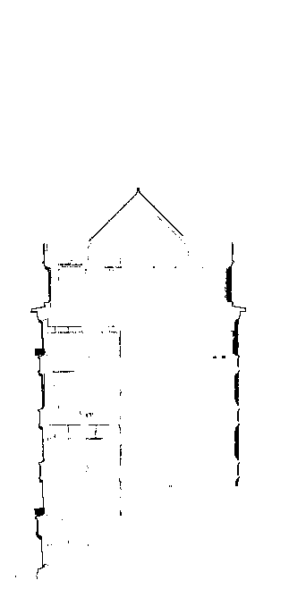
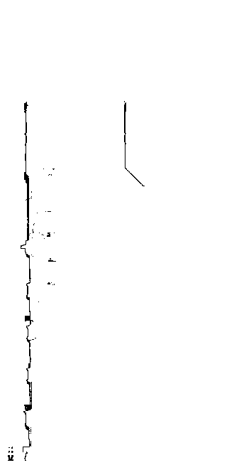
3D Data Preprocessing (1)
Slice Extraction
  Two ways for extraction
Notes:
Likewise, we can do slice extraction from other directions.
Here are some slices extracted vertically along X axis. These slices can provide extra information for 3D reconstruction.

Slide 12

3D Data Preprocessing (2)
Slice Extraction
  Motivation
  Two ways for extraction
Noise Reduction
Notes:
Because of the occlusion, the input data is not perfect at all. There are noise existing and some data missing.
To reduce the noise, we simply apply bounding boxes on the 2D slices.
For example, for the low part of the building, the bounding box looks like this. Currently, we are relying on user input for bounding box definition. All noise falling outside of the dark region will be clipped away.

Slide 13
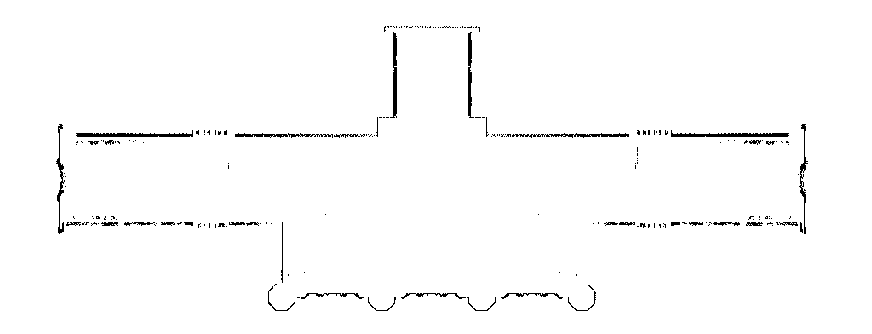
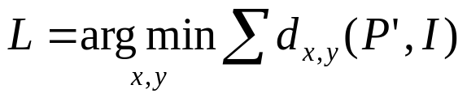
3D Data Preprocessing (3)
Slice Extraction
  Motivation
  Two ways for extraction
Noise Reduction
Missing Data Recovering
  Symmetry detection
  Lightweight 2D computation
Notes:
Based on the observation that most of the buildings are self symmetry with respect to symmetry lines, we can partially recover the missing data by symmetry computation.
As we know that 3D symmetry computation is expensive. Fortunately, we have convert the problem to 2D images. And to make the problem even simpler, we only consider the symmetry with respect to vertical or horizontal lines. Since the 3D data has been rectified, this simplification will not lose much performance.
Once symmetry line L is computed, we can recover some missing data by reflection as shown in the bottom figure.

Slide 14
Lightweight 3D Reconstruction (1)
Extrusion Detection
  Identify keyslices based on similarity measurement
Notes:
The pre-processing stage has extracted and enhanced the 2D cross-sectional images. Now let’s take a look at the reconstruction stage.
Our goal is to model the 3D point cloud via a series of push-pull operation. To do this, we need to detect the extrusion structure from the 2D cross-sectional slices.
This is equivalent to identify “keyslices” from 2D cross-sectional images. Here the concept of keyslice is similar to “key frame” in computer animation. Therefore, the whole 3D model can be reconstructed by the interpolation among the keyslices. We can identify the keyslices based on the similarity measurement on the 2D cross-sectional images.

Slide 15
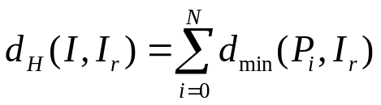

Lightweight 3D Reconstruction (1)
Extrusion Detection
  Identify keyslices based on similarity measurement
  Hausdorff distance
I is keyslice if
Notes:
To do the similarity measurement on the raster images, hausdorff distance is chose as the objective distance function.
Let’s say I_r is a reference image, and I is a new image to be evaluated, the HD d_H is defined as the summation of the minimum distance from a point in I to a point in I_r. If the HD for a new I is greater than a threshold \tau_d, we regard this new image I as a keyslice image, and update the I_r to be the new image I.
Emphasis: Here, \tau_d is an important threshold. Tuning it can tune the resolution of the final reconstructed 3D model. The smaller \tau_d we have, the higher resolution final model we will obtain.
Q: why HD? 1. good for raster image computation. 2. computational efficient.

Slide 16
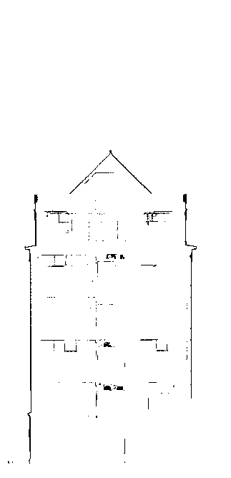
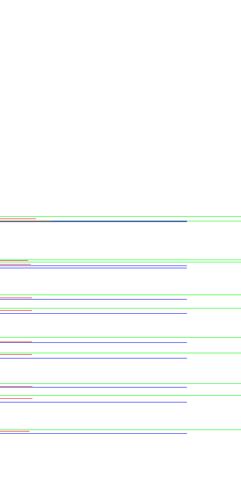
Lightweight 3D Reconstruction (1)
Extrusion Detection
  Identify keyslices based on similarity measurement
  Hausdorff distance
  Curvature based computation
I is keyslice if
Notes:
Although the Hausdorff distance computation is efficient, the weakness is when \tau_d is relative large for approximated model, some keyslices which contain salient features may be lost.
In order to keep these salient feature, we came up with a complemental method, which is curvature based keyslice detection. This idea is based on the observation that the salient feature is usually shown as a curvature in the slices extracted from orthogonal directions, such as the ledger part as shown in the image. So we can compute the curvatures to keep the salient feature. Here are the samples of slices extracted from orthogonal direction, the curvatures are computed for each slices as shown in this image [[ red one show the center of the curvature, the blue and green lines show the starting and ending points of the curvature.]???]
Once these curvature are computed, they can be mapped to the corresponding keyslices in the horizontal direction. By combining the HD and Curvature computation, we can avoid missing those important keyslices.

Slide 17
Lightweight 3D Reconstruction (2)
Boundary Vectorization
  Ball Pivoting Algorithm (BPA) based contour computation
Notes:
The keyslices we computed are still raster images. To reconstruct the model, we have to vectorize those image to obtain the contour.
The difficulty about the vectorization is the gaps or holes in the boundary of these raster images. (Douglas-Peucker could not handle gaps)
To conquer this problem, we proposed an adaptive ball-pivoting algorithm which is based on iterative process.
The idea of ABPA is straightforward, We first choose a large radius for the initial BPA. This is shown in the demo… Pivot this ball on a data point until it touches another data point which will be used as a new point for pivot. Keep doing this process until the ball reaches the end of data point. As we can see, the touched data points form a coarse, low-resolution contour. To get more precise or higher resolution of the contour, an iterative refinement process is carried out on the initial contour.

Slide 18
Lightweight 3D Reconstruction (2)
Boundary Vectorization
  Ball Pivoting Algorithm (BPA) based contour computation
  Adaptive BPA algorithm (ABPA)
Notes:
The refinement process works on the same way as initial BPA, but with a smaller circle as shown here.
It checks whether the line segment in the contour can be replaced by finer structure or not. As you can see in the demo, this line is replaced by the detailed structure from these three short lines. The same to this line. For this big gap case here, the smaller ball could not reach the next end point of the line segment, therefore this line is kept. Thanks to the initial pivoting, so that we do not have any broken contour. After this, the ball will start from this point and refine the remaining lines.
This refinement continues until the radius is smaller than a threshold \tau_r. This will generate a high-resolution model if the threshold \tau_r is small enough.
The adaptive BPA might generate a lot short line segments belonging to the same long line segment. So we tried to merge these short lines by incorporating line segments detected by Hough Transform.

Slide 19
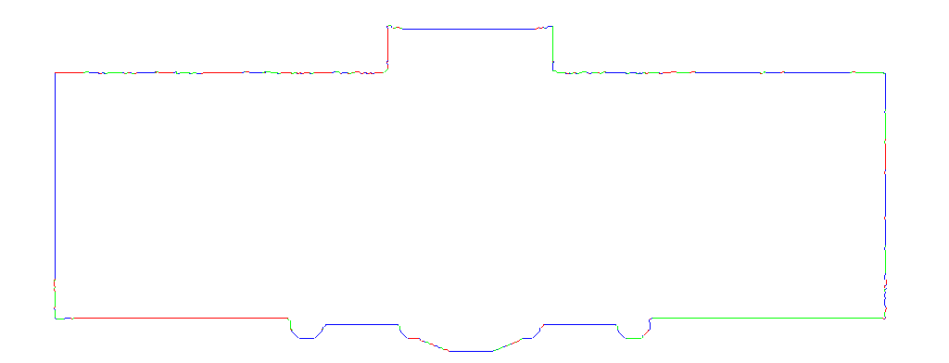
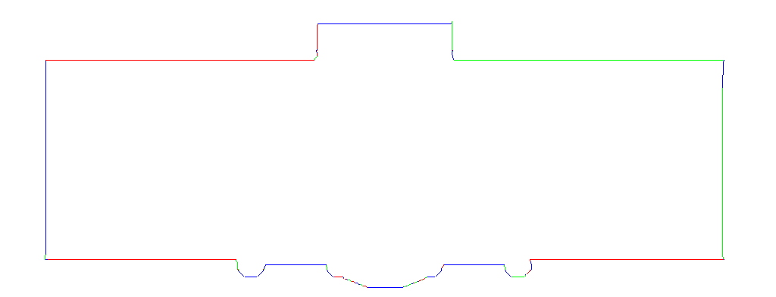
Lightweight 3D Reconstruction (2)
Boundary Vectorization
  Ball Pivoting Algorithm (BPA) based contour computation
  Adaptive BPA algorithm (ABPA)
  The integration of ABPA and Hough Transform
Notes:
Open it first … SHOW THE MODEL WITH GOOGLE SKETCHUP - C:\Program Files\Google\Google SketchUp 6\Plugins\models\IR_skp_face_1000_4_2_no_tapered.skp
SWITCH TO THE SKETCHUP ------ SHOW THE PROBLEM OF THE ROOF TAPERED STRUCTURE
Actually, this merging is mainly a cosmetic process to beautify the contour. As you can see in the image, the top part of the contour in the left image which consists of a bunch of short line segments are replaced by two long straight lines computed by HT.
At this point, we can actually reconstruct the final 3D model based on the vectorized contours of keyslices.
.

Slide 20
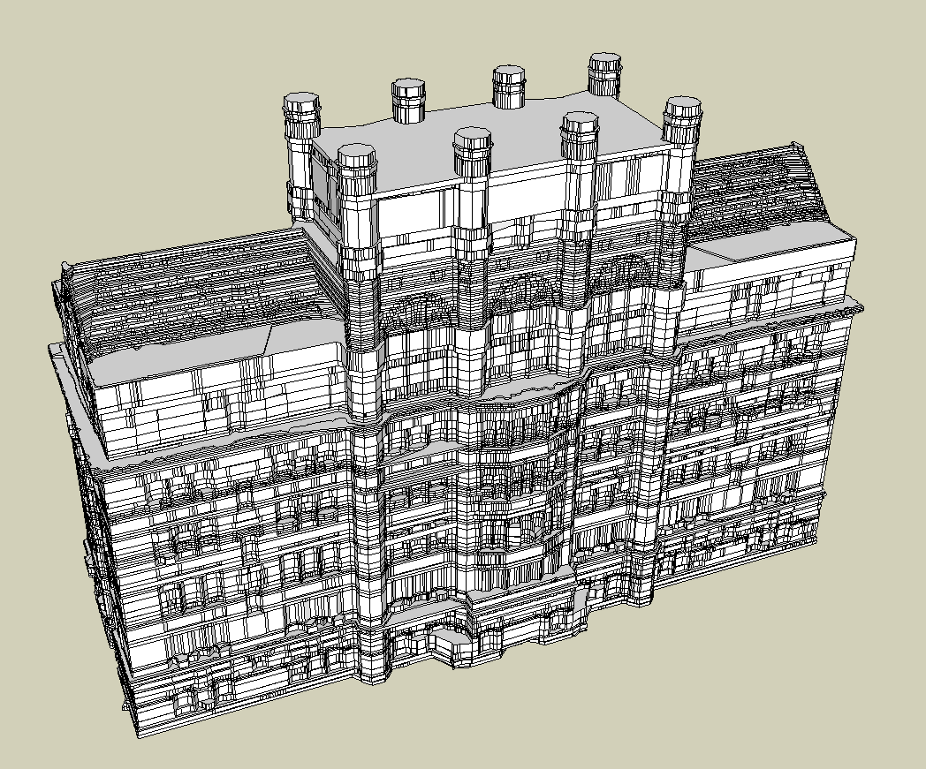
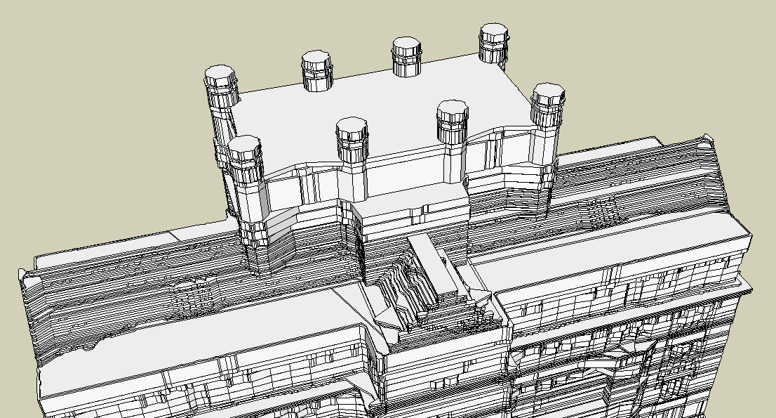
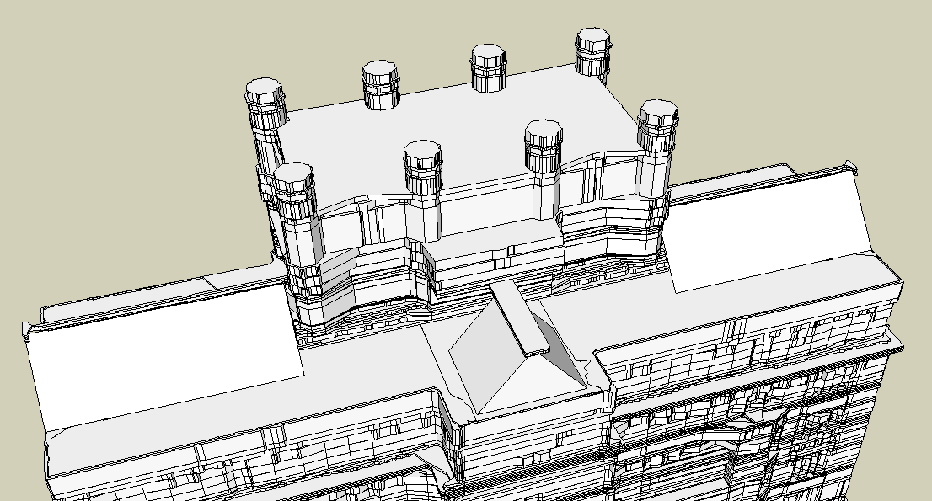
Lightweight 3D Reconstruction (3)
Tapered Structure Detection (Taper to line)
Notes:
Here is a snapshot of the model reconstructed with about 100 keyslices through push-pull operations in Google SchetchUp. This model is not bad although a lot of keyslices are dedicated to the roof part of the building which is a mixture structure of extrusion and taper to a line structure. We can further improve the model by inferring the taper to a line structure as shown in the right.

Slide 21

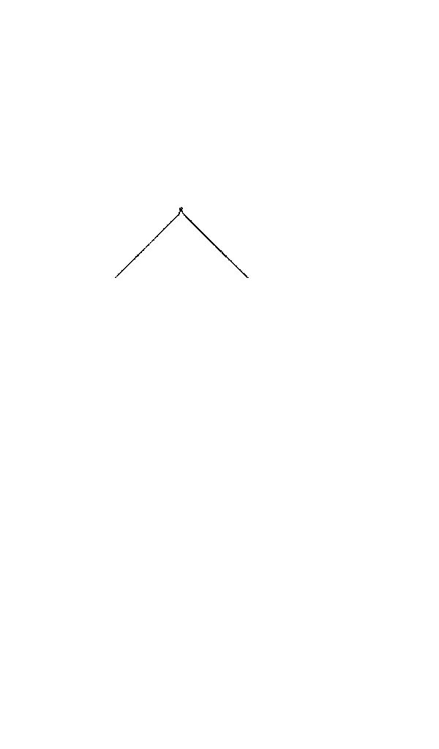
Lightweight 3D Reconstruction (3)
Tapered Structure Detection (Taper to line)
  Locate the range
  Segment the part into sub-structures
  Segmentation based on similarity
Notes:
To do this, the first step is to locate the range of tapered structure. This can be done based on the observation that tapered structure exhibits a high and even distribution of keyslices.
After detecting the range of tapered structure, we can segment the data in this range into sub-structures. For each sub-structure, it either only contains a taper to a line structure, or only contains a extrusion structure. This segmentation can be done by similarity measurement on 2D slices extracted vertically.
So, we can scan from left to right, top to bottom, searching for a special structure as shown in these figures. This special structure is an intersection of two line segment. The bottom two points indicate the base contour, and the intersection point indicates the tapered contour. By computing the three end points, we can reconstruct the tapered structure.

Slide 22
Outline
Introduction
Methodologies
  3D point cloud preprocessing
  Lightweight 3D reconstruction
  Model generation
Preliminary Results
Tasks and Timeline
Notes:
Here is the outline of my talk:
Brief intro the background and motivation for this research. Then, I will talk about the …., which consists of three main parts:1, 2, and 3.
After that, I will show you some preliminary results, and finally the timeline and summary.

Slide 23
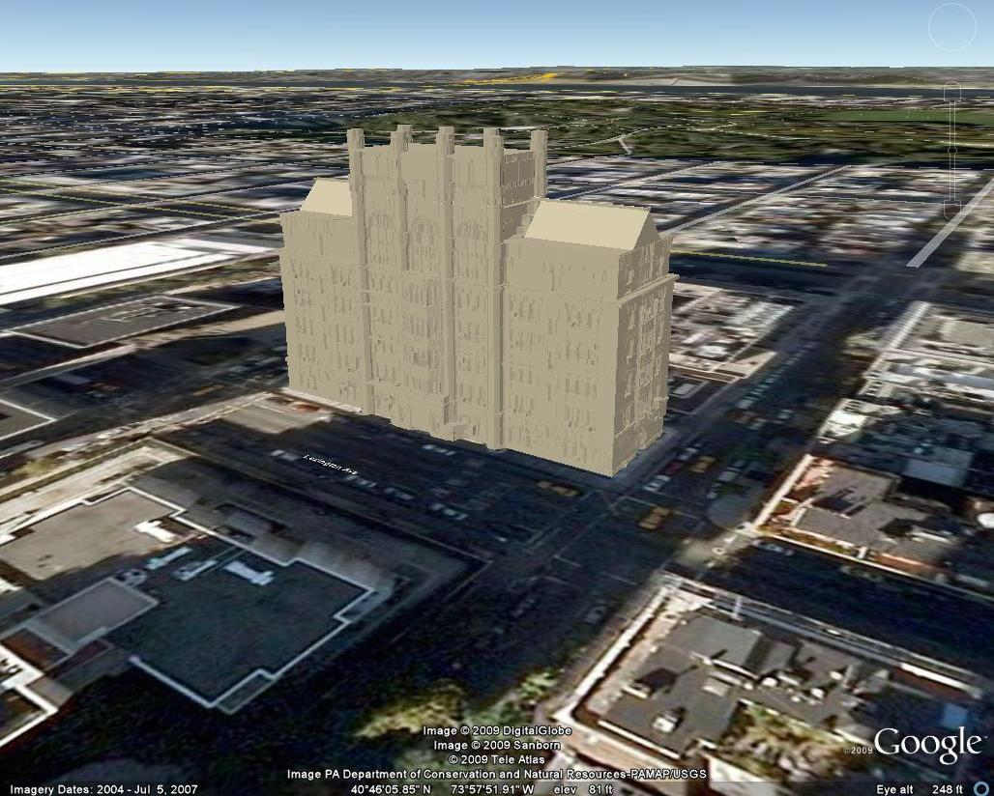
The Reconstructed 3D Model
Coordinates Transformation
Notes:
To generate the final 3D model of the point cloud data, the 2D vectorization coordinates need to be transformed back to 3D world coordinates. This is the inverse transformation of the slice extraction.
The extrusion structure is generated by a push-pull operation on the contour of its keyslice. The taper structure is created by connecting the vertices of the the base contour and their corresponding tapered points to create faces.
The left image shows a snapshot of the reconstructed model rendered with lighting. And the model is also put into the GE as shown in the right image.

Slide 24
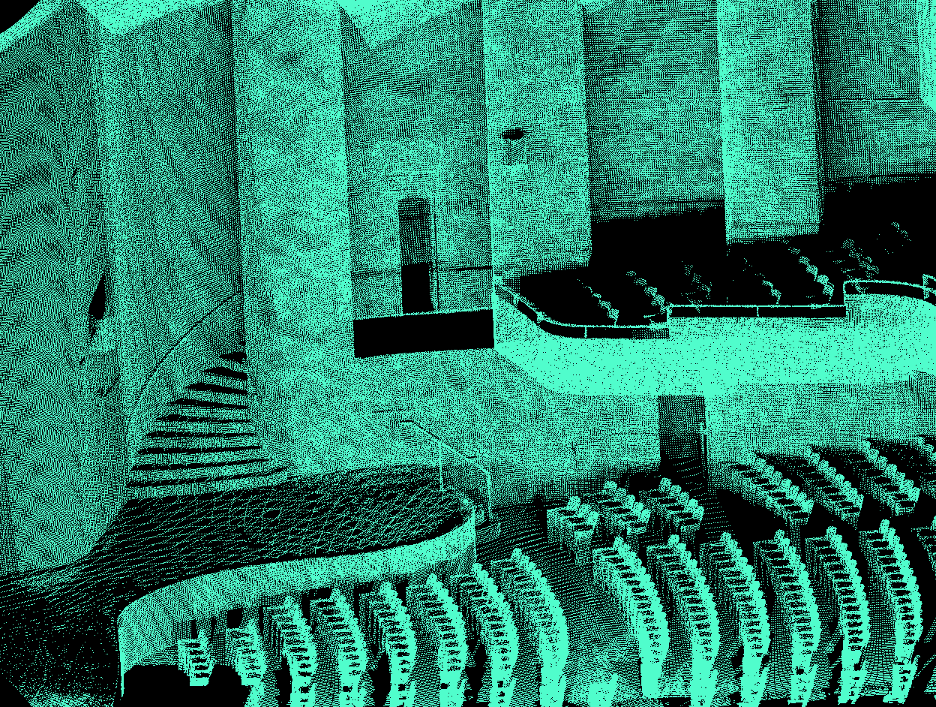
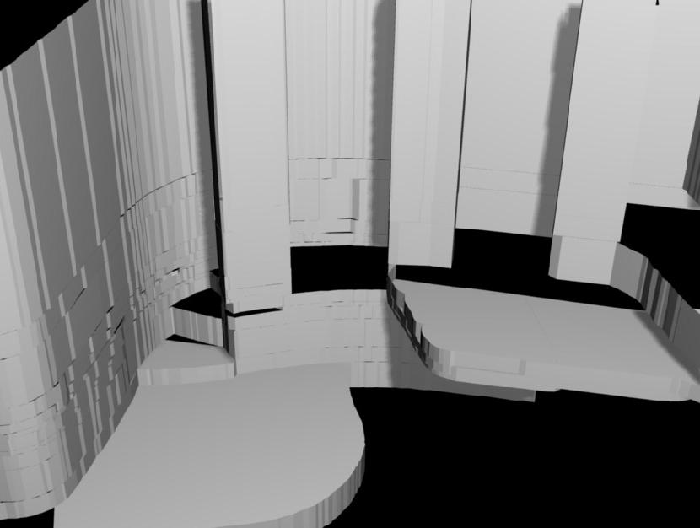
The Reconstructed 3D Model
Coordinates Transformation
Notes:
Here is another example which is an interior scanning of the Thomas’ hall at hunter college. The left image is a snapshot of the registered 3D point cloud and the right image is a snapshot of the reconstructed model. For interior scanning, it is more challenge in a sense that there are more finer details existed in the scene, such as the chairs. For now, we just ignore these details. The chairs could be added in by texture mapping.
BTW, there is no tapered structure existed in the scene and model.

Slide 25
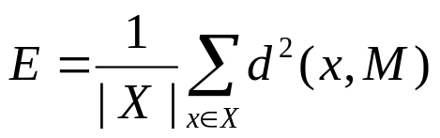
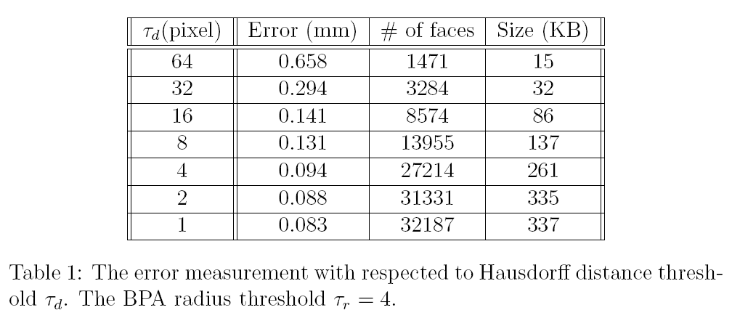
Performance Evaluation
Error Measurement
Notes:
To measure how accurate our reconstructed model is, we computed the errors for different settings.
Here, we defined our error as the average Euclidian distance from the raw point cloud to its nearest face as shown in the equation.
We generate a series of models based on the threshold of the HD. The unit for this threshold is in pixel. From the table we can see, when the threshold \tau_d decreases, the error also deceases, as expected, the #of faces and size of model increase.
To visualize the errors, we have also generated the deviation mapping for models.

Slide 26
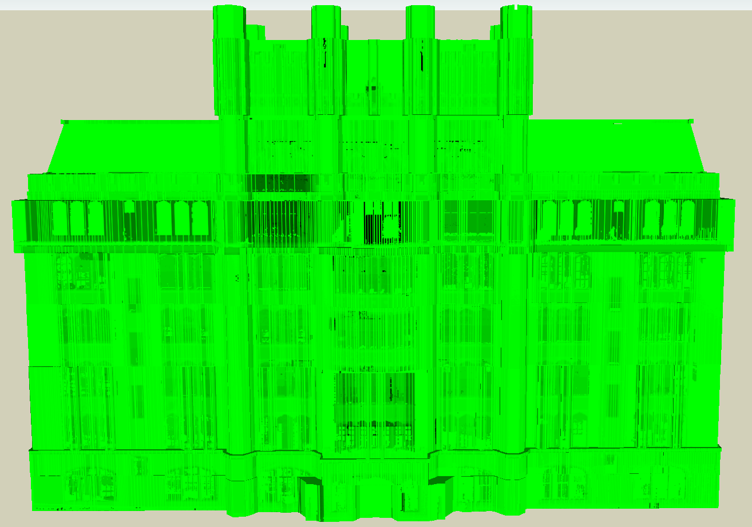
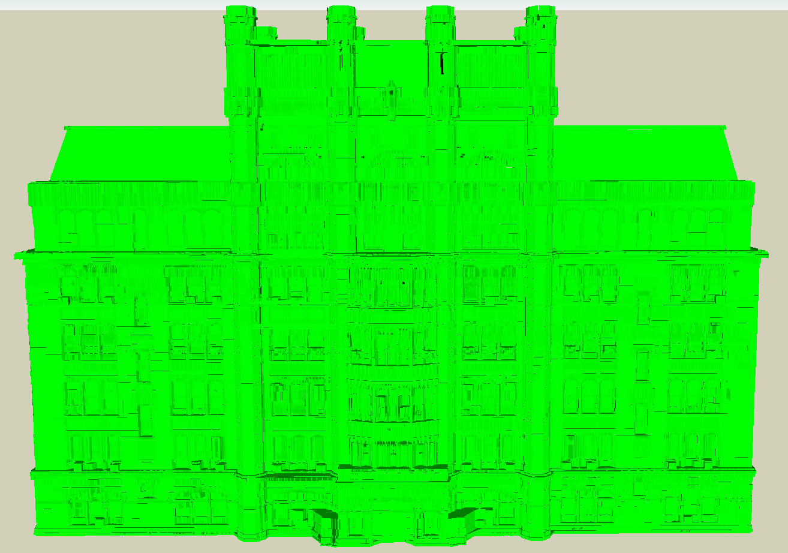


Performance Evaluation
Error Measurement
Deviation Mapping
Notes:
Essentially, the deviation mapping maps the errors of 3D data point into intensity value of pixels in the image. And these images are pasted on the faces of 3D model by texture mapping. The dark region means big error and the green color means small error. The threshold for these two models are shown in the bottom.

Slide 27
Outline
Introduction
Methodologies
  3D point cloud preprocessing
  Lightweight 3D reconstruction
  Model generation
Preliminary Results
Tasks and Timeline
Notes:
Finally, let’s take a look at the ongoing tasks and timeline.

Slide 28
Ongoing Tasks (1)
Taper to a Point
  Widely exists in Gothic architecture (churches)
  Keyslices converge to a point
  Match consecutive keyslices using dilation
Modeling of “Follow-Me” Structure
  Useful feature in Google SketchUp
  Underline geometry moves along a trajectory
  Template based tracking
Notes:
*. Prepare for submission for SIGGRAPH Asia
Based on what I have presented, we are preparing a paper targeting at SIGGRAPH Asia. In addition to what we have done, here are some ongoing tasks towards my dissertation defense.
First, investigate taper to a point structure. We have successfully infer the taper to a line structure existed in our data. As a further step, we will also infer the taper to a point structure, which widely exists in Gothic architecture, such as churches.
A nice characteristic of this structure is that the keyslices converges to a point. So a possible way to infer this structure would be matching consecutive keyslices using dilation.
The second task is to infer the “follow-me” structure which is a useful feature included in Google SketchUp. Basically, this structure can be viewed as a basic 2D geometry structure moves along a curve trajectory. Based on this definition, a possible way to infer this structure would be using template based tracking to get the trajectory of the underline geometry.

Slide 29
Ongoing Tasks (2)
Comparison with other Techniques
  Objective comparison
  Subjective comparison
  Compared with BPA and qslim
More Large-Scale Datasets
  Both exterior and interior scanning of buildings
  Results on half dozen large-scale datasets
Notes:
*. Prepare for submission for SIGGRAPH Asia
We will be doing comparison to state-of-the-art techniques for 3D model reconstruction. The criteria for the comparison will include both objective and subjective comparison. The objective comparison is based on the error between the models and raw data. And the subjective comparison will rely on the sharpness of the generated models.
And finally, we will be applying our tool on more large-scale dataset. This include both exterior scanning and interior scanning of buildings. Roughly, we will generate 3D models for about half-dozen large-scale datasets.

Slide 30
Timeline
Learning Curve
  3D tools and related programming languages
  20,000+ C++ and 2,000+ Ruby API code
Ongoing Tasks
  Tapering to a point (3 weeks)
  Modeling of “follow-me” structure (3 weeks)
  Comparison with other techniques (3 weeks)
  Results on half dozen large-scale datasets (3 weeks)
  Complete dissertation writing (4 weeks)
Defense in September
Notes:
*. Prepare for submission for SIGGRAPH Asia
*. This is just an estimation. If everything goes smoothly, I will do the dissertation defense in later July or early August.
I have been working on this project for several years and have earned in-depth knowledge on 3D tools and related PLs. Also I have built up the infrastructure in c++ and Ruby code, so it can be used to quickly implement any new ideas.
Based on the skills and the infrastructure, the estimated time for the proposed ongoing tasks is shown here: ….. Roughly, it will take 3 weeks for each ongoing task, and 4 weeks for thesis writing.
If everything went smoothly, the dissertation defense would be in September.

Slide 31
Thank you !

