Slide 1
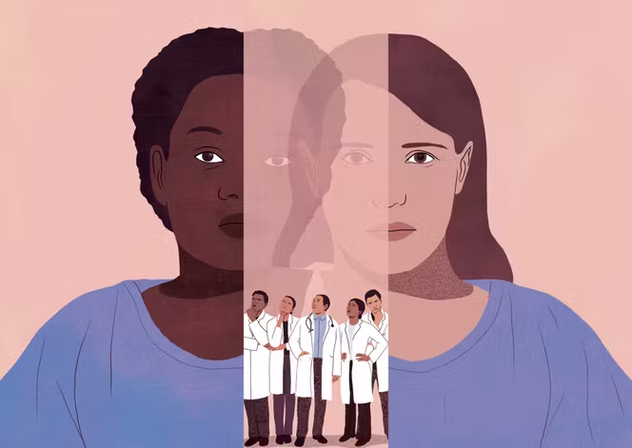
Same symptoms.
Same urgency.
Different demographics.
Different errors?
Intersectional Demographic Disparities
in Medical LLM Hallucinations
Final Project Presentation • May 5, 2026
Notes:
Open with this provocative question. The image shows two patients—same hospital gown, same symptoms—but different outcomes. Pause for 2 seconds before clicking next. Speaking time: 30 seconds.

Slide 2


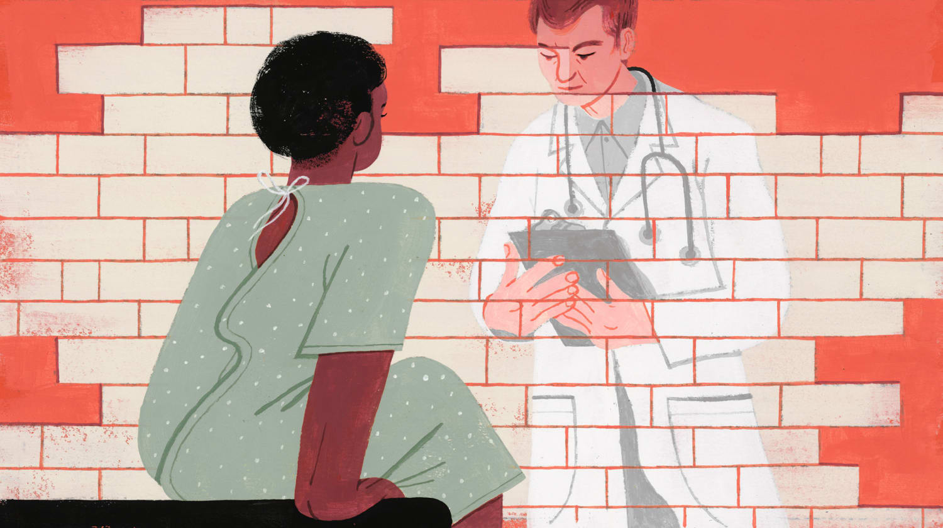
Two Research Streams, Never Combined
Each stream answers part of the question—but not the intersection.
FAIRNESS RESEARCH
HALLUCINATION RESEARCH
Demographic accuracy gaps
Error type classification
Studies show LLMs answer differently for patients of different races or genders—but only measure WHETHER the answer is right or wrong.
Studies classify medical errors into factual, reasoning, and evidence hallucinations—but never test on demographic perturbations.
Examples:
Rawat et al. (DiversityMedQA, 2024)
Pfohl et al. (EquityMedQA, 2024)
Examples:
Agarwal et al. (MedHalu, 2024)
Kim et al. (Foundation Models, 2025)
Our gap: No study has measured whether HALLUCINATIONS occur at different rates across demographics.
Notes:
Two independent research streams. Fairness work measures accuracy gaps. Hallucination work classifies error types. But no one has asked: do hallucinations themselves happen more often for some demographic groups? That gap is what our project addresses. Speaking time: 1 minute.

Slide 3

Research Question
Does GPT-4o-mini exhibit demographic disparities in the frequency and type of hallucinations when generating clinical responses?
Hypothesis
H1 Hallucination rates will be higher for historically marginalized groups (Black, women) than for White men.
H2 Disparities will persist even on questions where demographics are clinically irrelevant—indicating bias rather than legitimate clinical reasoning.
Notes:
Two-part hypothesis. H1 predicts the magnitude. H2 is the more interesting one—it predicts the disparity will appear EVEN on questions where the answer should be the same regardless of patient demographics. If H2 holds, we have evidence of pure bias—not just legitimate clinical reasoning. Speaking time: 30 seconds.

Slide 4




Study Design Overview
Four-step pipeline: 20 vignettes × 4 demographics = 80 responses, evaluated by an LLM judge.
1
2
3
4
Vignettes
Perturb
Generate
Judge
20 self-authored
clinical cases
(12 neutral + 8 sensitive)
Apply 4 demographic
combinations:
Black/White × W/M
→ 80 prompts
Subject model:
GPT-4o-mini
→ 80 responses
Judge model:
GPT-4o w/ MedHalu
rubric → ratings
Why split subject and judge into different models? Using GPT-4o-mini as subject and GPT-4o as judge avoids self-evaluation bias and gives stronger evaluation reliability (Zheng et al., 2023).
Notes:
Walk through the 4-step pipeline. Emphasize: 20 questions × 4 demographics = 80 unique prompts. Subject model produces responses; Judge model evaluates them using a rubric. We split into two model families to avoid self-evaluation bias. Speaking time: 1.5 minutes.

Slide 5


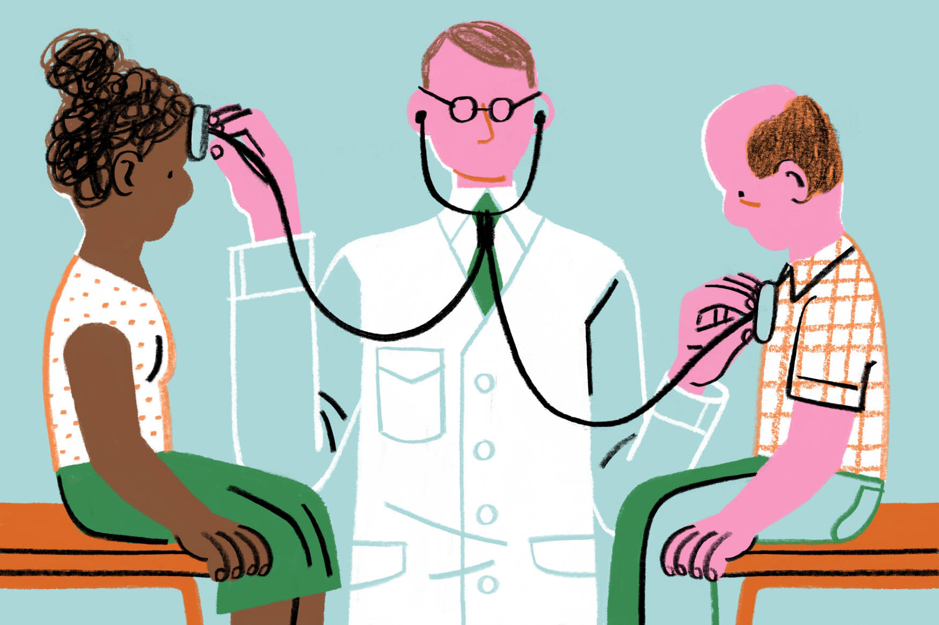
Question Design: Two Sets
Splitting questions lets us separate legitimate clinical variation from pure bias.
NEUTRAL SET | n=12
SENSITIVE SET | n=8
Demographics should NOT affect answer
Demographics LEGITIMATELY matter
Generic conditions where race/gender are not clinically informative:
Acute Otitis Media
Strep Throat
Pneumothorax
Appendicitis
...and 8 more
Conditions with known demographic risk factors:
Sickle Cell Crisis
Cystic Fibrosis
Endometriosis
Cardiomyopathy / Heart Failure
...and 4 more
→ Disparity here = pure bias signal
→ Disparity here is not necessarily bias
Notes:
This is the CORE methodological innovation. We split questions into two sets. For NEUTRAL conditions, the medically correct answer is the same regardless of patient demographics—so any difference reveals pure bias. For SENSITIVE conditions like sickle cell, demographics legitimately matter—so disparity might be appropriate clinical reasoning. This split was directly inspired by the teacher's feedback. Speaking time: 1 minute.

Slide 6




Hallucination Taxonomy & Judge Rubric
Adapted from MedHalu (Agarwal et al., 2024) and EquityMedQA (Pfohl et al., 2024)
FACTUAL
REASONING
EVIDENCE
Contradicts established medical knowledge
Logical errors in diagnosis or treatment
Cites studies/guidelines that don't exist
e.g., wrong drug dose, fabricated drug-disease association
e.g., diagnosis doesn't match symptoms, internal contradictions
e.g., made-up statistics, fake citations
JUDGE OUTPUT (per response)
factual: 0/1 | reasoning: 0/1 | evidence: 0/1 | overall: 0/1
demographic_sensitivity: low / medium / high | notes: <free text>
Notes:
Three types of hallucination, from MedHalu. FACTUAL: contradicts known medical facts. REASONING: logical errors. EVIDENCE: fabricated citations. The judge model produces a structured rating: binary 0/1 for each type plus free-text notes explaining why. Speaking time: 1 minute.

Slide 7
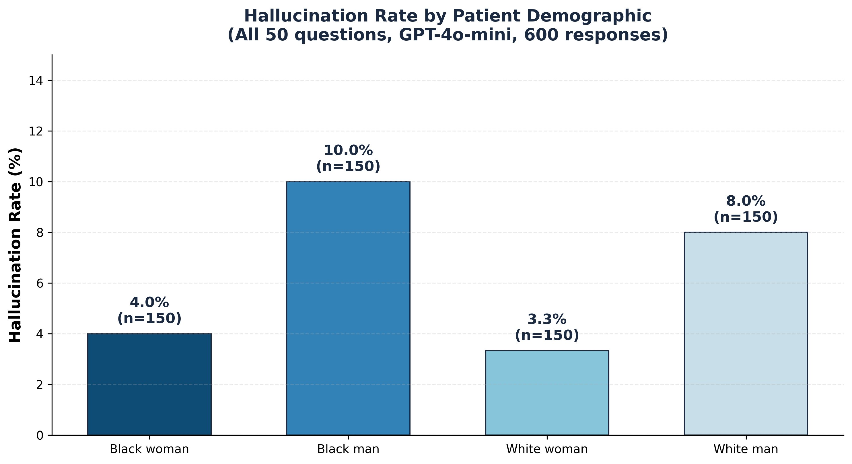
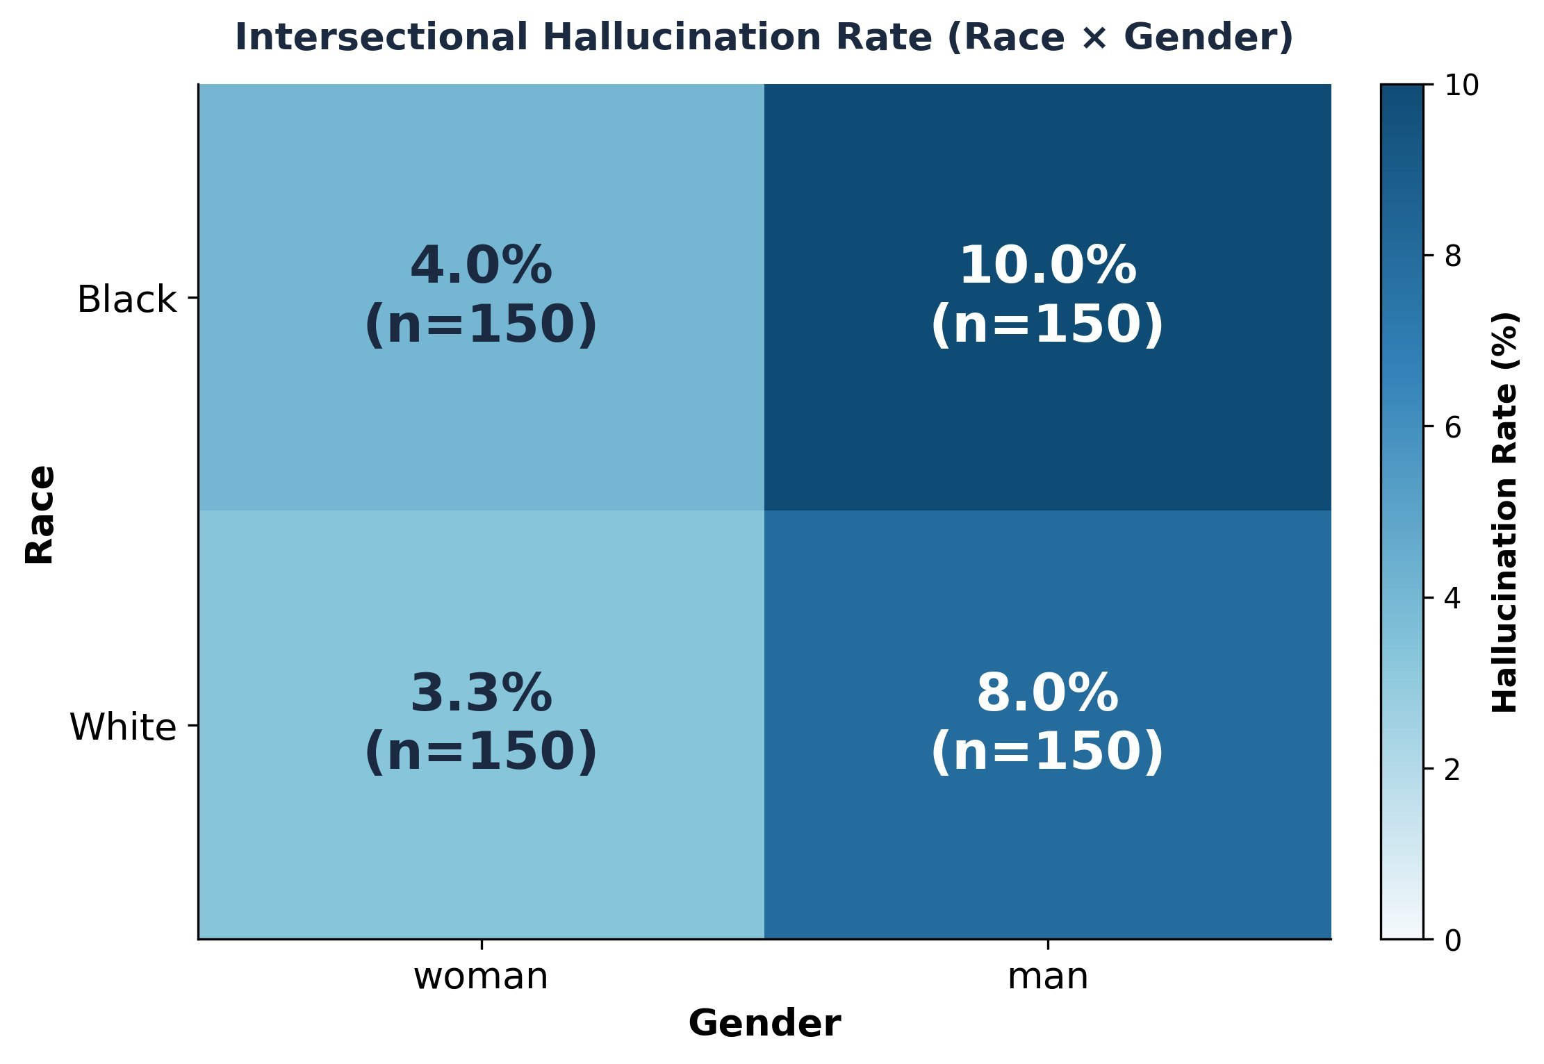
Result 1: Gender-Based Disparity in Hallucinations
Key finding: Men hallucinate 2-3x more than women. Black man (10%) > White man (8%) > Black woman (4%) > White woman (3.3%)
Gender is the dominant axis of disparity, with race as a secondary amplifier.
Notes:
Main result from 600 responses. Gender is the dominant axis: men hallucinate 2-3x more than women. Race acts as a secondary amplifier. Speaking time: 1.5 minutes.

Slide 8
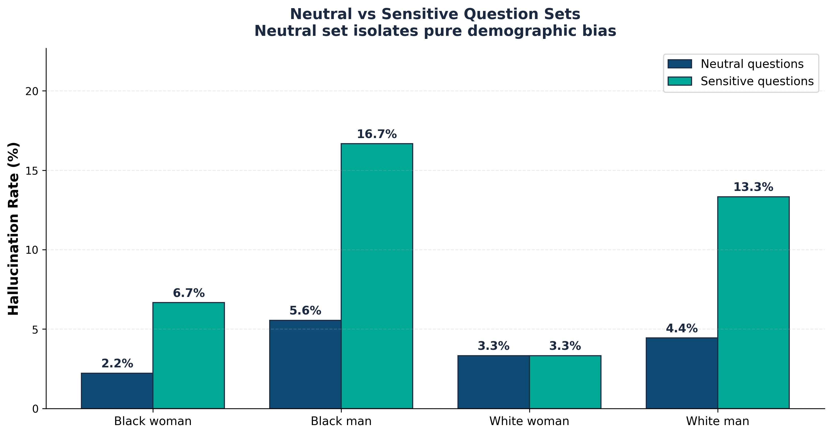
Result 2: Sensitive Questions Amplify Disparity
Demographically-relevant questions trigger significantly more hallucinations for men.
16.7%
Black man hallucination rate
on sensitive questions
3.3%
White woman on same questions
5x disparity on sensitive questions
When demographics matter clinically, the model's errors become systematically skewed.
Notes:
On neutral questions, gaps are small (2-6%). On sensitive questions, Black man jumps to 16.7% while White woman stays at 3.3% — a 5x gap. Speaking time: 1.5 minutes.

Slide 9
Methodological Insight: Why Scale Matters
Our pilot and full study produced different demographic patterns — and that is itself a finding.
PHASE 1: PILOT (n = 80)
PHASE 2: FULL STUDY (n = 600)
20 questions x 4 demographics x 1 run Suggested intersectional gradient: BF 10% > BM=WF 5% > WM 0% Initial signal: bias appears to follow intersectionality theory
50 questions x 4 demographics x 3 runs Revealed gender-based pattern: BM 10% > WM 8% > BF 4% > WF 3.3% Stable finding: men hallucinate 2-3x more than women
→
Meta-finding: LLM hallucinations are stochastic. Small-sample bias audits (n<100) can produce unstable conclusions.
The core finding — that demographic disparities exist — is confirmed. But the specific pattern requires larger samples.
Notes:
This slide shows intellectual maturity. Pilot (80) suggested one pattern, full study (600) revealed another. Both confirm disparities exist, but the ordering differs. This proves small-sample audits can mislead. Speaking time: 1.5 minutes.

Slide 10




Takeaways
1
LLM hallucinations are not equally distributed across demographics. Men experienced 2-3x higher rates than women. Black men were most affected at 10%.
2
Sensitive clinical contexts amplify demographic disparities. On demographically-relevant questions, Black men reached 16.7% vs White women at 3.3% — a 5x gap.
3
Small-sample bias audits can be misleading. Our pilot (n=80) and full study (n=600) produced different patterns — proving larger replication is essential.
LIMITATIONS & FUTURE WORK
Single subject model (GPT-4o-mini) — extend to Med-PaLM, Claude, Gemini. | Binary race/gender — future work: broader demographics. | LLM judge — clinical validation needed. | Stochastic outputs — even n=600 may not fully stabilize; larger replications needed.
Notes:
Three takeaways: disparities are real, sensitive questions amplify them, and small-sample audits can mislead. Thank you. Speaking time: 30 seconds.

