Slide 1
Identifying AI-generated Content in New Articles
Wenhao Li

Slide 2
Introduction
Is Anything Still True?
The advent of large language models like ChatGPT has revolutionized the way people work. However, this has also raised concerns about the potential spread of AI-generated news and misinformation.
Project Aims
Analyze the characteristics, respectively.
Distinguish machine-generated articles from human-written articles.
Applications
Help models to generate better texts
Develop tools for detecting AI-generated contents: fake contents, essay check, etc.

Slide 3
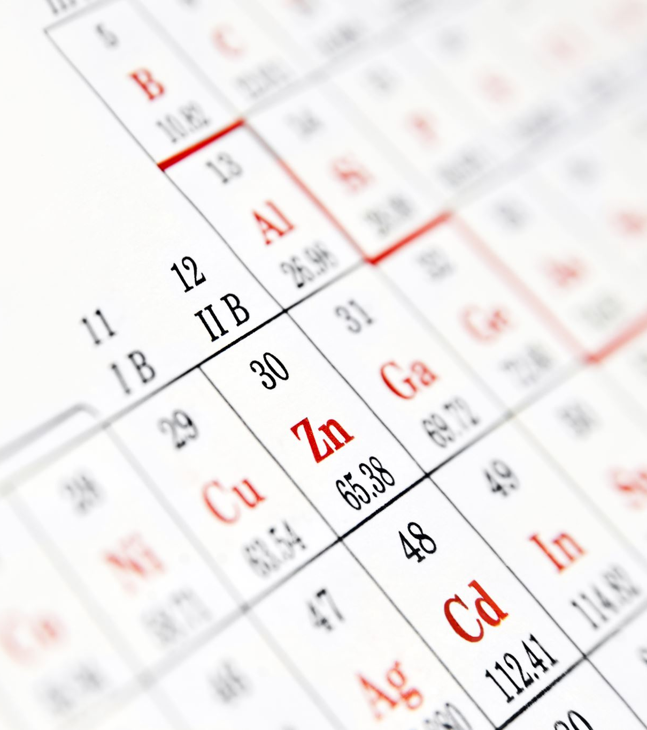
DataSet
txt files separated into different folders
Number of rows: 64000
32000 human-written articles
32000 AI-generated articles
All dataset was transferred into a CSV file

Slide 4
Accuracy scores
 | Tf-idf | Word2vec | Transformer
K-Nearest | 60.87 | 85.74
Logistic Regression | 82.55 | 93.63
SVM | 81.77 | 93.67
Neural Network | 83.34 | 90.02
Bert |  |  | 99.54
All model was trained in 10-fold cross-validation, and the result was the average of the accuracy score of each fold.

Slide 5
Conclusion and discussion
The K-Nearest model is not suitable for identifying AI-generated content versus human-written ones.
The Deep Neural Network combined with the transformer model yields the highest accuracy score.
Word2vec embedding performs better than the tf-idf approach in this dataset

