Slide 1
A Simple Queue Service
5090379001, Li Tingting
5090379073, Huang Tao
5090379085, Wang Jiajun
5090379107, Ban Yunmeng
5090379175, Li Wenhao

Slide 2
SQS
Distributed
Reliable
No need to worry about possible msg loss due to machine failures
Always available of queue service
Scalable
Multiple clients
Different machines
Consistent
Simple

Slide 3
C++ & event-driven
Libevent library
Distributed
Asynchronous
Event notification

Slide 4
Architecture
SQSClient
SQSMaster
SQSDataNode

Slide 5
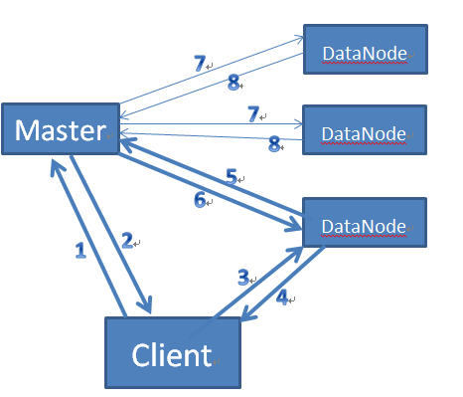
The whole process
7
DataNode
8
7
Master
8
DataNode
5
6
DataNode
1
2
3
4
Client

Slide 6
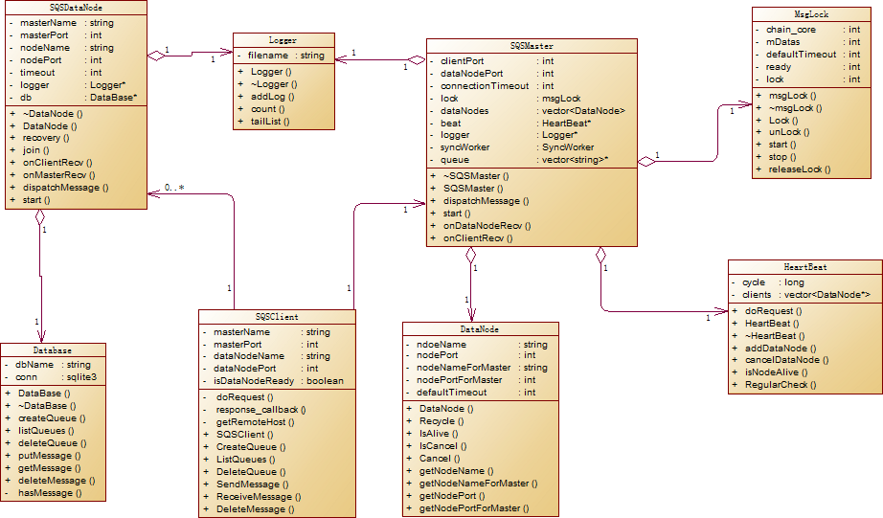
classes

Slide 7
SQSClient

Slide 8
SQSMaster

Slide 9
SQSDataNode

