Slide 1

2
0
1
8
天气预报项目
邓梅梅

Slide 2
INTRODUCTION
项目名称：天气预报
开发时间：2018.6.3
开发人员：邓梅梅
工具：python windows7

Slide 3
CONTENT
1
项目概述
2
数据来源
3
项目代码
4
天气查询结果

Slide 4
1
项目概述是

Slide 5

1
ADD TITLE HERE
LIFE OF THE ELDERLY IS A WISE, LIFE IS A LEARNED TEACHER
简介
本项目是设计来查询某个城市未来五天的天气情况，其中包括当天天气气温，最高温度，当天气压以及当天天气情况。

Slide 6
3
ADD TITLE HERE
LIFE OF THE ELDERLY IS A WISE, LIFE IS A LEARNED TEACHER
数据来源
未来七天天气：
http://api.openweathermap.org/data/2.5/forecast?q=zhengzhou,cn&mode=json&lang=zh_cn&&APPID=6a67ed641c0fda8b69715c43518b6996&units=metric
Json代码解析：
https://www.json.cn/

Slide 7
2
项目代码
LIFE OF THE ELDERLY IS A WISE, LIFE IS A LEARNED TEACHER, IT OFTEN SALUTARY INFLUENCE OF EDUCATION, SILENT TO GUIDE US, GIVE US INSPIRATION IN LIFE

Slide 8
2
ADD TITLE HERE
LIFE OF THE ELDERLY IS A WISE, LIFE IS A LEARNED TEACHER
壹
贰
city_pinyin=input("请输入城市拼音：")
address='http://api.openweathermap.org/data/2.5/forecast?q={chengdu},cn&mode=json&lang=zh_cn&&APPID=6a67ed641c0fda8b69715c43518b6996'
info=r.urlopen(address.format(city_pinyin)).read().decode('utf-8','ignore')
S
W
print(info)
print("欢迎使用本应用查看天气信息")
#json(dict)格式工具包
importjson
tianqi=json.loads(info)
for i in range(38):
O
T
叁
泗

Slide 9
3
采用方法
LIFE OF THE ELDERLY IS A WISE, LIFE IS A LEARNED TEACHER, IT OFTEN SALUTARY INFLUENCE OF EDUCATION, SILENT TO GUIDE US, GIVE US INSPIRATION IN LIFE

Slide 10
3
ADD TITLE HERE
LIFE OF THE ELDERLY IS A WISE, LIFE IS A LEARNED TEACHER
UNIT: MILLION
方法：
导入了urllib包，添加查询天气的链接，使用urlopen来打开链接;导入json包，将json转换成(dict)格式，便于项目操作。项目中还采取了for循环便于操作。
70%
LIFE OF THE ELDERLY IS A WISE LIFE IS A LEARNED , IT OFTEN SALUTARY INFLUENCE
2012
2013
2014
2015
2016

Slide 11
4
查询结果
LIFE OF THE ELDERLY IS A WISE, LIFE IS A LEARNED TEACHER, IT OFTEN SALUTARY INFLUENCE OF EDUCATION, SILENT TO GUIDE US, GIVE US INSPIRATION IN LIFE

Slide 12
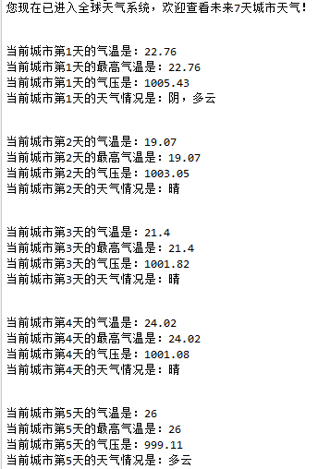
4
结果
LIFE OF THE ELDERLY IS A WISE, LIFE IS A LEARNED TEACHER
OK
OK
OK

Slide 13

总结
基于没什么基础学习大数据，所以学的比较困难，还有就是不知道怎得就是看见代码想睡就，但是经过老师的悉心教导，还是对大数据有了一定了解。通过学习，但是有些高级特性掌握起来还是有些难度，需要时间去消化。Python给我最大的印象就是语法简洁，就像写伪代码一样，很多其他语言要用很多行才能实现的操作Python可能几行就搞定了，这让人摆脱了繁杂的语法而专注于问题本身，，虽然它很强大.

Slide 14
2
0
1
8
THANK YOU
All
姓名

