Slide 1
Tencent Quantum Lab Solution for:
Quantum Computing for Drug Discovery Challenge
Presenter: Weitang Li
Team Member: Weitang Li
2023.10.31

Slide 2
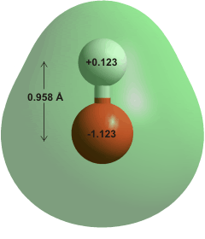
Problem setting
The model system
OH⁺ with STO-3G basis set. 8 electrons in 6 spatial-orbitals.
Employing Jordan-Wigner transformation, corresponds to 12 qubits.
Problem setting
Most accurate VQE energy with pre-optimized parameters
Gate noise and shot noise taken into account

Slide 3
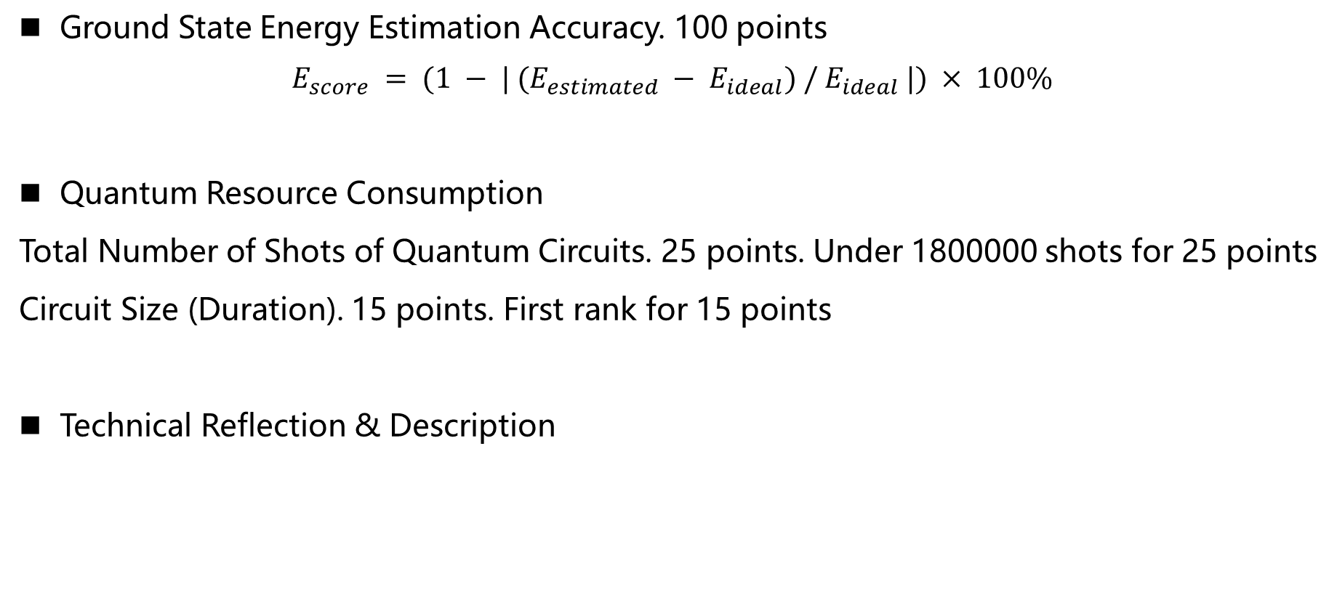
Scoring metric
Ground State Energy Estimation Accuracy. 100 points
$$E_{score} = (1 − | (E_{estimated} − E_{ideal}) / E_{ideal} |) × 100\%$$
Quantum Resource Consumption
Total Number of Shots of Quantum Circuits. 25 points. Under 1800000 shots for 25 points
Circuit Size (Duration). 15 points. First rank for 15 points
Technical Reflection & Description

Slide 4
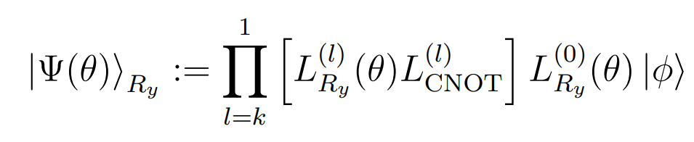
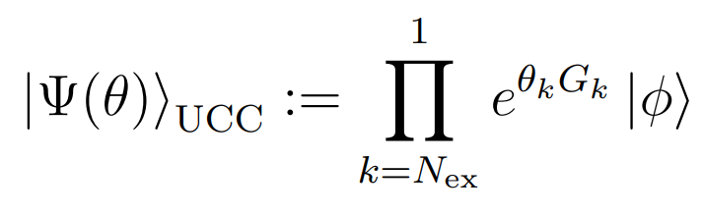
Choosing ansatz
Hardware Efficient Ansatz
Unitary Coupled-Cluster
Shallow circuit
High accuracy
Difficult initialization
Difficult parameter optimization
Deep circuit
High accuracy
Easy initialization
Easy parameter optimization
Notes:
Choose HEA since we care about shallow circuit, and don’t care about optimization difficulties.

Slide 5
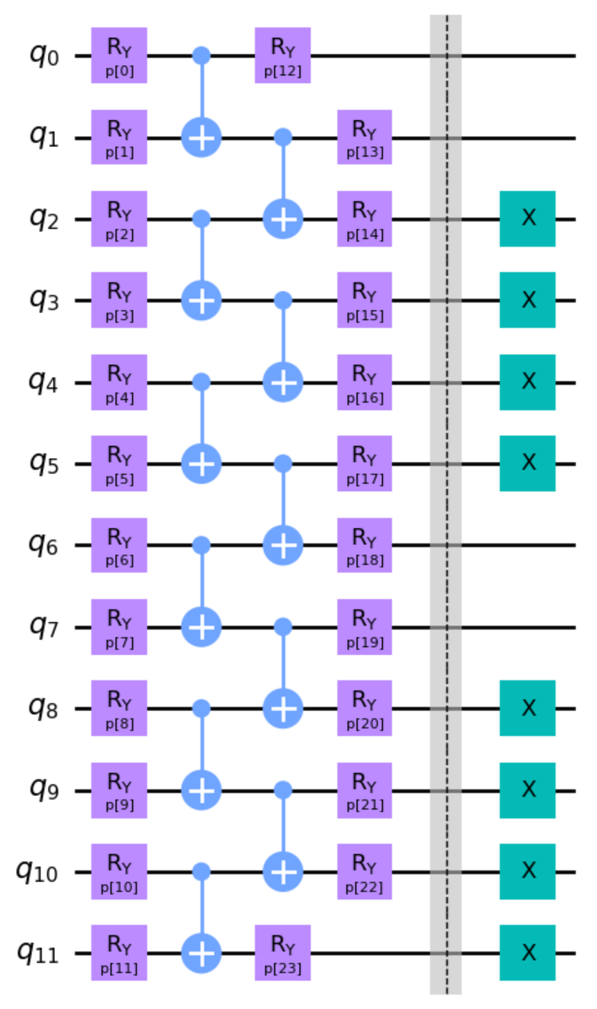
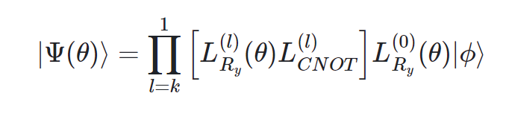
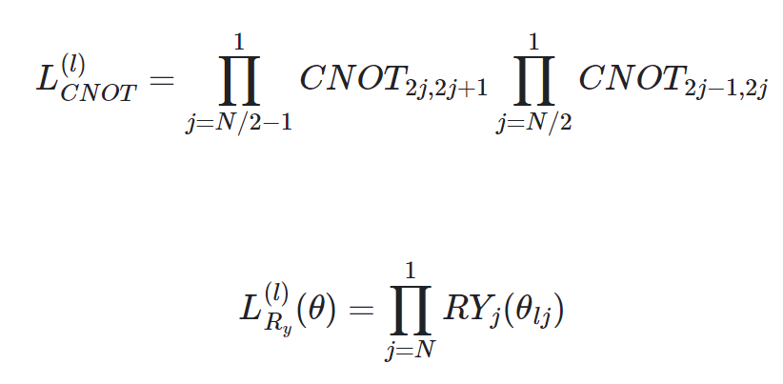
Choosing ansatz
Short but accurate enough!
Duration: 5024
Notes:
Use ry ansatz since it enforces real amplitudes, which is a desired property for molecular wavefunctions
One layer is enough for accuracy based on noiseless simulation
The X gates ensures that the whole circuit output the HF state when all parameters are set to 0

Slide 6
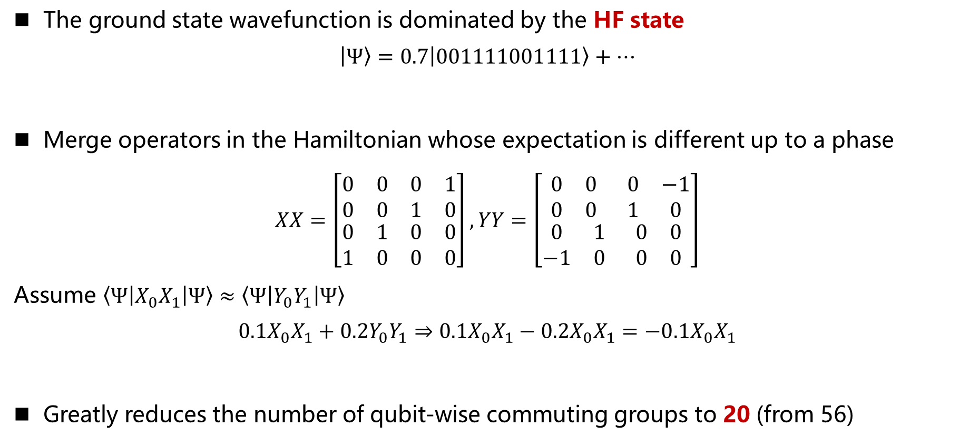
Measurement grouping
The ground state wavefunction is dominated by the HF state
$$\left|Ψ\right\rangle =0.7\left|001111001111\right\rangle +⋯$$
Merge operators in the Hamiltonian whose expectation is different up to a phase
$$XX=\left[\begin{matrix}\begin{matrix}0 & 0 \\ 0 & 0\end{matrix} & \begin{matrix}0 & 1 \\ 1 & 0\end{matrix} \\ \begin{matrix}0 & 1 \\ 1 & 0\end{matrix} & \begin{matrix}0 & 0 \\ 0 & 0\end{matrix}\end{matrix}\right],YY=\left[\begin{matrix}\begin{matrix}0 & 0 \\ 0 & 0\end{matrix} & \begin{matrix}0 & −1 \\ 1 & 0\end{matrix} \\ \begin{matrix}0 & 1 \\ −1 & 0\end{matrix} & \begin{matrix}0 & 0 \\ 0 & 0\end{matrix}\end{matrix}\right]$$
Assume $\left\langle Ψ\left|X_{0}X_{1}\right|Ψ\right\rangle ≈\left\langle Ψ\left|Y_{0}Y_{1}\right|Ψ\right\rangle$
$$0.1X_{0}X_{1}+0.2Y_{0}Y_{1}⇒0.1X_{0}X_{1}−0.2X_{0}X_{1}=−0.1X_{0}X_{1}$$
Greatly reduces the number of qubit-wise commuting groups to 20 (from 56)

Slide 7
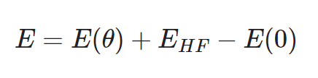
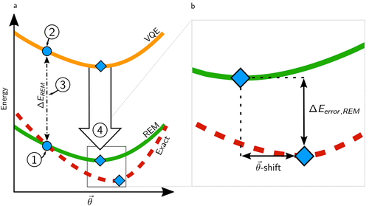

Error mitigation
Reference state error mitigation (REM)
Need only one additional energy measurement for $E(0)$
Before EM: -72.316. After EM: -74.462. Reference value: -74.387
Notes:
Requires that the circuit an output HF state

Slide 8

Summary
High-accuracy
Gate-noise
Tailored $R_{y}$ ansatz
Short circuit duration
Reference State EM
No parameter optimization
Measurement cost
Hamiltonian Grouping

Slide 9
Thank You！

