Slide 1

1
Mini Server Demo
Li wuqian
2020/06/24

Slide 2
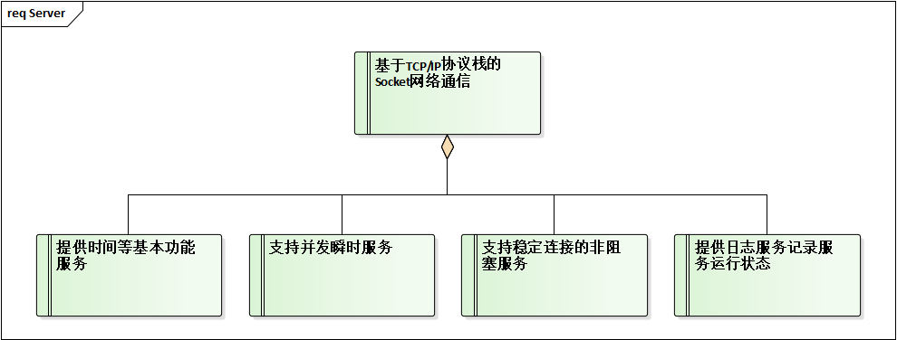
Requirements

Slide 3
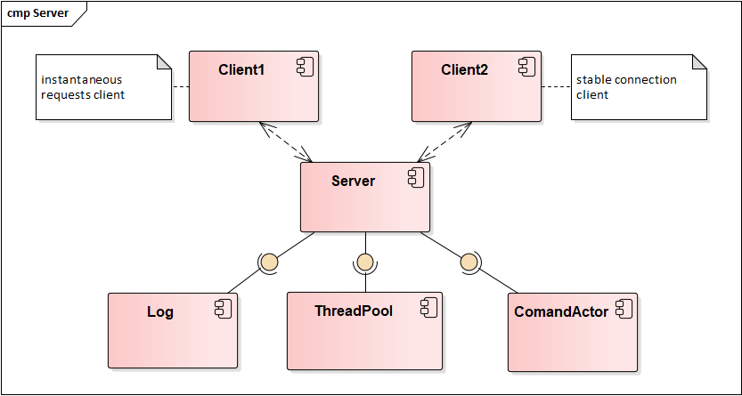
Component Model

Slide 4
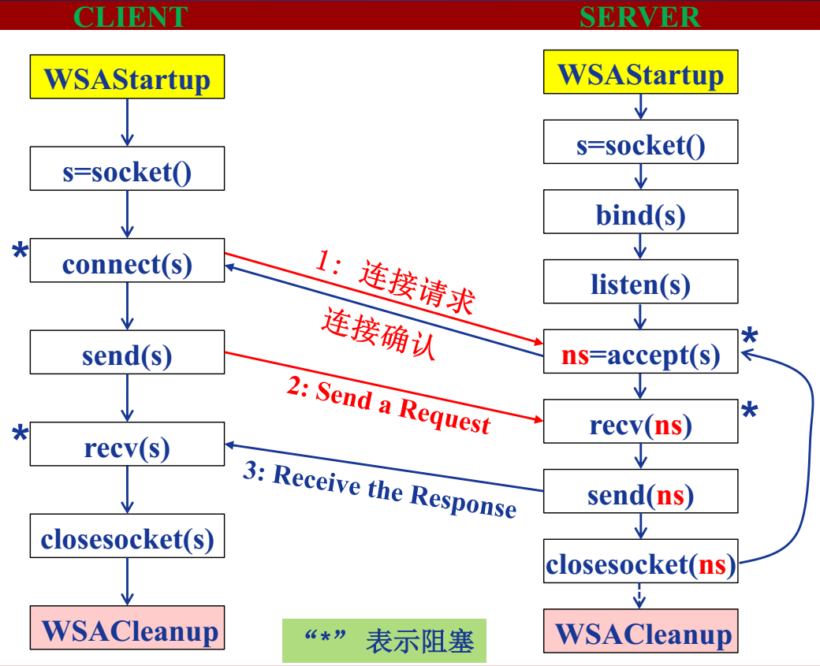
Design Model
Socket

Slide 5
Design Model
Server
Client1
Client2
Main
T1
T2
T3
Actor
Server

Slide 6
Design Model
Thread Pool
Thread Pool
Notify
Wait
T1
Task
Q1
Q2
Q3
T2
T3

Slide 7
Design Model
Log & Actor
Producer
Consumer
Task1
T1
Thread-Safe
Q1
Q2
Q3
T2
Task2
T3

Slide 8
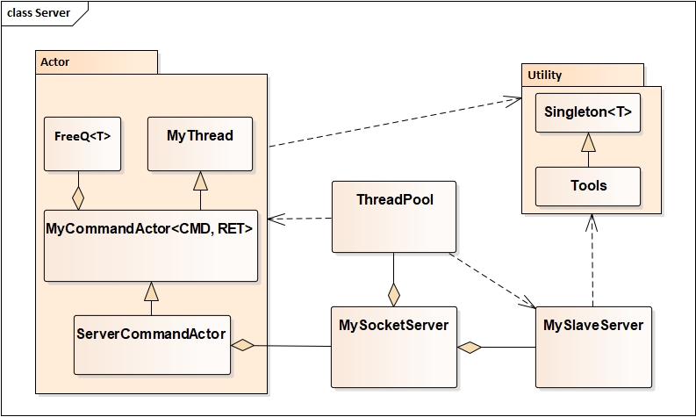
Class Model
Server

Slide 9
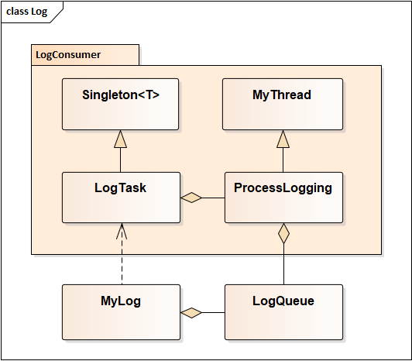
Class Model
Log

Slide 10
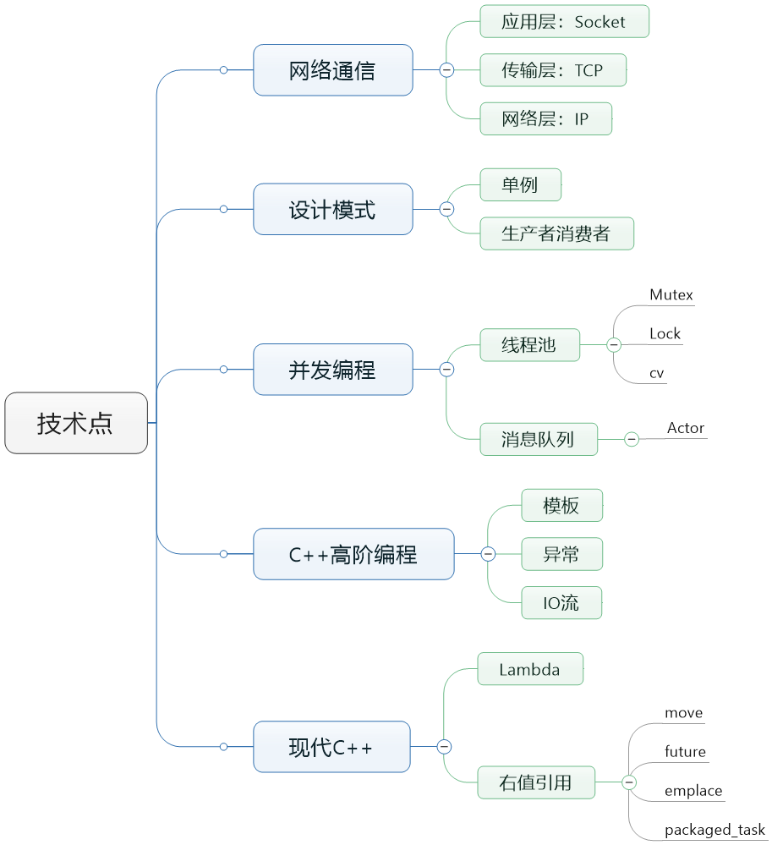
Summary
Technique

Slide 11
Thank you

