Slide 1

Project-HAMi(https://github.com/Project-HAMi/HAMi)
Heterogeneous AI Computing Virtualization Middleware(HAMi)
MengXuan Li(@archlitchi) - Senior Software Engineer at 4paradigm

Slide 2

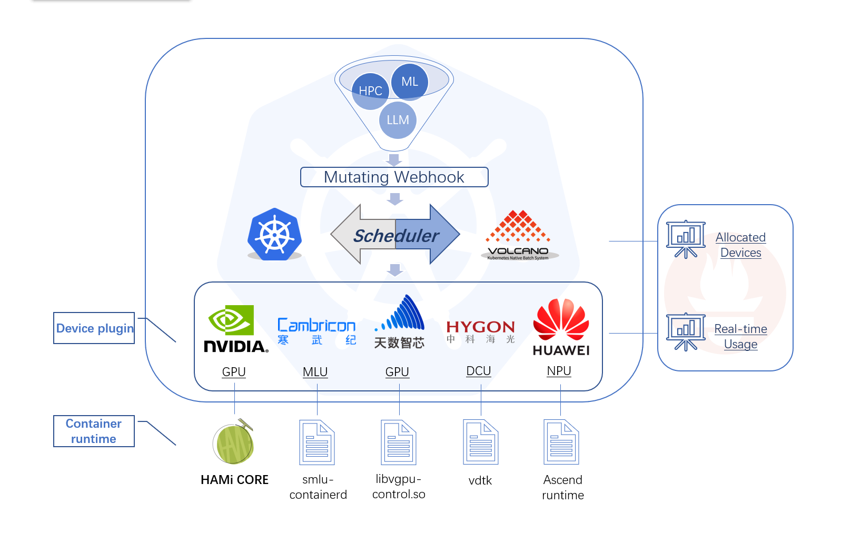
Project-HAMi：Architect

Slide 3
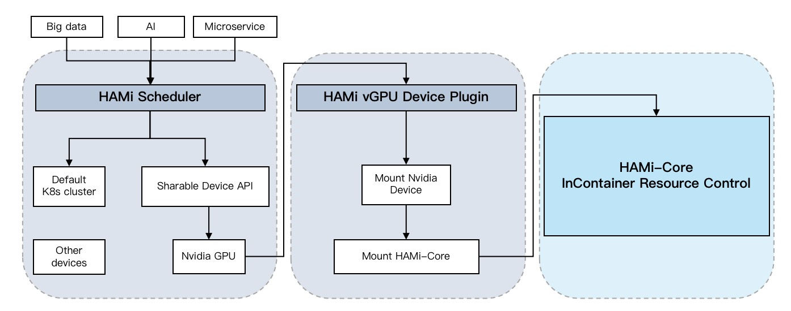
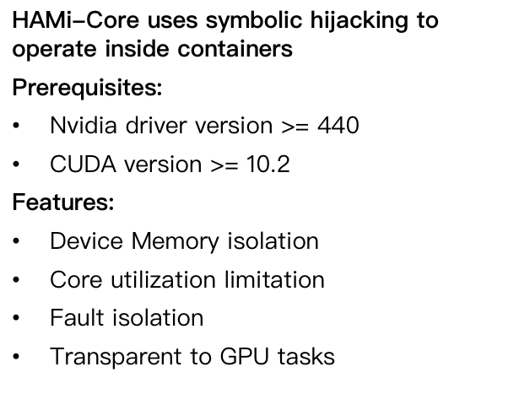
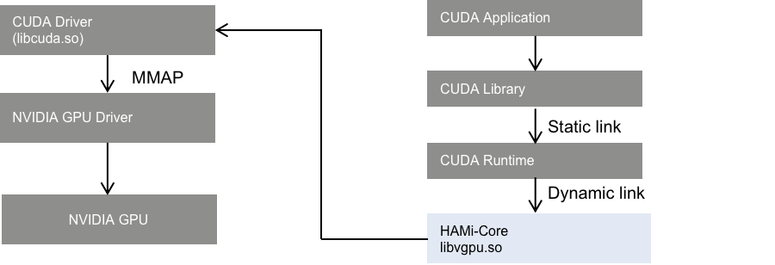
Project-HAMi：Architect

Slide 4
Contributing
Contributing Ladder: https://github.com/Project-HAMi/community/blob/main/CONTRIBUTOR-LADDER.md
Roles: Contributer, Member, Reviewer, Approver, Maintainer
Privileges: HAMi-related CNCF activities, HAMi-Hosted events

Slide 5
Developing
Refer to Developer guide in website: https://project-hami.io/docs/developers/build
Add Unit Test, Add documents is a good start
New Features need to be discussed in weekly meeting.

Slide 6
HAMi v2.5 new features
Dynamic MIG/MPS besides HAMi-core for selection
Detailed events for scheduling failure
Support Heterogeneous AI Computing devices in webui.
Support for Baidu Kunlun device sharing
Estimated release in Jan/2026

