Slide 1

基本原理
数据库是一个组织整体的一部分。好的数据库开发者应该能够高效地设计和实现数据库。
这些知识将使开发者能够创建健壮的数据库解决方案。
此模块将帮助学员理解关系数据库的相关概念。
Notes:
Student already have learnt about SCDs in Module I. Therefore, you can start this topic by asking the following questions to students:
What are type 1 SCDs?
Given an example to explain type 1 SCDs.
This will recapitulate what they have learnt about type 1 SCD in Module 1.
Now explain the strategy to load the data into these dimension tables with help of the given diagram. Relate this diagram to the example given in SG.

Slide 2
目标
在本章中，您将学习：
  定义数据库管理系统
  描述数据模型类型
  创建实体关系模型
  列出实体之间的关系类型
  定义关系数据库管理系统
  描述作用于关系的操作符
Notes:
Students have learnt the structure of different types of dimensions and the importance of surrogate keys in Module I. In this session, students will learn to load the data into the dimension tables after the data has been transformed in the transformation phase. In addition, students will also learn to update data into these dimension tables.
Students already know about different types of dimension tables. Therefore, you can start the session by recapitulating the concepts. Initiate the class by asking the following questions:
1. What are the different types of dimensions?
2. Define flat dimension.
3. What are conformed dimension?
4. Define large dimension.
5. Define small dimension.
6. What is the importance of surrogate key in a dimension table?
Students will learn the loading and update strategies theoretically in this session. The demonstration to load and update the data in the dimension table will be covered in next session.

Slide 3
数据库管理系统
数据库 是一个逻辑上相关的信息的集合。
数据库管理是一个维护数据库以便信息能够使用的任务。
执行数据库管理任务所需的软件称为数据库管理系统(DBMS)。
Notes:
Students know the importance of surrogate keys. In this session students will learn the strategy to generate the surrogate key. Give an example to explain the strategy to generate the surrogate keys by concatenating the primary key of the source table with the date stamp. For example, data from a Product table has to be loaded into the Product_Dim dimension table on Feb 09, 2006. The product_code is the primary key column in the Product table. To insert the surrogate key values before loading the data into the dimension table, you can combine the primary key value with the date on which the data has to be loaded. In this case the surrogate key value can be product_code+09022006.

Slide 4
数据模型
数据模型可以分成两类：
  基于对象的逻辑模型：着重于描述数据、数据以及为数据定义的约束之间的关系。
  基于记录的逻辑模型：着重于描述数据库管理系统中的数据结构和访问技术。
Notes:
Students know what is the structure of Flat dimension. You can initiate the session by asking the following questions:
1. What are flat dimension tables?
2. What is the structure of flat dimension?
3. Given examples of a flat dimension?
Next, tell the strategy to load the data into the flat dimension table. You can explain the loading strategy with the help of the example given in SG.
Continue this session by asking the following questions:
4. What are large flat dimension tables?
5. Give examples of large flat dimensions?
Then, explain the strategy to load data into the large flat dimension table.
Before explaining the strategy to load data into the small dimension table ask the following questions and the tell the strategy to load the data into the dimension table.
6. What are small flat dimension tables?
7. Give examples of small flat dimension tables.
With the help of these questions, students will be able to recall about flat dimensions, they have learnt in Module I.
Explain this topic with the help of an example given in SG.

Slide 5
基于对象的逻辑模型
有各种基于对象的模型。最常用的是由Peter Chen 在1976年引入的实体关系 (ER) 模型。
Notes:
Explain the strategy to load the data into conformed dimension with help of an example to load the data in the date dimension given in SG.
Explain the strategy to load the data into the Snowflaked dimension with the help of an example given in SG.

Slide 6
实体
Chen 将实体 定义为“可以简单识别的物体”。
实体是任何一个对象、位置、人物或记录数据的操作。
在图表技术中，实体在框中命名和表示。
实体类型是一组共享公共项目的项：
  STUDENT、COURSE 和 GRADE是实体类型的例子。
  实体类型通常是大写的。
Notes:
Explain the strategy to load the data into conformed dimension with help of an example to load the data in the date dimension given in SG.
Explain the strategy to load the data into the Snowflaked dimension with the help of an example given in SG.

Slide 7
实体（续）
实体的类型：
  相关实体：
    一个实体的存在要依赖于另一个实体的存在，那么这个实体称为相关实体。它也称为弱实体。
  独立实体：
    独立实体不依赖于任何其他实例的存在。它也称为常规实体。
Notes:
Explain the strategy to load the data into conformed dimension with help of an example to load the data in the date dimension given in SG.
Explain the strategy to load the data into the Snowflaked dimension with the help of an example given in SG.

Slide 8
关系
Chen 将关系定义为“实体之间的联系”。
  例如，在学生和老师之间有一个关系。这个关系代表老师可以教几个学生，而学生可以由几个老师教。这个关系可命名为 TEACH。
用一个带有关系类型名称的菱形来描述关系。
Notes:
Explain the strategy to load the data into conformed dimension with help of an example to load the data in the date dimension given in SG.
Explain the strategy to load the data into the Snowflaked dimension with the help of an example given in SG.

Slide 9
关系（续）
关系类型是实体类型的联合 （STUDENT-INSTRUCTOR）。
关系可以将实体本身联系起来。例如，学校的老师可以和另一位老师结婚。
相同实体中可以存在多个关系。
Notes:
Explain the strategy to load the data into conformed dimension with help of an example to load the data in the date dimension given in SG.
Explain the strategy to load the data into the Snowflaked dimension with the help of an example given in SG.

Slide 10
课间思考
从某个案例中抽取了以下语句，这个案例是有关一个生产厂商的数据维护：“供应商供应某些部件”。请确定此语句中涉及的实体和它们之间的关系。请画图描述。

Slide 11
课间思考（续）
答案：
  实体： SUPPLIER, PARTS
  关系： SHIP （或 SHIPMENT)
SUPPLIERS
SHIP
PARTS

Slide 12
关系类型
有三种关系类型：
  一对一
  一对多（或多对一）
  多对多
Notes:
Student already have learnt about SCDs in Module I. Therefore, you can start this topic by asking the following questions to students:
What are type 1 SCDs?
Given an example to explain type 1 SCDs.
This will recapitulate what they have learnt about type 1 SCD in Module 1.
Now explain the strategy to load the data into these dimension tables with help of the given diagram. Relate this diagram to the example given in SG.

Slide 13
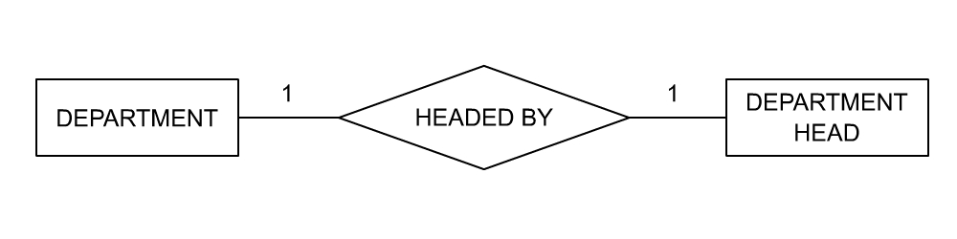
一对一关系
请考虑一个学校示例。对于某个DEPARTMENT（如社会科学系），只有一位DEPARTMENT HEAD。这就是一对一关系的示例。
Notes:
Student already have learnt about type 2 SCDs in Module I. Therefore, you can start this topic by asking the following questions to students:
What are type 2 SCDs?
Given an example to explain type 2 SCDs.
This will recapitulate what they have learnt about type 2 SCD in Module 1.
Now explain the strategy to update the data into these dimension tables with help the example given in SG.
After explaining the examples, you can ask students to think of an example of a type 2 SCD and then tell the strategy to update the data into this dimension table.

Slide 14
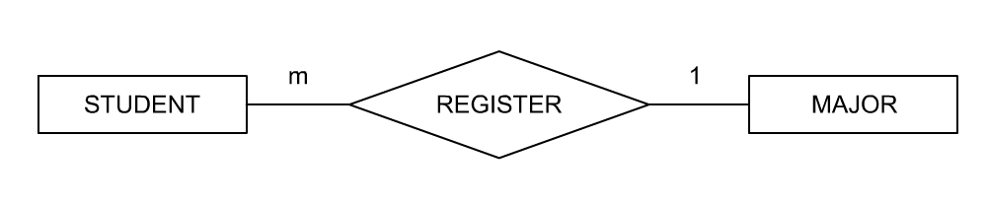
多对一关系
STUDENT 可以MAJOR一个课程，但是许多STUDENT 可以同时注册一个给定的MAJOR 课程。这就是多对一的关系。
Notes:
Student already have learnt about type 2 SCDs in Module I. Therefore, you can start this topic by asking the following questions to students:
What are type 2 SCDs?
Given an example to explain type 2 SCDs.
This will recapitulate what they have learnt about type 2 SCD in Module 1.
Now explain the strategy to update the data into these dimension tables with help the example given in SG.
After explaining the examples, you can ask students to think of an example of a type 2 SCD and then tell the strategy to update the data into this dimension table.

Slide 15
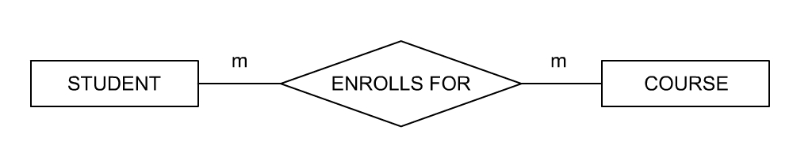
多对多关系
一个STUDENT 可以上多门 COURSE。多个STUDENT 可以注册一门给定的COURSE。这就是多对多的关系。
Notes:
Student already have learnt about type 2 SCDs in Module I. Therefore, you can start this topic by asking the following questions to students:
What are type 2 SCDs?
Given an example to explain type 2 SCDs.
This will recapitulate what they have learnt about type 2 SCD in Module 1.
Now explain the strategy to update the data into these dimension tables with help the example given in SG.
After explaining the examples, you can ask students to think of an example of a type 2 SCD and then tell the strategy to update the data into this dimension table.

Slide 16
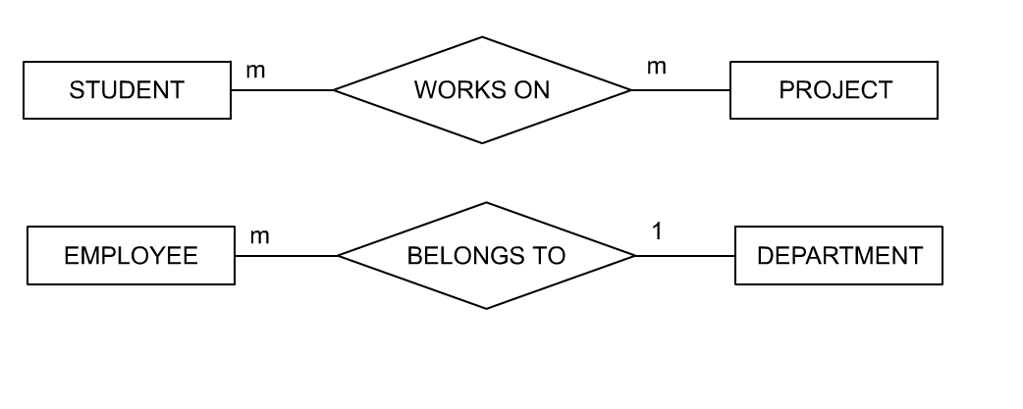
课间思考
以下 ER 图代表什么？

Slide 17
课间思考（续）
答案：
  多个学生可以进行多个项目。
  多个员工仅属于一个部门。

Slide 18
课间思考
请注意生产公司的以下语句：
“供应商供应一些部件。某个特定部件不必要仅由一个供应商来供应，没有一个供应商只供应一个部件。”
这是一种什么关系？请画图描述。
答案：
  多对多类型
SUPPLIER
m
m
SHIP
PARTS

Slide 19
属性
属性是给定实体的特性。
属性可以用椭圆表示，其中标有属性名。
Notes:
Student already have learnt about type 3 SCDs in Module I. Therefore, you can start this topic by asking the following questions to students:
What are type 3 SCDs?
Given an example to explain type 3 SCDs.
This will recapitulate what they have learnt about type 3 SCD in Module 1.
Now explain the strategy to update the data into these dimension tables with help the example given in SG.
After explaining the examples, you can ask students to think of an example of a type 3 SCD and then tell the strategy to update the data into this dimension table.
You can now ask the student to explain the difference between the update strategy for all the three SCDs.
You can also ask students to think of a scenario where you have a type 3 SCD and then ask them how to update the data in such dimension tabels.
Also tell student that they will learn to load data into these dimension table using SSIS.

Slide 20
课间思考
厂商需要维护以下有关供应商的详细信息：
a. 名称
b. 地址
c. 信用状态
d. 分配的代码号
请画出一张描述这些信息的图。

Slide 21
课间思考（续）
答案：
代码
名称
供应商
添加
CR_STATUS

Slide 22
子类型和超级类型
子类型：
  子类型是另一个实体的子集。它的存在始终依赖于超级类型。
  子类型通过未命名的关系连接到超级类型。
超级类型：
  超级类型通过一条包含交叉栏的线条连接到关系成员。
  超级类型由属于所有子类型的属性来描述。子类型由其唯一的属性来描述。

Slide 23
课间思考
有两种类型的供应商。一种供应商允许用信用卡支付，而另一种坚持在发货之前现金支付。厂商希望对这两种类型的供应商维护不同的信息，对于信用支付的供应商需要记录“信用周期”和 “信用极限”，对现金支付的供应商，需要存储“支付日期”。请用图形来表示。
答案：
供应商
现金
信用
PAY_DT
CR_LIMIT
CR_PERIOD

Slide 24
基于记录的逻辑模型
三种基于记录的模型类型是：
  分层模型
    在分层模型中，数据以树的形式表示。
  网络模型
    网络模型类似于这样一个分层模型，在模型中，数据和数据之间的关系以记录和链接的形式表示。
  关系模型
    在关系模型中，数据库中的表有固定的记录长度和固定数量的属性或字段。
Notes:
Student already have learnt about SCDs in Module I. Therefore, you can start this topic by asking the following questions to students:
What are type 1 SCDs?
Given an example to explain type 1 SCDs.
This will recapitulate what they have learnt about type 1 SCD in Module 1.
Now explain the strategy to load the data into these dimension tables with help of the given diagram. Relate this diagram to the example given in SG.

Slide 25
关系模型
Dr. E. F. Codd 第一次描述关系模型是在1970 年。
关系模型是一种简化数据库结构的尝试。
它将数据库中的所有数据表示为以行和列为格式的一张简单表。
RDBMS 可以定义为数据库关系系统，其中用户可见的所有数据都严格以数据值表的形式组织，所有数据库操作都是在这些表上完成的。
Notes:
Student already have learnt about SCDs in Module I. Therefore, you can start this topic by asking the following questions to students:
What are type 1 SCDs?
Given an example to explain type 1 SCDs.
This will recapitulate what they have learnt about type 1 SCD in Module 1.
Now explain the strategy to load the data into these dimension tables with help of the given diagram. Relate this diagram to the example given in SG.

Slide 26
关系数据结构
关系数据库中的组织原则是表，数据值在表中是行列排列的：
  表称为关系。
  表中的行（或记录）称为元组。
  列（或字段）称为属性。
  元组数称为表为基数，属性号称为表的等级。
  行是无序的，并且每行必须有能够唯一识别表中每个行的一些列或列的组合。该列（或多个列）称为表的主键。
域是一个值池，从该池中，一个或多个属性（列）绘制它们的实际值。
Notes:
Student already have learnt about SCDs in Module I. Therefore, you can start this topic by asking the following questions to students:
What are type 1 SCDs?
Given an example to explain type 1 SCDs.
This will recapitulate what they have learnt about type 1 SCD in Module 1.
Now explain the strategy to load the data into these dimension tables with help of the given diagram. Relate this diagram to the example given in SG.

Slide 27
代表缺少的信息
在 RDBMS 中，缺少或未知信息在表中用 NULL 表示：
  NULL 不是一个空格或0。
Notes:
Student already have learnt about SCDs in Module I. Therefore, you can start this topic by asking the following questions to students:
What are type 1 SCDs?
Given an example to explain type 1 SCDs.
This will recapitulate what they have learnt about type 1 SCD in Module 1.
Now explain the strategy to load the data into these dimension tables with help of the given diagram. Relate this diagram to the example given in SG.

Slide 28
代表 RDBMS 中的关系
在任何给定的时间，表中的两行不能在列或列组合中包含相同的值。该列（或多个列）称为表的主键。
一个表中某列的值匹配其他表中的主键，则这个列称为外键。
主键和外键一起创建连接其表之间的父子关系。
Notes:
Student already have learnt about SCDs in Module I. Therefore, you can start this topic by asking the following questions to students:
What are type 1 SCDs?
Given an example to explain type 1 SCDs.
This will recapitulate what they have learnt about type 1 SCD in Module 1.
Now explain the strategy to load the data into these dimension tables with help of the given diagram. Relate this diagram to the example given in SG.

Slide 29
关系操作符
关系模型基于关系代数的原理：
  关系代数是操作关系的操作符集合。
  每个操作符将一个或两个关系作为其输入，然后产生一个新的关系作为其输出。
关系操作符有以下类型：
  RESTRICT：根据某个条件从给定的关系中抽取指定的元组或行。
  PROJECT：从给定关系中抽取指定的属性或列。
  PRODUCT：从两个指定的关系中构建一个关系。它包括这两个关系中的元组所有可能的组合，即，两个关系中每个元组彼此组合。
Notes:
Student already have learnt about SCDs in Module I. Therefore, you can start this topic by asking the following questions to students:
What are type 1 SCDs?
Given an example to explain type 1 SCDs.
This will recapitulate what they have learnt about type 1 SCD in Module 1.
Now explain the strategy to load the data into these dimension tables with help of the given diagram. Relate this diagram to the example given in SG.

Slide 30
关系操作符（续）
  UNION：从指定的一个或两个关系中都出现的元组中构建关系。要实现 union 兼容，两个表应该具有相同类型的属性。
  INTERSECT：构建一个关系，该关系包括两个关系中都出现的元组。
  DIFFERENCE：构建两个指定关系中第一个但不是第二个关系中出现的元组关系。
  JOIN：从两个指定的关系构建一个关系。此关系包括两个关系中满足指定条件的元组的所有可能组合。
  DIVIDE：Divide 操作符采用两个关系并构建另一个关系，此关系包括一个与其他关系中所有值相匹配的关系的属性值。DIVIDE 操作是PRODUCT 操作的反操作。
Notes:
Student already have learnt about SCDs in Module I. Therefore, you can start this topic by asking the following questions to students:
What are type 1 SCDs?
Given an example to explain type 1 SCDs.
This will recapitulate what they have learnt about type 1 SCD in Module 1.
Now explain the strategy to load the data into these dimension tables with help of the given diagram. Relate this diagram to the example given in SG.

Slide 31
RDBMS的应用程序
RDBMS 的一些典型的应用程序是：
  飞机票和火车票预定
  银行应用程序
  制造业
  订单处理
  医院管理系统
  图书馆管理系统
  旅馆业
Notes:
Student already have learnt about SCDs in Module I. Therefore, you can start this topic by asking the following questions to students:
What are type 1 SCDs?
Given an example to explain type 1 SCDs.
This will recapitulate what they have learnt about type 1 SCD in Module 1.
Now explain the strategy to load the data into these dimension tables with help of the given diagram. Relate this diagram to the example given in SG.

Slide 32
RDBMS的应用程序（续）
当今有几个可用的 RDBMS 产品。一些流行的产品是：
  Sybase
  Oracle
  Microsoft SQL Server
  Ingress
  DB2
Notes:
Student already have learnt about SCDs in Module I. Therefore, you can start this topic by asking the following questions to students:
What are type 1 SCDs?
Given an example to explain type 1 SCDs.
This will recapitulate what they have learnt about type 1 SCD in Module 1.
Now explain the strategy to load the data into these dimension tables with help of the given diagram. Relate this diagram to the example given in SG.

Slide 33
小结
在本章中，您学习了：
  数据模型可分成：
    基于对象的模型
    基于记录的模型
  在 ER 图表技术中：
    实体用矩形表示。
    关系用菱形表示。
    属性用椭圆表示。
  多对多、一对多或一对一关系可以用符号表示。
  弱实体用双线框表示。
  子类型通过未命名的、上面标记为交叉栏的关系连接到超级类型。
Notes:
You can summarize the session by running through the summary given in SG.
In addition, you can also ask students summarize what they have learnt in this session.

Slide 34
小结（续）
  在关系模型中，数据在表（关系）的行（元组）和列（属性）中表示。
  元组数称为表的基数，属性数称为表的级别。
  每个元组中唯一的属性（或属性集）称为主键。
  未知或缺少的信息在表中用 NULL 表示。
  外键是表中与另一个表的主键相匹配的列。
  关系模型基于关系代数的原理。
  对关系执行操作的八个操作符是：restrict、project、product、union、intersect、difference、join 和divide。
Notes:
You can summarize the session by running through the summary given in SG.
In addition, you can also ask students summarize what they have learnt in this session.

