Slide 1

目标
在本章中，你将学到：
  创建和管理索引
Notes:
Begin the session by sharing the objectives with the students.

Slide 2
识别索引类型
Flash演示：实现索引
索引：
  索引是一个与表相关联的数据结构
  确保快速访问数据
  加快连接表的查询和完成排序和分组
  增强行的唯一性
  包含存储在内存B-树中的一组键和指针
Notes:
In this topic, you need to explain the concept of indexes to the students. While teaching the topic, you need to stress on the following points:
Importance of naming conventions while creating indexes.
Advantages of using indexes.
Creating appropriate indexes for appropriate columns.
Mention that indexes are used to speed up queries and are created on columns that are used in joins, the WHERE clause, the ORDER BY clause, or the GROUP BY clause.
Additional Inputs
If a primary key constraint is not created, then a unique clustered index can be used to implement the primary key and entity integrity. However, a foreign key constraint cannot reference such a column since a primary key constraint is not defined. However, in such cases, referential integrity can be implemented from the child table by using a trigger.
Creating multiple indexes on a column is not a good practice.
Indexes created by creation of constraints like the Primary key or Unique cannot be dropped by using the DROP INDEX statement. To drop these indexes, you need to drop the constraint.
In a SELECT statement without a WHERE clause, indexes belonging to the column mentioned first in the select list are used.
A unique index enforces uniqueness on the column for which it is mentioned. If nulls are allowed, it will allow only one NULL. A second null value will become a duplicate. A unique index can be clustered or non-clustered, the default is clustered.
While creating an index, the FILLFACTOR can be mentioned. The FILLFACTOR is a percentage to which the leaf level pages of the index are filled up. Similarly, PAD INDEX can be used to mention the number of non-leaf level pages that are filled. PAD INDEX cannot be used without fillfactor. A separate percentage value cannot be mentioned for PAD INDEX as it takes the fillfactor value only.

Slide 3
识别索引类型（续）
索引有两种类型：
  簇索引：它基于它们的键值排序和存储表中的数据行。
  非簇索引：包含索引键值和行定位器，它指向表中数据的存储位置。因此，在非簇索引中，行的物理顺序与索引顺序不同。
Notes:
In this slide, you need to explain to the students about a clustered index and a nonclustered index. Do not provide details on the type of indexes as they will be discussed later in the slides.

Slide 4
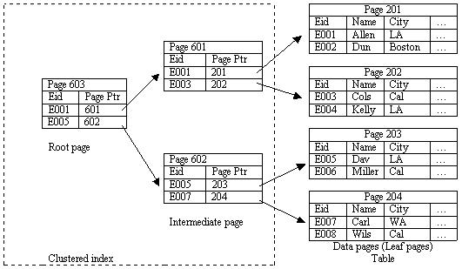
识别索引类型（续）
簇索引的工作过程：
Notes:
In this slide, you need to explain how a clustered index searches for a particular string. You can refer to the Student Guide to explain the steps.

Slide 5
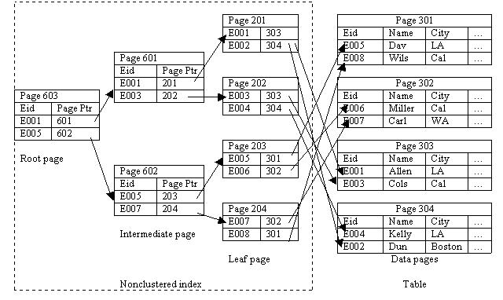
识别索引类型（续）
非簇索引的工作过程：
Notes:
In this slide, you need to explain how a nonclustered index searches for a particular string. You can refer to the Student Guide to explain the steps.

Slide 6
创建索引
索引：
  在表中最常查询的列上创建索引
  基于一列或多列的索引被称为组合索引
  可以使用CREATE INDEX语句创建索引
Notes:
In this slide, you need to explain the guidelines to be followed while creating an index.

Slide 7
创建索引（续）
语法 ：
  CREATE [UNIQUE][CLUSTERED | NONCLUSTERED] INDEX
  index_name
  ON [{database_name.[schema_name]. | schema_name.}]
  {table_or_view_name}(column [ASC | DESC][,...n])
  [INCLUDE (column_name [,...n])]
  [WITH(<relational_index_option>[,...n])]
  [ON {partition_scheme_name(column_name[,...n])
  | filegroup_name | DEFAULT}]
Notes:
In this slide, you need to explain the syntax of the CREATE INDEX statement. In addition, you need to describe the various parameters of the CREATE INDEX statement.
In this session, you will not teach the topic on creating XML indexes (given in the book). However, you can ask the students to read the topic at home. The concept will not be tested in the MT.
CG Input: Before creating any index, please log on by using sa and execute the CreateTable.sql data file present in the Chapter 6\Instep Demo folder.

Slide 8
创建索引（续）
  <relation_index_option>::= {PAD_INDEX = {ON | OFF}
  | FILLFACTOR = fillfactor | SORT_IN_TEMPDB = {ON | OFF}
  | IGNORE_DUP_KEY = {ON | OFF}
  |STATISTICS_NO_RECOMPUTE = {ON | OFF}
  | DROP_EXISTING = {ON | OFF} | ONLINE = {ON | OFF}
让我们看看如何…
Notes:
You can use the examples given in the Student Guide to clarify the concept to the students. Further, you can execute the following statements to explain the concept:
Example: CLUSTERED INDEX
CREATE CLUSTERED INDEX IX_EmployeeID
ON Employee (EmployeeID)
WITH FILLFACTOR = 10
Example: NONCLUSTERED INDEX
CREATE NONCLUSTERED INDEX IDX_Employee_ManagerID
ON Employee (ManagerID)

Slide 9
创建 XML 索引
XML 索引：
  可以创建在存储XML数据值的列上
  仅支持单一XML列上的索引
  有两种类型：
    主XML索引
    第二XML索引
Notes:
In this slide, you need to explain the concept the XML Indexes to the students.

Slide 10
课间思考
哪种类型的索引实现物理的数据排序?
答案：
  簇索引
Notes:
Reiterate the concepts taught earlier by asking the given question.

Slide 11
课间思考
哪种类型的XML索引首先要在表上创建?
答案：
  主XML索引
Notes:
Reiterate the concepts taught earlier by asking the given question.

Slide 12
课间思考
下面哪个被用于指定每个索引页的空间百分比?
  1. 填充因子
  2. 填充索引
  3. 路径索引
  4. 值索引
答案：
  1. 填充因子
Notes:
Reiterate the concepts taught earlier by asking the given question.

Slide 13
管理索引
包括：
  禁止索引
  使能索引
  重命名索引
  删除索引
  优化索引
让我们看看如何…
Notes:
In this slide, you will explain how to disable, enable, rename, delete, and optimize indexes. You can use the examples given in the Student Guide to clarify the concept to the students. Further, you can execute the following statements to explain the concept:
Example: (Disabling indexes)
The following statement disables a nonclustered index, IdX_Employee_LoginID, on the Employee table:
ALTER INDEX IdX_Employee_LoginID
ON HumanResources.Employee DISABLE
Example: (Enabling indexes)
You can enable a disabled index by rebuilding it by using one of the following methods:
ALTER INDEX statement with the REBUILD clause
CREATE INDEX with the DROP_EXISTING clause
DBCC DBREINDEX
Example: (Renaming indexes)
The following statement renames the IX_JobCandidate_EmployeeID index in the JobCandidate table to IX_EmployeeID:
EXEC sp_rename 'HumanResources.JobCandidate.IX_JobCandidate_EmployeeID',
'IX_EmployeeID','index'
Example: (Dropping indexes)
The following statement drops the IX_JobCandidate_EmployeeID index in the JobCandidate table:
DROP INDEX IX_JobCandidate_EmployeeID
ON HumanResources.JobCandidate;
Example: (Optimizing indexes)
The following statement helps you identify an index that contains a high level of fragmentation in the Employee table:
SELECT a.index_id AS IndexID, name AS IndexName,
avg_fragmentation_in_percent AS Fragmentation
FROM sys.dm_db_index_physical_stats (DB_ID (N'AdventureWorks'),
OBJECT_ID ('HumanResources.Employee'), NULL, NULL, NULL) AS a
JOIN sys.indexes AS b on a.object_id = b.object_id and a.index_id = b.index_id ORDER BY Fragmentation DESC

Slide 14
演示：创建索引
问题描述：
  AdventureWorks, Inc的产品经理需要经常浏览产品模式中Product表的数据。他需要经常基于产品号搜索数据。
  Product表包含大量数据，因此查询花费时间去执行。为了减少执行查询花费的时间，你需要提出一个解决方案以提高性能。对于它，你需要在应用建议的解决方案之前和之后检查查询的性能。
Notes:
You need to ensure that after the end of this demo, the students are able to implement indexes in the tables.
To perform this demo, you need to provide the SHOWPLAN permissions to the user account that you are using to perform the demo.
CG Input: The table already contains an index on the ProductNumber column. The name of the index is AK_Product_ProductNumber. Therefore, before performing this demo, you need to ensure that you drop the existing index by executing the following statement:
DROP INDEX [AK_Product_ProductNumber] ON [Production].Product] WITH ( ONLINE = OFF )
In the task 3 of the demo, the execution plan will display an icon of a clustered index scan. You can inform the students that this index is applied on the ProductID column. However, an index is to be applied on the ProductNumber column.

Slide 15
演示：创建索引（续）
解决方案：
  为了解决上述问题，你可以在经常搜索数据的列上应用索引。为了应用索引，你需要完成下面的任务：
    1. 确定要索引的列。
    2. 使能查询执行计划的显示。
    3. 检查查询的I/O的花销。
    4. 创建索引以提高性能。
    5. 在查询执行中验证改进。

Slide 16
小结
在本章，你已经学到：
  索引被创建来增强查询的性能。
  有两种类型的索引，簇和非簇索引。
  使用CREATE INDEX语句创建索引。
  簇索引在属性上建立，属性的值是唯一的，并且不经常改变。数据在物理上是在簇索引中排序的。
  在非簇索引中，行的物理顺序与行索引顺序是不同的。
  非簇索引是使用CREATE INDEX语句创建的默认索引。
Notes:
You can summarize the session with the help of the Summary given in the Student Guide.
In addition, you can ask the students to summarize what they have learned in this session.

Slide 17
小结（续）
  XML索引是在带有XML数据类型的列上创建的。
  索引也可以基于值范围被分区。
  公共索引维护任务包括禁止、使能、重命名和删除索引。
Notes:
You can summarize the session with the help of the Summary given in the Student Guide.
In addition, you can ask the students to summarize what they have learned in this session.

