Slide 1

基本原理
用户界面是用户通过它与应用程序进行交互的手段。
基于Windows的应用程序的用户交互是通过Windows窗体和控件来实现的。
使用.NET框架进行GUI应用开发的目的是为了给学生提供真是的环境来学习Microsoft Windows窗体应用开发的核心技能。
Notes:
Share the rationale of the module with the students.

Slide 2
目标
在本章，你将学到：
  评价图形用户界面
  识别图形用户界面的控件
  了解.NET Framework的特性
  使用Visual Studio .NET集成开发环境来创建和执行Windows项目
Notes:
Start the session by sharing the session objectives with the students.

Slide 3
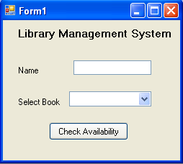
GUI环境介绍
与应用程序进行交互的两种方法是：
  通过使用字符用户界面（CUI）
  通过使用图形用户界面（GUI）
在CUI中用户通过键入命令与系统进行交互。
下图给出了通过使用CUI创建的一个应用程序的输出样例。
GUI提供了一种面向图片或图形化的方式与系统进行 交互。
下图给出了通过使用GUI创建的一个应用程序的输出样例。
Enter your name: John
Enter a book name: Famous Five
Sorry, The book is not available.
Do you want to check for another book (y/n):
Notes:
Start the session by discussing the features of CUI based application. Ask the students to list down the possible disadvantages of CUI applications. Collate the answers given by the students and list down the following points:
The user needs to enter the data.
The user needs to remember the commands.
Lengthy code has to be written for simple tasks.
The display area is restricted to 25 rows and 80 columns.
Now take the discussion towards the GUI . Discuss the advantages of GUI as being WYSIWYG (What you see is what you get).
Discuss with the students that there are several controls available in GUI that can be used to take input from the user. This input can be validated easily.

Slide 4
GUI 环境介绍（续）
GUI 应用程序的优势：
  更容易学习和使用。
  用户不需要记住复杂的语法。
  大多数命令都可以使用鼠标来执行。
Notes:
Discuss the advantages of GUI applications listed here.

Slide 5
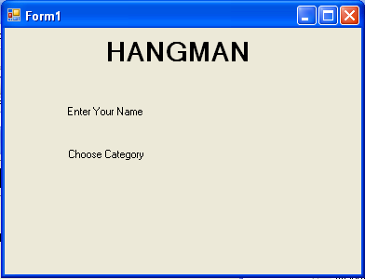
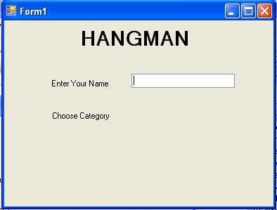
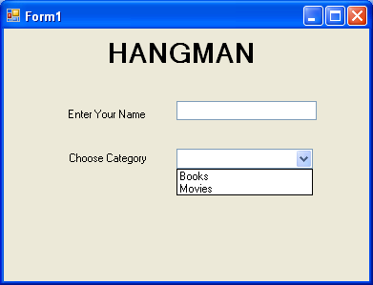
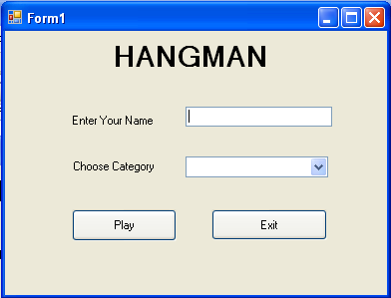
识别GUI界面的控件
一个典型的应用程序屏幕包含如按钮和文本框组件。
这些组件使你能够键入信息并定制其它参数。这些组件被称为控件。
下图给出了包含各种控件（如，标签、按钮、文本框和组合框）。
标签控件
文本框控件
组合框控件
按钮控件
Notes:
Some of controls that appear in the dialog box are explained in the following list.
Label: Displays text that users cannot directly edit.
TextBox: Accepts input from the user.
Combo Box: Displays items in a drop-down list. It is a combination of a text box in which a user types something, and a drop-down list from which the user selects an item.
Button: Provides options such as OK, Cancel etc.
Discuss with the students that there are 2 types of components, visual and non-visual components. Visual components are the ones which the users can see. They are also called as controls.

Slide 6
课间思考
____________ 是一种包含其他控件的控件。
答案：
  容器
Notes:
Reiterate the concepts taught earlier by asking the given question.

Slide 7
识别GUI界面的控件（续）
Windows提供如下类型的对话框：
  Modal （模态）
  System modal （系统模态）
  Modeless（非模态）
Notes:
Discuss all the three types of dialog boxes with the students with appropriate examples.
Example of:
Modal: Save As Dialog Box, that does not allow to move the control else where unless the user selects some option or closes the dialog box
System Modal : Windows Log On Dialog Box, that takes control of the entire Windows Environment.
Modeless: Find and Replace Dialog Box, that stays on screen and is available for use at any time.

Slide 8
课间思考
哪种对话框允许用户切换到应用程序的另一个区域？
答案：
  非模态对话框
Notes:
Reiterate the concepts taught earlier by asking the given question.

Slide 9
课间思考
__________充当一组相关控件的容器。
答案：
  对话框
Notes:
Reiterate the concepts taught earlier by asking the given question.

Slide 10
识别Windows环境的特性
允许应用程序与用户进行有效交互的Windows环境的最重要特性是：
  事件驱动编程：
    基于用户的输入产生一个事件并执行相应的代码。
  动态链接：
    Windows应用程序能够在运行时链接到现有库函数。
Notes:
Using this slide, discuss with the students that all windows based applications accept the input and process the input on the basis of an event. Take a simple example of adding two numbers. For this application, the user enters two numbers in the text boxes. Only when he clicks on the button, will he be able to see the results of addition. Here, clicking of a button is an example of an event being generated.
Now proceed the discussion towards another example of Student’s Data Entry form. After entering all the values in the required fields, the user needs to ensure the data is transferred into the database. The code to transfer the database will be written on the click event of the button. Therefore, after entering the data, the user needs to click on the button to transfer the data to the database.
In addition, also discuss with the students that Windows Applications allow to link the application to the existing library function. For example, there is a library function to connect to the desired database where the user needs to just specify the name and location of database. Therefore, instead of writing the code again and again, the user can use the in-built function and connect to the database quickly.

Slide 11
.NET Framework
.NET提供了用于开发和部署应用程序的完整套件。
该套件包括：
  .NET 产品
  .NET 服务
  .NET 架构
Microsoft已经引入了Visual Studio .NET，它是一个通过使用诸如Visual Basic、Visual C#和Visual C++这样的编程语言开发.NET应用程序的工具。
这些产品的目的是允许开发人员创建众多的应用程序。
Notes:
Discuss with the students that .NET is a product that developers can use to easily build, debug, and deploy powerful applications. Visual Studio .NET includes a range of new features and enhancements for every type of developer, and offers key improvements directed at mobile device developers and enterprise developers.
The advantages of using Visual Studio .NET are:
It helps create powerful applications quickly and effectively.
Applications can span any platform or device.

Slide 12
.NET Framework （续）
.NET提供了用于开发和部署应用程序的完整套件。
该套件包括：
  .NET 产品
  .NET 服务
  .NET 架构
Microsoft已经推出了它自己的Web服务集，称为My Services。这些服务基于用于如Hotmail这样的Web应用程序的Microsoft Passport Authentication（护照身份验证）服务。
此服务允许用户通过将日历、电话簿、地址簿和个人资料链接到护照身份验证服务来访问数据。

Slide 13
.NET Framework （续）
.NET提供了用于开发和部署应用程序的完整套件。
该套件包括：
  .NET 产品
  .NET 服务
  .NET 架构
.NET架构是设计、开发和部署应用程序的基础。
它是一种一致和简化的编程模型，可以帮助您方便地构建健壮的应用程序。

Slide 14



.NET Framework的组件
下图说明了.NET Framework的不同组件。
CLR是所有使用.NET技术的程序的执行环境。
CLR通过将代码翻译成中间语言（Intermediate Language ，IL）以允许跨越不同的平台执行代码。
IL是一种CLR理解的低级语言。
.NET Framework 类库可以用于任何 .NET语言，如VB.NET、VC++ .NET和VC#。
.NET Framework类库由程序集中包含的命名空间组成。
在表示层中，.NET提供了三种用户接口。它们是Windows 窗体、Web 表单和控制台应用程序。
Notes:
Using this slide, discuss with the students that .NET Framework consists of 3 different components. Discuss each of the components one by one. Try to give an example of the components.

Slide 15
.NET Framework的组件（续）
.NET Framework的一些优点如下：
  一致的编程模型
  多平台应用程序
  多语言集成
  自动资源管理
  容易部署
Notes:
Using this slide discuss the advantages of .NET framework

Slide 16
使用Visual Studio .NET IDE
Visual Studio .NET IDE（集成开发环境）提供了一种用于开发各种应用程序的通用界面 。
IDE还提供了一个集中式的场所，用于为应用程序设计用户界面、编写代码以及编译和调试应用程序。
让我们了解.NET IDE的各种组件。
Notes:
Using this slide discuss the .NET IDE with the students. An effective way of explaining the IDE to the students will be to open the .NET windows application project and discuss each of the components including:
Windows Form Designer
Code Window
Toolbox
Properties Window
Solution Explorer Window
Error-view Window
Output Window
And the menu and toolbars available within the IDE.
The faculty should also discuss the following templates in .NET:
Windows Application
Class Library
Windows Control Library
Console Application
Device Application
Crystal Reports Application

Slide 17
课间思考
哪种模板为Pocket PC 2003或更新版本创建一个 .NET Compact Framework 2.0窗体应用程序？
1. Windows Control Library
  2. Class Library
  3. Device Application
  4. Web Control Library
答案：
  3. Device Application
Notes:
Reiterate the concepts taught earlier by asking the given question.

Slide 18
课间思考
哪种窗口可以显示Visual Studio .NET IDE中提供的各种特性的状态消息？
答案：
  Output 窗体
Notes:
Reiterate the concepts taught earlier by asking the given question.

Slide 19
课间思考
哪种窗口允许查看服务器的资源，如服务、进程和事件日志。
答案：
  Server Explorer 窗口
Notes:
Reiterate the concepts taught earlier by asking the given question.

Slide 20
Visual Studio .NET IDE中的导航特性
除了各种窗口, Visual Studio .NET IDE还提供三种导航特性。
包括：
  Docking（停靠窗口）
  Tabbed Navigation（标签导航）
  Auto Hide（自动隐藏）
让我们来了解Visual Studio .NET IDE的导航特性。
Notes:
While discussing the IDE, the faculty must also explain that .NET also provides three navigational features with almost all the windows. Demonstrate each of them for a better understanding of the features.

Slide 21
创建项目和解决方案
在Visual Studio .NET中，一个应用程序可以包含多个文件和文件夹。
为了高效地组织这些项，Visual Studio .NET提供了两种容器：
  项目
  解决方案
让我们看看如何创建项目和解决方案。
Notes:
The faculty must demonstrate the steps to create projects and solutions.

Slide 22
编译并执行项目
为了编译并执行应用程序，需要完成如下步骤：
  1. 选择Build→Build Solution或按下F6来编译应用程序。
  选择 Debug→Start Debugging或按下F5 来执行应用程序。
Notes:
While discussing the IDE, create a small form to demonstrate the IDE and at the same time build and execute the project so that the students are able to understand and remember the steps to do so.

Slide 23
小结
在本章中，你已经学到：
  Windows提供了一种允许用户通过使用图形组建与应用程序交互的GUI。
  Windows提供了三种类型的对话框：
    模态对话框
    系统模态对话框
    非模态对话框
  .NET架构有很多组件构成：
    公共语言运行库（CLR）
    .NET Framework 基类
    用户和程序接口
Notes:
You can summarize the session by using the summary given in the slides.
In addition, you can also ask students summarize what they have learnt in this session.

Slide 24
小结（续）
  Visual Studio 2005 IDE提供了一个用于在.NET Framework上开发各种应用程序的通用界面。
  在Visual Studio .NET中，一个应用程序可以包含一个或多个项，如文件和文件夹。.
  为了高效地组织这些项，Visual Studio .NET提供了两种容器：项目和解决方案。
  除了各种窗口，Visual Studio .NET IDE还提供了三种导航特性，它们是：
    停靠窗口
    标签导航
    自动隐藏

