Slide 1

目标
在本章，你将学到：
  使用Windows窗体
  使用Windows窗体控件
  使用剪贴板执行拖放操作
Notes:
Students have already learnt the basic syntax and program structure in C#. They have already designed console based application. Now the students will be familiarized with windows based applications.
Start the session by sharing the session objectives with the students.

Slide 2
Windows Forms介绍
Windows Forms（窗体）表示在应用程序中显示的任何窗口。
窗体用于接受用户的输入并显示录入的信息。
当为Windows应用程序创建一个新的项目时，将一个窗体自动添加到项目中。该窗体的默认名为Form1.cs。
Windows中的每个窗体都是从System.Windows.Forms 命名空间的Form类派生而来的类。
Notes:
The students have already understood the difference in CUI and GUI applications. Also, they are aware of the advantages of the GUI applications as being more user friendly. Therefore, the faculty should start the session with the same concept of designing GUI applications. In order to design these applications the students require Windows Form. This is a container that can contain other controls such as a label, textbox, button, list box etc.
Explain the concept of form by taking a real life example. Compare this with the Admissions form to be filled by students to take admission in a university. Discuss with the students, that each students is handed over a similar form to be filled. This reduces the ambiguity, as otherwise each student will write details at their own will. This will make it difficult for the Admissions department to extract the required information.
Explain to the students that a form is added by default when a new windows application project is opened. The students can customize this form according to their requirements.

Slide 3
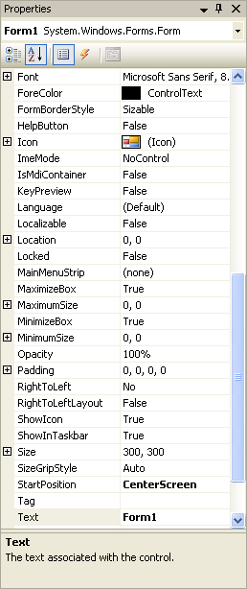
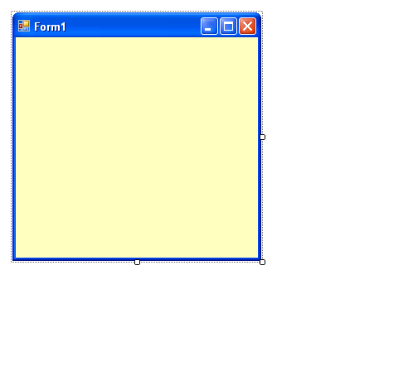
Windows Forms属性
Windows Forms的属性用来决定窗体在运行时的外观。
Font 属性用于为窗体的各种控件上显示的文本指定字体的样式、尺寸和类型。
Backcolor 属性用来指定窗体的背景颜色。
Size 属性用于指定窗体的高度和宽度。
StartPosition 属性用于指定屏幕上窗体的位置。
Text属性用于指定在窗体的标题栏中显示的标题。
Notes:
To customize the form, the students can use several properties of the forms. Some of these properties have been displayed here.

Slide 4
Windows Forms方法
Windows Forms方法允许您执行各种任务，如打开、激活和关闭窗体。
方法有：
Form1 frmObj = new Form1();
frmObj.show();
frmObj.hide();
frmObj.Activate();
frmObj.Close();
// 用来显示窗体。
Notes:
Besides properties, a Form control also has various methods that can be used to customize an application according to customer’s requirements. Here the faculty must display a demo form that helps the students to understand the way properties, methods, and events can be attached to a form.
The faculty can also display the purpose of the methods such as show(), hide(), close(), activate().

Slide 5
Windows Forms方法（续）
Windows Forms方法允许您执行各种任务，如打开、激活和关闭窗体。
方法有：
Form1 frmObj = new Form1();
frmObj.show();
frmObj.hide();
frmObj.Activate();
frmObj.Close();
// 用来隐蔽窗体。

Slide 6
Windows Forms方法（续）
Windows Forms方法允许您执行各种任务，如打开、激活和关闭窗体。
方法有：
Form1 frmObj = new Form1();
frmObj.show();
frmObj.hide();
frmObj.Activate();
frmObj.Close();
//用来激活一个窗体并在它上面设置焦点。

Slide 7
Windows Forms方法（续）
Windows Forms方法允许您执行各种任务，如打开、激活和关闭窗体。
方法有：
Form1 frmObj = new Form1();
frmObj.show();
frmObj.hide();
frmObj.Activate();
frmObj.Close();
//用来关闭窗体 。

Slide 8
Windows Forms 事件
当用户执行操作时会产生事件，如单击鼠标或按下键。
可以在一个特殊的称为事件处理程序（event handler）的方法内指定出现某事件时将要执行的操作。
在用户需要显式调用方法时，事件处理器方法中的代码在事件产生时同时执行。
窗体中使用的常见事件有：
  Click
  FormClosed
  Deactivate
  Load
  MouseMove
Notes:
In GUI programming, the most important thing is an event. Events can be used to perform an action. The faculties must explain to the students that all the controls have various events attached to them. For example, display a simple form to the students that is being to add two numbers. While creating this form do not insert any buttons. Insert only 3 labels and 3 textboxes ( to accept 1st number, 2nd number, display result).
Now insert numbers in the 1st and 2nd textbox.
After this ask the students, how will they be able to see the result. Collate the answers from the students.
Now add a button to the form and create code in the click event of the button.
With this example, you can discuss the importance of the events in a GUI application.

Slide 9
使用Windows窗体控件
控件是用于接受用户输入或在窗体上显示某些信息的组件。
每个控件都有它自己的一套属性、方法和事件，以便使它适合于完成某种特定的任务。
可以在设计期间通过使用Properties窗口来设置控件的属性。
还可以在运行时通过编写代码来设置控件的属性。

Slide 10
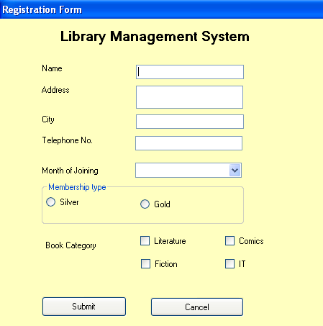
使用Windows窗体控件（续）
让我们识别窗体的各种控件。
标签控件
文本框控件
组合框控件
单选按钮控件
分组框控件
复选框控件
按钮控件
Notes:
The faculty must demonstrate all the commonly used controls with the help of a form. These have been shown in the given figure.

Slide 11
课间思考
下面哪种控件充当图像的存储库？
  1. PictureBox
  2. ListView
  3. ImageList
  4. ListBox
答案：
  3. ImageList

Slide 12
控件事件
与各种控件相关的事件可以分为如下几类：
  键盘事件
  鼠标事件
  控件特有的事件
例如，KeyDown、KeyUp、KeyPress
例如， MouseUP、MouseDown、MouseMove
例如， Resized、VisibleChanged
Notes:
Explain to the students that there are three basic categories of events. These are keyboard, mouse, and control-specific events. The keyboard events are generated when the keyboard keys are pressed or released. The mouse events are generated when the mouse keys are pressed or released. Mouse events are also generated when the mouse is rolled over a control. The control-specific events are associated to a particular control.
You can write the following code to demonstrate one of the keyboard events:
Create a text box on the form n then write the following code in the KeyPress event of the form:
private void textBox1_KeyPress(object sender, KeyPressEventArgs e)
{
MessageBox.Show("keypressed");
}
You can write the following code to demonstrate one of the mouse events. This code needs to be written in the MouseUp event of the form.
private void Form1_MouseUp(object sender, MouseEventArgs e)
{
MessageBox.Show("MouseUp");
}

Slide 13
在Windows窗体中动态加载空间
在运行时加载控件称为动态加载（dynamic loading）控件。
每个控件都是从System.Windows.Forms.Control 类派生得到的一个类。
为了在运行时添加控件：
  创建将要添加的控件的一个实例。
  设置该控件的属性。
  将新控件添加到父控件的Controls集合中。
让我们看看如何在运行时添加控件。
Notes:
Explain the concept of loading controls dynamically with the help of the following example:
The controls need to be dynamically loaded in an Order Detail Entry form. This is because one of the customer may have purchased five items while the other may have purchased 15 items. Now if the form contains only 10 text box controls to accept input, the user will not be able to enter details for all the items for the second customer in a single bill. He might have to create two bills. Therefore, to overcome such a problem, the user must have the flexibility to add as many text boxes as the number of items purchased by the customers at the run time.
In addition, the faculty must demonstrate an application that loads controls dynamically to the form.

Slide 14
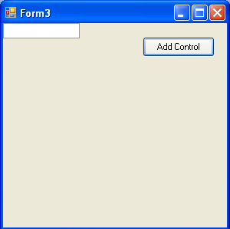
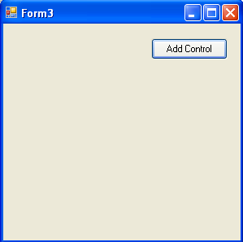
在Windows窗体中动态加载空间（续）
示例，要动态加载一个文本控件需要编写如下代码：
private void button1_Click(object sender, EventArgs e)
{
TextBox t1 = new TextBox();
this.Controls.Add(t1);
}

Slide 15
课间思考
写出在向窗体动态添加一个控件时需要采取哪些步骤？
答案：
  1.创建将要添加的控件的一个实例
  2.设置控件的属性
  3.将控件添加到父控件的Controls集合中

Slide 16
在运行时创建事件处理程序
如果在运行时将一个控件添加到窗体，那么在运行时创建事件处理程序是必需的。
当在运行时创建一个事件处理程序时，首先必须创建一个方法，该方法具有和希望处理的事件相同的参数。
然后必须将该事件与指定事件处理程序的代码联系起来。

Slide 17
演示：使用Windows窗体控件进行操作
问题描述：
  创建一个应用程序通过启动屏幕来接受用户名和口令。应用程序应该检查登录名是否为“sa”并且口令是“callcenter”。应该提供用户三次登录尝试，在三次不成功的登录尝试后，应用程序应该显示一个错误消息并关闭屏幕。
Notes:
Use this and the next slide to create an application containing Windows Forms Controls. Discuss with the students the various controls, methods, and events that are added within the form application.

Slide 18
演示：使用Windows窗体控件进行操作（续）
解决方案：
  为了创建登录窗体（Login Form），需要执行如下的任务：
    1. 创建一个新的VC#应用程序
    2. 设计应用程序窗体
    3. 添加验证用户的输入的代码
    4. 执行应用程序并检验输出

Slide 19
使用剪贴板执行拖放操作
拖放功能允许在一个应用程序中将对象从一个位置拖动到另一个位置。
Notes:
Before discussing this topic with the students, the faculty must demonstrate the drag-and-drop operation using any of the Windows based application such as wordpad or notepad.
Although the students would have already worked with the clipboard while working with MS-Word or MS-Exccel, the faculty should also discuss the features of clipboard with the students.
Using this and the next two slides, explain to the students that they can use a clipboard in their VC# applications with the help of Clipboard functions.

Slide 20
拖放操作事件
为了执行拖放操作，Windows Forms 应用程序需要处理如下事件：
  ItemDrag
  DragEnter
  DragOver
  DragDrop
  DragLeave
  GiveFeedback
Notes:
The faculty must also discuss these Drag-and-Drop operation events with the students.

Slide 21
拖放操作阶段
为了执行拖放操作，用户必须执行如下的一系列步骤：
  1. 通过调用控件的MouseDown或 ItemDrag 事件的DoDragDrop()方法来启动拖放操作。
  2. 处理事件以便向用户提供有关拖放操作的信息。这些事件包括DragEnter、DragLeave和GiveFeedback。
  3. 为了允许目标控件接受放置的数据，将它的AllowDrop 属性设为true。
  4. 在目标控件的DragDrop 事件中编写代码来指定如何处理放置的数据。
Notes:
Before discussing this topic with the students, the faculty must demonstrate the drag-and-drop operation using any of the Windows based application such as wordpad or notepad.
Although the students would have already worked with the clipboard while working with MS-Word or MS-Exccel, the faculty should also discuss the features of clipboard with the students.
Using this and the next two slides, explain to the students that they can use a clipboard in their VC# applications with the help of Clipboard functions.

Slide 22
在Windows窗体应用程序中提供剪贴板支持
剪贴板充当任何在Windows操作系统上运行的应用程序的临时存储区。
通过使用System.Windows.Forms.Clipboard类提供的方法，可以将剪贴板功能集成到VC#应用程序中。
有三种操作：
  将数据存储到剪贴板中
  识别剪贴板上的数据类型
  检索剪贴板中的数据
要将数据存储到剪贴板中，使用如 SetAudio(), SetData(), SetImage()方法
要识别剪贴板上的数据类型，使用如ContainsAudio(), ContainsData(), ContainsImage()方法
要检索剪贴板中的数据，使用如 GetAudioStream(), GetData(), GetImage()方法

Slide 23
课间思考
当用户将一个对象拖动到TreeView或ListView控件中时会出现哪个事件？
  1. DragEnter 事件
  2. DragOver事件
  3. GiveFeedback事件
  4. ItemDrag事件
答案
  4. ItemDrag 事件

Slide 24
在应用程序之间执行拖放操作
如下代码有助于用户在WordPad文件中键入文本框并在其窗体上的文本框控件中拖此文本框：
private void textBox1_DragEnter(object sender,DragEventArgs e)
{
if(e.Data.GetDataPresent(DataFormats.Text))
e.Effect = DragDropEffects.Copy;
else
e.Effect = DragDropEffects.None; }
Notes:
For the following example to be functional, you need to add a text box control named textBox1 to the form and write the given code in the corresponding textbox events

Slide 25
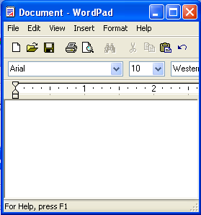
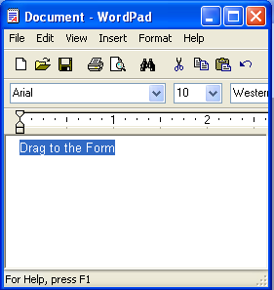
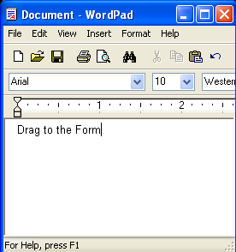
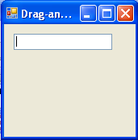
在应用程序之间执行拖放操作（续）
private void textBox1_DragDrop(object sender, DragEventArgs e)
{
textBox1.Text = e.Data.GetData(DataFormats.Text).ToString();
}
Drag to the Form

Slide 26
演示：执行拖放操作
问题描述：
  创建一个利用VC#提供的拖放特性的应用程序。使用TextBox和TreeView控件作为数据源，并使用ListBox控件作为目标控件。
  如何创建这个应用程序？
Notes:
Use this and the next slide to discuss the concept of drag-and-drop operations. Ask students to provide examples of different applications where these drag-and-drop operations can be used.

Slide 27
演示：执行拖放操作（续）
解决方案：
  为了创建展示拖放操作的应用程序，需要执行如下的任务：
    1. 创建一个新的VC# 应用程序。
    2. 设计应用程序窗体。
    3. 添加执行拖放操作的代码。
    4. 执行应用程序并验证输出。

Slide 28
小结
在本章中，你已经学到：
  使用窗体来接受用户输入并将信息重新呈现给用户。
  窗体具有很多属性、方法和事件。
  执行诸如单击鼠标或按下键盘中的某个键时会产生一个事件。
  当触发一个事件时，将执行事件处理程序中的代码。
  可以将控件添加到窗体中来接受用户的输入或在窗体上显示某些信息。
  一些常用的控件是TextBox、Label、CheckBox、RadioButton和Button控件。
  可以在设计时或运行时添加控件。
  拖放功能允许用户在窗体上将一个对象从一个位置移动到另一个位置。
Notes:
You can summarize the session by using the summary given in the slides.
In addition, you can also ask students to summarize what they have learnt in this session.

Slide 29
小结（续）
  需要处理多种事件以便在应用程序中支持拖放操作，这些事件包括：
    ItemDrag 事件
    DragEnter 事件
    DragOver 事件
    DragDrop 事件
    DragLeave 事件
    GiveFeedback 事件
  Clipboard是数据的临时存储区。
  通过使用System.Windows.Forms.Clipboard类提供的方法可以将Clipboard功能集成到应用程序中。

