Slide 1

Objectives
In this session, you will learn to:
  Appreciate message-based communication
  Implement Service Broker

Slide 2
Introduction to Service Broker
Flash presentation: Implementing Service Broker
Notes:
Refer SG to explain

Slide 3
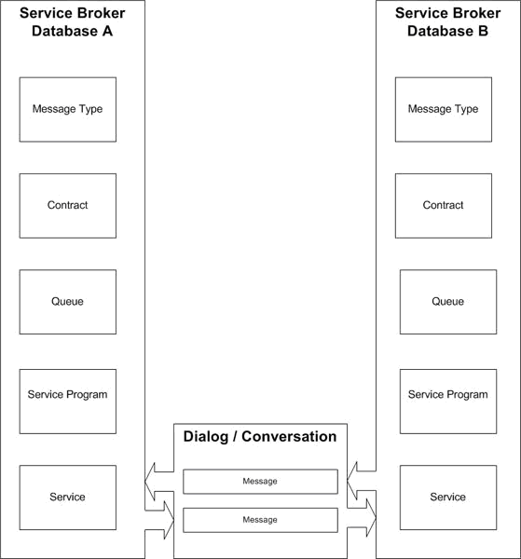
Introduction to Service Broker Conversation Process
Is explained by the following diagram.
Notes:
Refer SG to explain

Slide 4
Just a minute
Which of the following objects processes a message from a queue?
  Service
  Service program
  Contract
Answer:
  Service program

Slide 5
Creating Messages
Message:
  Is an entity that is exchanged between the Service Broker services
  Can contain a validation over the datatype that a message possesses
  Is of a specific message type
Message Type:
  Can be created by using the CREATE MESSAGE TYPE command
  Syntax:
    CREATE MESSAGE TYPE message_type_name
    [ VALIDATION = { NONE | EMPTY | WELL_FORMED_XML | VALID_XML WITH SCHEMA COLLECTION schema_collection_name } ] [ ; ]
Let’s see how…
Notes:
For example, the following statement creates a message type named sendMessage:
CREATE MESSAGE TYPE
sendMessage
VALIDATION = WELL_FORMED_XML
The above statements create a message type named sendMessage, which ensures that the message is a valid XML snippet.

Slide 6
Creating Queues
Queue:
  Is an object that stores the messages
  Can be viewed like a pipeline for messages
  Is created by using the CREATE QUEUE command
  Syntax:
    CREATE QUEUE <object> [ WITH [ STATUS = { ON | OFF } [ , ] ] [ RETENTION = { ON | OFF } [ , ] ] [ ACTIVATION ( [ STATUS = { ON | OFF } , ] PROCEDURE_NAME = <procedure> , MAX_QUEUE_READERS = max_readers , EXECUTE AS { SELF | 'user_name' | OWNER } ) ] ]
Let’s see how…
Notes:
For example, the following statements create a queue named sendQueue:
CREATE QUEUE sendQueue WITH STATUS = OFF,
RETENTION = ON,
ACTIVATION
( PROCEDURE_NAME = dbo.sendProc,
MAX_QUEUE_READERS = 10,
EXECUTE AS SELF ) ON [DEFAULT] ;
The above stated statements create a queue named sendQueue which has sendProc as a service program attached to it.

Slide 7
Creating Contracts
Contract:
  Is an agreement between two services that need to communicate with each other
  Specifies the type of message that will be used in a conversation
  Is created by using the CREATE CONTRACT command
  Syntax:
    CREATE CONTRACT contract_name
    [ AUTHORIZATION owner_name ]
    ( { { message_type_name | [ DEFAULT ] }
    SENT BY { INITIATOR | TARGET | ANY } } [ ,...n] ) [ ; ]
Let’s see how…
Notes:
For example, the following statements create a contract named sendContract:
CREATE CONTRACT sendContract
(
sendMessage SENT BY INITIATOR
);

Slide 8
Creating Services
Service:
  Is used by the Service Broker to deliver messages to the correct queue within a database
  Is used to route messages, to enforce the contract for a conversation, and to determine the remote security for a new conversation
  Is created by using the CREATE SERVICE command
  Syntax:
  CREATE SERVICE service_name
  [ AUTHORIZATION owner_name ] ON
  QUEUE
  [ schema_name. ]queue_name [ ( contract_name | [DEFAULT] [ ,...n ] ) ]
  [ ; ]
Let’s see how…
Notes:
For example, the following statements create a service named sendService:
CREATE SERVICE sendService
ON QUEUE
[dbo].[sendQueue] (sendContract)

Slide 9
Beginning a Conversation
Services communicate through a dialog.
Conversation can begin using the BEGIN DIALOG command.
Syntax:
BEGIN DIALOG [ CONVERSATION ]
@dialog_handle FROM SERVICE initiator_service_name
TO SERVICE 'target_service_name']
[ ON CONTRACT contract_name ]
Let’s see how…
Notes:
For example, the following statements begin a conversation between service sendMessage and receiveMessage on the contract named sendContrace:
DECLARE @dialog_handle UNIQUEIDENTIFIER ;
BEGIN DIALOG CONVERSATION @dialog_handle FROM
SERVICE [sendService] TO SERVICE 'recieveService' ON CONTRACT [sendContract] ;

Slide 10
Sending and Receiving Messages
Messages are sent using the SEND ON CONVERSATION command.
Syntax:
SEND ON CONVERSATION conversation_handle
[ MESSAGE TYPE message_type_name ] [ ( message_body_expression ) ] [ ; ]
Let’s see how…
Notes:
For example, the following example sends a message named sendMessage
SEND ON CONVERSATION
@dialog_conversation [sendMessage]
[<name>John</name>]

Slide 11
Demo: Implementing Service Broker
Problem Statement:
  The management of AdventureWorks, Inc. wants to know the exact yearly sales at any point of the year to help them plan future strategies. The aggregated yearly sales data is maintained in the SalesDetails table of the SalesDB database.
  The sales transaction details are stored in the SalesOrderHeader and SalesOrderDetails tables in the AdventureWorks database. To keep the yearly sales data updated, you need to ensure that whenever any order is processed and its shipping date is updated in the AdventureWorks database, the total monetary value of that order, stored in the SubTotal column of the table, should be added to the total yearly sales in the SalesDB database.
Notes:
For this activity, you need to create another database, named SalesDB. To create this database, you can use the Chapter11_datafile.sql data file given in the Datafiles_for_faculty\Chapter 11 folder in the TIRM CD.

Slide 12
Demo: Implementing Service Broker
Solution:
  To solve the preceding problem, you need to perform the following tasks:
    1. Create a service program.
    2. Create message types, contract, queues, and service objects.
    3. Create a trigger on the SalesOrderHeader table.
    4. Verify the functionality.
Notes:
You can also check that the transaction is committed even if the database is not available by detaching the database. Next, you can execute the INSERT statement in the Sales.SalesOrderHeader table in the AdventureWorks database. The record will be inserted in the table even if the SalesDB database is not available. Finally, you can again attach the SalesDB database. After attaching the database, you will notice that the sales amount will be added to the total yearly sales amount.

Slide 13
Summary
In this session, you learned that:
  Service Broker provides a platform that allows the developers to create asynchronous and reliable query processing.
  In Service Broker, the developers create services that converse with each other by sending and receiving messages.
  A message is data exchanged between services.
  Each message is of a specific message type.
  A service is a database object that provides an endpoint for a conversation.
  A contract is an agreement between the services that participate in a conversation.
  Each service is associated with a queue that acts as a container that stores messages.
  A service program provides the required service to which a message is forwarded by the queue for processing.
Notes:
You can summarize the session by running through the summary given in SG.
In addition, you can also ask students summarize what they have learnt in this session.

Slide 14
Summary (Contd.)
  When implementing Service Broker, you need to create message, queue, contract, service, and conversation database objects.
  A message can be created by using the CREATE MESSAGE TYPE command.
  A queue can be created by using the CREATE QUEUE command.
  A contract can be created by using the CREATE CONTRACT command.
  A service can be created by using the CREATE SERVICE command.
  A conversation can be started by using the BEGIN DIALOG command.
  Messages can be sent by using the SEND ON CONVERSATION command.
Notes:
You can summarize the session by running through the summary given in SG.
In addition, you can also ask students summarize what they have learnt in this session.

