Slide 1

目标
在本章中，您将学习到：
  执行条件格式化
  使用XPath
  以不同的格式呈现数据
Notes:
Introduce the students to the course by asking them what they know about forensics. Next, ask the students what they know about system forensics and why is it required in organizations dependent on IT. This could be a brief discussion of about 5 minutes.
Lead the discussion to the objectives of this chapter.

Slide 2
执行条件格式化
条件格式化指的是根据指定条件格式化数据。
条件格式化的两个元素是：
  if
  choose
Notes:
Introduce the students to the different types of threats that systems face by:
Asking the students to give examples of what they think are environmental and human threats.
Asking the students to give instances of what they think are malicious and non-malicious threats.
Conclude the discussion on the different types of threats by giving additional examples of malicious and non malicious threats.

Slide 3
执行条件格式化（续）
条件格式化指的是根据指定条件格式化数据。
条件格式化的两个元素是：
  if
  choose
  提供一个 if-then 构造。
  语法如下：
  <xsl:if test="condition">
  [actions to be performed if the
  condition is true]
  </xsl:if>
Notes:
Introduce the students to the different types of threats that systems face by:
Asking the students to give examples of what they think are environmental and human threats.
Asking the students to give instances of what they think are malicious and non-malicious threats.
Conclude the discussion on the different types of threats by giving additional examples of malicious and non malicious threats.

Slide 4
执行条件格式化（续）
条件格式化指的是根据指定条件格式化数据。
条件格式化的两个元素是：
  if
  choose
  允许您从两个或更多可能的操作中选择。
  语法如下：
  <xsl:choose>
  [action to be taken]
  </xsl:when>
  :
  :
  <xsl:otherwise>
  [action to be taken]
  </xsl:otherwise>
  </xsl:choose>
Notes:
Introduce the students to the different types of threats that systems face by:
Asking the students to give examples of what they think are environmental and human threats.
Asking the students to give instances of what they think are malicious and non-malicious threats.
Conclude the discussion on the different types of threats by giving additional examples of malicious and non malicious threats.

Slide 5
明确比较和布尔运算符
choose 和if 元素可与比较和布尔运算符一起使用来缩小格式化标准。
下表列出了各个比较和布尔运算符。
操作符 | 含义 | 示例
等于
PRICE[. = 20]
PRODUCTNAME[. = ‘Mini Bus’]
=
PRICE[. != 20]
PRODUCTNAME[. != ‘Barbie Doll’]
!=
不等于
&lt;
小于
PRICE[. &lt; 20]
&gt;
大于
PRICE[. &gt; 20]
&lt;=
小于等于
PRICE[. &lt;= 20]
&gt;=
大于等于
PRICE[. &gt;= 20]
and
逻辑与
PRICE[. &gt 20 and . &lt; 30]
or
逻辑或
PRICE[. = 20 or . = 45]
not
取反运算符
PRICE[not(. = 30)]
Notes:
While explaining the definition of system forensics, ask the students to note the following key words in the definition:
Identify
Extract
Process
Analyze
Digital and hardware evidence
Tell the students that these form an integral aspect of system forensics and would be discussed in detail.
Before moving on to the next slide, hold a brief discussion on why is it important for organizations to take the help of system forensics. The discussion should be focused on:
The role that system forensics plays in organizations having an IT set up.
This discussion will serve as a precursor to the next slide.

Slide 6
使用XPath
XPath：
  用于从XML 文件中搜索和检索信息。
  它将XML 文档视为相关分支和节点的树。如下图所示。
PRODUCTDATA
PRODUCT
PRODID=“P001”
CATEGORY
=“TOY”
PRODUCTNAME
DESCRIPTION
PRICE
QOH
Mini Bus
This toy is for
children aged
4 and above
75
54
Notes:
While explaining the definition of system forensics, ask the students to note the following key words in the definition:
Identify
Extract
Process
Analyze
Digital and hardware evidence
Tell the students that these form an integral aspect of system forensics and would be discussed in detail.
Before moving on to the next slide, hold a brief discussion on why is it important for organizations to take the help of system forensics. The discussion should be focused on:
The role that system forensics plays in organizations having an IT set up.
This discussion will serve as a precursor to the next slide.

Slide 7
说明XPath 表达式
XPath 表达式可用于根据特定条件检索数据。
XPath 表达式根据名称和值识别XML 文档中节点。
下表列示了用于创建XPath 表达式所使用的运算符。
运算符/ 特定符号 | 示例 | 说明
/ | /PRODUCTDATA | 选择PRODUCTDATA的直接子元素如果此运算符出现在模式开始时，则其指出子元素应从根节点中选择。
// | //PRODUCTNAME | 在任一节点级搜索指定的元素。
. | .PRODUCTNAME | 指示当前上下文。
.. | ../PRODUCTNAME | 选择存在于当前元素父级的PRODUCTNAME 元素。
* | * | 选择所有元素。
Notes:
While explaining the definition of system forensics, ask the students to note the following key words in the definition:
Identify
Extract
Process
Analyze
Digital and hardware evidence
Tell the students that these form an integral aspect of system forensics and would be discussed in detail.
Before moving on to the next slide, hold a brief discussion on why is it important for organizations to take the help of system forensics. The discussion should be focused on:
The role that system forensics plays in organizations having an IT set up.
This discussion will serve as a precursor to the next slide.

Slide 8
说明XPath 表达式（续）
运算符 / 特定符号 | 示例 | 说明
@ | @PRODUCTID | 用作属性的前缀。
@* | @* | 选择所有属性。
: | : | 从元素或属性名称中分隔出命名空间前缀。
( ) | (PRICE*QUANTITY) | 用于组合运算。
[ ] | [@PRODUCTID='P001'] | 应用筛选器模式。
+ | num1 + num2 | 返回两个数值之和。
- | num1 - num2 | 返回两个数值之差。
* | num1 * num2 | 返回两个数值的乘积。
div | num1 div num2 | 返回两个数值之商。
mod | num1 mod num2 | 返回模数，即整数除法的余数。
Notes:
While explaining the definition of system forensics, ask the students to note the following key words in the definition:
Identify
Extract
Process
Analyze
Digital and hardware evidence
Tell the students that these form an integral aspect of system forensics and would be discussed in detail.
Before moving on to the next slide, hold a brief discussion on why is it important for organizations to take the help of system forensics. The discussion should be focused on:
The role that system forensics plays in organizations having an IT set up.
This discussion will serve as a precursor to the next slide.

Slide 9
说明XPath 函数
XPath 函数用于计算和作为一个报告显示数据。
XPath 中的各个函数类别为：
  字符串函数（string）：用于执行字符串运算。
  节点集函数（node-set）：用于操纵节点集或返回有关这些节点集的信息。
  布尔函数（Boolean）：用于计算表达式并返回true 或 false。
  数值函数（numeric）： 用于数值计算。
Notes:
Elaborate on the role that system forensics plays in an organization, based on the discussion in the previous slide and the information given on this slide.

Slide 10
演示：在XSLT样式表中使用XPath模式
问题描述：
  CyberShoppe 的管理人员需要按产品排序显示订单报告。产品和订单数据存储在XML文档中。此数据包括产品详细信息，例如产品ID、名称和单价。对于每个产品，针对此产品所下的所有订单的详细信息还存储在文档中。订单详细信息包括订单号、运输地址、订购总量和订单价值。每个产品的总销售值也需要显示。
Notes:
While explaining the definition of system forensics, ask the students to note the following key words in the definition:
Identify
Extract
Process
Analyze
Digital and hardware evidence
Tell the students that these form an integral aspect of system forensics and would be discussed in detail.
Before moving on to the next slide, hold a brief discussion on why is it important for organizations to take the help of system forensics. The discussion should be focused on:
The role that system forensics plays in organizations having an IT set up.
This discussion will serve as a precursor to the next slide.

Slide 11
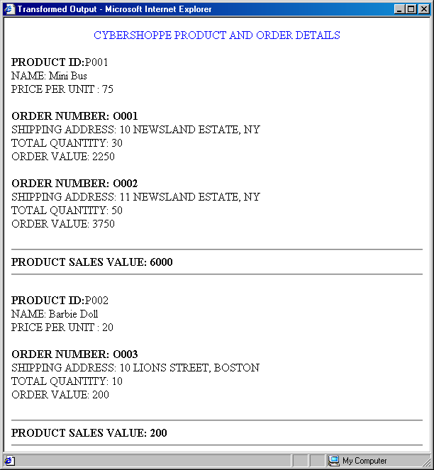
演示：在XSLT样式表中使用XPath模式（续）
问题描述（续）：
  下图说明了数据显示格式。
Notes:
While explaining the definition of system forensics, ask the students to note the following key words in the definition:
Identify
Extract
Process
Analyze
Digital and hardware evidence
Tell the students that these form an integral aspect of system forensics and would be discussed in detail.
Before moving on to the next slide, hold a brief discussion on why is it important for organizations to take the help of system forensics. The discussion should be focused on:
The role that system forensics plays in organizations having an IT set up.
This discussion will serve as a precursor to the next slide.

Slide 12
演示：在XSLT样式表中使用XPath模式（续）
问题描述（续）：
  以下图形显示了对应XML文档的结构。
SUMMARY
PRODUCT
ORDER
SHIPPING
ADDRESS
QUANTITY
Notes:
While explaining the definition of system forensics, ask the students to note the following key words in the definition:
Identify
Extract
Process
Analyze
Digital and hardware evidence
Tell the students that these form an integral aspect of system forensics and would be discussed in detail.
Before moving on to the next slide, hold a brief discussion on why is it important for organizations to take the help of system forensics. The discussion should be focused on:
The role that system forensics plays in organizations having an IT set up.
This discussion will serve as a precursor to the next slide.

Slide 13
演示：使用XSLT编辑器创建样式表
问题描述：
  公司的雇员信息存储在文件employee.xml中。此文件中存储的数据如下所示：
    <?xml version="1.0"?>
    <EMPDETAILS>
    <EMP EMPID="E001">
    <ENAME>Karen</ENAME>
    <DESG>MANAGER</DESG>
    <DEPT>SALES</DEPT>
    <SALARY>250</SALARY>
    </EMP>
    <EMP EMPID="E002">
    <ENAME>George</ENAME>
    <DESG>Executive</DESG>
    <DEPT>ACCOUNTS</DEPT>
    <SALARY>300</SALARY>
Notes:
While explaining the definition of system forensics, ask the students to note the following key words in the definition:
Identify
Extract
Process
Analyze
Digital and hardware evidence
Tell the students that these form an integral aspect of system forensics and would be discussed in detail.
Before moving on to the next slide, hold a brief discussion on why is it important for organizations to take the help of system forensics. The discussion should be focused on:
The role that system forensics plays in organizations having an IT set up.
This discussion will serve as a precursor to the next slide.

Slide 14
演示：使用XSLT编辑器创建样式表（续）
问题描述（续）：
    </EMP>
    <EMP EMPID="E003">
    <ENAME>Steve</ENAME>
    <DESG>Manager</DESG>
    <DEPT>FINANCE</DEPT>
    <SALARY>320</SALARY>
    </EMP>
    <EMP EMPID="E004">
    <ENAME>Ricky</ENAME>
    <DESG>Clerk</DESG>
    <DEPT>SALES</DEPT>
    <SALARY>150</SALARY>
    </EMP>
Notes:
While explaining the definition of system forensics, ask the students to note the following key words in the definition:
Identify
Extract
Process
Analyze
Digital and hardware evidence
Tell the students that these form an integral aspect of system forensics and would be discussed in detail.
Before moving on to the next slide, hold a brief discussion on why is it important for organizations to take the help of system forensics. The discussion should be focused on:
The role that system forensics plays in organizations having an IT set up.
This discussion will serve as a precursor to the next slide.

Slide 15
演示：使用XSLT编辑器创建样式表（续）
问题描述（续）：
    <EMP EMPID="E005">
    <ENAME>Richard</ENAME>
    <DESG>Divisional Manager</DESG>
    <DEPT>MARKETING</DEPT>
    <SALARY>375</SALARY>
    </EMP>
    </EMPDETAILS>
  以绿色显示收入高于$250的员工姓名、职位和所在部门，以红色显示剩余部分。您需要将详细信息显示为公告列表。使用XSLT 编辑器创建样式表。
Notes:
While explaining the definition of system forensics, ask the students to note the following key words in the definition:
Identify
Extract
Process
Analyze
Digital and hardware evidence
Tell the students that these form an integral aspect of system forensics and would be discussed in detail.
Before moving on to the next slide, hold a brief discussion on why is it important for organizations to take the help of system forensics. The discussion should be focused on:
The role that system forensics plays in organizations having an IT set up.
This discussion will serve as a precursor to the next slide.

Slide 16
以不同的格式表示数据
可以组合HTML 和XSLT 的特征以格式化来自XML 文档中的数据，用于适当的显示。
可以将HTML 代码嵌入到XSLT 文档中以显示数据。
Notes:
While explaining the definition of system forensics, ask the students to note the following key words in the definition:
Identify
Extract
Process
Analyze
Digital and hardware evidence
Tell the students that these form an integral aspect of system forensics and would be discussed in detail.
Before moving on to the next slide, hold a brief discussion on why is it important for organizations to take the help of system forensics. The discussion should be focused on:
The role that system forensics plays in organizations having an IT set up.
This discussion will serve as a precursor to the next slide.

Slide 17
以不同的格式表示数据（续）
下表列出了以制表格式显示数据所需的HTML 元素。
HTML 标记 | 说明
TABLE | 作为用于指定表中数据外观的所有其它标记的容器。其属性允许您指定表格的外观，例如边界、背景色、单元格填充、单元格间距和宽度。
THEAD | 用于指定表头。
TBODY | 用作TR 和TD元素的父元素。
TR | 用于表示表格中的行。此标记作为TH 和TD元素的容器。
TH | 用于添加列标题。
TD | 用于指定列中要显示的数据。
Notes:
While explaining the definition of system forensics, ask the students to note the following key words in the definition:
Identify
Extract
Process
Analyze
Digital and hardware evidence
Tell the students that these form an integral aspect of system forensics and would be discussed in detail.
Before moving on to the next slide, hold a brief discussion on why is it important for organizations to take the help of system forensics. The discussion should be focused on:
The role that system forensics plays in organizations having an IT set up.
This discussion will serve as a precursor to the next slide.

Slide 18
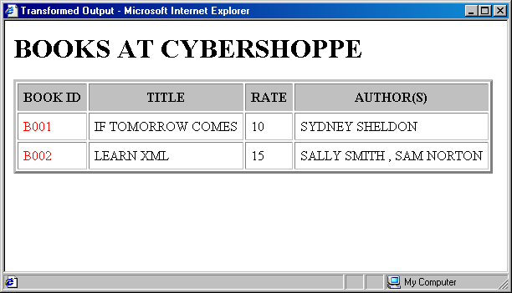
演示：在表中显示数据
问题描述：
  在CyberShoppe处可销售的书籍详细信息存储在XML 文档中。书籍详细信息应显示在表格中，例如书籍ID、书名、价格、作者姓名。作者姓名应显示在第一列AUTHOR(S)中。如果一本书有几个作者，则这些姓名要用逗号隔开。下图显示了样本输出。
Notes:
While explaining the definition of system forensics, ask the students to note the following key words in the definition:
Identify
Extract
Process
Analyze
Digital and hardware evidence
Tell the students that these form an integral aspect of system forensics and would be discussed in detail.
Before moving on to the next slide, hold a brief discussion on why is it important for organizations to take the help of system forensics. The discussion should be focused on:
The role that system forensics plays in organizations having an IT set up.
This discussion will serve as a precursor to the next slide.

Slide 19
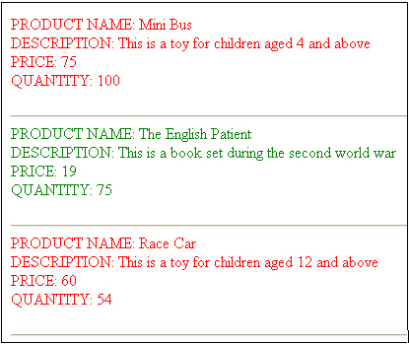
练习
问题描述：
  需要显示在CyberShoppe 处销售的产品列表。这些产品需要根据其价格分类，产品价格高于$50的用红色显示，剩余的用绿色显示。应显示每个产品的产品名称、说明、价格和手边数量，如下图所示。
  将为您提供product.xml 文件。
Notes:
While explaining the definition of system forensics, ask the students to note the following key words in the definition:
Identify
Extract
Process
Analyze
Digital and hardware evidence
Tell the students that these form an integral aspect of system forensics and would be discussed in detail.
Before moving on to the next slide, hold a brief discussion on why is it important for organizations to take the help of system forensics. The discussion should be focused on:
The role that system forensics plays in organizations having an IT set up.
This discussion will serve as a precursor to the next slide.

Slide 20
实践问题
您需要显示月薪为$1200的所有员工的详细信息。员工的详细信息在XML文档中用SALARY 元素表示。您将使用以下哪个语句来根据指定的标准筛选员工数据？
  a. <xsl:if test=“SALARY[. = 1200]”>
  b. <xsl:if test=“SALARY[. = ‘1200’] />
  c. <xsl:if select=“SALARY[. = ‘1200’]”>
  d. <xsl:if match=“SALARY[. = 1200]”>
答案：
  a. <xsl:if test=”SALARY[. = 1200]”>
Notes:
Reiterate the concepts taught earlier by asking the given question.

Slide 21
实践问题
以下XPath 表达式将返回什么？
starts-with(“Hello World”, “world”)
  a. 0
  b. True
  c. False
  d. 7
答案：
  c. False
Notes:
Reiterate the concepts taught earlier by asking the given question.

Slide 22
实践问题
以下XPath 表达式将返回什么？
sum(100 + 200)
  a. 300
  b. NaN
  c. 表达式将产生错误
  d. 空
答案：
  c. 表达式将产生错误
Notes:
Reiterate the concepts taught earlier by asking the given question.

Slide 23
实践问题
考虑以下语句：
语句A：XPath 将XML 文档视为相关分支和节点的树。
语句B：节点可以是任一类型，例如元素、属性、处理指令 (PI)、注释、文本或命名空间。
对于上述语句，以下哪个是正确的？
  a. 语句 A 为 true，语句 B 为 false。
  b. 语句 A 为 False，语句 B 为 True。
  c. 两个语句均为 True。
  d. 两个语句均为 false。
答案：
  c. 两个语句均为 True。
Notes:
Reiterate the concepts taught earlier by asking the given question.

Slide 24
实践问题
您将使用以下哪个语句来显示名为partno的属性的值？
  a. <xsl:text select=“partno”/>
  b. <xsl:value-of select= “@partno” />
  c. <xsl:value-of select= “partno” />
  d. <xsl:value-of select= “@partno” >
答案：
  b. <xsl:value-of select= “@partno” />
Notes:
Reiterate the concepts taught earlier by asking the given question.

Slide 25
小结
在本章中，您学习了：
  XSLT中的if 和choose 元素允许您根据某个条件格式化数据。
  if 元素提供了简单的if-then 构造。具有单个测试属性，指定了执行某个操作所需的标准。
  choose 元素从大量可能的选项中选择一个元素。包含大量when 元素，后跟可选的otherwise 元素。
  XPath 语言用于从XML 文件中搜索和检索信息。
  XPath 的主要目的是处理部分XML 文档，并操纵字符串、数字和布尔值。

Slide 26
小结（续）
  XPath 表达式可以匹配特定的模式，检索结果并执行与返回的节点有关的其它运算。
  XPath 提供了以下类型的函数：
    字符串：用于基本字符串运算，例如查找字符串的长度或将字符串从大写转换为小写。
    节点集：用于操纵节点集或返回与节点集有关的信息。
    布尔：根据传递的参数用于返回true 或false。
    数值：用于根据数值执行计算。
  您可以在XSLT 样式表中使用HTML 代码按不同格式显示数据。
  import 元素用于将一个XSLT 样式表导入到另一个XSLT 样式表。

