Slide 1

目标
在本章中，您将学习：
  实现数据绑定在 Windows 表单的控件中显示值
  过滤数据以显示所选的记录
Notes:
Introduce the students to the course by asking them what they know about forensics. Next, ask the students what they know about system forensics and why is it required in organizations dependent on IT. This could be a brief discussion of about 5 minutes.
Lead the discussion to the objectives of this chapter.

Slide 2
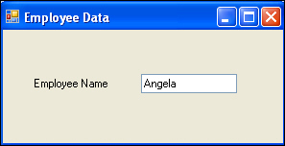
介绍数据绑定
数据绑定是将数据源的一些元素与Windows表单的控件进行绑定的一种功能。
下图显示的是将员工表的 Employee Name 字段与 Windows 表单的文本框控件进行绑定以显示数据：
根据可以通过 Windows 表单的控件显示的绑定值的数量，数据绑定可归类为：
  简单数据绑定
  复杂数据绑定
Notes:
Introduce the students to the different types of threats that systems face by:
Asking the students to give examples of what they think are environmental and human threats.
Asking the students to give instances of what they think are malicious and non-malicious threats.
Conclude the discussion on the different types of threats by giving additional examples of malicious and non malicious threats.

Slide 3
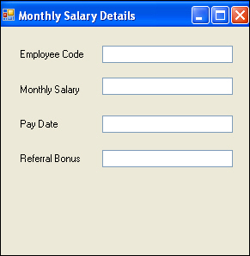
简单数据绑定
简单数据绑定是将控件（如文本框或标签）绑定到数据集中的单个值的过程。
数据集的值可以通过使用控件的属性绑定到控件。
请思考这样一个场景，其中需要创建 Windows 表单来显示员工的每月工资详细信息。
Notes:
Introduce the students to the different types of threats that systems face by:
Asking the students to give examples of what they think are environmental and human threats.
Asking the students to give instances of what they think are malicious and non-malicious threats.
Conclude the discussion on the different types of threats by giving additional examples of malicious and non malicious threats.

Slide 4
简单数据绑定（续）
要执行简单数据绑定，需要执行以下步骤：
  选择 View→Properties Window 来打开 Properties 窗口。
  在 Properties 窗口中选择第一个 text box 来显示其属性。
  展开 (DataBindings) 属性。
  选择 Text 属性以启用下拉列表。单击下拉列表。
  在下拉列表中单击 Add Project Data Source。
  创建与 HR 数据库的连接，并选择 MonthlySalary 表。
  展开 Other Data Sources→Project Data Sources→HRDataSet→MonthlySalary 节点，选择cEmployeeCode 列。这绑定了第一个文本框中此列的数据，创建了 monthlySalaryBindingSource。
Notes:
Introduce the students to the different types of threats that systems face by:
Asking the students to give examples of what they think are environmental and human threats.
Asking the students to give instances of what they think are malicious and non-malicious threats.
Conclude the discussion on the different types of threats by giving additional examples of malicious and non malicious threats.

Slide 5
简单数据绑定（续）
  选择第二个 text box。
  展开 (DataBindings) 属性。
  选择 Text 属性以启用下拉列表。
  展开 monthlySalaryBindingsource 节点，选择 mMonthlySalary 列来绑定第二个 text box。
  类似地，分别将 dPayDate 和 mReferralBonus 列与第三和第四个文本框进行绑定。
Notes:
Introduce the students to the different types of threats that systems face by:
Asking the students to give examples of what they think are environmental and human threats.
Asking the students to give instances of what they think are malicious and non-malicious threats.
Conclude the discussion on the different types of threats by giving additional examples of malicious and non malicious threats.

Slide 6
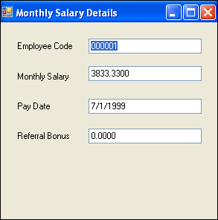
简单数据绑定（续）
  按 F5或选择 Debug→Start Debugging来运行 Windows 表单。显示最终的输出，如下图所示。
Notes:
Introduce the students to the different types of threats that systems face by:
Asking the students to give examples of what they think are environmental and human threats.
Asking the students to give instances of what they think are malicious and non-malicious threats.
Conclude the discussion on the different types of threats by giving additional examples of malicious and non malicious threats.

Slide 7
复杂数据绑定
复杂数据绑定是绑定组件（如 DataGridView 控件或 ListBox 控件）从数据集显示多个值的过程。
复杂数据绑定是绑定组件（如 DataGridView 控件或 ListBox 控件）从数据集显示多个值的过程。
控件 | 描述
ListBox | 此控件用来从数据集的多条记录显示列的数据。ListBox 控件的 DataSource 属性用来将控件绑定到数据源，如 DataSet 或 DataTable。ListBox 控件的 DisplayMember 属性用来将控件绑定到特定数据元素，如 DataTable 的列。
ComboBox | 此控件有两部分，用于输入数据的文本框和用于显示数据的下拉列表。ComboBox 控件的 DataSource 属性用于将控件绑定到 DataSource，如 DataSet 或 DataTable。ComboBox 控件的 DisplayMember 属性用于将控件绑定到特定数据元素，如 DataTable 的列。
Notes:
Introduce the students to the different types of threats that systems face by:
Asking the students to give examples of what they think are environmental and human threats.
Asking the students to give instances of what they think are malicious and non-malicious threats.
Conclude the discussion on the different types of threats by giving additional examples of malicious and non malicious threats.

Slide 8
复杂数据绑定（续）
控件 | 描述
DataGridView | 此控件可从多条记录以及多个列显示数据。DataGridView 控件的 DataSource 属性用于绑定到特定的数据元素，如 DataTable 的列。
Notes:
Introduce the students to the different types of threats that systems face by:
Asking the students to give examples of what they think are environmental and human threats.
Asking the students to give instances of what they think are malicious and non-malicious threats.
Conclude the discussion on the different types of threats by giving additional examples of malicious and non malicious threats.

Slide 9
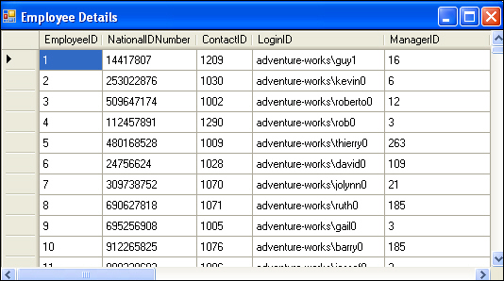
复杂数据绑定（续）
例如，下图使用 DataGridView 控件以网格格式显示了存储在 AdventureWorks 数据库中的员工详细信息。
Notes:
Introduce the students to the different types of threats that systems face by:
Asking the students to give examples of what they think are environmental and human threats.
Asking the students to give instances of what they think are malicious and non-malicious threats.
Conclude the discussion on the different types of threats by giving additional examples of malicious and non malicious threats.

Slide 10
课间思考
以下哪一个控件用来执行简单数据绑定：
  Label
  Combo Box
  List Box
  DataGridView
答案：
  1. Label
Notes:
In this slide you need to show the calculation to determine the sum of an arithmetic progression for bubble sort algorithm. Refer to student guide.

Slide 11
在记录之间进行导览
对于绑定到 Windows 表单控件的每个数据源，有一个 BindingNavigator 控件。
BindingNavigator 控件通过在记录列表的当前条目上保持一个指针来处理到数据源的绑定。
下图举例说明了 BindingNavigator 控件和 Windows 表单之间的关系。
Windows表单
控件 1
控件 2
控件 3
BindingNavigator 1
数据源 1
BindingNavigator 2
数据源 2
BindingNavigator 3
数据源 3
Notes:
Introduce the students to the different types of threats that systems face by:
Asking the students to give examples of what they think are environmental and human threats.
Asking the students to give instances of what they think are malicious and non-malicious threats.
Conclude the discussion on the different types of threats by giving additional examples of malicious and non malicious threats.

Slide 12
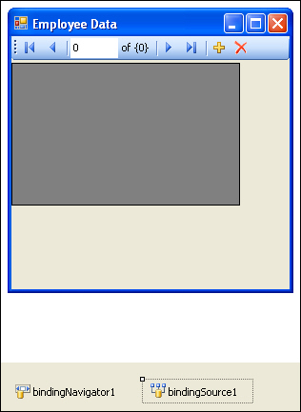
在记录之间进行导览（续）
BindingNavigator 控件经常与 BindingSource 控件一起使用使用户导览表单中的数据，并与记录进行交互。
下图显示了Windows表单中显示的 BindingNavigator 控件和 BindingSource 控件。
Notes:
Introduce the students to the different types of threats that systems face by:
Asking the students to give examples of what they think are environmental and human threats.
Asking the students to give instances of what they think are malicious and non-malicious threats.
Conclude the discussion on the different types of threats by giving additional examples of malicious and non malicious threats.

Slide 13
在记录之间进行导览（续）
BindingNavigator 控件具有各种控件用于修改数据源。
下表描述了BindingNavigator 控件中的各种控件、其符号和功能。
控件 | 符号 | 功能
bindingNavigatorAddNewItem button |  | 将一个新行插入到数据源中。
bindingNavigatorDeleteItem button |  | 从数据源中删除当前行。
bindingNavigatorMoveFirstItem button |  | 移动至数据源中的第一个条目。
bindingNavigatorMoveLastItem button |  | 移动至数据源中的最后一个条目。
bindingNavigatorMoveNextItem button |  | 移动至数据源中的下一条目。
Notes:
Introduce the students to the different types of threats that systems face by:
Asking the students to give examples of what they think are environmental and human threats.
Asking the students to give instances of what they think are malicious and non-malicious threats.
Conclude the discussion on the different types of threats by giving additional examples of malicious and non malicious threats.

Slide 14
在记录之间进行导览（续）
控件 | 符号 | 功能
bindingNavigatorMovePreviousItem button |  | 移动至数据源中的上一条目。
bindingNavigatorPositionItem text box |  | 返回数据源中的当前位置。
bindingNavigatorCountItem text box |  | 返回数据源中的总的条目数量。
Notes:
Introduce the students to the different types of threats that systems face by:
Asking the students to give examples of what they think are environmental and human threats.
Asking the students to give instances of what they think are malicious and non-malicious threats.
Conclude the discussion on the different types of threats by giving additional examples of malicious and non malicious threats.

Slide 15
课间思考
BindingNavigator 的哪一个控件返回数据源中的当前位置？
  bindingNavigatorMoveFirstItem 按钮
  bindingNavigatorPositionItem 文本框
  bindingNavigatorMoveLastItem 按钮
  bindingNavigatorCountItem 文本框
答案：
  2. bindingNavigatorPositionItem 文本框
Notes:
In this slide you need to show the calculation to determine the sum of an arithmetic progression for bubble sort algorithm. Refer to student guide.

Slide 16
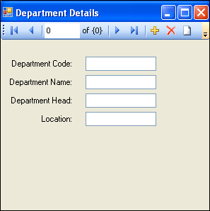
演示：实现数据绑定
问题描述：
  Peter Parkinson 是在美国占据领导地位的快餐生产商和销售商 Tebisco 的 HR 副总裁。Peter 需要以定制的格式查看组织中各个部门功能的详细信息，如下图所示。
Notes:
While explaining the definition of system forensics, ask the students to note the following key words in the definition:
Identify
Extract
Process
Analyze
Digital and hardware evidence
Tell the students that these form an integral aspect of system forensics and would be discussed in detail.
Before moving on to the next slide, hold a brief discussion on why is it important for organizations to take the help of system forensics. The discussion should be focused on:
The role that system forensics plays in organizations having an IT set up.
This discussion will serve as a precursor to the next slide.

Slide 17
演示：实现数据绑定（续）
  作为开发团队的一部分，需要以上述格式为 Peter 检索部门详细信息。
  提示：需要引用 HR 数据库的 Department 表。
Notes:
While explaining the definition of system forensics, ask the students to note the following key words in the definition:
Identify
Extract
Process
Analyze
Digital and hardware evidence
Tell the students that these form an integral aspect of system forensics and would be discussed in detail.
Before moving on to the next slide, hold a brief discussion on why is it important for organizations to take the help of system forensics. The discussion should be focused on:
The role that system forensics plays in organizations having an IT set up.
This discussion will serve as a precursor to the next slide.

Slide 18
课间思考
通过保持记录列表中当前条目上的指针_______ 控件处理到数据源的绑定。
  bindingNavigatorPositionItem
  BindingSource
  BindingNavigator
  DataGridView
答案：
  3. BindingNavigator
Notes:
In this slide you need to show the calculation to determine the sum of an arithmetic progression for bubble sort algorithm. Refer to student guide.

Slide 19
过滤数据
可能有一种情况，仅需要显示所选择的记录。在这种情况下，为了仅显示想要的记录而过滤数据。
有两种方法用于过滤数据：
  创建参数化的查询
  使用Windows表单的控件过滤数据
Notes:
While explaining the definition of system forensics, ask the students to note the following key words in the definition:
Identify
Extract
Process
Analyze
Digital and hardware evidence
Tell the students that these form an integral aspect of system forensics and would be discussed in detail.
Before moving on to the next slide, hold a brief discussion on why is it important for organizations to take the help of system forensics. The discussion should be focused on:
The role that system forensics plays in organizations having an IT set up.
This discussion will serve as a precursor to the next slide.

Slide 20
创建参数化的查询
对开发人员而言，存储过程总是从数据库存取数据的首选方法。
存储过程有益于预编译的执行，减少网络流量，有效地重用代码，增强了数据库中存储的安全措施。
但是，更安全的方法是创建参数化的查询。
使用参数化的查询，可以基于用户在运行时输入的条件过滤数据。
Notes:
While explaining the definition of system forensics, ask the students to note the following key words in the definition:
Identify
Extract
Process
Analyze
Digital and hardware evidence
Tell the students that these form an integral aspect of system forensics and would be discussed in detail.
Before moving on to the next slide, hold a brief discussion on why is it important for organizations to take the help of system forensics. The discussion should be focused on:
The role that system forensics plays in organizations having an IT set up.
This discussion will serve as a precursor to the next slide.

Slide 21
创建参数化的查询（续）
以下代码段显示了如何设置和执行参数化的查询：
  SqlConnection con = new
  SqlConnection();
  con.ConnectionString =
  "Data Source= SQLSERVER01;
  Initial Catalog=HR; User
  ID=sa; Password=niit#1234";
  con.Open();
  string serachemployeecode;
  searchemployeecode =
  textBox1.Text;
创建连接字符串
建立数据库连接
textBox1 包含employeecode的值，该值需要从数据库中抽取
Notes:
While explaining the definition of system forensics, ask the students to note the following key words in the definition:
Identify
Extract
Process
Analyze
Digital and hardware evidence
Tell the students that these form an integral aspect of system forensics and would be discussed in detail.
Before moving on to the next slide, hold a brief discussion on why is it important for organizations to take the help of system forensics. The discussion should be focused on:
The role that system forensics plays in organizations having an IT set up.
This discussion will serve as a precursor to the next slide.

Slide 22
创建参数化的查询（续）
  string query = "SELECT *
  FROM MonthlySalary WHERE
  cemployeeCode =
  @employeecode";
  SqlCommand cmd = new
  SqlCommand(query, con);
  cmd.Parameters.Add(new
  SqlParameter("@employeeco
  de", searchempcode));
  SqlDataReader dr =
  cmd.ExecuteReader();
设置要执行的SQL语句
初始化命令对象以执行连接
传递参数对象
执行命令并返回 DataReader
Notes:
While explaining the definition of system forensics, ask the students to note the following key words in the definition:
Identify
Extract
Process
Analyze
Digital and hardware evidence
Tell the students that these form an integral aspect of system forensics and would be discussed in detail.
Before moving on to the next slide, hold a brief discussion on why is it important for organizations to take the help of system forensics. The discussion should be focused on:
The role that system forensics plays in organizations having an IT set up.
This discussion will serve as a precursor to the next slide.

Slide 23
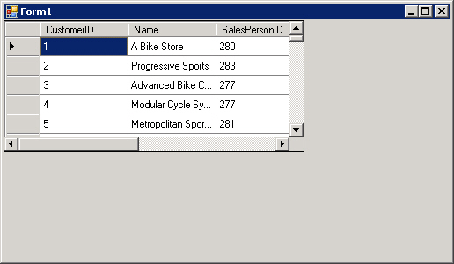
使用 Windows 表单的控件过滤数据
从数据源检索到数据后，可过滤此数据查看所选的记录。
可通过传递参数化的查询或使用Windows 表单中的控件进行过滤。
请思考一个示例，其中组织的销售经理想要使用网格格式查看各个商店的销售信息。通过建立到数据库的连接和使用 DataGridView 控件绑定数据来显示数据。这显示在下图中。
Notes:
While explaining the definition of system forensics, ask the students to note the following key words in the definition:
Identify
Extract
Process
Analyze
Digital and hardware evidence
Tell the students that these form an integral aspect of system forensics and would be discussed in detail.
Before moving on to the next slide, hold a brief discussion on why is it important for organizations to take the help of system forensics. The discussion should be focused on:
The role that system forensics plays in organizations having an IT set up.
This discussion will serve as a precursor to the next slide.

Slide 24
使用 Windows 表单的控件过滤数据（续）
FillBy 是一个 TableAdapter 查询。TableAdapter 查询是应用程序可以对数据库执行的 SQL 语句或存储过程。
通过调用 FillBy（） 方法代码（该代码出现在 FillByToolStrip 控件的 Click 事件中），可执行 TableAdapter 查询。
FillBy()方法植入来自数据表中的数据源的数据。
除 FillByToolStrip 控件之外，还可使用Windows表单的 DataView 控件过滤数据。
DataView 控件创建数据表中存储的数据的定制的视图。默认情况下，每个表具有附加到其上的数据视图。
Notes:
While explaining the definition of system forensics, ask the students to note the following key words in the definition:
Identify
Extract
Process
Analyze
Digital and hardware evidence
Tell the students that these form an integral aspect of system forensics and would be discussed in detail.
Before moving on to the next slide, hold a brief discussion on why is it important for organizations to take the help of system forensics. The discussion should be focused on:
The role that system forensics plays in organizations having an IT set up.
This discussion will serve as a precursor to the next slide.

Slide 25
使用 Windows 表单的控件过滤数据（续）
可添加和绑定 DataView 控件到Windows表单来创建根据一些条件过滤记录的数据的定制的视图。
要将 DataView 控件添加到Windows表单，需要执行以下步骤：
  1. 从 Toolbox 面板的 All Windows Form 下拉列表将 DataView 控件拖放到Windows表单。
  如果 DataView 控件在工具箱中不可见，可右键单击 Toolbox 窗口，从下拉列表中选择 Choose Items 选项。这将打开 Choose Toolbox Items 对话框。从对话框的 .NET Framework Components 选项卡选中 DataView 选项。这将使 DataView 控件在工具箱中可见。
Notes:
While explaining the definition of system forensics, ask the students to note the following key words in the definition:
Identify
Extract
Process
Analyze
Digital and hardware evidence
Tell the students that these form an integral aspect of system forensics and would be discussed in detail.
Before moving on to the next slide, hold a brief discussion on why is it important for organizations to take the help of system forensics. The discussion should be focused on:
The role that system forensics plays in organizations having an IT set up.
This discussion will serve as a precursor to the next slide.

Slide 26
使用 Windows 表单的控件过滤数据（续）
  2. 设置 Properties 窗口的 DataView 控件的属性。下表描述了 DataView 控件的各个属性。
属性 | 描述
Allow Delete, Allow Add, and Allow Edit | 这些属性用来指定是否记录可以被单独添加、删除或编辑。
ApplyDefaultSort | 此属性用来指定默认的排序，如果 Sort 属性未设置。
GenerateMember | 此属性指定是否成员变量将为控件而生成。
Modifiers | 此属性指定 DataView 对象的可见性级别。
RowFilter | 此属性用来指定用来过滤记录的字符串格式的表达式/条件。满足条件的记录将只被包括在视图中。
Notes:
While explaining the definition of system forensics, ask the students to note the following key words in the definition:
Identify
Extract
Process
Analyze
Digital and hardware evidence
Tell the students that these form an integral aspect of system forensics and would be discussed in detail.
Before moving on to the next slide, hold a brief discussion on why is it important for organizations to take the help of system forensics. The discussion should be focused on:
The role that system forensics plays in organizations having an IT set up.
This discussion will serve as a precursor to the next slide.

Slide 27
使用 Windows 表单的控件过滤数据（续）
属性 | 描述
RowStateFilter | 此属性指定此 DataView 返回的数据的版本。
Sort | 此属性用来指定将按其排序记录的表达式。表达式包括列名称和排序限定符，其为 ASC 或 DESC，以升序或降序来显示记录。
Table | 此属性用来指定数据视图将引用的 DataTabl。此属性可在设计的时候或运行时设置。
Notes:
While explaining the definition of system forensics, ask the students to note the following key words in the definition:
Identify
Extract
Process
Analyze
Digital and hardware evidence
Tell the students that these form an integral aspect of system forensics and would be discussed in detail.
Before moving on to the next slide, hold a brief discussion on why is it important for organizations to take the help of system forensics. The discussion should be focused on:
The role that system forensics plays in organizations having an IT set up.
This discussion will serve as a precursor to the next slide.

Slide 28
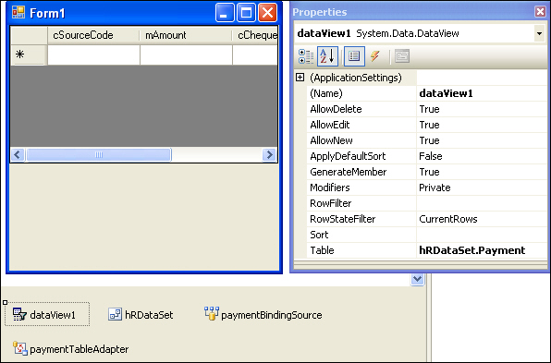
使用 Windows 表单的控件过滤数据（续）
下图显示了DataView 控件及其属性。
Notes:
While explaining the definition of system forensics, ask the students to note the following key words in the definition:
Identify
Extract
Process
Analyze
Digital and hardware evidence
Tell the students that these form an integral aspect of system forensics and would be discussed in detail.
Before moving on to the next slide, hold a brief discussion on why is it important for organizations to take the help of system forensics. The discussion should be focused on:
The role that system forensics plays in organizations having an IT set up.
This discussion will serve as a precursor to the next slide.

Slide 29
课间思考
DataView 控件的哪一个属性指定过滤记录的字符串格式的表达式/条件？
  1. Modifiers
  2. RowStateFilter
  3. Sort
  4. RowFilter
答案：
  4. RowFilter
Notes:
In this slide you need to show the calculation to determine the sum of an arithmetic progression for bubble sort algorithm. Refer to student guide.

Slide 30
课间思考
DataView 控件的哪一个属性指定 DataView 返回的数据的版本？
  1. Table
  2. AllowEdit
  3. RowStateFilter
  4. GenerateMembers
答案：
  3. RowStateFilter
Notes:
In this slide you need to show the calculation to determine the sum of an arithmetic progression for bubble sort algorithm. Refer to student guide.

Slide 31
演示：实现过滤数据
问题描述：
  Robert Smith 是 Tebisco 的 HR 经理，需要查看候选人代码、员工代码、内部工作发布代码、申请的职位代码、申请日期、测试日期、测试分数、面试日期、面试者、面试评价、等级评定、状态和得分在前两个范围（90-100 之间和 80-90 之间）之内的候选人的测试分数。作为组织中的开发人员，需要设计将显示必需的详细信息的应用程序。
  提示：需要引用 HR 数据库的InternalCandidate 表。
Notes:
While explaining the definition of system forensics, ask the students to note the following key words in the definition:
Identify
Extract
Process
Analyze
Digital and hardware evidence
Tell the students that these form an integral aspect of system forensics and would be discussed in detail.
Before moving on to the next slide, hold a brief discussion on why is it important for organizations to take the help of system forensics. The discussion should be focused on:
The role that system forensics plays in organizations having an IT set up.
This discussion will serve as a precursor to the next slide.

Slide 32
小结
在本章中，您学习了：
  数据绑定是将数据源的一些元素与Windows表单的控件进行绑定的功能。
  数据绑定有两种类型：
    简单数据绑定
    复杂数据绑定
  简单数据绑定是将控件（如文本框或标签）绑定到数据集中的值的过程。
  复杂数据绑定是将组件（如 DataGridView 控件或 ListBox 控件）绑定以显示数据集的多个列的值的过程。

Slide 33
小结（续）
  可以过滤数据仅显示想要的记录。
  有两种过滤数据的方法：
    创建参数化的查询
    使用Windows表单的控件过滤数据
  通过使用参数化的查询，可以基于用户在运行时输入的条件来过滤数据。
  在Windows表单中的 FillByToolStrip 和 DataView 控件可用来过滤数据以查看所选的记录。

