Slide 1

Rationale
Business applications need to manage voluminous data. Data is generally stored in a relational database in the form of related tables or is stored in text format in XML documents. Most business applications allow users to retrieve the data stored in a database and present it in a user-friendly interface without writing the database commands. ADO.NET is a model used by .NET applications to communicate with a database for retrieving, accessing, and updating data. This module will provide the necessary skills to the students to work as a database application developer in the industry.

Slide 2
Prerequisites
A student registering for this module should be able to perform the following tasks:
  Work with XML
  Work with SQL queries

Slide 3
Case Study - Tebisco
Brief History
  Tebisco is a leading producer and distributor of snacks in the U.S., as well as in most of the company’s 23 international markets. In 1998, consumers spent $9.2 billion on Tebisco’s snacks, $1.4 billion more than in the previous year.
  Tebisco started as a small bakery in Round Rock, Texas in 1978. In a short time, its gingersnaps, macaroons, shortbread and other cookies were popular all over the U.S. Three years ago, the management embarked on a rapid expansion plan. They set up offices in Asia and Europe, in addition to strengthening their U.S. operations.
  Tebisco has got a centralized database management system whereby the information about all the HR activities is maintained.

Slide 4
Objectives
In this session, you will learn to:
  Understand the ADO.NET object model
  Create and manage connections

Slide 5
Understanding ADO.NET
Business applications allow users to retrieve data from a database by presenting data in a user-friendly interface.
User need not remember the database commands for retrieving or updating data in the database.
Microsoft has created a family of data access technologies to help programmers build efficient applications to access data, regardless of its source.
The guidelines that can be followed for selecting an appropriate data access technology are:
Use ADO.NET for writing a managed code targeting the .NET Framework in Visual Basic, C#, and C++.
Use Microsoft ODBC for writing a native code targeting Windows by using C or C++.
Use (OLE) DB for writing a Microsoft
based application, a VB 6 COM application, or a C++ application using COM.
Use JDBC for writing a Java code targeting SQL Server.

Slide 6
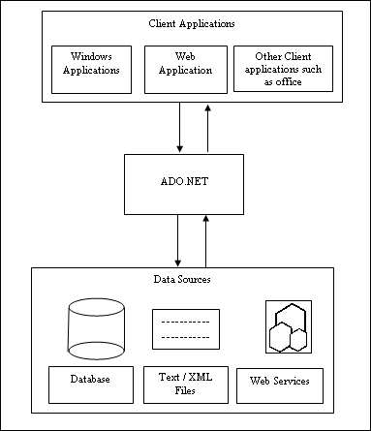
Understanding ADO.NET (Contd.)
ADO.NET is a part of the .NET Framework architecture.

Slide 7
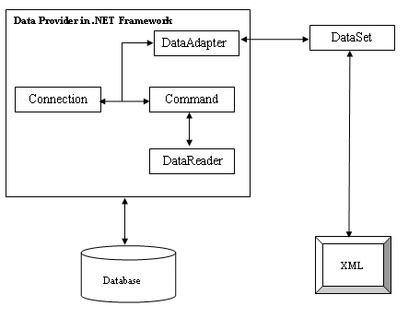
The ADO.NET Object Model
ADO.NET is based on an object model that is based on the standards laid down by W3C.
The following figure shows the ADO.NET object model.

Slide 8
The ADO.NET Object Model (Contd.)
The two key components of ADO.NET Object model are:
  Data provider
  Dataset
  Is required for:
    Connecting to a database.
    Retrieving data.
    Storing the data in a dataset.
    Reading the retrieved data.
    Updating the database.
  Has four key components:
    Connection
    Command
    DataReader
    DataAdapter

Slide 9
The ADO.NET Object Model (Contd.)
The two key components of ADO.NET Object model are:
  Data provider
  Dataset
  Is a disconnected, cached set of records that are retrieved from a database.
  Is present in the Dataset class in the System.Data namespace.
  Has the following key components:
    DataTableCollection
    DataRelationCollection
    DataTable
    DataRowCollection
    DataColoumnCollection

Slide 10
Just a minute
Which of the following components of a data provider is used to retrieve, insert, delete, or modify data in a data source?
  Connection
  Command
  DataReader
  DataAdapter
Answer:
  2. Command

Slide 11
Features of ADO.NET
The key features of ADO.NET are:
  Disconnected data architecture
  Data cached in datasets
  Scalability
  Data transfer in XML format
Applications connect to the database only while retrieving and updating data.
Connection with the database is closed, once the data is retrieved.
Connection is re-established when the data needs to be updated.
The data is retrieved and stored in datasets.
You can work with the records stored in a dataset as you work with real data.
The dataset is independent of data source and you remain disconnected from the data source.
Database operations are performed on the dataset instead of on the database.
As a result, resources are saved and the database can meet the increasing demands of users more efficiently.
XML is the fundamental format for data transfer in ADO.NET.
Because a dataset is stored in the XML format, you can transmit it between different types of applications.

Slide 12
Creating and Managing Connections
To create and manage connections, you need to:
  Create a connection object.
  Create a command object.
  Open the connection object.
  Execute the SQL statement in the command object.
  Close the connection object.

Slide 13
Creating a Connection Object
Execute the following steps to create a connection to the database:
  SqlConnection connection =
  new SqlConnection();
  connection.ConnectionString =
  "Data Source=SQLSERVER01;
  Initial Catalog=HR;
  User ID=sa;
  Password=password";
Create a SqlConnection object.
SqlConnection class is used to connect to a SQL Server.
The ConnectionString property
provides information, such as the data source and database name, that is used to establish a connection with a database.
Name of the Server to be used when a connection is open
Name of the database
Used to specify the Server login account
Login password for the Server account

Slide 14
Just a minute
Which of the following parameters of ConnectionString is used to specify the name of the database?
  1. Provider
  2. Initial Catalog
  3. Data source
  4. Database
Answer:
  2. Initial Catalog

Slide 15
Creating a Command Object
Execute the following steps to create a command object:
  SqlCommand cmd = new
  SqlCommand
  (“SELECT * FROM
  monthlysalary“
  ,connection);
To execute an SQL statement, you need to
create an instance of the SqlCommand
class.
The two parameters that are passed to the SqlCommnad object are, the SQL query to be executed and the SqlConnection object.

Slide 16
Opening the Connection Object
Execute the following steps to open a connection:
  //SqlConnection connection
  connection.Open();
It opens a database connection with the property settings specified by the
ConnectionString property.

Slide 17
Executing SQL Statements in the Command Object
To execute the query passed in the Command object, you can call one of the following methods:
// Creating a SqlConnection object
SqlConnection connection = new SqlConnection();
// Creates a connection string to the HR database
connection.ConnectionString = "Data Source= SQLSERVER01; Initial Catalog=HR; User ID=sa; Password=niit#1234";
connection.Open();
// Creating a SqlCommand object
SqlCommand cmd = new SqlCommand("select * from monthlysalary", connection);
// Creating SqlReader object
SqlDataReader myReader = cmd.ExecuteReader();

Slide 18
Closing the Connection Object
Execute the following steps to close a connection:
  //SqlConnection connection
  connection.Close();
It closes the connection to the database.

Slide 19
Closing the Connection Object (Contd.)
Handling Connection Events:
  The two key events for the SqlConnection class are:
    StateChange event
    InfoMessage event
This event occurs when the state of the connection changes.
It receives an argument of type StateChangeEventArgs.
StateChangeEventArgs has the following properties:
    CurrentState
    OriginalState
This event occurs when an informational message or warning is returned from a data source.
It receives an argument of type SqlInfoMessageEventArgs.
SqlInfoMessageEventArgs has the following properties:
    Errors
    Message
    Source

Slide 20
Implementing Connection Pooling
Connection pooling enables a data source to reuse connections for a particular user.
Connection pooling is controlled by certain parameters that are placed into the connection string.
    Connection timeout
    Min pool size
    Max pool size
    Pooling
    Connection reset
    Load balancing
    timeout, connection
    lifetime
    Enlist
It is the time in seconds to wait while a connection to the data source is attempted. The default value is 15 seconds.
It is used to mention the minimum number of connections maintained in the pool. The default value is 0.
It is used to mention the maximum number of connections allowed in the pool. The default value is 100.
When true, it causes the request for a new connection to be drawn from the pool.
It indicates that the database connection will be reset when the connection is removed from the pool.
It specifies the maximum time in seconds that a pooled connection should live.
When the value is true, the connection is automatically enlisted into the creation thread’s current transaction context.

Slide 21
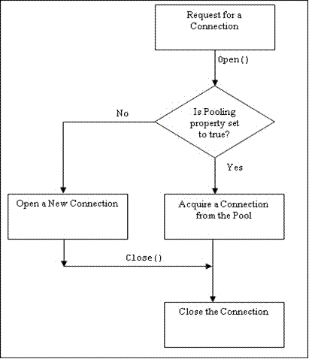
Implementing Connection Pooling (Contd.)
A request for a connection is made by the application using the Open() method.
If the Pooling property is set to true, the pooler attempts to acquire a connection from the pool otherwise a new connection is created.
Close the connection by calling the close() method.

Slide 22
Demo: Retrieving Data from a SQL Database
Problem Statement:
  Tebisco is a leading producer and distributor of snacks in the United States. It is planning to start its annual appraisal process. Before starting up with the appraisal process, the senior management requires a list of all employees. The details include employee name, employee code, current position, designation, and joining date.
  As a member of the development team, you have been asked to develop an application that will display the employee details.
  Hint: You need to refer to the Employee table of the HR database.

Slide 23
Summary
In this session, you learned that:
  ADO.NET is a data access programming model for accessing the data stored in a database from a .NET application.
  The ADO.NET object model consists of two main components, data provider and dataset.
  A data provider is used for connecting to a database, retrieving data, storing the data in a dataset, reading the retrieved data, and updating the database.
  The various types of data providers are:
    .NET Framework data provider for SQL Server
    .NET Framework data provider for OLEDB
    .NET Framework data provider for ODBC
    .NET Framework data provider for Oracle

Slide 24
Summary (Contd.)
  The four key components of a data provider are:
    Connection
    Commnd
    DataReader
    DataAdapter
  The dataset is memory-based relational representation of data.
  The main features of ADO.NET are:
    Disconnected data architecture
    Data cached in datasets
    Scalability
    Data transfer in XML format

Slide 25
Summary (Contd.)
  In order to create and manage connection to the database, you need to perform the following steps:
    1. Create a connection object.
    2. Create a command object.
    3. Open the connection object.
    4. Execute the SQL statement in the command object.
    5. Close the connection object.
  The two key events for the SqlConnection class are:
    StateChange event
    InfoMessage event
  Connection pooling enables a data source to reuse connections for a particular user.

