Slide 1

Objectives
In this session, you will learn to:
  Implement data binding to display values on the controls of a Windows form
  Filter the data to display the selected records
Notes:
Introduce the students to the course by asking them what they know about forensics. Next, ask the students what they know about system forensics and why is it required in organizations dependent on IT. This could be a brief discussion of about 5 minutes.
Lead the discussion to the objectives of this chapter.

Slide 2
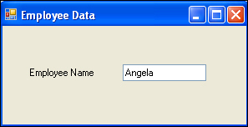
Introducing Data Binding
Data binding is the ability to bind some elements of a data source with the controls of a Windows form.
The following figure shows binding of employee name field with the text box control of a Windows form to display data.
On the basis of the number of bound values that can be displayed through a control of a Windows form, binding can be classified into:
  Simple data binding
  Complex data binding
Notes:
Introduce the students to the different types of threats that systems face by:
Asking the students to give examples of what they think are environmental and human threats.
Asking the students to give instances of what they think are malicious and non-malicious threats.
Conclude the discussion on the different types of threats by giving additional examples of malicious and non malicious threats.

Slide 3
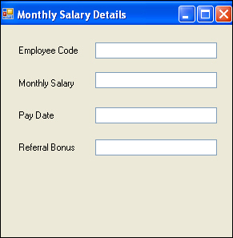
Simple Data Binding
Simple data binding is the process of binding a control, such as a text box or a label, to a single value in a dataset.
The dataset value can be bound to the control by using the properties of the control.
Consider an example where you need to perform simple data binding on the following Windows form to display the monthly salary details of an employee.
Notes:
Introduce the students to the different types of threats that systems face by:
Asking the students to give examples of what they think are environmental and human threats.
Asking the students to give instances of what they think are malicious and non-malicious threats.
Conclude the discussion on the different types of threats by giving additional examples of malicious and non malicious threats.

Slide 4
Simple Data Binding (Contd.)
To perform simple data binding, you need to perform the following steps:
  Select View→Properties Window to open the Properties window.
  Select the first text box to display its properties in the Properties window.
  Expand the (Data Bindings) property.
  Select the Text property to enable the drop-down list. Click the drop-down list.
  Click the Add Project Data Source in the drop-down list.
  Create a connection with the HR database and select the MonthlySalary table.
  Expand the Other Data Sources→Project Data Sources→HRDataSet→MonthlySalary nodes and select the cEmployeeCode column. This binds the data of this column in the first text box and creates monthlySalaryBindingSource.
Notes:
Introduce the students to the different types of threats that systems face by:
Asking the students to give examples of what they think are environmental and human threats.
Asking the students to give instances of what they think are malicious and non-malicious threats.
Conclude the discussion on the different types of threats by giving additional examples of malicious and non malicious threats.

Slide 5
Simple Data Binding (Contd.)
  Select the second text box.
  Expand the (DataBindings) property.
  Select the Text property to enable the drop-down list.
  Expand monthlySalaryBindingsource node and select mMonthlySalary column to bind second text box.
  Similarly, bind dPayDate, and mReferralBonus columns to the third and fourth text boxes, respectively.
Notes:
Introduce the students to the different types of threats that systems face by:
Asking the students to give examples of what they think are environmental and human threats.
Asking the students to give instances of what they think are malicious and non-malicious threats.
Conclude the discussion on the different types of threats by giving additional examples of malicious and non malicious threats.

Slide 6
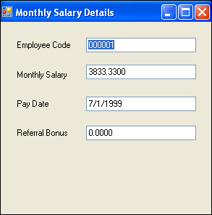
Simple Data Binding (Contd.)
  Press F5 or select Debug→Start Debugging to run the Windows form. The final output is displayed, as shown in the following figure.
Notes:
Introduce the students to the different types of threats that systems face by:
Asking the students to give examples of what they think are environmental and human threats.
Asking the students to give instances of what they think are malicious and non-malicious threats.
Conclude the discussion on the different types of threats by giving additional examples of malicious and non malicious threats.

Slide 7
Complex Data Binding
Complex data binding is the process of binding a component, such as a DataGridView control or a ListBox control, to display multiple values from a dataset.
The following table describes the controls that are generally used to bind data from a database to a Windows form.
Control | Description
ListBox | This control is used to display data for a column from multiple records of a dataset. The DataSource property of the ListBox control is used to bind the control to a data source, such as a DataSet or DataTable. The DisplayMember property of the ListBox control is used to bind the control to a specific data element, such as a column of a DataTable.
ComboBox | This control has two parts, a text box for entering data and a drop-down list box for displaying the data. The DataSource property of the ComboBox control is used to bind the control to a DataSource, such as DataSet or DataTable. The DisplayMember property of the ComboBox control is used to bind the control to a specific data element, such as a column of a DataTable.
Notes:
Introduce the students to the different types of threats that systems face by:
Asking the students to give examples of what they think are environmental and human threats.
Asking the students to give instances of what they think are malicious and non-malicious threats.
Conclude the discussion on the different types of threats by giving additional examples of malicious and non malicious threats.

Slide 8
Complex Data Binding (Contd.)
Control | Description
DataGridView | This control can display data from multiple records as well as multiple columns. The DataSource property of the DataGridView control is used to bind the to a specific data element, such as a column of a DataTable.
Notes:
Introduce the students to the different types of threats that systems face by:
Asking the students to give examples of what they think are environmental and human threats.
Asking the students to give instances of what they think are malicious and non-malicious threats.
Conclude the discussion on the different types of threats by giving additional examples of malicious and non malicious threats.

Slide 9
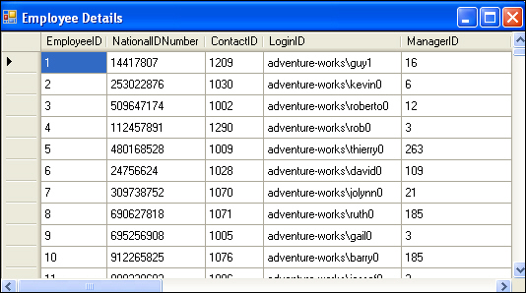
Complex Data Binding (Contd.)
For example, the following figure displays employee details, stored in the AdventureWorks database, in a grid format by using the DataGridView control.
Notes:
Introduce the students to the different types of threats that systems face by:
Asking the students to give examples of what they think are environmental and human threats.
Asking the students to give instances of what they think are malicious and non-malicious threats.
Conclude the discussion on the different types of threats by giving additional examples of malicious and non malicious threats.

Slide 10
Just a minute
Which of the following controls is used to perform simple data binding:
  Label
  Combo Box
  List Box
  DataGridView
Answer:
  1. Label
Notes:
In this slide you need to show the calculation to determine the sum of an arithmetic progression for bubble sort algorithm. Refer to student guide.

Slide 11
Navigating Between Records
For every data source that is bound to a Windows Form control, there exists a BindingNavigator control.
The BindingaNavigator control handles the binding to the data source by keeping a pointer to the current item in the record list.
The following figure illustrates the relationship between the BindingNavigator control and a Windows form.
Windows Form
Control 1
Control 2
Control 3
BindingNavigator 1
DATA SOURCE 1
BindingNavigator 2
DATA SOURCE 2
BindingNavigator 3
DATA SOURCE 3
Notes:
Introduce the students to the different types of threats that systems face by:
Asking the students to give examples of what they think are environmental and human threats.
Asking the students to give instances of what they think are malicious and non-malicious threats.
Conclude the discussion on the different types of threats by giving additional examples of malicious and non malicious threats.

Slide 12
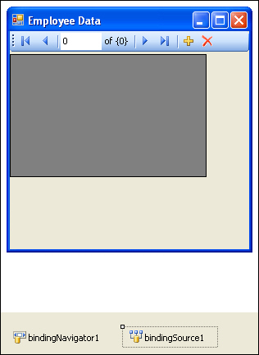
Navigating Between Records (Contd.)
The BindingNavigator control is frequently used with the BindingSource control to enable users to navigate through data records on a form and interact with the records.
The following figure displays the BindingNavigator control and the BindingSource control displayed in a Windows form.
Notes:
Introduce the students to the different types of threats that systems face by:
Asking the students to give examples of what they think are environmental and human threats.
Asking the students to give instances of what they think are malicious and non-malicious threats.
Conclude the discussion on the different types of threats by giving additional examples of malicious and non malicious threats.

Slide 13
Navigating Between Records (Contd.)
The BindingNavigator control has various controls for modifying the data source.
The following table describes the various controls, their symbols, and functions in the BindingNavigator control.
Control | Symbol | Function
bindingNavigatorAddNewItem button |  | Inserts a new row to the data source.
bindingNavigatorDeleteItem button |  | Deletes the current row from the data source.
bindingNavigatorMoveFirstItem button |  | Moves to the first item in the data source.
bindingNavigatorMoveLastItem button |  | Moves to the last item in the data source.
bindingNavigatorMoveNextItem button |  | Moves to the next item in the data source.
Notes:
Introduce the students to the different types of threats that systems face by:
Asking the students to give examples of what they think are environmental and human threats.
Asking the students to give instances of what they think are malicious and non-malicious threats.
Conclude the discussion on the different types of threats by giving additional examples of malicious and non malicious threats.

Slide 14
Navigating Between Records (Contd.)
Control | Symbol | Function
bindingNavigatorMovePreviousItem button |  | Moves to the previous item in the data source.
bindingNavigatorPositionItem text box |  | Returns the current position within the data source.
bindingNavigatorCountItem text box |  | Returns the total number of items in the data source.
Notes:
Introduce the students to the different types of threats that systems face by:
Asking the students to give examples of what they think are environmental and human threats.
Asking the students to give instances of what they think are malicious and non-malicious threats.
Conclude the discussion on the different types of threats by giving additional examples of malicious and non malicious threats.

Slide 15
Just a minute
Which control of the BindingNavigator returns the current position within the data source?
  bindingNavigatorMoveFirstItem button
  bindingNavigatorPositionItem text box
  bindingNavigatorMoveLastItem button
  bindingNavigatorCountItem text box
Answer:
  2. bindingNavigatorPositionItem text box
Notes:
In this slide you need to show the calculation to determine the sum of an arithmetic progression for bubble sort algorithm. Refer to student guide.

Slide 16
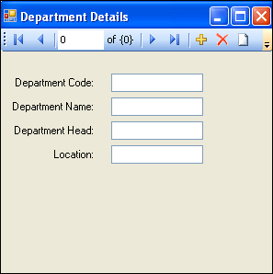
Demo: Implementing Data Binding
Problem Statement:
  Peter Parkinson is the HR Vice President at Tebisco, a leading producer and distributor of snacks in the United States. Peter needs to view the details of various departments functioning in the organization in a customized format, as shown in the following figure.
Notes:
While explaining the definition of system forensics, ask the students to note the following key words in the definition:
Identify
Extract
Process
Analyze
Digital and hardware evidence
Tell the students that these form an integral aspect of system forensics and would be discussed in detail.
Before moving on to the next slide, hold a brief discussion on why is it important for organizations to take the help of system forensics. The discussion should be focused on:
The role that system forensics plays in organizations having an IT set up.
This discussion will serve as a precursor to the next slide.

Slide 17
Demo: Implementing Data Binding (Contd.)
  As part of the development team, you need to retrieve the department details for Peter, in the preceding format.
  Hint: You need to refer to the Department table of the HR database.
Notes:
While explaining the definition of system forensics, ask the students to note the following key words in the definition:
Identify
Extract
Process
Analyze
Digital and hardware evidence
Tell the students that these form an integral aspect of system forensics and would be discussed in detail.
Before moving on to the next slide, hold a brief discussion on why is it important for organizations to take the help of system forensics. The discussion should be focused on:
The role that system forensics plays in organizations having an IT set up.
This discussion will serve as a precursor to the next slide.

Slide 18
Just a minute
_______ control handles the binding to the data source by keeping a pointer to the current item in the record list.
  bindingNavigatorPositionItem
  BindingSource
  BindingNavigator
  DataGridView
Answer:
  3. BindingNavigator
Notes:
In this slide you need to show the calculation to determine the sum of an arithmetic progression for bubble sort algorithm. Refer to student guide.

Slide 19
Filtering Data
There may be a situation where you need to display only selective records. In such cases, you filter the data so as to display only the desired records.
There are two methods for filtering data:
  Creating parameterized queries.
  Filtering data using controls of a Windows form.
Notes:
While explaining the definition of system forensics, ask the students to note the following key words in the definition:
Identify
Extract
Process
Analyze
Digital and hardware evidence
Tell the students that these form an integral aspect of system forensics and would be discussed in detail.
Before moving on to the next slide, hold a brief discussion on why is it important for organizations to take the help of system forensics. The discussion should be focused on:
The role that system forensics plays in organizations having an IT set up.
This discussion will serve as a precursor to the next slide.

Slide 20
Creating Parameterized Queries
For developers, stored procedures have always been the preferred method of data access from a database.
Stored procedures provide the benefits of precompiled execution, reduced network traffic, efficient reuse of code, and enhanced security measures for the data stored in a database.
However, a more secure way is to create parameterized queries.
By using parameterized queries, data can be filtered based on the criterion entered by a user at run time.
Notes:
While explaining the definition of system forensics, ask the students to note the following key words in the definition:
Identify
Extract
Process
Analyze
Digital and hardware evidence
Tell the students that these form an integral aspect of system forensics and would be discussed in detail.
Before moving on to the next slide, hold a brief discussion on why is it important for organizations to take the help of system forensics. The discussion should be focused on:
The role that system forensics plays in organizations having an IT set up.
This discussion will serve as a precursor to the next slide.

Slide 21
Creating Parameterized Queries (Contd.)
The following code snippet shows how to setup and execute the parameterized query:
  SqlConnection con = new
  SqlConnection();
  con.ConnectionString =
  "Data Source= SQLSERVER01;
  Initial Catalog=HR; User
  ID=sa; Password=niit#1234";
  con.Open();
  string serachemployeecode;
  searchemployeecode =
  textBox1.Text;
Creating a connection string
Establishing a connection with the database
textBox1 contains value of employeecode for which data needs to be extracted from database
Notes:
While explaining the definition of system forensics, ask the students to note the following key words in the definition:
Identify
Extract
Process
Analyze
Digital and hardware evidence
Tell the students that these form an integral aspect of system forensics and would be discussed in detail.
Before moving on to the next slide, hold a brief discussion on why is it important for organizations to take the help of system forensics. The discussion should be focused on:
The role that system forensics plays in organizations having an IT set up.
This discussion will serve as a precursor to the next slide.

Slide 22
Creating Parameterized Queries (Contd.)
  string query = "SELECT *
  FROM MonthlySalary WHERE
  cemployeeCode =
  @employeecode";
  SqlCommand cmd = new
  SqlCommand(query, con);
  cmd.Parameters.Add(new
  SqlParameter("@employeeco
  de", searchempcode));
  SqlDataReader dr =
  cmd.ExecuteReader();
Setting up the SQL statement to be executed
Initializing the command object to execute the connection
Passing parameter objects
Executing the command and returning the DataReader
Notes:
While explaining the definition of system forensics, ask the students to note the following key words in the definition:
Identify
Extract
Process
Analyze
Digital and hardware evidence
Tell the students that these form an integral aspect of system forensics and would be discussed in detail.
Before moving on to the next slide, hold a brief discussion on why is it important for organizations to take the help of system forensics. The discussion should be focused on:
The role that system forensics plays in organizations having an IT set up.
This discussion will serve as a precursor to the next slide.

Slide 23
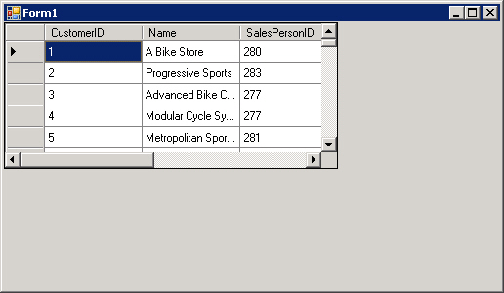
Filtering Data Using Controls of a Windows Form
After the data is retrieved from a data source, you can filter this data to view selective records.
This filtering can be done by either passing parameterized queries or by using controls in a Windows form.
Consider an example, where the sales manager of an organization wants to view the sales information of various stores in a grid format. This data can be displayed by establishing the connection to the database and binding the data by using the DataGridView control, as shown in the following figure.
Notes:
While explaining the definition of system forensics, ask the students to note the following key words in the definition:
Identify
Extract
Process
Analyze
Digital and hardware evidence
Tell the students that these form an integral aspect of system forensics and would be discussed in detail.
Before moving on to the next slide, hold a brief discussion on why is it important for organizations to take the help of system forensics. The discussion should be focused on:
The role that system forensics plays in organizations having an IT set up.
This discussion will serve as a precursor to the next slide.

Slide 24
Filtering Data Using Controls of a Windows Form (Contd.)
FillBy is a TableAdapter query. TableAdapter queries are SQL statements or stored procedures that an application can execute against a database.
You can execute TableAdapter queries by calling the FillBy() method code that appears in the Click event of the FillByToolStrip control.
The FillBy() method populates the data from a data source in a datatable. This method can also return a new datatable populated with the data returned by a TableAdapter query.
In addtition to FillByToolStrip control, you can also filter the data using the DataView control of a Windows form.
A DataView control creates a customized view of the data stored in a datatable. By default, every table has a data view attached to it.
Notes:
While explaining the definition of system forensics, ask the students to note the following key words in the definition:
Identify
Extract
Process
Analyze
Digital and hardware evidence
Tell the students that these form an integral aspect of system forensics and would be discussed in detail.
Before moving on to the next slide, hold a brief discussion on why is it important for organizations to take the help of system forensics. The discussion should be focused on:
The role that system forensics plays in organizations having an IT set up.
This discussion will serve as a precursor to the next slide.

Slide 25
Filtering Data Using Controls of a Windows Form (Contd.)
You add and bind a DataView control to a Windows form to create a customized view of the data that filter records according to some criterion.
To add a DataView control to a Windows form, you need to perform the following steps:
  1. Drag the DataView control from the All Windows Form
  drop-down list box of the Toolbox pane to the Windows form.
  If the DataView control is not visible in the toolbox, you can right-click the Toolbox window and select Choose Items option from the drop-down list box. This will open the Choose Toolbox Items dialog box. Check the DataView option from the .NET Framework Components tab in the dialog box. This will make the DataView control visible in the toolbox.
Notes:
While explaining the definition of system forensics, ask the students to note the following key words in the definition:
Identify
Extract
Process
Analyze
Digital and hardware evidence
Tell the students that these form an integral aspect of system forensics and would be discussed in detail.
Before moving on to the next slide, hold a brief discussion on why is it important for organizations to take the help of system forensics. The discussion should be focused on:
The role that system forensics plays in organizations having an IT set up.
This discussion will serve as a precursor to the next slide.

Slide 26
Filtering Data Using Controls of a Windows Form (Contd.)
  2. Set the properties for the DataView control in the Properties window. The following table describes the various properties of the DataView control.
Property | Description
Allow Delete, Allow Add, and Allow Edit | These properties are used to specify whether the records can be added, deleted, or edited respectively.
ApplyDefaultSort | This property is used to specify the default sort, if the Sort property is not set.
GenerateMember | This property specifies if a member variable will be generated for the control.
Modifiers | This property specifies the visibility level of the DataView object.
RowFilter | This property is used to specify an expression/condition in a string format used to filter the records. The records that satisfy the condition will only be included in the view.
Notes:
While explaining the definition of system forensics, ask the students to note the following key words in the definition:
Identify
Extract
Process
Analyze
Digital and hardware evidence
Tell the students that these form an integral aspect of system forensics and would be discussed in detail.
Before moving on to the next slide, hold a brief discussion on why is it important for organizations to take the help of system forensics. The discussion should be focused on:
The role that system forensics plays in organizations having an IT set up.
This discussion will serve as a precursor to the next slide.

Slide 27
Filtering Data Using Controls of a Windows Form (Contd.)
Property | Description
RowStateFilter | This property specifies the versions of data returned by this DataView.
Sort | This property is used to specify an expression on the basis of which the records will be sorted. The expression includes the column name and the sort qualifier, which is ASC or DESC, to display the records in the ascending or descending order .
Table | This property is used to specify the DataTable to which the data view would refer. The property can be set either at design time or run time.
Notes:
While explaining the definition of system forensics, ask the students to note the following key words in the definition:
Identify
Extract
Process
Analyze
Digital and hardware evidence
Tell the students that these form an integral aspect of system forensics and would be discussed in detail.
Before moving on to the next slide, hold a brief discussion on why is it important for organizations to take the help of system forensics. The discussion should be focused on:
The role that system forensics plays in organizations having an IT set up.
This discussion will serve as a precursor to the next slide.

Slide 28
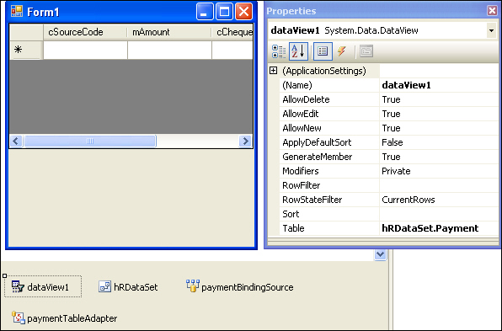
Filtering Data Using Controls of a Windows Form (Contd.)
The DataView control and its properties are displayed in the following figure.
Notes:
While explaining the definition of system forensics, ask the students to note the following key words in the definition:
Identify
Extract
Process
Analyze
Digital and hardware evidence
Tell the students that these form an integral aspect of system forensics and would be discussed in detail.
Before moving on to the next slide, hold a brief discussion on why is it important for organizations to take the help of system forensics. The discussion should be focused on:
The role that system forensics plays in organizations having an IT set up.
This discussion will serve as a precursor to the next slide.

Slide 29
Just a minute
Which property of the DataView control specifies an expression/condition in a string format to filter the records?
  1. Modifiers
  2. RowStateFilter
  3. Sort
  4. RowFilter
Answer:
  4. RowFilter
Notes:
In this slide you need to show the calculation to determine the sum of an arithmetic progression for bubble sort algorithm. Refer to student guide.

Slide 30
Just a minute
Which property of the DataView control specifies the versions of data returned by a DataView?
  1. Table
  2. AllowEdit
  3. RowStateFilter
  4. GenerateMembers
Answer:
  3. RowStateFilter
Notes:
In this slide you need to show the calculation to determine the sum of an arithmetic progression for bubble sort algorithm. Refer to student guide.

Slide 31
Demo: Implementing Filtering of Data
Problem Statement:
  Robert Smith, the HR Manager of Tebisco, needs to view the candidate code, employee code, internal job posting code, position code applied for, date of application, test date, test score, interview date, interviewer, interview comments, rating, status, and test scores of candidates who scored in the top two ranges (between 90-100 and between 80-90). As a developer in the organization, you need to design an application that will display the required details.
  Hint: You need to refer to the InternalCandidate table of the HR database.
Notes:
While explaining the definition of system forensics, ask the students to note the following key words in the definition:
Identify
Extract
Process
Analyze
Digital and hardware evidence
Tell the students that these form an integral aspect of system forensics and would be discussed in detail.
Before moving on to the next slide, hold a brief discussion on why is it important for organizations to take the help of system forensics. The discussion should be focused on:
The role that system forensics plays in organizations having an IT set up.
This discussion will serve as a precursor to the next slide.

Slide 32
Summary
In this session, you learned that:
  Data binding is the ability to bind some elements of a data source with the controls of a Windows Form.
  Data binding is of two types:
    Simple data binding
    Complex data binding
  Simple data binding is the process of binding a control, such as a textbox or a label, to a value in a dataset.
  Complex data binding is the process of binding a component, such as a DataGridView control or a ListBox control, to display the values of multiple columns from a dataset.

Slide 33
Summary (Contd.)
  The data can be filtered to display only the desired records.
  There are two methods for filtering data:
    Creating parameterized queries.
    Filtering data using controls of a Windows form.
  By using parameterized queries, data can be filtered based on the criterion entered by a user at run time.
  FillByToolStrip and DataView controls in a Windows form can be used to filter the data to view selective records.

