Slide 1

Objectives
In this session, you will learn to:
  The technical context for Web services
  Key components of Web service technology
  Create a Web service and client
  Deploy and use a Web service
  Debug a Web service
  Determine Web service connectivity
  Explain XML serialization of user-defined classes
  Pass complex data types between a Web service and a client

Slide 2
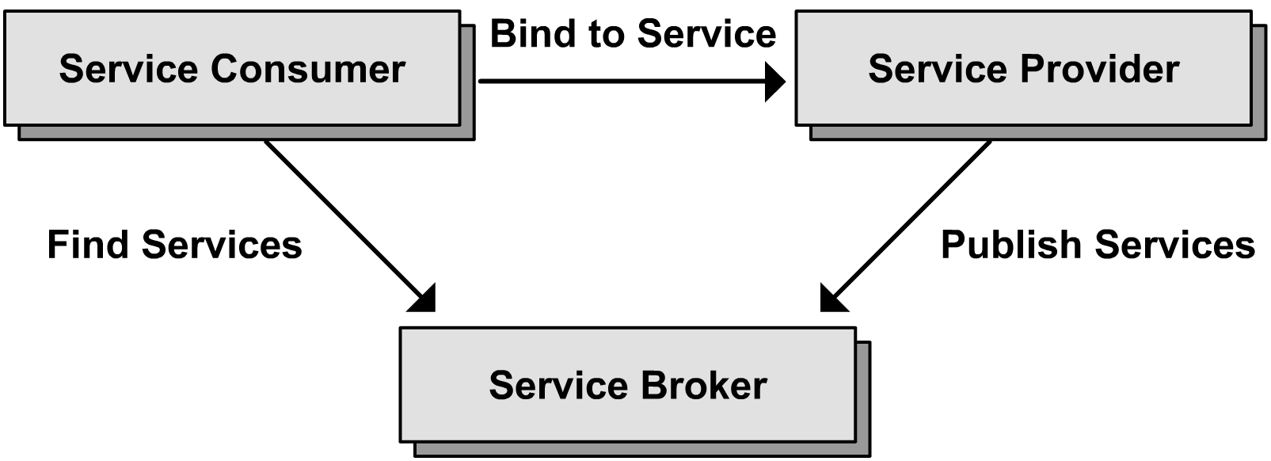
Web Services
Web Services:
  It is a set of functions that, packaged as a component and can be invoked over heterogeneous network. An Web Service resides on Web Server.
Web Services Architecture:
  The following figure shows the elements of Web Services in a service oriented architecture:

Slide 3
Technical Context of Web Services
Key features of Web Services:
  Web Services are based on Extensible Markup Language (XML).
  Web Services integrate applications running on different operating systems and programming languages.
  Web services are based on established standards and are highly platform independent.
  Client and server are loosely coupled.

Slide 4
Technical Context of Web Services (Contd.)
Comparing Web Services with Other Distributed Technologies:
  .Net Remoting and Web Services
    In .Net Remoting the client and server are very tightly coupled and there is less concern with inter-platform interoperability.
    Distributed applications built with web services are not efficient but are more interoperable with other systems.
  Message Queues and Web Services
    Message queues are particularly useful when message processing is asynchronous and the communications link availability is intermittent.

Slide 5
Technical Context of Web Services (Contd.)
Service-Oriented Architecture:
  Is a set of components that can be invoked and whose interface descriptions can be published and discovered.
  Includes service providers, service consumers, and a service repository.
Native Support in the .NET Framework:
  .NET Framework supports the creation and use of Web services.

Slide 6
Components of Web Service Technology
XML:
  Stands for Extensible Markup language.
  Is a popular standards for platform-neutral interchange of structured data managed by the W3C.
  Is an intrinsic part of the .NET framework providing features for manipulating XML documents.
SOAP:
  Stands for Simple Object Access Protocol.
  Is an XML-based messaging technology standardized by the W3C.
  Specifies all the necessary rules for communicating with the Web services.

Slide 7
Components of Web Service Technology (Contd.)
HTTP:
  Stands for Hypertext Transfer Protocol.
  Is used by Web services to transfer the SOAP-formatted documents between cooperating computers.
WSDL:
  Stands for Web Services Description Language.
  Is an XML file that encloses the interface schema for the XML Web services.
  Provides information about accessing published XML Web services to clients.

Slide 8
Components of Web Service Technology (Contd.)
UDDI:
  Stands for Universal Description, Discovery, and Integration.
  Specifies the standard for publishing and discovering information about XML web services.

Slide 9
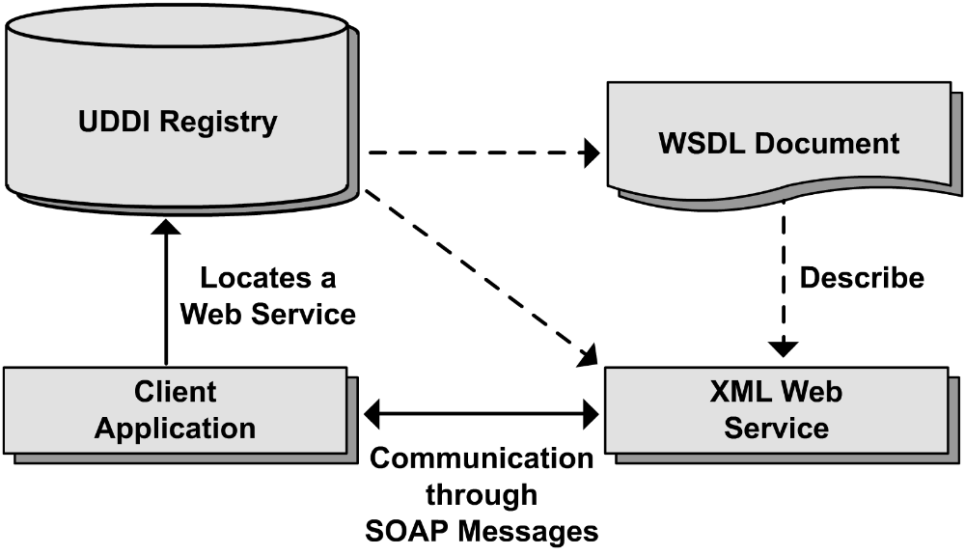
Components of Web Services
Components of Web Services:

Slide 10
Demo: Building and Consuming a Simple XML Web Service
Problem Statement 1: Creating a Web Service and Client
  You are a developer in the International Trade department of the Adventure Works cycle-manufacturing company. You have been asked to provide a Web service for other applications within the company. One function of the service is to take a string representing a country and return the name of the currency used in that country.

Slide 11
Demo: Building and Consuming a Simple XML Web Service (Contd.)
Solution:
  To solve this problem, you need to perform the following tasks:
    Create a Web Service.
    Create a client for the Web service.
    Examine the discovery features of the Web Service.

Slide 12
Demo: Building and Consuming a Simple XML Web Service (Contd.)
Problem Statement 2: Working with the Client Proxy
  Examine the client-side code for a Web service.

Slide 13
Demo: Building and Consuming a Simple XML Web Service (Contd.)
Solution:
  To solve this problem, you need to perform the following tasks:
    Modify the Web method attributes.
    Create a proxy class manually.

Slide 14
Demo: Building and Consuming a Simple XML Web Service (Contd.)
Problem Statement 3: Deploying a Web Service and Configuring a Client
  Until now, you have used the ASP.NET development Server to host the Web service. This is convenient, because you do not require IIS to develop and test Web services. The ASP.NET Development server makes it possible to develop applications quickly if IIS is not available, or in development environments where IIS has been removed for security reasons. However, the ASP.NET Development Server is not suitable for production use. You will be required to deploy the Web Service to an IIS host.

Slide 15
Demo: Building and Consuming a Simple XML Web Service (Contd.)
Solution:
  To solve this problem, you need to perform the following tasks:
    Create a Web Setup project and deploy the Web service to IIS.
    Update the client application to use the deployed Web Service on IIS.

Slide 16
Demo: Building and Consuming a Simple XML Web Service (Contd.)
Problem Statement 4: Debugging and Exception Handling in Web Services
  Add a new method to the Web service and Debug the Web method.

Slide 17
Demo: Building and Consuming a Simple XML Web Service (Contd.)
Solution:
  To solve this problem, you need to perform the following tasks:
    Add a new method to the Web service.
    Debug the Web method.

Slide 18
Demo: Building and Consuming a Simple XML Web Service (Contd.)
Problem Statement 5: Determine Web Service Connectivity
  You will look at technique for a client to determine if a Web service is active. This is important when the communication between a Web service client and server takes place over the Internet or a wide are network (WAN) and where the connectivity may be unreliable or intermittent.

Slide 19
Demo: Building and Consuming a Simple XML Web Service (Contd.)
Solution:
  To solve this problem, you need to perform the following task:
    Determine Web service connectivity from client to server.

Slide 20
XML Serialization
XML Serialization:
  Is a process of converting data to XML is known as XML serialization and the reverse is known as deserialization.
  .NET Framework supports two serialization mechanisms:
    XML Serialization: It is used by Web services.
    Binary Serialization: It is used by other service architecture.
  System.Runtime.Serialization.Formatters.Soap. SoapFormatter class handles the formatting of a remote procedure call when using SOAP.
  SoapFormatter class uses the System.Xml.Serialization.XmlSerializer class to serialize and deserialize parameters and results.

Slide 21
XML Serialization (Contd.)
  Both SoapFormatter and XMLSerializer class uses the .NET Framework metadata and generate XML using commonly accepted defaults.
    These defaults can be overridden by adding attributes to the Web service class, to individual methods within that class, and to the definitions of classes used to hold parameter and result types.

Slide 22
How to Use Complex Data Types in Web Services
Methods Can Use Any Class Accepted by XmlSerializer:
  Methods of a Web service use objects of any class for parameter values and results, provided that those classes can be serialized and deserialized by using XmlSerializer.
  The following Code snippet defines a WebMethod Scale:
  public class Coordinate{
  public double x;
  public double y;
  }
  [WebMethod] public Coordinate Scale(Coordinate p){….}
Method of web service takes single parameter of coordinate class

Slide 23
How to Use Complex Data Types in Web Services (Contd.)
Only Public Data Members Are Serialized:
  When a client-side proxy is created for a class defined by Web services, only public data members of the class are created, and the XML serializer only works with public data members.
  Private and protected data members of a class, as well as methods of any kind, are never serialized.
Pass by Reference Is Simulated by Copying:
  If a parameter is passed by reference, the parameter value is copied from client to server when the Web method call is made and copied back again when the method returns.

Slide 24
Summary
In this session, you learned that:
  Key features of Web Services :
    Builds on existing Web technologies
    Platform-independent
    Loosely coupled
    Collaborative
  Web services are more interoperable and are useful for both synchronous and asynchronous communications.
  Web services are used to implement a service-oriented architecture.
  The .NET Framework supports the creation and use of Web services.

Slide 25
Summary (Contd.)
  The various components of Web Service technology are:
    XML
    SOAP
    HTTP
    WSDL
    UDDI
  Web services make extensive use of XML for formatting messages and data.
  Methods of Web service use objects of those classes which can be serialized and deserialized.
  No private or protected members and methods are serialized.
  Pass by reference is simulated by copying.

