Slide 14
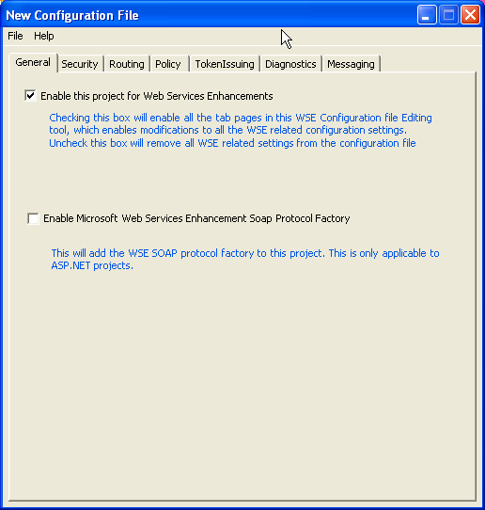
What Is Message Transmission Optimization Mechanism (MTOM)? (contd.)
Configure MTOM Server Mode:
  Right click on the solution explorer and select the WSE 3.0 .Select Enable this project for Web Service Enhancement soap protocol.

