Slide 1
Objectives
In this session, you will learn to:
  Describe the purpose and features of the servlet context
  Develop a servlet context listener to initialize a shared application resource
  Describe the Analysis model
  Design entity components
  Design service components
Notes:
Start the session by explaining the objectives listed in Slide 1. Students should understand how to share application data in the context scope. They will also learn how to create a servlet context listener to initialize application data.
Students should understand the two fundamental Model components: Services and Entities.
These two types of components are part of Unified Process’ (UP) Analysis model, but are called Control and Entity in Jacobson’s original work. I changed “Control” to “Service” to: (a) eliminate the confusion that would occur with Controller components, and (b) be more aligned with modern service-oriented architectures (SOA). It is good to remember that these two types of Model components are very closely aligned with the J2EE model, where a Service maps to a Session bean and an Entity maps to an Entity bean.
Use the following flow for this module:
● Describe the purpose and features of the servlet context
● Develop a servlet context listener to initialize a shared application resource
Exercise 1: Share the DVD list using the context scope
Exercise 2: Load the DVD list from a resource file
● Describe the Analysis model
● Design entity components
● Design service components
Exercise 1: Recognizing Model Functionality
Exercise 2: Designing a DVD Library Service
Exercise 3: Refactor the DVD Application Using the DVD Library Service

Slide 2
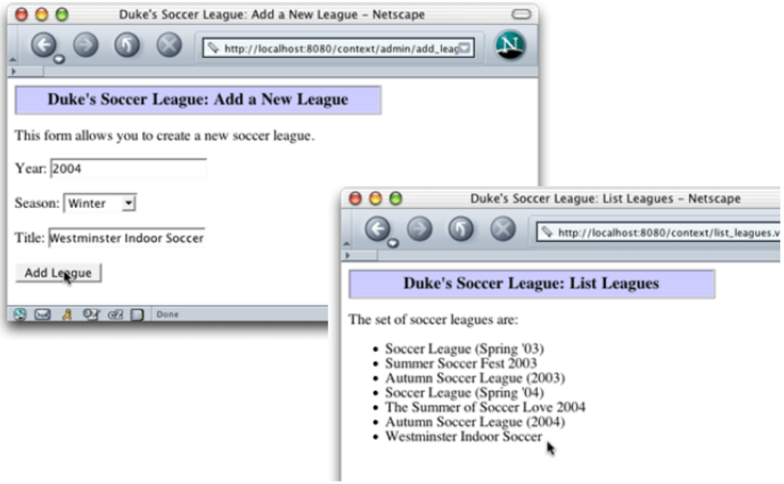
Soccer League Demonstration
Notes:
Use this slide to explain the students how the AddLeague servlet adds a league that is displayed by the ListLeagues servlet.

Slide 3
Servlet Context
A web application is a self-contained collection of static and dynamic resources.
The web application deployment descriptor is used to specify the structure and services used by a web application.
A ServletContext object is the runtime representation of the web application.
Notes:
Use this slide to explain about the servlet context. The container creates the ServetContext when the web application is deployed. The ServletContext interface defines a set of methods that a servlet uses to communicate with its servlet container. There is one context per web application. The information in the ServletContext is common to all the components.

Slide 4
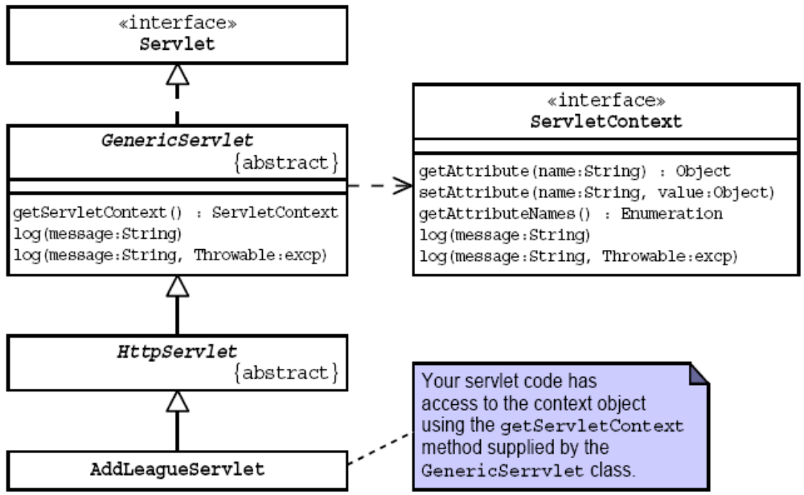
The ServletContext API
Notes:
Use Slides 4 and 5 to explain about the ServletContext API. Explain the methods of the ServletContext interface, as given in page 5-6 of the SG.

Slide 5
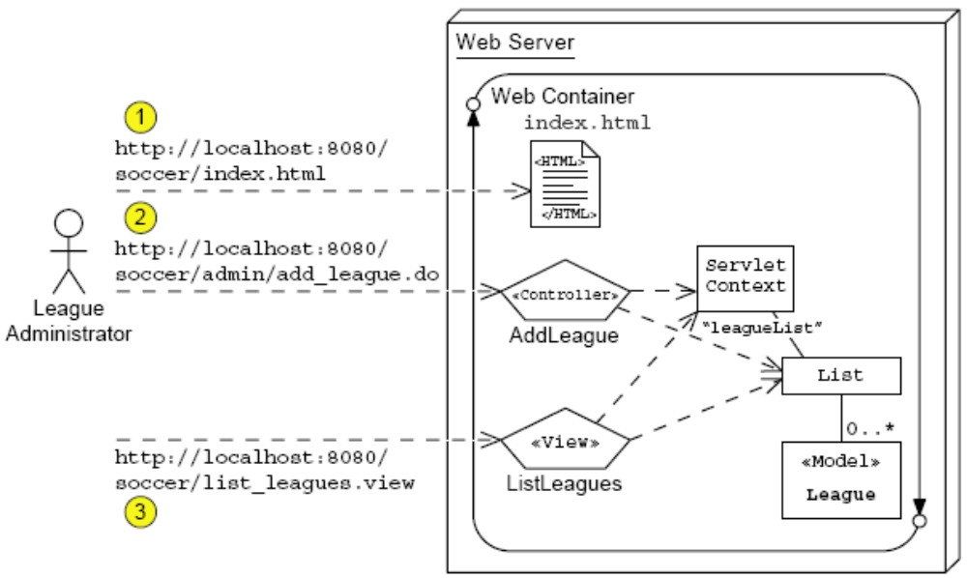
The ServletContext API (Contd.)

Slide 6
Modified AddLeagueServlet Code
63
64 // Perform business logic
65 League league = new League(year, season, title);
66 // Store the new league in the request-scope
67 request.setAttribute(“league”, league);
68
69 // Store the new league in the leagueList
context-scope attribute
70 ServletContext context = getServletContext();
71 List leagueList = (List)
context.getAttribute(“leagueList”);
72 leagueList.add(league);
73
74 // Send the Success view
75 RequestDispatcher view
76 = request.getRequestDispatcher(“success.view”);
77 view.forward(request, response);
78 return;
Notes:
Use this slide to explain about the modified AddLeagueServlet code.

Slide 7
Modified ListLeaguesServlet Code
14
15 public class ListLeaguesServlet extends HttpServlet {
16
17 public void doGet(HttpServletRequest request,
18 HttpServletResponse response)
19 throws IOException {
20
21 // Set page title
22 String pageTitle = “Duke’s Soccer League: List
Leagues”;
23
24 // Retrieve the list of leagues from the context-scope
25 ServletContext context = getServletContext();
26 List leagueList = (List)
context.getAttribute(“leagueList”);
27
28 // Specify the content type is HTML
29 response.setContentType(“text/html”);
30 PrintWriter out = response.getWriter();
31
32 // Generate the HTML response
33 out.println(“<html>”);
Notes:
Use Slides 7 and 8 to explain about the modified ListLeaguseServlet code.

Slide 8
Modified ListLeaguesServlet Code (Contd.)
46
47 // Generate main body
48 out.println(“<p>”);
49 out.println(“The set of soccer leagues are:”);
50 out.println(“</p>”);
51
52 out.println(“<ul>”);
53 Iterator items = leagueList.iterator();
54 while ( items.hasNext() ) {
55 League league = (League) items.next();
56 out.println(“ <li>” + league.getTitle() + “</li>”);
57 }
58 out.println(“</ul>”);

Slide 9
League List Initialization Example
The following tasks need to be performed to initialize the leagueList context-scoped attribute:
  Determine the location of the leagues.txt file.
  Read the leagues.txt file.
  Create League objects for each row in the leagues.txt file and store them in a List object.
  Store the list of leagues in the leagueList context attribute.
  Log the fact that the list was initialized, or log any exception thrown by this code.
Notes:
Use this slide to explain the tasks that need to be performed to initialize the leagueList context-scoped attribute.

Slide 10
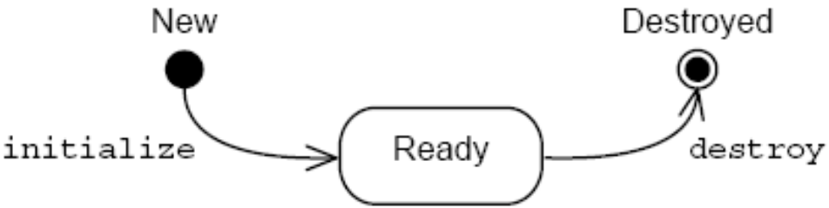
Web Application Life Cycle
When the web container is started, each web application is initialized.
When the web container is shut down, each web application is destroyed.
A servlet context listener can be used to receive these web application life cycle events.
Notes:
Use this slide to explain the life cycle of a Web application.

Slide 11
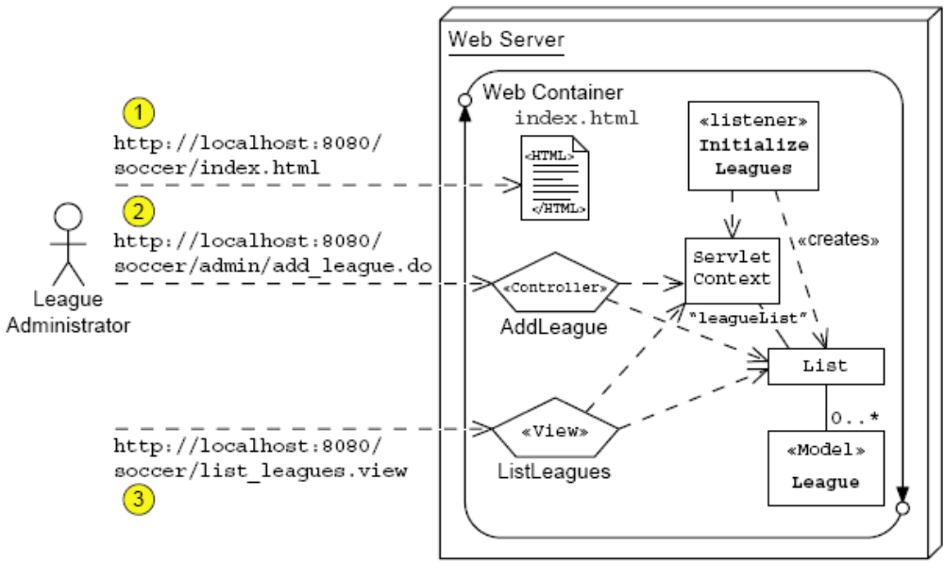
Soccer League Architecture Model (Revisited)
Notes:
Use this slide to explain the Architecture model of the Soccer League Web application.

Slide 12
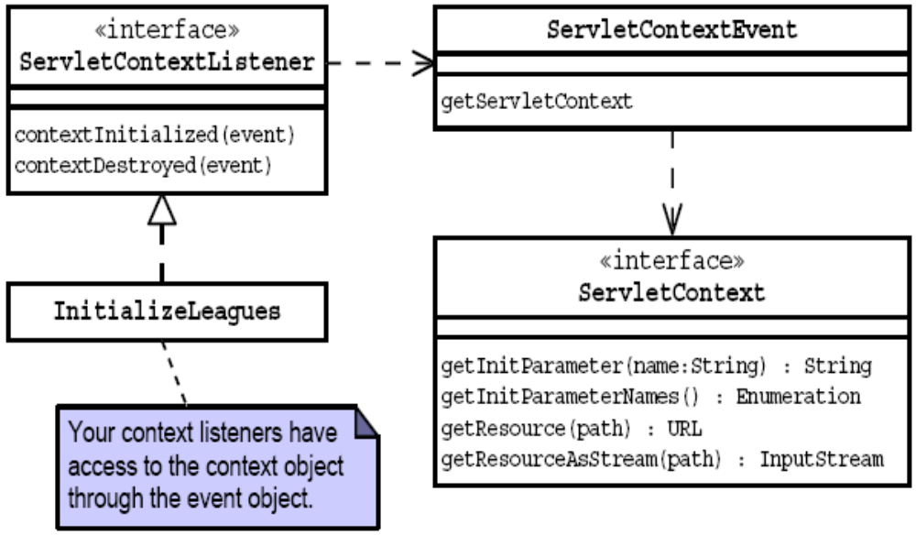
The ServletContextListener API
Notes:
Use this slide to explain the ServletContextListener API. If the class wants to listen for application startup and shutdown events, then the ServletContextListener interface needs to be implemented. This interface contains two methods:
public void contextInitialized(ServletContextEvent sc);
public void contextDestroyed(ServletContextEvent sc);

Slide 13
The InitializeLeagues Code
3 import javax.servlet.ServletContextListener;
4 import javax.servlet.ServletContextEvent;
5 import javax.servlet.ServletContext;
6 // Support classes
7 import java.io.InputStream;
8 import java.io.InputStreamReader;
9 import java.io.BufferedReader;
10 // Model classes
11 import sl314.model.League;
12 import java.util.List;
13 import java.util.LinkedList;
14
15 public class InitializeLeagues implements
ServletContextListener {
16
17 public void contextInitialized(ServletContextEvent
event) {
18 ServletContext context = event.getServletContext();
19 List leagueList = new LinkedList();
20 String leaguesFile = context.getInitParameter
(“leagues-file”);
21 InputStream is = null;
22 BufferedReader reader = null;
Notes:
Use the Slides 13, 14, and 15 to explain the InitializeLeagues code.

Slide 14
The InitializeLeagues Code (Contd.)
23
24 try {
25 is = context.getResourceAsStream(leaguesFile);
26 reader = new BufferedReader(new
InputStreamReader(is));
27 String record;
28
29 // Read every record (one per line)
30 while ( (record = reader.readLine()) != null ) {
31 String[] fields = record.split(“\t”);
32
33 // Extract the data fields for the record
34 int year = Integer.parseInt(fields[0]);
35 String season = fields[1];
36 String title = fields[2];
37
38 // Add the new League item to the list
39 League item = new League(year, season, title);
40 leagueList.add(item);
41 }

Slide 15
The InitializeLeagues Code (Contd.)
42
43 context.setAttribute(“leagueList”, leagueList);
44
45 context.log(“The league list has been loaded.”);
46
47 } catch (Exception e) {
48 context.log(“Exception occured while processing the
leagues file.”, e);
49
50 } finally {
51 if ( is != null ) {
52 try { is.close(); } catch (Exception e) {}
53 }
54 if ( reader != null ) {
55 try { reader.close(); } catch (Exception e) {}
56 }
57 }
58
59 } // END of contextInitialized

Slide 16
Soccer League Deployment Descriptor
3 <web-app
4 xmlns=”http://java.sun.com/xml/ns/j2ee”
5 xmlns:xsi=”http://www.w3.org/2001/XMLSchema-instance”
6 xsi:schemaLocation=”http://java.sun.com/xml/ns/j2ee
7 http://java.sun.com/xml/ns/j2ee/web-app_2_4.xsd”
8 version=”2.4”>
9
10 <display-name>SL-314 WebApp Example</display-name>
11 <description>
12 This Web Application demonstrates using the
context-scope to store
13 a common resource: the “leagueList” for the Soccer
League webapp.
14 </description>
15
16 <context-param>
17 <param-name>leagues-file</param-name>
18 <param-value>/WEB-INF/data/leagues.txt</param-value>
19 </context-param>
20
21 <listener>
22 <listener-class>sl314.web.InitializeLeagues
</listener-class>
23 </listener>
Notes:
Use this slide to explain about the deployment descriptor for the Soccer League Web application.

Slide 17
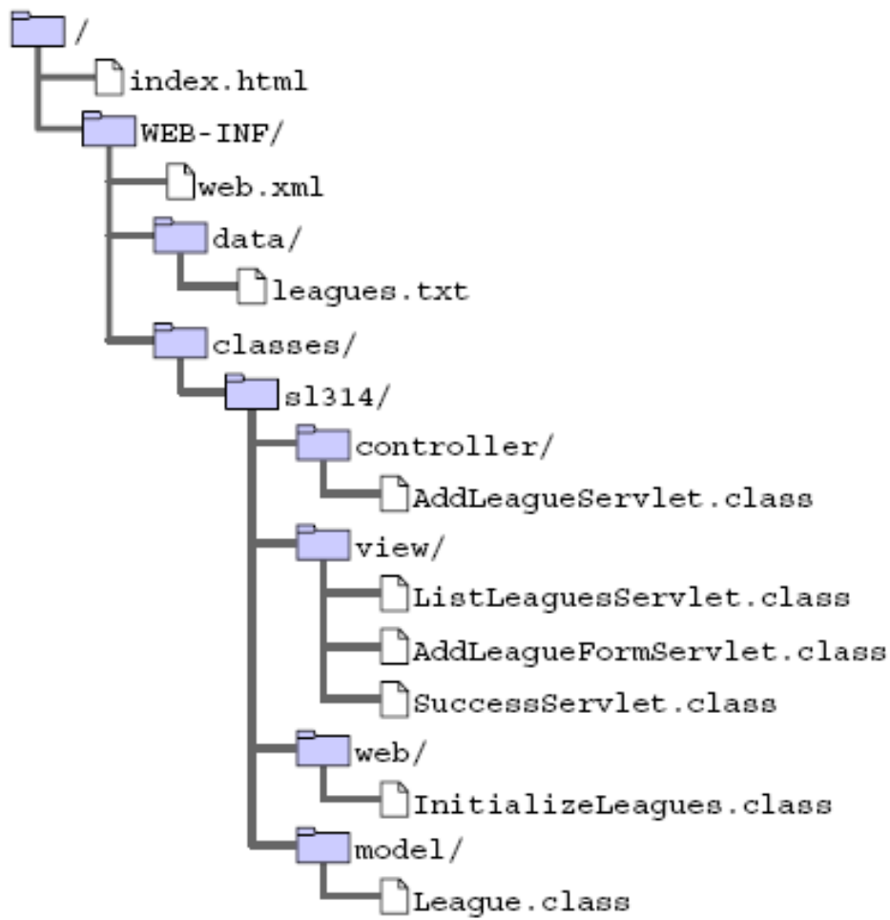
Soccer League Physical Hierarchy
Notes:
Use this slide to explain about the physical hierarchy of the Soccer League Web application.

Slide 18



Describing the Analysis Model
An Analysis model is used to bridge the gap between use case analysis and component design.
An Analysis model consists of three abstract component types:
Component | Symbol | Description
Boundary |  | Communicates between the user and the system.
Service |  | Provides a services-oriented layer between boundary and entity components.
Entity |  | Represents domain objects and persistent data.
Notes:
Use this slide to explain about the Analysis model. Start by describing about the Analysis model and then explain its three components.

Slide 19
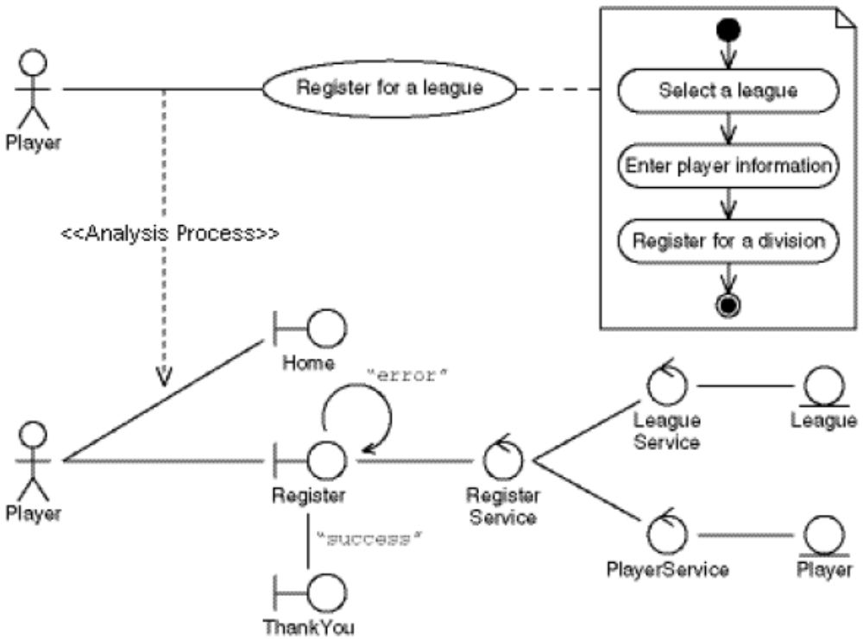
Registration Use Case Analysis Process
Notes:
Use this slide to describe the Register for a League Use Case Analysis Model.

Slide 20
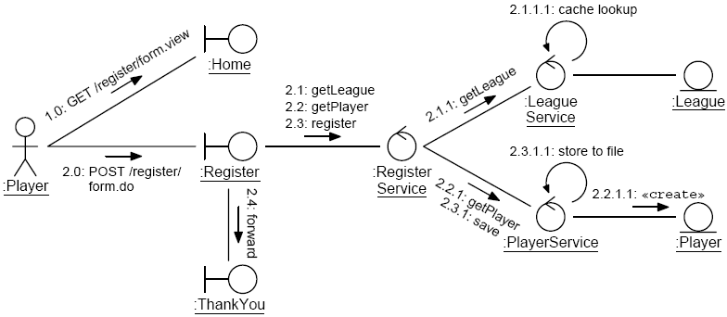
Detailed Analysis Model
Notes:
Use this slide to explain the detailed Analysis model.

Slide 21
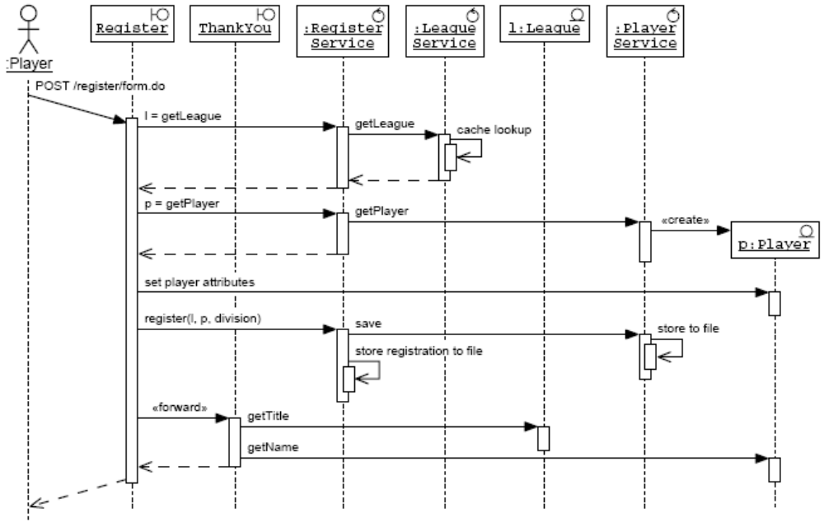
Another View: UML Sequence Diagram
Notes:
Use this slide to explain about the UML sequence diagram. Sequence diagrams realize the use cases by describing the flow of events in the use cases when they are executed.

Slide 22
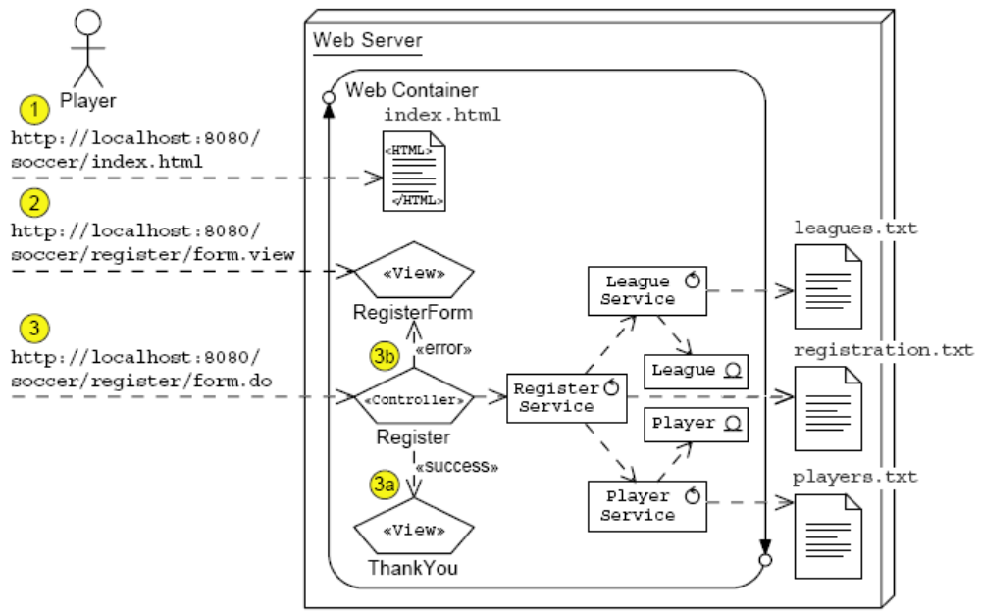
Another View: UML Deployment Diagram
Notes:
Use this slide to explain about the UML Deployment diagram for the Register for a League Use Case.

Slide 23
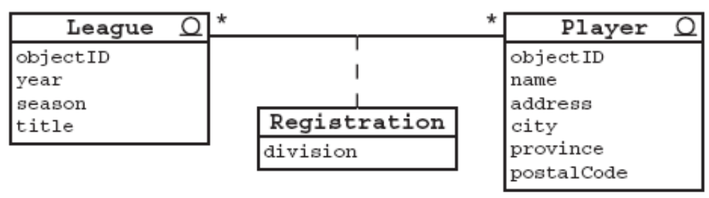
Domain Entities
Domain entities are real world business objects.
For example:
Can you name other entities that might exist in a Soccer League application?
What about other domains (such as retail, financial, and so on)?
Notes:
Use this slide to explain about the Domain Entities. Ask the students about other use cases that might be added to the Soccer League system. Examples might include View Team Rosters, View Team Schedule, Draft Players to Teams, Assign Teams to Divisions, or even an expansion of the Register for a League use case (in which a player can volunteer to captain a team).

Slide 24
The Player Code
1 package sl314.model;
2
3 /**
4 * This domain object represents a player in a soccer
league.
5 */
6 public class Player {
7
8 String name = ““;
9 String address = ““;
10 String city = ““;
11 String province = ““;
12 String postalCode = ““;
13
14 /**
15 * This is the constructor. It is package-private to
prevent misuse.
16 * The PlayerService.getPlayer method should be used
to create a
17 * new player object.
18 */
19 Player(String name) {
20 this(name, ““, ““, ““, ““);
21 }
Notes:
Use Slides 24, 25, and 26 to explain the coding for the Player class.

Slide 25
The Player Code (Contd.)
14 /**
15 * This is the constructor. It is package-private to
prevent misuse.
16 * The PlayerService.getPlayer method should be used
to create a
17 * new player object.
18 */
19 Player(String name) {
20 this(name, ““, ““, ““, ““);
21 }
22
23 /**
24 * This is the full constructor.
25 */
26 Player(String name, String address, String city,
27 String province, String postalCode) {
28 this.name = name;
29 this.address = address;
30 this.city = city;
31 this.province = province;
32 this.postalCode = postalCode;
33 }
34

Slide 26
The Player Code (Contd.)
35 public String getName() {
36 return name;
37 }
38 public void setName(String value) {
39 name = value;
40 }
41 public String getAddress() {
42 return address;
43 }
44 public void setAddress(String value) {
45 address = value;
46 }
47 public String getCity() {
48 return city;
49 }
50 public void setCity(String value) {
51 city = value;
52 }
53 public String getProvince() {
54 return province;
55 }

Slide 27

Entity Service
Some entity-related operations cannot be performed by the entity component itself:
  Creation – Creating a new instance of the entity
  Retrieval – Retrieving a unique instance in the data store
  Selection – Retrieving a set of instances in the data store
  Aggregation – Performing a calculation (such as an average) over a set of instances
  Deletion – Removing an instance from the data store
Notes:
Use this slide to explain about the Entity service.

Slide 28
The LeagueService Code
1 package sl314.model;
2
3 import java.util.List;
4 import java.util.LinkedList;
5 import java.util.Iterator;
6 import java.util.Collections;
7 import java.io.File;
8 import java.io.FileReader;
9 import java.io.BufferedReader;
10 import java.io.FileWriter;
11 import java.io.PrintWriter;
12 import java.io.IOException;
13
14 /**
15 * This object performs a variety of league services,
such as looking
16 * up league objects and creating new ones.
17 */
18 public class LeagueService {
19
Notes:
Use Slides 28, 29, 30, and 31 to explain the code for the LeagueService class.

Slide 29
The LeagueService Code (Contd.)
20 /** The cache of League objects. */
21 private static final List LEAGUES_CACHE = new
LinkedList();
22 private String dataDirectory;
23
24 public LeagueService(String dataDirectory) {
25 this.dataDirectory = dataDirectory;
26
27 // Make sure that the leagues cache has been
initialized
28 synchronized ( LEAGUES_CACHE ) {
29 if ( LEAGUES_CACHE.isEmpty() ) {
30 cacheLeagues();
31 }
32 }
33 }
34
35 /**
36 * This method returns a complete set of leagues.
37 */
38 public List getAllLeagues() {
39 // Return an immutable List; which makes this read-only

Slide 30
The LeagueService Code (Contd.)
40 return Collections.unmodifiableList(LEAGUES_CACHE);
41 }
42
43 /**
44 * This method finds the specified League object from
45 * the complete set of leagues.
46 */
47 public League getLeague(int year, String season)
48 throws ObjectNotFoundException {
49
50 // Search in the cache.
51 Iterator set = LEAGUES_CACHE.iterator();
52 while ( set.hasNext() ) {
53 League l = (League) set.next();
54 if(season.equals(l.getSeason())&&(year ==
l.getYear())){
55 return l;
56 }
57 }
58
59 // Throw an exception if the league was not found.
60 throw new ObjectNotFoundException();
61 }

Slide 31
The LeagueService Code (Contd.)
62
63 /**
64 * This method adds a new League object.
65 */
66 public League createLeague(int year, String season,
String title) {
67
68 // Determine the next league objectID
69 int nextID = LEAGUES_CACHE.size() + 1;
70
71 // Create new league object
72 League league = new League(nextID, year, season,
title);
73
74 // Store the league object
75 storeLeague(league);
76
77 // Record the league in the cache for easy retrieval
78 LEAGUES_CACHE.add(league);
79
80 return league;
81 }
82

Slide 32
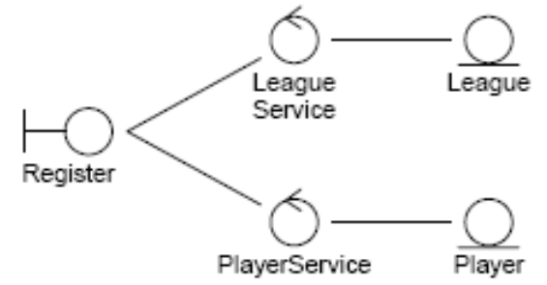
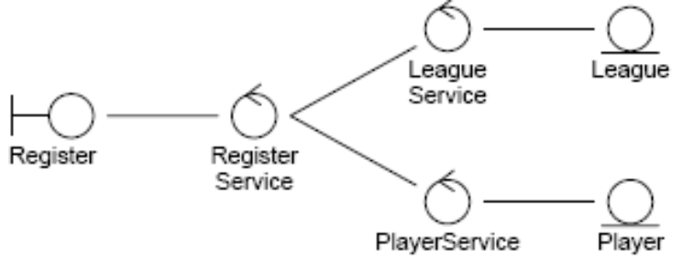
Façade Service
A façade service might be used to reduce coupling between boundary components and other services.
  High Coupling Low Coupling
Notes:
Use this slide to explain about the Facade service. Explain the figures given in the slide to describe the concept of Facade service.

Slide 33
The RegisterService Code
1 package sl314.model;
2
3 import java.io.File;
4 import java.io.FileWriter;
5 import java.io.PrintWriter;
6 import java.io.IOException;
7
8 /**
9 * This object performs a variety of league registration
10 services. It acts a Facade into the business logic of
11 registering a Player for a League.
12 */
13 public class RegisterService {
14 private String dataDirectory;
15
16 public RegisterService(String dataDirectory) {
17 this.dataDirectory = dataDirectory;
18 // do nothing
19 }
20
Notes:
Use Slides 33, 34, and 35 to explain the code for the RegisterService class.

Slide 34
The RegisterService Code (Contd.)
21 /**
22 * This method finds the specified league, by
23 delegating to the LeagueService object.
24 */
25 public League getLeague(int year, String season)
26 throws ObjectNotFoundException {
27 LeagueService leagueSvc = new
LeagueService(dataDirectory);
28 return leagueSvc.getLeague(year, season);
29 }
30
31 /**
32 * This method return a Player object for the named
33 person, by delegating to the PlayerService object.
34 */
35 public Player getPlayer(String name) {
36 PlayerService playerSvc = new
PlayerService(dataDirectory);
37 return playerSvc.getPlayer(name);
38 }

Slide 35
The RegisterService Code (Contd.)
39
40 /**
41 * This method stores the registration information for
42 the player, based on the league and division
information.
43 */
44 public void register(League league, Player player,
String division) {
45
46 // Use the player service to save the player object
47 PlayerService playerSvc = new
PlayerService(dataDirectory);
48 playerSvc.save(player);
49
50 // Record the registration
51 insertRegistration(league, player, division);
52 }
53

Slide 36
Demo: Add a New League
Demo: Add a New League
Notes:
Use this slide to demonstrate about developing dynamic forms. You can run the project, ModelDemo stored at Datafiles For Faculty\Session09\Demo1\mod06_model.zip file in the TIRM CD for demonstration.
To demonstrate about adding a new league, you need to perform the following tasks:
1. Create the InitializeModelProperties.java in the sl314.util package.
2. Create the AddLeagueServlet.java and RegisterServlet.java files in the sl314.controller package.
3. Create the AddLeagueFormServlet.java, ListLeaguesServlet.java, RegisterFormServlet.java, SuccessServlet.java, ThankYouServlet.java files in the sl314.view package.
4. Create the League.java, LeagueService.java, ObjectNotFoundException.java, Player.java, PlayerService.java, RegisterService.java files in the sl314.model package.
5. Configure the web.xml file.

Slide 37
Summary
In this session, you learned:
  The ServletContext object can store application attributes (name/object pairs) globally across all web components.
  You can initialize shared application resources by creating a class that implements the ServletContextListener interface.
  An Analysis model bridges the gap between analysis (of use cases) and design (of application components).
  Boundary components have two aspects: views and controllers.
  Entity components represent real world business objects.
  Service components provide functional services to the boundary components for manipulating entities.
Notes:
End the session by discussing the summary points as given in this slides.

