Slide 1

Objectives
In this session, you will learn to:
  Describe how to build web page layouts from reusable presentation components
  Include JSP segments
  Develop layouts using the Struts Tiles framework
Notes:
Start the session by explaining the objectives listed in Slide 1. Struts was introduced in session 8. That session only described the controller aspects of Struts. This session describes the view aspects of Struts. In particular, this session covers the action form classes that encapsulate HTML form data and the html tag library from Struts which defines a set of tags that can be used to repopulate form fields.
Code reusability can take many forms. In this session, students are introduced to the concept of presentation component reuse. That is, segments of static or dynamic presentation content are used in a set of complete web pages. These segments promote a consistent look and feel across the whole web application.
Use the following flow in this session:
● Describe the components in a Struts application
● Develop an ActionForm class
● Develop a JSP page for a View form
● Configure the View forms
Exercise 1: Developing a Struts Action Form
Advanced Exercise 2: Using the Struts HTML Tag Library
● Describe how to build web page layouts from reusable presentation components
● Include JSP segments
● Develop layouts using the Struts Tiles framework
Exercise 1: Create a layout page from a template
Exercise 2: Create the tiles pages for the DVD application

Slide 2
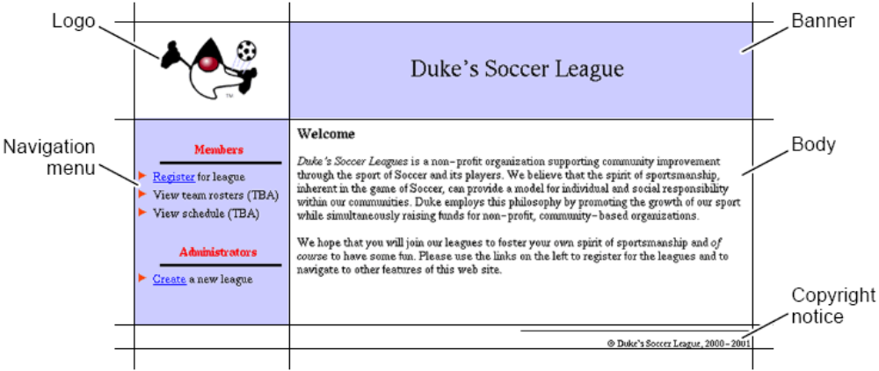
Complex Page Layouts
Notes:
Use Slides 2 and 3 to explain about the complex page layouts. Demonstrate the Soccer League application. Demonstrate several paths through the application. There are two versions: step1 and step2. Both versions are identical from the look and feel perspective. Build the examples/jsp_reuse/step1/ lab files directory and use the http://localhost:8080/jsp_reuse1/ URL.

Slide 3
Complex Page Layouts (Contd.)
Use a hidden table to construct your layout:
  <body>
  <table border=’0’ cellpadding=’0’ cellspacing=’0’ width=’640’>
  <tr>
  <td width=’160’> <!-- logo here --> </td>
  <td width=’480’> <!-- banner here --> </td>
  </tr>
  <tr>
  <td width=’160’> <!-- navigation menu here --> </td>
  <td width=’480’> <!-- main content here --> </td>
  </tr>
  <tr>
  <td width=’160’> <!-- nothing here --> </td>
  <td width=’480’> <!-- copyright notice here --> </td>
  </tr>
  </table>
  </body>

Slide 4
Presentation Segment Overview
A segment can be any text file that contains static HTML or dynamic JSP technology code:
  1 <%@ taglib prefix=”myTags” uri=”/WEB-INF/myTags.tld” %>
  2
  3 <spacer height=’15’>
  4 <hr width=’50%’ align=’right’ size=’1’ noshade
  color=’blue’>
  5 <font size=’2’ face=’Helvetica, san-serif’>
  6 &copy; Duke’s Soccer League,
  2000-<myTags:getCurrentYear />
  7 </font>
Note: Segments should not contain html, head, or body
tags.
Notes:
Use this slide to explain about the presentation segment.

Slide 5
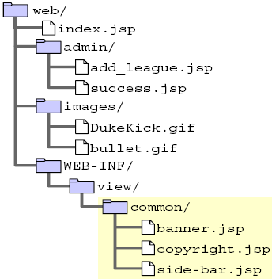
Organizing Presentation Segments
You should isolate your reusable segments.
Notes:
Use Slides 5 and 6 to explain about organizing presentation segments.

Slide 6
Organizing Presentation Segments (Contd.)
Content pages can be anywhere in the web application.
If stored with other content (such as images), the content segments can be accessed directly from a client browser.
You can protect content from direct access by a browser by storing the segments under the WEB-INF directory.

Slide 7
Including JSP Page Segments
There are two techniques for including presentation segments in your main JSP pages:
  The include directive
  The jsp:include standard action
Notes:
Use this slide to explain about including JSP page segments.

Slide 8
Using the include Directive
The include directive lets you include a segment into the text of the main JSP page at translation time.
  Syntax:
    <%@ include file=”segmentURL” %>
  Example:
    75 <!-- START of copyright notice -->
    76 <td align=’right’ width=’480’>
    77 <%@ include file=”/WEB-
    INF/view/common/copyright.jsp” %>
    78 </td>
    79 <!-- END of copyright notice -->
Notes:
Use this slide to explain about using the include directive. The include directive allows you to include a static file in a JSP file at translation time. The text of the included file is added to the JSP page. The included file can be a JSP file, an HTML file, a text file, or a code file written in the Java programming language.

Slide 9
Using the jsp:include Standard Action
The jsp:include action lets you include a segment into the text of the HTTP response at runtime.
  Syntax:
    <jsp:include page=”segmentURL” />
  Example:
    36 <!-- START of navigation menu -->
    37 <td bgcolor=’#CCCCFF’ width=’160’ align=’left’>
    38 <jsp:include page=”/WEB-
    INF/view/common/navigation.jsp” />
    39 </td>
    40 <!-- END of navigation menu -->
Notes:
Use this slide to explain about the <jsp:include> tag. The <jsp:include> standard action allows you to include either a static or a dynamic file. A static file is parsed and its content is included in the calling JSP page. A dynamic file acts on the request and sends back a result that is included in the JSP page.
Since the <jsp:include> element handles the static as well as the dynamic content, it is convenient to use when you do not know about the type of content.

Slide 10
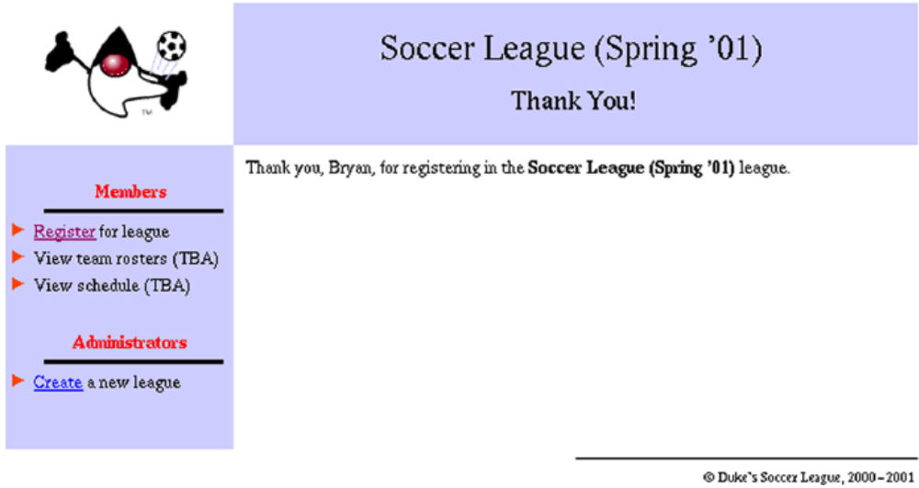
Using the jsp:param Standard Action
Notes:
Use Slides 10, 11 and 12 to explain about the jsp:param standard action. If you include a dynamic resource in the JSP page by using the <jsp:include> element, you can use a <jsp:param> element to pass the name and value of a parameter to the resource.

Slide 11
Using the jsp:param Standard Action (Contd.)
The jsp:include action can take dynamically specified
parameters using the jsp.param standard action.
For example, in the Soccer League home page:
  24 <!-- START of banner -->
  25 <jsp:include page=”/WEB-
  INF/view/common/banner.jsp”>
  26 <jsp:param name=”subTitle” value=”Welcome” />
  27 </jsp:include>
  28 <!-- END of banner -->

Slide 12
Using the jsp:param Standard Action (Contd.)
The subTitle parameter is attached to the request object.
  12
  13 <font size=’5’ face=’Helvetica, san-serif’>
  14 ${bannerTitle}
  15 </font>
  16
  17 <c:if test=”${not empty param.subTitle}”>
  18 <br/><br/>
  19 <font size=’4’ face=’Helvetica, san-serif’>
  20 ${param.subTitle}
  21 </font>
  22 </c:if>

Slide 13
Developing Layouts Using Struts Tiles
The basic idea of Tiles is to have a single (or small number) of layout files, rather than duplicating the layout code from one page to another.
  Views call the layout file.
  The layout file provides the layout and dynamically includes information provided by the views.
Notes:
Use this slide to explain about developing layouts using struts tiles. Tiles is a framework for developing the user interface. Tiles help develop the web applications by assembling the reusable tiles, like jsp, html. Tiles uses the concept of reuse and allows you to define a template for the web site. This layout is then used to populate the content of the web site.

Slide 14
The layoutPage.jsp Page
1 <%@ taglib prefix=”tiles”
2 uri=”http://jakarta.apache.org/struts/tags-tiles” %>
3 <%@ taglib prefix=”c”
4 uri=”http://java.sun.com/jsp/jstl/core” %>
5
6 <%-- Generate the HTML response --%>
7 <html>
8
9 <head>
10 <title>Duke’s Soccer League: <tiles:getAsString
name=”subTitle”/></title>
11 </head>
12
13 <body bgcolor=’white’>
14
Notes:
Use Slides 14, 15, 16, and 17 to explain about the layoutPage.jsp page.

Slide 15
The layoutPage.jsp Page (Contd.)
15 <table border=’0’ cellspacing=’0’ cellpadding=’0’
width=’640’>
16
17 <tr height=’100’>
18
19 <td align=’center’ valign=’center’ width=’160’
height=’100’>
20 <img src=’<c:url value=”/images/DukeKick.gif”/>’
21 alt=’Duke’s Soccer League Logo’>
22 </td>
23
24 <td bgcolor=’#CCCCFF’ align=’center’ valign=’center’
width=’480’ height=’100’>
25 <!-- START of banner -->
26 <c:set var=”subTitle”><tiles:getAsString
name=’subTitle’ /></c:set>
27 <jsp:include page=”/WEB-INF/view/common/banner.jsp”>
28 <jsp:param name=”subTitle” value=”${subTitle}” />
29 </jsp:include>
30 <!-- END of banner -->
31 </td>
32
33 </tr>

Slide 16
The layoutPage.jsp Page (Contd.)
34
35 <tr valign=’top’>
36
37 <!-- START of navigation menu -->
38 <td bgcolor=’#CCCCFF’ width=’160’ align=’left’>
39 <jsp:include page=”/WEB-INF/view/common/navigation.jsp”/>
40 </td>
41 <!-- END of navigation menu -->
42
43 <td width=’480’ align=’left’>
44 <div style=’margin-top: 0.1in; margin-left: 0.1in;
45 margin-bottom: 0.1in; margin-right: 0.1in’>
46 <!-- START of main content -->
47 <tiles:insert attribute=’body’ />
48 <!-- END of main content -->
49 </div>
50 </td>
51
52 </tr>
53

Slide 17
The layoutPage.jsp Page (Contd.)
54 <tr>
55
56 <td width=’160’>
57 <!-- nothing here -->
58 </td>
59
60 <!-- START of copyright notice -->
61 <td align=’right’ width=’480’>
62 <%@ include file=”/WEB-INF/view/common/copyright.jsp” %>
63 </td>
64 <!-- END of copyright notice -->
65
66 </tr>
67
68 </table>
69
70 </body>
71 </html>

Slide 18
Tiles Layout
View pages can include the layout page, passing
information as Tiles variables.
For example, the Registration Thank You page is:
  1 <%@ taglib prefix=”tiles”
  2 uri=”http://jakarta.apache.org/struts/tags-tiles”%>
  3
  4 <tiles:insert page=”/WEB-INF/view/layout/layoutPage.jsp”>
  5 <tiles:put name=”subTitle” value=”Thank You”/>
  6 <tiles:put name=”body” value=”/WEB-
  INF/view/register/thank_you.jsp”/>
  7 </tiles:insert>
  The variables subTitle and body provide content.
  Other views would provide different content.
Notes:
Use this slide to explain about the tiles layout. Tiles allows you to break the presentation page into small JSP snippets that perform a specific function but are not complete pages in their own rights. Each such snippet is known as a tile and you can create a presentation JSP by putting these tiles together.
The tiles mechanism is dynamically configurable. You can define an application layout and fill its portions dynamically based on the values that are known at runtime, such as the current locale settings.

Slide 19
Content Body
Content files are segments that provide only the content you
want to have in that part of the layout.
  1 <%@ page session=”true” %>
  2
  3 <p>
  4 Thank you, ${sessionScope.player.name}, for
  registering for
  5 the <i>${sessionScope.league.title}</i> league.
  6 </p>
Notes:
Use this slide to explain about the content body.

Slide 20
Demo: Building Reusable Web Presentation Components
Demo: Building Reusable Web Presentation Components
Notes:
In this demo, you demonstrate the use of filters in a Web application. You can run the two projects, JSPReuseDemo and TilesDemo, stored at Datafiles For Faculty\Session20\Demo2\mod14_jsp_reuse.zip file in the TIRM CD for demonstration.

Slide 21
Summary (Contd.)
In this session, you learned:
  Most modern web sites use graphically rich layouts.
  Graphically rich layouts include a lot of bulky HTML code to structure the hidden tables that create the page layout.
  The Tiles framework can help organize the layout code into a separate, easily maintained file.
  The layout file then includes various presentation segments.
    Some segments are reusable components, such as banners and navigation menus.
    Some segments are the actual body content of the page.
Notes:
End the session by discussing the summary points as given in Slide 21.

