Slide 1
AI boosted pQFT
automatic calculation
方尤乐，黄瑞钧，李想，母道明，谈澳 （Peking University）
Tsinghua University Hackathon
2025/08/24

Slide 2
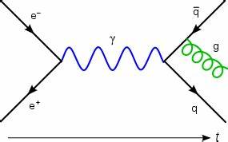
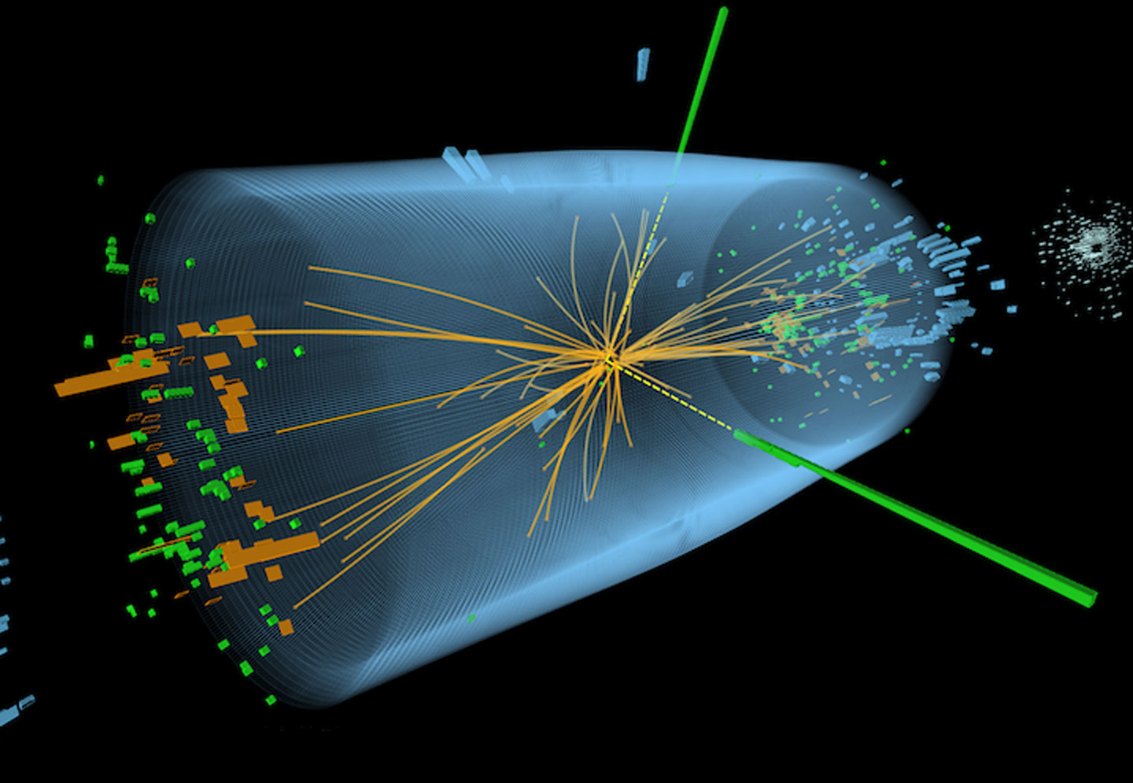
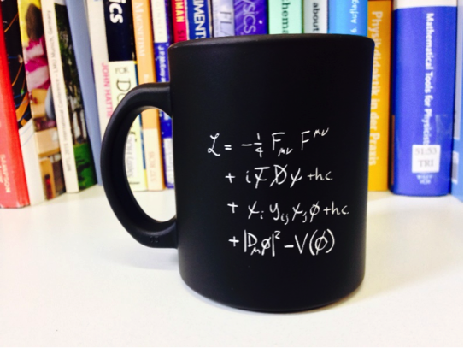
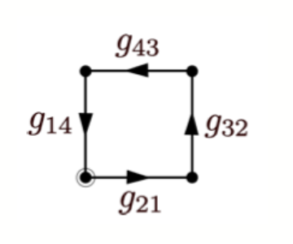
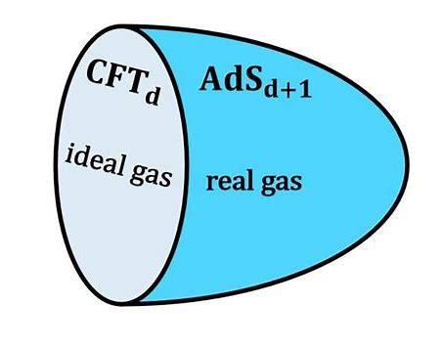
Quantum Field Theory
QFT as a function from nature to human knowledge:
New Physics?

Slide 3
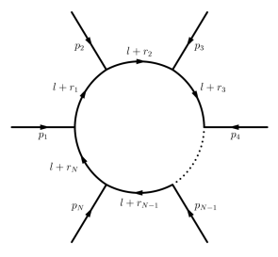
Perturbative Calculation
One-loop
One topology
Simple amplitudes
Known integrals
Package-X, MadGraph, …

Slide 4
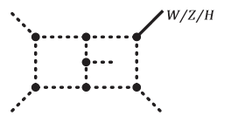
Perturbative Calculation
One-loop
Higher-loop
One topology
Simple amplitudes
Known integrals
Multiple topologies
Complex amplitudes
Unknown integrals
Package-X, MadGraph, …
FeynArts, Calcloop, Blade, Amflow,…

Slide 5
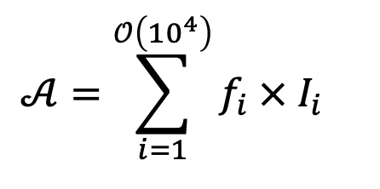
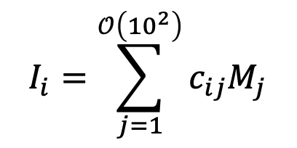
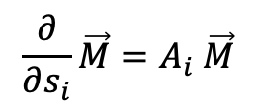
Perturbative Calculation
One-loop
Higher-loop
One topology
Simple amplitudes
Known integrals
Multiple topologies
Complex amplitudes
Unknown integrals
Package-X, MadGraph, …
FeynArts, Calcloop, Blade, Amflow,…
Feynman Amplitudes
Integral reduction
Integral calculation
$$\frac{∂}{∂s_{i}}\vec{M}=A_{i} \vec{M}$$
O(minutes/hours)
O(days/weeks)
O(minutes/hours)

Slide 6

Perturbative Calculation
One-loop
Higher-loop
One topology
Simple amplitudes
Known integrals
Multiple topologies
Complex amplitudes
Unknown integrals
Package-X, MadGraph, …
FeynArts, Calcloop, Blade, Amflow,…
Feynman Amplitudes
Integral reduction
Integral calculation
PhD degree
$$\frac{∂}{∂s_{i}}\vec{M}=A_{i} \vec{M}$$
O(minutes/hours)
O(days/weeks)
O(minutes/hours)
O(years)

Slide 7
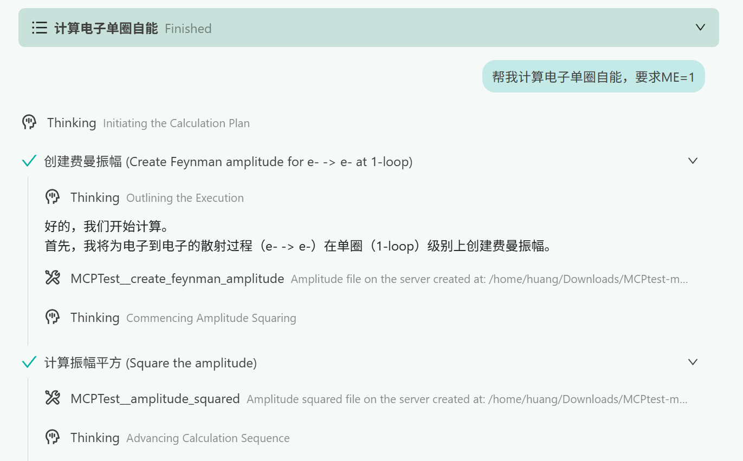
AI boosted automatic calculation

Slide 8
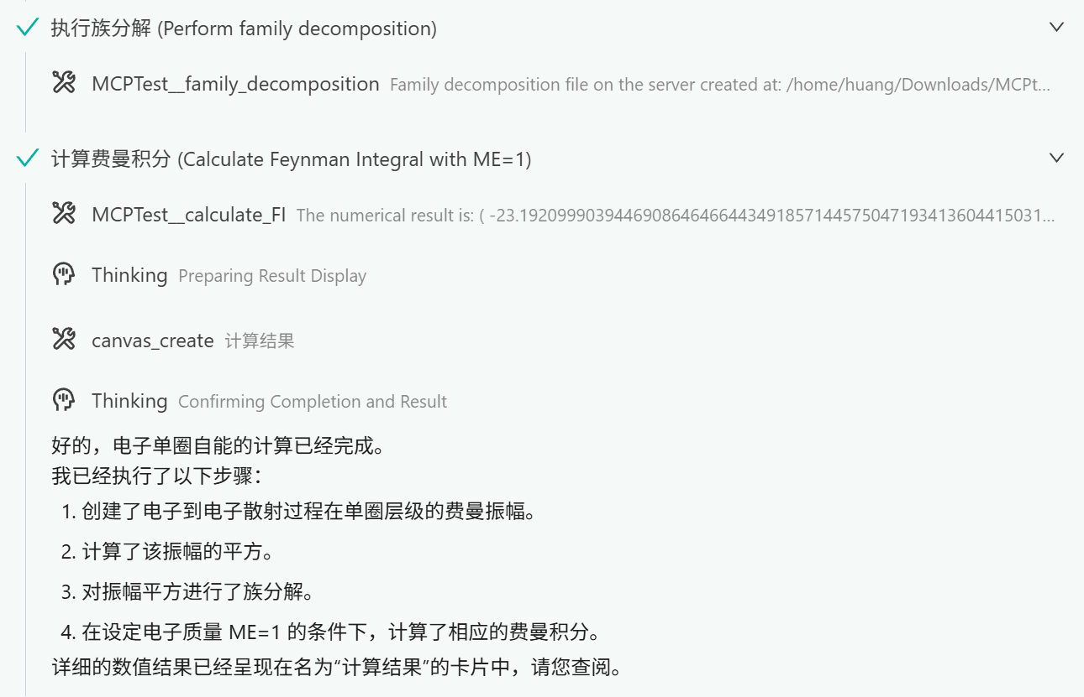
AI boosted automatic calculation

Slide 9
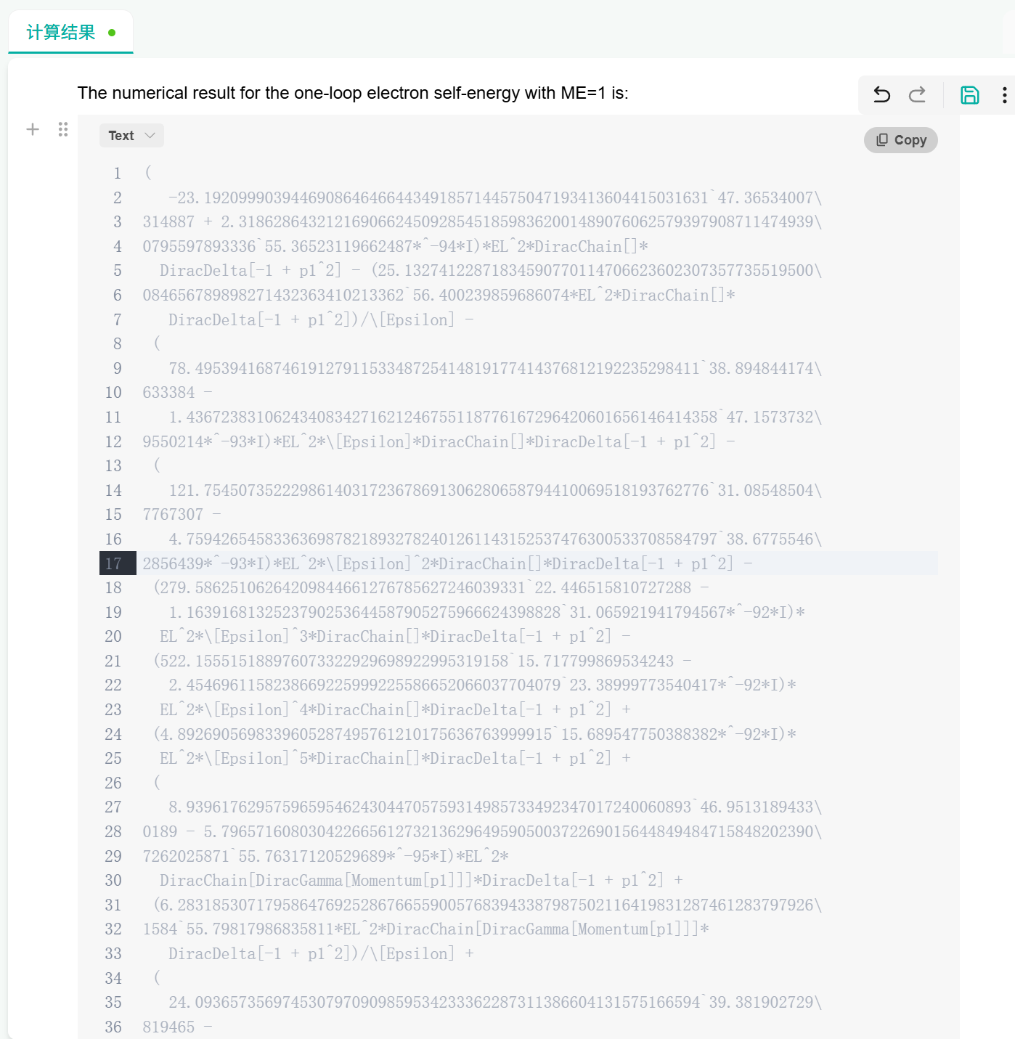
AI boosted automatic calculation

Slide 10
Summary and Outlook
Confirm the complete calculation process for forward scattering amplitude/total cross section
Create Feynman amplitudes
Complete Algebra Calculation
Decompose to integral families
Reduce to master integrals
Calculate master integrals at given phase points
User friendly
Remind users of incomplete input
Save complete and verifiable calculation processes
Starting from any intermediate steps
Outlook
Measurement beyond total cross section
Effective Field Theory
(Semi-)Analytic results

