Slide 1
Information Visualisation Assignment 4 Navigation in Visualisation
Xiaochen LI
1315943

Slide 2
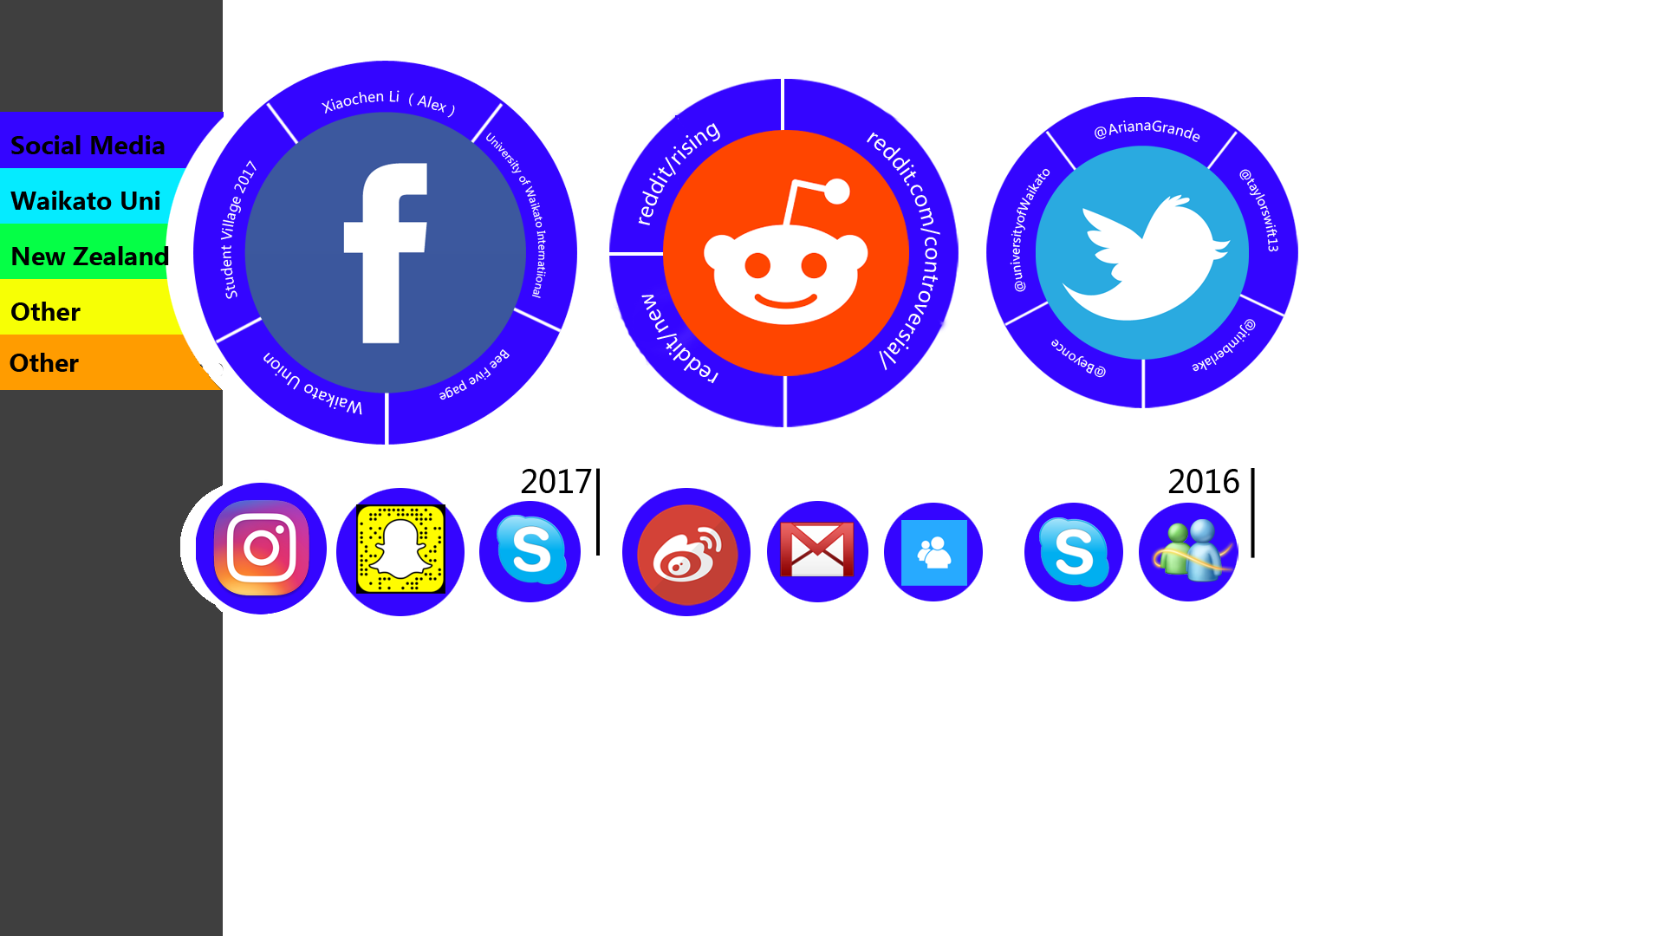
The idea of my design is to navigate all of my favorited websites in a web page.
The color bar on the left side shows the categories of the web pages.
Alongside to the color background of circle present the same type as well
For the circles, the size of the circle shows the frequency of the website.
For example, if a user goes to this website often and it would show in the first with large size.
The line of circles in the bottom presents the timeline of each web page that user saved, which can remind user the time when they save it.

Slide 3

Organizing websites by same URL
http://www.waikato.ac.nz/
https://elearn.waikato.ac.nz/
http://www.waikato.ac.nz/library/
https://www.waikato.ac.nz/landing/student.shtml
http://www.waikato.ac.nz/
http://www.waikato.ac.nz/study/international

Slide 4
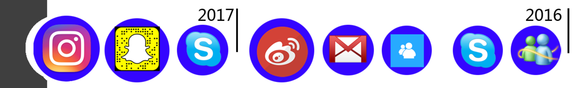
Order by timeline, and the size represent the how many time of user visit.
Plus, the color of circle background represent the category as well.
This is because we usually save some websites that we not visited usually but want to save it for later.

Slide 5





How to cope with large data set?

Slide 6
How to cope with large data set?
For dealing with over 1000+ objects, my solution to pop up with more circles that contains more website links in the page. Some circles may overlay with others. The idea is to hide website with less visit frequency so that we can show more web link in one page.

