Slide 1
Callback
LESSON 7 · MID-TERM · PRODUCT PROTOTYPE
We help you own the room — with clear, provable words.
For STEM students first: turn real work into evidence you can explain, alone, in the interview.
Fictional customer: Mei Lin · Financial figures are labeled assumptions · Callback does not predict hiring
Notes:
ELEVATOR PITCH (about 2 minutes across slides 1–4)
Every year, international STEM students walk into interviews with real results — a model that works, a dashboard people use — and walk out unheard. Not because the work is weak, but because they cannot narrate it under pressure. We built Callback. We help you own the room — with clear, provable words.

Slide 2
Strong results, weak narration
✓
The work is real
BEFORE · MEI
Projects, internships, and research with results the student did produce.
“I’m a data science student. I know Python, SQL, and Power BI.”
?
Follow-ups expose the gap
Who used it? What changed? What did you decide? Answers fall apart.
True — and it proves nothing. No one used it, nothing changed, no link to the job.
!
Generic AI writes for you
Polished answers that overclaim — and that you can’t defend live.
Results are the proof. Narration is the missing skill.
Notes:
Here is Mei, a fictional data science student. Her first answer: "I know Python, SQL, and Power BI." True — but it proves nothing. Results are the proof. Narration is the missing skill.

Slide 3
One loop from resume to a defensible answer
1
Paste resume + JD
2
Pick up to 3 job needs
3
Map your evidence
Read on your device; contact details can be removed first.
Each need quotes the exact JD sentence.
Only facts you supplied and confirmed. Qualifiers stay.
4
Answer + up to 3 follow-ups
5
Feedback that quotes you
6
Retry, coaching hidden
Probes what’s missing: who used it, what changed, fit.
Four rubric scores, one priority fix, your own words.
Compare first vs. retry; diagnosis says what to practice.
Notes:
Callback trains that skill in one loop. Paste your resume and the job description. Pick the three needs that matter. Connect each to evidence you actually supplied. Then practice: answer one question, get up to three follow-ups on what is missing, see feedback that quotes your own words, and retry with the coaching hidden — so you find out what you can explain alone.

Slide 4
Three things that make it different
AI follow-ups that probe, not praise
Language support for international students
Feedback as rewrite + progress tracking
Answer one question. Get up to 3 follow-ups on what’s missing — who used it, what changed, how it fits this role.
Think it through in your preferred language first. Nothing is added to your story until you confirm it.
Not just a score. A quoted priority fix, a retry with coaching hidden, and first vs. retry side by side.
“Who used the dashboard, and what did it help them monitor?”
Write details in Chinese → confirm the fact → practice in English.
Mei’s relevance: first 2 → retry 4 (fictional prepared example).
Notes:
Three things make it different. Follow-ups that probe instead of praise. Language support: think it through in Chinese or Hindi first, and nothing enters your story until you confirm it. And feedback that shows progress — first answer versus retry. Mei went from "I know Power BI" to "Twelve supervisors used my dashboard in their daily stand-up" — and Callback stopped her from claiming it cut delays, because she cannot prove that. We start free with campus pilots, then an affordable student plan. Let me show you the prototype.
[END OF 2-MINUTE PITCH]

Slide 5
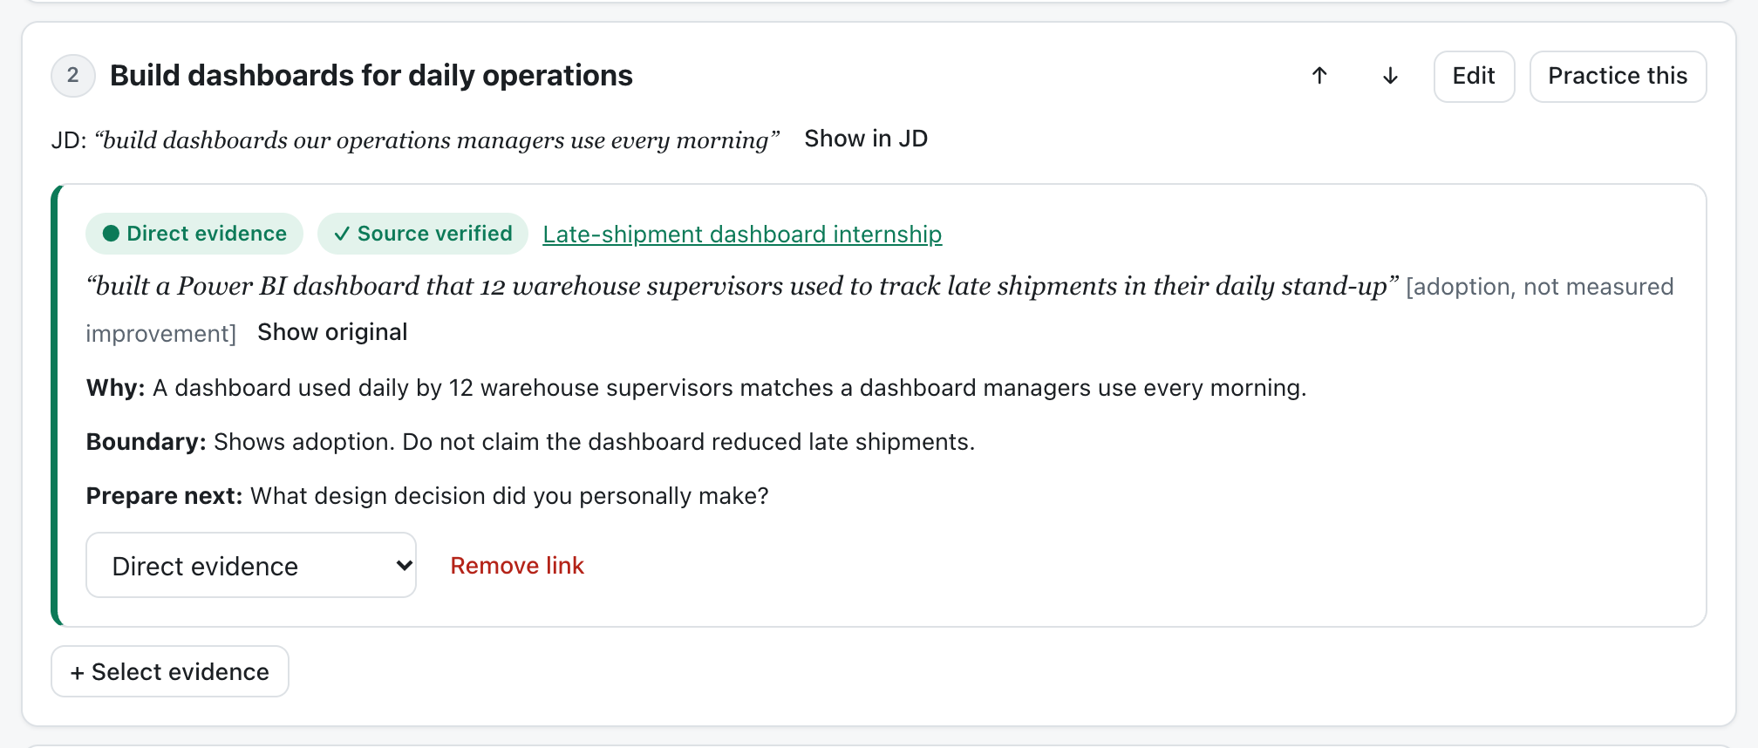
Use case: Mei Lin applies to Bayline Freight
FICTIONAL CUSTOMER
Mei Lin
M.S. Data Science, Bayview University (expected 2028)
Target: Data Analyst Intern, Summer 2027
20 minutes a day to prepare
JD need
“build dashboards our operations managers use every morning”
Value map in the prototype: the JD quote and her resume quote are both verified against the source. “Direct evidence” — with the boundary written down.
Her evidence
Power BI dashboard used by 12 warehouse supervisors in their daily stand-up.
Notes:
Our fictional customer is Mei Lin, applying for a data analyst internship at a fictional freight company whose on-time delivery fell. Callback pulls the job need straight from the JD and links it to the one piece of evidence that matches: her dashboard. Note the boundary line: it shows adoption, not delivery improvement.

Slide 6
Mei’s drill: probe, retry, compare
Interviewer
Criterion | First | Retry
Relevance | 2 | 4
Evidence and ownership | 2 | 3
Organization | 3 | 4
Clear language | 3 | 4
Tell me about a time your work supported a team’s daily operational decisions.
Mei
During my internship, I built a Power BI dashboard for the warehouse team.
Follow-up 1 · evidence
Who used the dashboard, and what did it help them monitor?
Same question, coaching hidden. Prepared fictional scores.
Follow-up 2 · outcome
INDEPENDENT RETRY
What can you say about the outcome of that work?
“…a Power BI dashboard that 12 warehouse supervisors used to track late shipments in their daily stand-up. … I cannot claim it reduced delivery delays.”
Follow-up 3 · relevance
How does that experience connect to this internship?
Notes:
In the drill, the interviewer asks who used the dashboard, what changed, and how it connects to this role. Then Mei answers the same question again with the coaching hidden. Relevance goes from 2 to 4 — and the boundary stays: she does not claim delays went down. These are prepared, fictional scores.

Slide 7
Market fit: who it’s for and what we add
What students need | Generic AI chat | Mock-interview apps | Callback
Claims you can defend | Writes freely, can overclaim | Varies by product | Every claim cites a confirmed fact
Follow-ups on what’s missing | Only if you ask | Often offered | Up to 3, targeted
Proof you can say it alone | Not tracked | Partly | Hidden-coaching retry + comparison
Think in your own language | Yes | Varies | Yes — confirmed before use
WHO
STEM students preparing for internship and first-job interviews
International students first: real results, interviews in a second language.
WHO PAYS
Students (low-cost plan). Career centers later, after pilots.
Category-level view from public product pages; not tested across every plan.
Notes:
Our first market is STEM students — international students first — preparing for internship and first-job interviews. Generic AI chat will happily write an answer you cannot defend. Mock-interview apps vary. Callback adds three things: every claim cites a fact you confirmed, follow-ups target what is missing, and a hidden-coaching retry shows what you can say alone.

Slide 8
Company goal and pilot objectives
Goal: every STEM student can explain their real work clearly and honestly — without a script.
O1 · Prove learning
O2 · Prove demand
O3 · Prove the model
In blind counselor review, the retry is rated clearer than the first answer in most pairs.
Run campus pilots and see students finish the full loop, including the unassisted retry.
Keep AI cost per active student low enough for a student-priced plan.
Target: > 60% of pairs
Target: 2 pilots, 100 students, 40% finish a retry
Target: AI cost < $2.50 per student per month
Targets for the pilot phase, not results. No customers or measured outcomes yet.
Notes:
The company goal is simple: every STEM student can explain their real work clearly and honestly. For the pilot phase we set three objectives — prove learning, prove demand, and prove the model. These are targets; we have no customers or measured outcomes yet.

Slide 9
Roadmap aligned to the goals
Phase 1 — now
Phase 2 — later
Phase 3 — later
STEM student interviews
All majors
Career advancement, promotion reviews
Serves O1 · O2 · O3
Grows O2 once O1 is proven
New segment after O3 holds
Built in the Phase 1 prototype
Next, before the first pilot
Value map with source-verified quotes
Drill: ≤ 3 follow-ups, hidden-coaching retry
Rubric feedback + first-vs-retry comparison
Practice diagnosis, team-priority simulation
Prep-time planner within your minutes
AI backend with output validation
Verify live AI on real student answers (O1)
Speech-to-text for spoken practice (O1)
Accounts + opt-in sharing with counselors (O2)
Cost tracking per student (O3)
Notes:
The roadmap follows the goals. Phase 1, now, is STEM student interviews — that is what the prototype covers. Phase 2 opens to all majors, and Phase 3 moves to career advancement; both come later, only after the pilot objectives hold. Before the first pilot we need live-AI verification, speech-to-text, accounts with opt-in sharing, and cost tracking.

Slide 10
Pricing: free pilots, then a student plan
Campus pilot
Student plan
Career center license
Free
$9 / month
Not decided
One term with a cohort. We cover AI costs to measure O1 and O2.
Price hypothesis to test. Practice drills, retries, and progress tracking.
An option to test after pilots, not decided.
How we test the price in pilots: a willingness-to-pay survey and the share of pilot students who choose the paid plan. No customers or prices yet — both are hypotheses.
Notes:
Pricing starts free: campus pilots for one term, where we cover the AI cost. Then an affordable student plan — our hypothesis is nine dollars a month, which we will test with a willingness-to-pay survey and conversion in the pilots. A career center license is an option to test after the pilots; it is not decided.

Slide 11
Unit economics per paying student (assumptions)
Monthly, per paying student (USD)
≈ 82
Price
$9.00
paying students a month to cover $500 of fixed costs at $6.14 contribution each
AI cost
$2.00
Payment fees
$0.56
Assumptions
AI: Claude Opus 5.5 list price, $4 / $20 per million input / output tokens
One drill ≈ 13.5k input + 6.4k output tokens ≈ $0.18
8 drills + other AI help a month ≈ $2.00
Card fees 2.9% + $0.30; team unpaid in pilots
Hosting share
$0.30
Contribution
$6.14
$9.00 − $2.00 − $0.56 − $0.30 = $6.14 contribution
Notes:
The financial model is unit economics, and every number is an assumption. At a nine-dollar plan, AI costs about two dollars a month per active student, based on Claude Opus 5.5 list prices and about eight drills a month. After card fees and hosting, each paying student contributes about six dollars. With five hundred dollars of monthly fixed costs, break-even is about 82 paying students. Pilots will replace these estimates with measured usage.

Slide 12
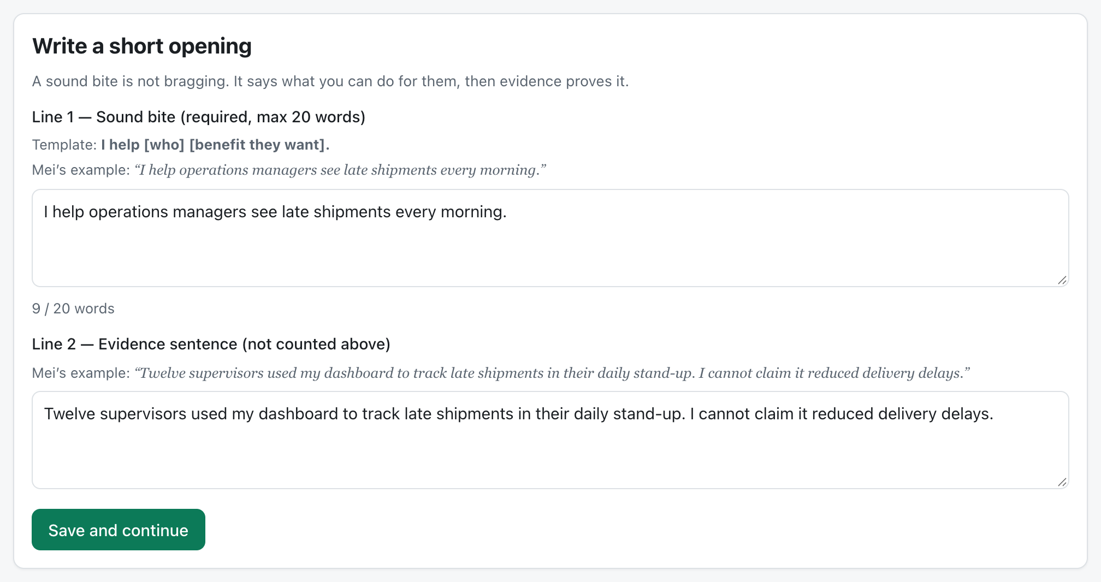
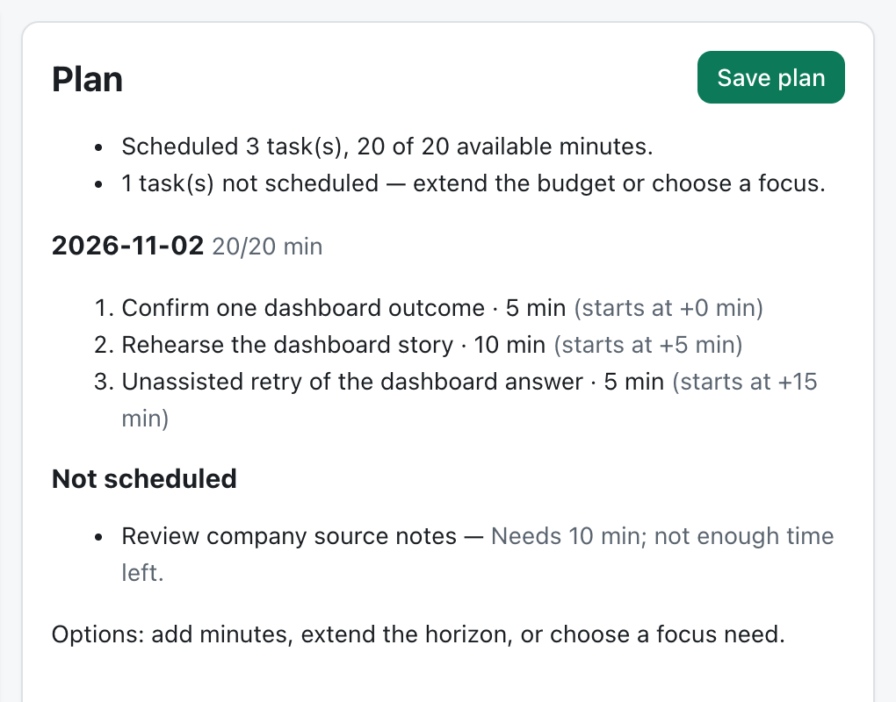
Prototype: what the live demo shows
Opening: a sound bite (≤ 20 words), then evidence.
Planner: 20 minutes → A+B+C scheduled, D left out.
Demo path: Home → Try Mei’s example → Value map → Drill with follow-ups → First vs. retry → Plan my prep time.
Built with Claude Code from a 17-step prompt kit: React + TypeScript, local-first storage, Claude Opus 5.5 backend with validated output, 42 automated tests.
Notes:
Now the live prototype. I will open the home page, load Mei's fictional example, show the value map, run the drill with follow-ups, compare the first answer with the retry, and finish with the prep planner. The prototype was built with Claude Code from a seventeen-step prompt kit; it runs locally, with an AI backend whose output is validated before it is shown.

Slide 13
Help us run the first pilot
THE ASK
One campus career center for a free spring pilot, and ten STEM students to try the drill this month.
What Callback does not do
No answers during a real interview. Preparation only.
No hiring predictions.
Never adds achievements you did not supply and confirm.
We help you own the room — with clear, provable words.
Notes:
To close: we are looking for one campus career center for a free spring pilot, and ten STEM students to try the drill this month. And a reminder of what Callback will never do: give answers during a real interview, predict hiring, or add achievements you did not supply. We help you own the room — with clear, provable words. Thank you.

