Slide 1
Modeling the cognitive process during experimental games using hidden Markov models
Xiaomin Li, Jan 2020

Slide 2
Motivations
How to model the dynamic strategic reasoning using choice process data: eye-tracking and mouse tracking?
Generalizable: Easy to apply to any games
Explainable: Help us better understand the cognitive process
Dimension Reduction: Be able to see the main effect
Notes:
More and more research started to focus on the process of strategic reasoning, using eye tracking or mouse tracking. But a generalizable model for these kind of data is still missing. In this paper, we will try to find a feasible model to do this thing. There are three criteria that is important for such a model: this model should be

Slide 3
Background
Crawford, Costa-gomes and Broseta (2001), mouse-tracking and information search.
Wang, Spezio and Camerer (2010) , Polonio Guida and Coricelli (2015), Polonio, Devetag and Guida (2016), Zonca, Coricelli and Polonio (2019), eye-tracking on different non-cooperative games, pre-specified patterns
Krajbich, Armel and Rangel (2010), Krajbich and Rangel (2011), , Golman, Bhatia and Kane (2019) : Sequential sampling method to model gaze (DDM)
Notes:
Type classify players: sophisticated, naïve, optim, pessi.

Slide 4
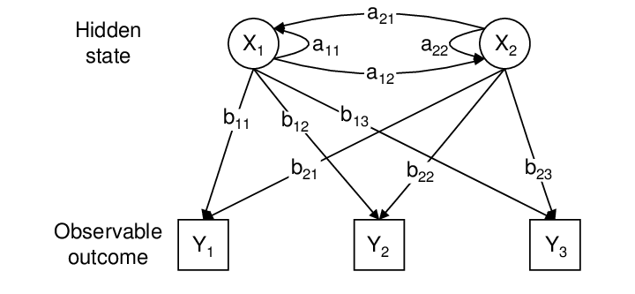
Hidden Markov Model
HMM is a machine learning model for problems where the goal is to recover a data sequence that is not immediately observable
Unobserved? Thoughts
Observed?
Gaze

Slide 5
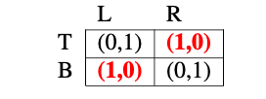
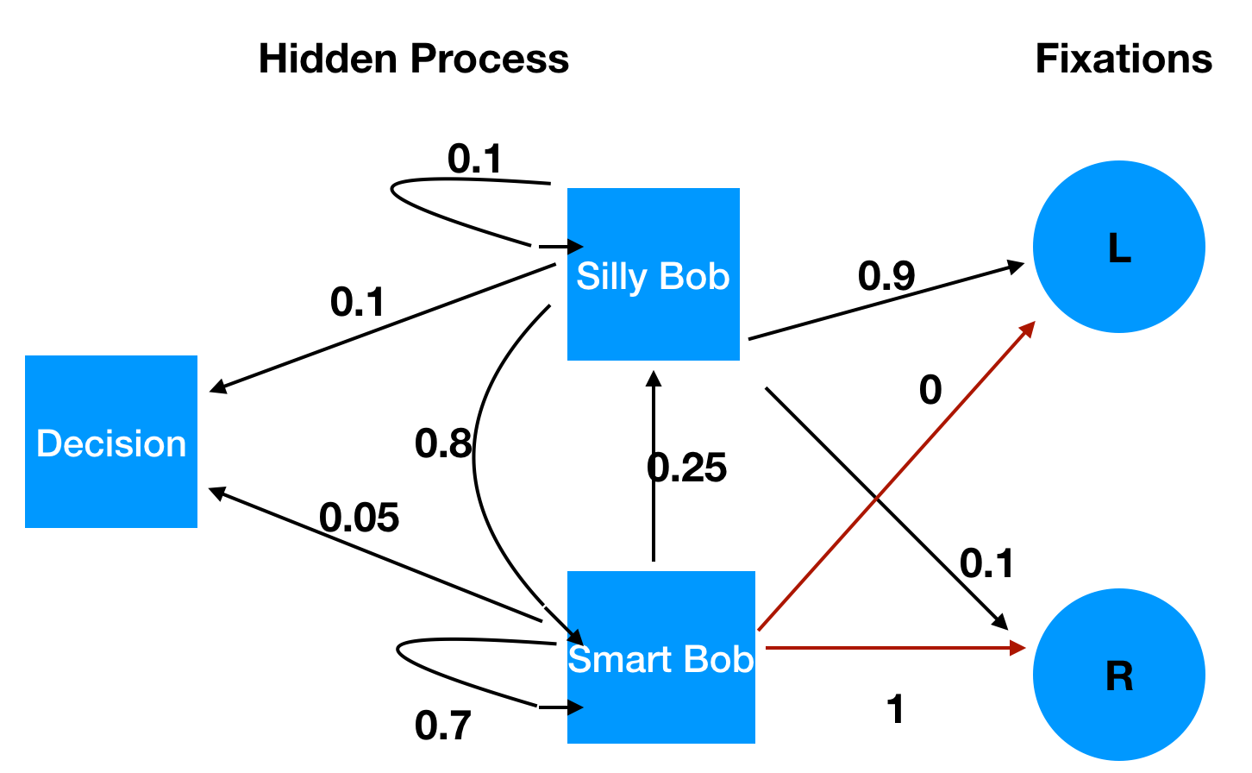
A Naïve example
Begin
Ann
Unobserved, Typical Markov Chain
Emissions
Bob
Notes:
First, let me try to illustrate the central connection between strategic thinking and a hidden markov model using a matching penny game.
Hidden markov models are classic models used in cs and ML. it is widely used in speech recognition and recommendation systems. the model framework and estimation method are both matured for us to borrow.
Unobserved part, observed part.
Now, let me use a simple HMM to describe a player's belief changes before a strategy is finalized. This will help us understand how this model connects the observed part and the unobserved part.
This sample is on the perspective of ANN, After the game starts, Ann needs to form a belief about Bob’s strategy dynamically, it could be the trivil strategy that whether Bob is choosing top or or bottom. Ann first think, Bob will chose Top, L, bottom, so on so forth.
This dynamic transition process of beliefs can never be directly measured, therefore, was not mentioned either in most of the level of reasoning models. But fixation transitions give us hope. Fixations can be understood as probalistic projections of the mental states at each time.
We we want to do is trying to back out both the hidden state partition and the transition matrixs using the data we have.
1min 26s

Slide 6
Hidden Markov Model in Strategic Games
P:
Transition Probabilities in hidden states
B: Mapping: hidden states to observations
Pi: Prior distribution

Slide 7
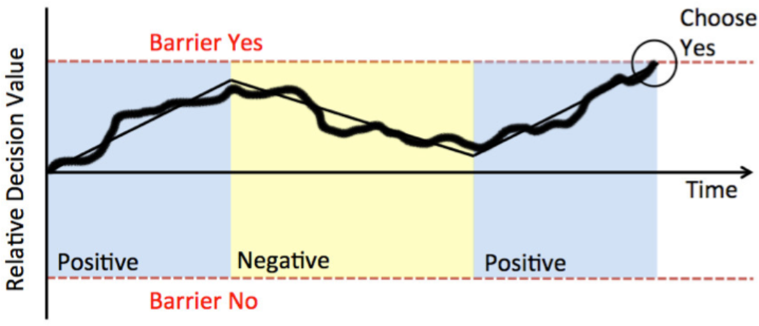
Why we need HMM?
DDM restricts the fixation data only on choices themselves, it cannot incorporate other information like counterpart payoff.
DDM limits in the number of choices, it works best for a two choices problem.

Slide 8
Application 1: Normal Form Games

Slide 9
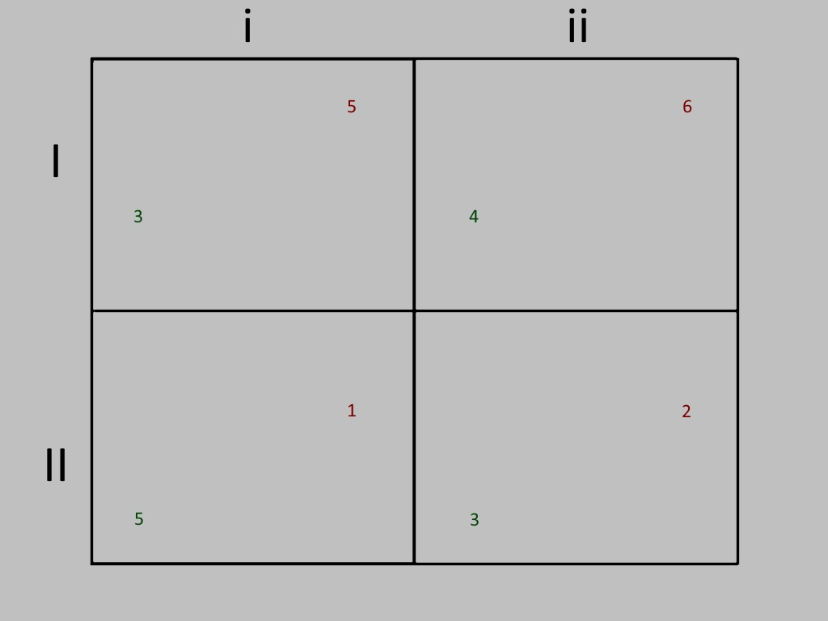
Dataset – Zonca, Coricelli and Polonio (2019)
48 games, 16 DSS, 16 DSO, 16 multiple equilibria
N=100
Mean Fixation Number = 25
Only row players
Fixations: eight AOIs (payoffs)

Slide 10
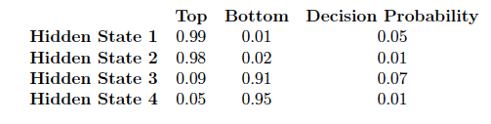
HMM in normal-form games
Strong saliency effect
Information structure
Action x Role
No diagonal transfer
“Hypothetical play”

Slide 11
Application 1: Locations games

Slide 12
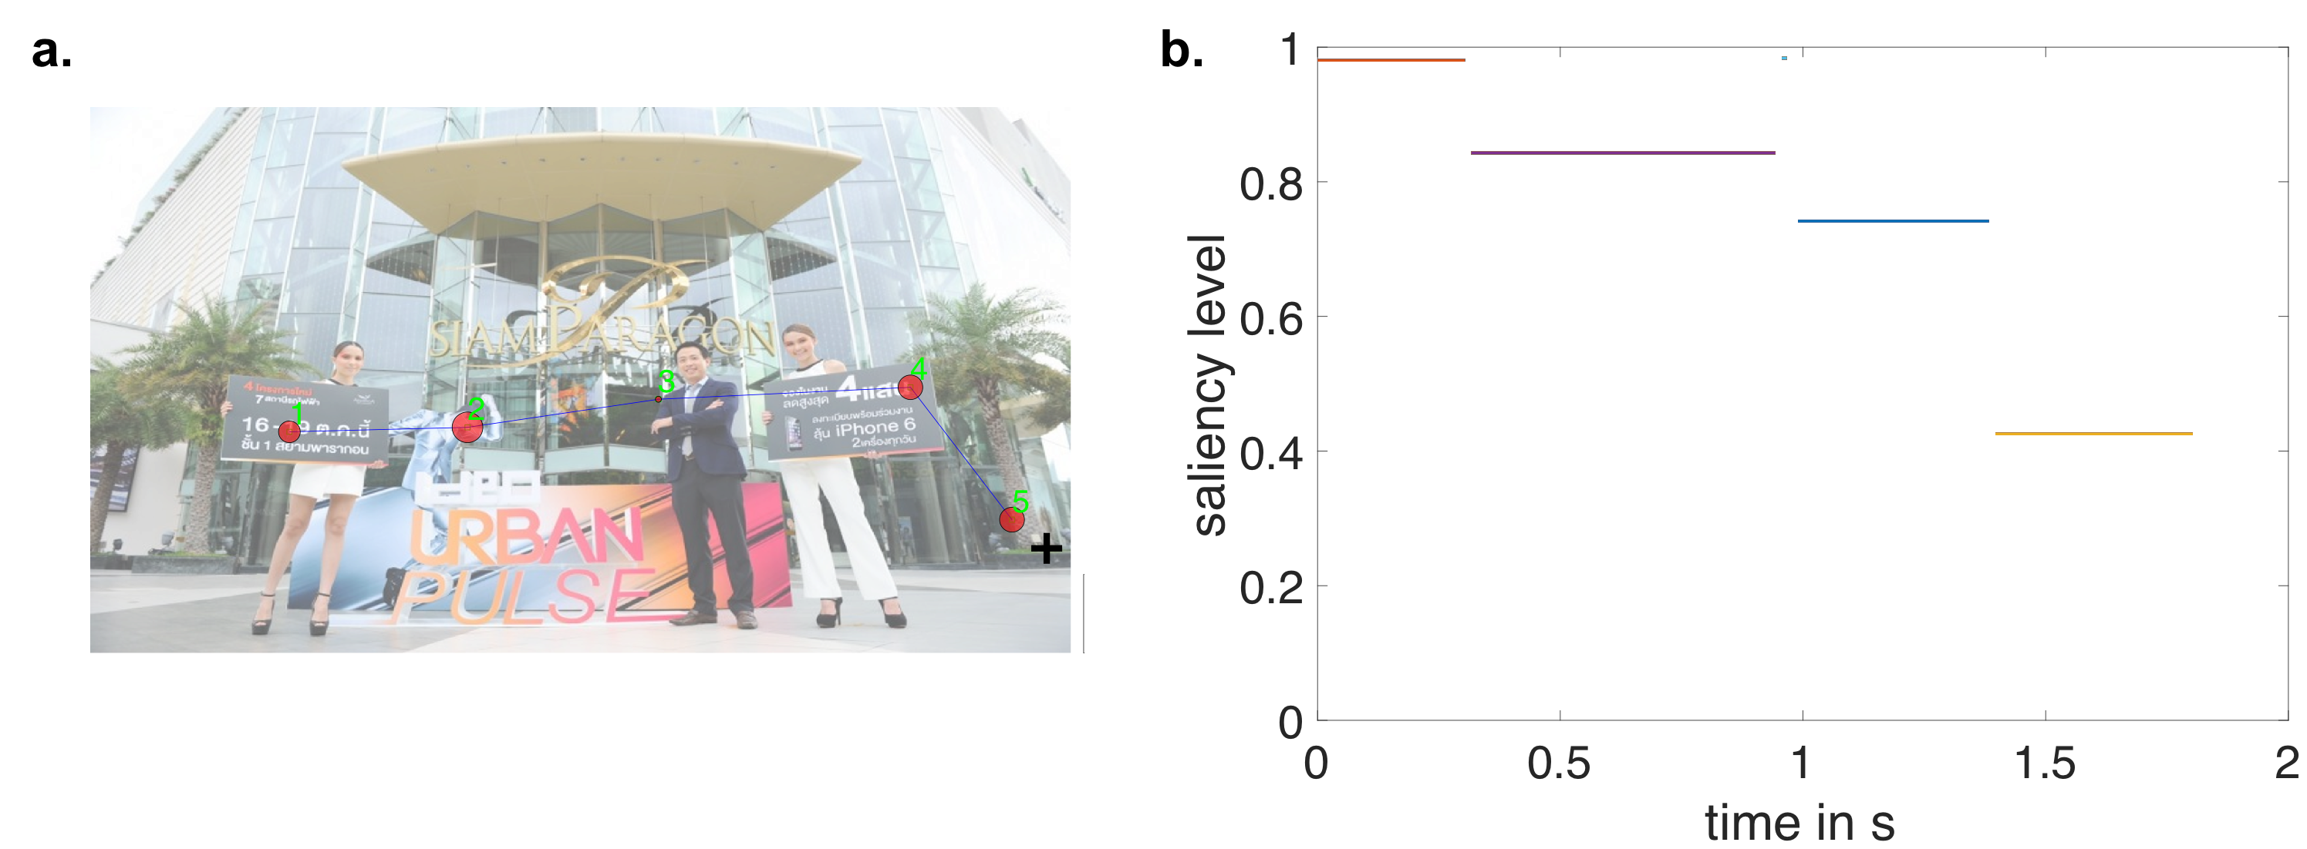
Fixation Data
Notes:
We will use the experimental data in chapter one to show how this model can be estimated and understood.
And This is a sample of what eye tracking data looks like.
It consists of fixation and saccades.
Fixations Definiation, when you look at a location for long enough.
Saccadeds are simply transition trajectory between fixations.

Slide 13
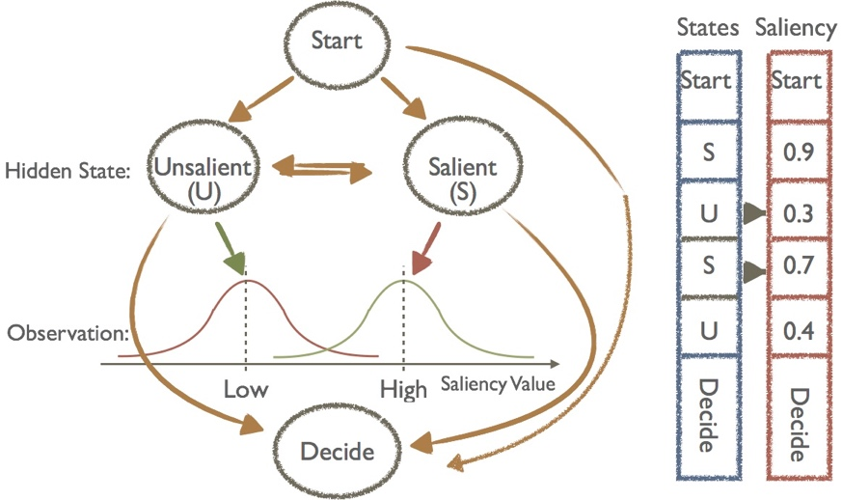
Gaussian hidden markov model (gHMM)
Transition Matrix
Observational Map
Notes:
To use the model in the image game from chapter one, we assume there are only two hidden states and we apply the model in the space of saliency.
Therefore, each fixation location in the 2D image space is now reduced to be one dimensional saliency value.
If we forward look the model, we will see that when the game starts, decision maker go to one of the two hidden states, he transits back and forth until a final decision is made. The blue bar shows a possible transition tragectory for a given model
When he is on different hidden states, he will look the picture with different visual patterns. We assume this probablity distribution to be gaussian.
Data,
And based on the fixation dataset we have, our goal is to estimate both the transition matrix and the oberservational map.

Slide 14
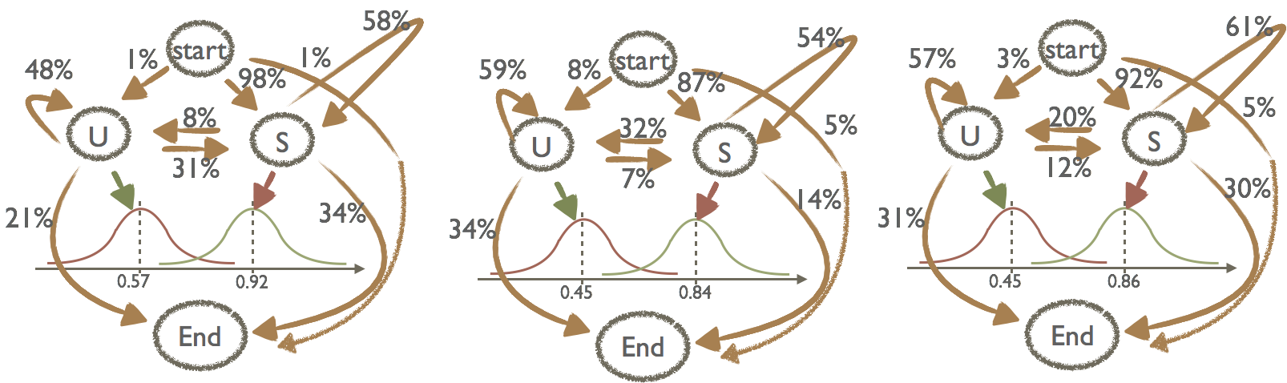






Fitted Model
$$σ=0.07$$
$$σ=0.02$$
$$σ=0.07$$
$$σ=0.03$$
$$σ=0.07$$
$$σ=0.03$$
saliency
saliency
saliency
Matching
Hiding
Seeking
Estimate the model using a standard Baum–Welch algorithm
Notes:
We fit three different models using the standard BW algorithm, for three strategic cases.
We can see that the First fixation can be reliably predicted by the bottom up process and is common regardless of tasks.
On later fixations, top down control takes into place and people start to sample the unsalient locations more.
After the fixation fixation, hider and seekers start to transit more the unsalient state comparing to the matchign case and this key different causes the later choice changes under different tasks.

Slide 15
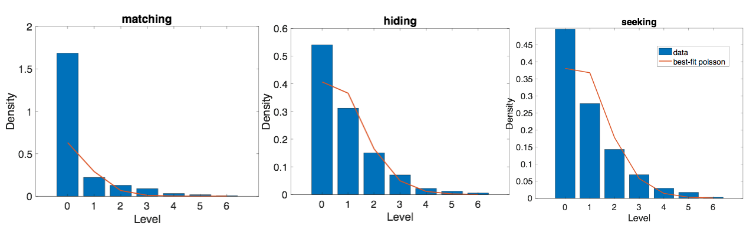
Gaze predicted strategic levels
Levels are defined as transitions among hidden states along the direction of the best response function.
Example: { S, U , S}, level 2, { S, U}, level 1, { S}, level 0
Mean = 0.5
0.97
0.9
Notes:
The hidden markov approach naturally induce the levels of reasoning.
Level zero: Unlike the traditional methods
The decision maker will move to the next level as long as he transit to a different state on the direction of the best response function. It's also simple to understand, for hider seeker games, when he is on salient state, he should imagine the next level to be on unsalient state.
Examples.
notice that even if we make no level zero assumption, the estimated level zero behaviors will be consistent with the previous SCH model because the bottom up process is so strong that most people initiate from salient locations.
This figure shows the estimated levels of reasoning for the dataset we have. Recall that this result is purely estimated from gaze data only.
The distribution of levels fits well with poisson distribution which was assumed in previous literature. And the estimated mean level is around 1 for hider-seeker game, 1/2 for matching game. indicating that most people don't go very far in this process.
2min

Slide 16
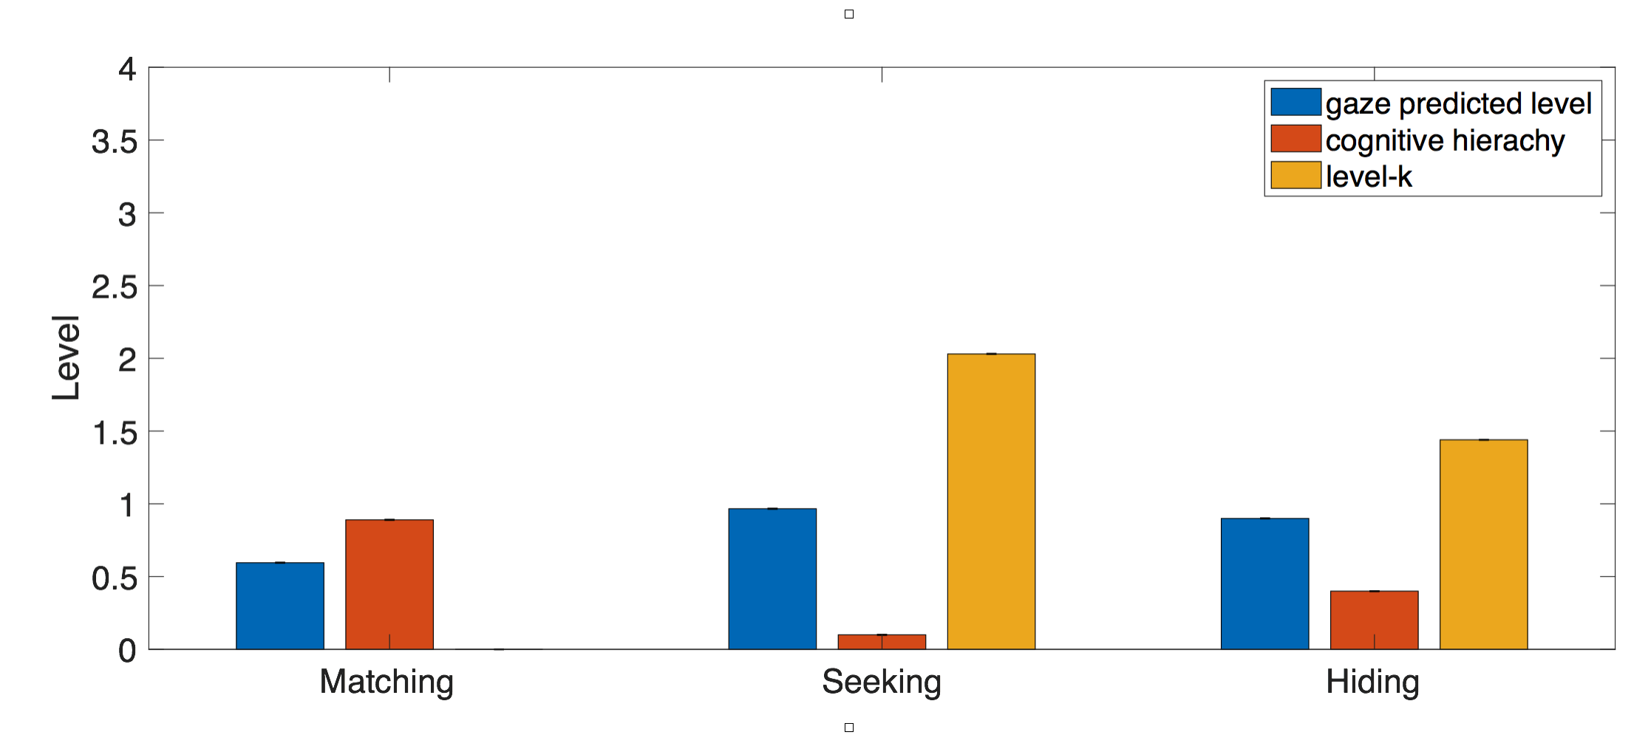
Gaze-predicted strategic levels
Advantages:
It is directly defined on mental states transitions
No assumption for level zero behaviors
Defined on a trial basis instead of individual basis
Connects well to the traditional definition for validations
Notes:
Comparing to the traditional behavioral approach, this new model has its unique advantages.
The comparison of the estimated level using three methods are shown here.
1min30s

Slide 17
Continuous-time gaussian hidden markov model (ctHMM)
Discrete Emission: U -- S – U – S – End
Continuous Emission: U -.2s- S -.1s- U -.4s- S -.7- End
Include fixation duration time to the HMM model
Now, the observation matrix are known!
Need to modify: the hidden transition matrix changes from P to P(t).
P_{ij}(t): at each time point, condition on that I am at i state, the probability I will transit to j state.
Notes:
Later, we further extended the model to incorporate the fixation duration along with the fixation location.
The model now becomes a continuous-time Gaussian hidden markov model. In the discrete case, our goal is to predict a sequence of hidden states without time. For continuous version, we just want a prediction to look like the purple sequence, with time in between states!
The good news is that we don’t need to re-estimate everything from scratch! We already have the observation map from hidden state to fixation space already. This way, we only needs to estimate P_ij(t).
1min 14s

Slide 18
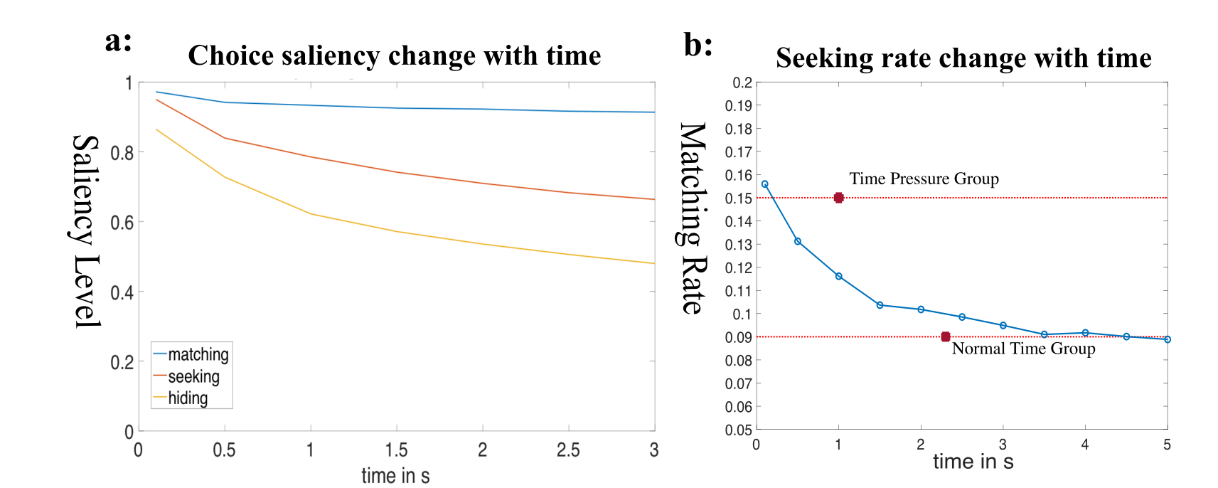
Use cgtHMM to predict time pressure effect
State transitions: U, S , U, S, S, U, End
Time in s: 0.3, 0.4, 0.5,0.3,0.2,0.4, End
Hard Stop
Natural Stop
Force a Choice
Notes:
With the estimated model, A use of the cgtHMM is trying to predict choices under time pressure. To do that, we boldly assume that the last state a subject is considering will be his decision schema when we set a hard stop on the markov chain.
A hard stop means that we truncate the chain manually in the middle at a given time. This way, subjects are forced to make a choice without full consideration.
Now, we will let this trained model play the hider-seeker game and see whether they will show seeker advantage and how does this rate change when they face a time pressure.
We first simulated the probability of being at each state as times goes by, this is shown in figure one. We can easily get the fixation saliency value according to the observational map. Then, we need to back out choice on the 2D image from saliency value. We go back to the image pool and choose the corresponding pixel according to the saliency value. With large enough images, we got the seeking rate changed over time shown in figure b. The two red bars are the data level for both the normal group seeking rate and the time limit group seeking rate.
We can see that this model converges to .09. And it’s the magic seeking rate we found over and over and couldn’t get it to any lower.
This result, estimating purely from eye tracking data and saliency space confirms that bottom saliency is the main driving force for our finding. With a HMM model, we can see clearly that bottom up process only affects the first fixation and the decision function causes the later influence. That's why this effect was not that strong comparing to the first fixation but super robust.

Slide 19
Conclusion
Proposed a new method, HMM, to dynamically model eye-tracking data.
1. Easy to generalize and estimate. 2. Noise resistant and learns principle components.
Two applications:
In normal form games, discrete action space, information space: payoff and actions.
Learned that people do levels of reasoning from a common start point
2) In location games, continuous action space, information space: non-neutral frame/images without payoff.
Still see a transitional effect and strong saliency effect.
HMM induces a new system of levels that have many advantages.
HMM can further incorporate duration time and make predictions about time effect.

