Slide 1
Bioinformatics miniseries - 1
Sept

Slide 2

1. Linux Basics

Slide 3
Contents
Brief description of Linux
Shell
Linux file directories
Navigate
File process
Install softwares

Slide 4

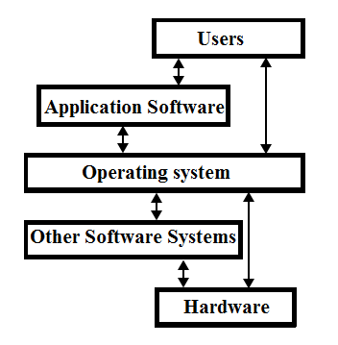
Linux is an operation system
Open source
Built on Linux kernel ( interface to interact with hardware)
Many distributions

Slide 5
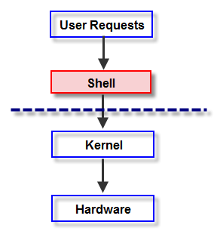
Shell
Shell is a program interpreter that runs other program
The interface to interact with shell is the terminal emulator in a desktop environment
In ubuntu, it is bash (Bourne Again Shell)

Slide 6
Linux File Directories

Slide 7
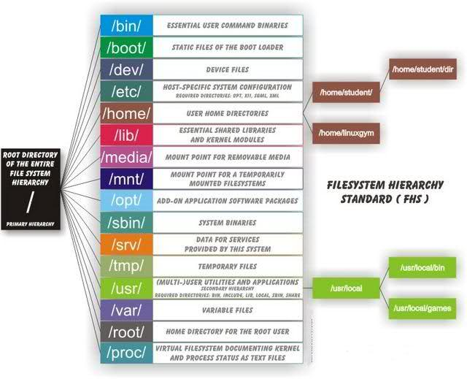

Slide 8
/ : The root directory, holds everything, needs sudo privileges. (admin in windows).
/bin : Contains binaries (software) installed by the system.
/home: each regular user will be assigned a directory, e.g. /home/Xiaoping, where the user have write previleges
/lib: shared library files used by the system
/usr: files used by the regular users

Slide 9
Command Structure
Command [-options] [arguments]
cp [OPTION] Source Destination
cp [OPTION] Source Directory
cp [OPTION] Source-1 Source-2 Source-3 Source-n Directory
Cp –R dir1 dir2
man command
Command –help [-h]

Slide 10
Commands to navigate in the directories
pwd : to get current directory
cd : to change directory
ls: list files in a directory
.. : parent directory
. : current directory
~: home directory
/: root directory

Slide 11
Practice time:
Go to /usr/bin directory
Go back to /usr/
Go back to your home directory

Slide 12
File Handling

Slide 13
Create a directory
Mkdir
mkdir [option] directory_name(s)
For example:
Mkdir Bioinformatics
Mkdir -p Bioinformatics/metafile

Slide 14
Practice
Create a directory in your home directory called “Tools”
Tools contains a “Fastqc” folder

Slide 15
List a directory
ls
ls [OPTION]... [FILE]...
For example:
ls -l (long format)
ls -a (all files)
ls –lh (long format human readable)

Slide 16
Long format example
-rw-r--r– 1 root root 209 Mar 30 17:41 printcap
Field 1 | Field 2 | Field 3 | Field 4 | Field 5 | Field 6 | Field 7 | Field 8 | Field 9 | Field 10
- | rw- | r-- | r-- | 1 | root | root | 209 | Mar 30 17:41 | printcap
Field 1: - regular file, d directory
Field 2: access rights for owner
Field 3: access rights for group
Field 4: access rights for others
Field 5: number of hard links
Field 6: username of file’s owner
Field 7: name of the group
Field 8: file size in bytes
Field 9: Date and Time of last modification
Field 10: Name of the file

Slide 17
Practice
List all the contents in your home directory in a long human readable format

Slide 18
Create a new file
touch filename

Slide 19
Create a new file (Cont’d)
Standard input and standard output and standard error
Standard input: (by default) keyboard
Standard output / Standard error: special files in the system where programs would send the results to them if not specified. (by default) it is linked to the screen.
E.g. ls ~
E.g. ls notexist
Redirect stdout (1) and stderr (2)
1, 2: are file descriptor
Stdout: 1
Stdin: 2
Use > to direct output to a file or use < direct content of a file to a command
>> append to the previous file

Slide 20
Create a new file (Cont’d)
Stdout example:
ls -l ~ 1> contents.txt or ls –l ~ > content.txt
Stderr example:
Ls –l notexist 2> error.txt
One line
Ls –l ~ notexist 1> contents.txt 2> error.txt
One file
Ls –l ~ notexist > onefile.txt 2>&1

Slide 21
Create a new file (Cont’d)
Cat [option] file
If cat is without arguments, then it reads from stdinput (wait us to type) and display it on stdout
For example:
Cat
Cat > hello.txt
Cat file1 file2 > together

Slide 22
Practice
Go to desktop, create a folder named “mycat”
Go to mycat, create a tab separated text file (txt) called myfile with 2 lines:
Line1: Cat displays contents of a file on the screen if you give it a file.
Line2: Cat asks you to type in something if there is no file.
Redirect myfile to a new file call “from_myfile”
See the contents change:
cat myfile file0 > newfile
cat myfile file0 2> error.txt
cat myfile file0 > newfile 2>&1
cat >> newfile

Slide 23
Remove a file
Use rm [option]… [file]…
Be careful!! (Once removed, it’s gone forever, not in the trash-can)
Interactive mode with –i flag

Slide 24
Copy and move a file
Cp [option]… source… directory
cp file1 file2 file3 directory
mv [option]… source… directory
Mv can be used to rename a file too

Slide 25
Practice
Create a file called “myfile” on desktop
Make a new folder called “myfolder”
Copy “myfile” to “myfolder” and change the name of “myfile” on the current directory to “myfile0”
Move “myfile0” to “myfolder”

Slide 26
View a file
Cat file
Less and more
q exit
G -> end; g -> beginning; space -> turn page; enter -> scroll each line
/ -> search a pattern
Head and tail
Default first(last) 10 lines
-n specify n lines

Slide 27
Pipeline
Commands can be piped by using “|”: run the first command and the result will be processed by the one following the “|”
For example:
List all the files in “mycat” folder and use cat to save it in a file called “inmycat.txt”
ls -l mycat | cat - > inmycat.txt

Slide 28
Practice
Create a file called “more_manual.txt” on desktop that contains the manual of more command
Use keys to navigate (space, G, g, enter)
Use pattern search to look for “option”
Use head and tail, and specify –n flag to see first(last) n lines of the file

Slide 29
Zip and unzip file
Compression programs:
Gzip, bzip
Archiving programs:
Tar, zip

Slide 30
Gzip, bzip
Gzip is used to compress one or more files and replace the original (.gz)
Gunzip: unzip the gz.
Bzip: uses difference compression algorithm at the cost of the speed.
Don’t do gzip picture.jpg or music.mp3 (compressed already)

Slide 31
Tar ( bundles many files into one single file)
c -> create an archive from a list of files and/or directories
x -> extract an archive
t -> list the contents of an archive
f -> archive file name
k -> keep the old file when extracting
z -> extract tar.gz file
tar –cf newfile.tar newfile
tar –xf newfile.tar

Slide 32
zip
zip [options] zipfile file
zip newfile.zip newfile
unzip newfile.zip

Slide 33
Practice
go to your desktop directory, make a folder called “mytar”
tar all the files in “mycat” into “mytar”
use tar –t to list the contents
download an example reads(tar.gz) use tar to release the reads to .fastq

Slide 34
Regular expression for searching patterns
metacharacters
.^$[]()\
. matches any character
* zero or more occurrence (wild card)
? 0 or 1 occurrence
+ 1 or more occurrence
^ match the beginning
$ match the end
[] match any in this range of characters
[^char] match any NOT in this range of characters
for example: [0-9] -> will gives a range of numbers from 0-9; [0-9]? -> match zero or 1 number; [0-9]+ -> match more than one number

Slide 35
grep or egrep (extended regular expression)
grep pattern file
to match all gmail emails: grep “@gmail.com$” address_book.txt
to count occurrence use –c: grep –c “@gmail.com$” address_book.txt
egrep includes more metacharacters for match, and is same as grep -E

Slide 36
more regular expression
you can use with ls or other commands to select files to show:
ls ^A
ls .*fastq
rm * remove all the files rm –rf * remove all files and directories

Slide 37
Practice1
go to desktop, create a file called “regexp”
go to Box, download address_book.txt in the material folder and save it in “regexp”. Use grep to match Fred with the gmail in the address_book.txt
Count how many users with gmail

Slide 38
Practice2
In the “regexp” folder, create a serial of files using: touch A{0..9}.txt B{0..9}.txt
use pipeline of ls and grep and regular expression to match all files starts “A”
same as above task, to match the file that has a number in the range from 5 to 8

Slide 39
Working with Column data with cut and columns
cut [option]… [file]…
-f field
-d delimiter default(“\t”)
e.g. cut –f 2 address_book.txt cut –f 2-3 address_book.txt

Slide 40
column: columnate rows
cut –f 1 address_book.txt | column
column numbers –c 40

Slide 41
Practice
get just the name and emails from address_book.txt

Slide 42
sort file
sort [option]… [file]…
sort address_book.txt
sort –k 2 address_book.txt

Slide 43
Practice
check manual of sort, find out which flag you need to sort address_book.txt by email in reversed alphabetical order

Slide 44
Download files
wget
wget url
curl: (need to install) you can use it to send http requests, if to download, specify –o
curl –o name url

Slide 45
Install software in linux
from package manager (command or Desktop GUI app center)
macOS has homebrew as the package manager, to install homebrew:
/usr/bin/ruby -e "$(curl –fsSL https://raw.githubusercontent.com/Homebrew/install/master/install)"
from source
download source file and compile
download binary (compiled) file and expose its path to the global path

Slide 46
apt manager
install from package manage system ( no need to compile source code)
sudo apt-get update
sudo apt-get install packagename
can do a search first
sudo apt-get update
sudo apt-cache package
To remove:
sudo apt purge package (recommended: removes dependencies)
sudo apt remove package

Slide 47
install deb package
sudo dpkg –i packagename
sudo apt-get install –f
Remove
sudo dpkg –r packagename
sudo dpkg –P packagename (remove all dependencies)

Slide 48
compile source
Always check with README or INSTALL
usually steps (have to install build-essential):
configure
make
makeinstall

Slide 49
Practice
Follow instruction to install newest R in your machine ( and Rstudio)
get the url for ubuntu 18.04/debian from rstudio download
wget url directory_where_you_want_to_save_the_file
go to directory_where_you_want_to_save_the_file
install latest R (copy and paste the following):
sudo apt-key adv --keyserver keyserver.ubuntu.com --recv-keys E298A3A825C0D65DFD57CBB651716619E084DAB9
sudo add-apt-repository 'deb https://cloud.r-project.org/bin/linux/ubuntu bionic-cran35/’
sudo apt-get update
sudo apt-get install r-base
install gdebi-core
sudo gdebi –I .deb
type rstudio to see if it works.

Slide 50
Practice2 install SeqKit (https://github.com/shenwei356/seqkit)
download the software
then expose the path by doing: sudo cp seqkit /usr/local/bin/
check by run: seqkit -h

Slide 51
Practice2 install seqtk
install zlib, git
git clone https://github.com/lh3/seqtk.git;
cd seqtk; make

Slide 52
Practice3 install jupyter notebook
sudo apt install python3-pip
pip3 install jupyter
export PATH=$PATH:~/.local/bin

Slide 53
Practice4: Install Conda
go to https://docs.conda.io/en/latest/miniconda.html
download based off your platform
bash Miniconda*.sh
Follow the instruction. You can specify it to install on the location you want

Slide 54
Practice5: install Qiime2
wget https://data.qiime2.org/distro/core/qiime2-2019.7-py36-linux-conda.yml
Go to qiime2 install doc
wget https://data.qiime2.org/distro/core/qiime2-2019.7-py36-linux-conda.ymlconda env create -n your_env_name (e.g. qiime2-2019-7) --file qiime2-2019.7-py36-linux-conda.yml
# OPTIONAL CLEANUP
rm qiime2-2019.7-py36-linux-conda.yml

