Slide 1
Sept
Bioinformatics miniseries - 1

Slide 2

1. Linux Basics

Slide 3
Goals
Understand shell
Understand Linux Directories
Learn to use basic commands to navigate Linux:
pwd
cd, cd ~ , cd ..
Learn to use basic commands to operate on files:
ls, find, locate, cp, mv, cat, echo, grep, less, gzip, tar

Slide 4

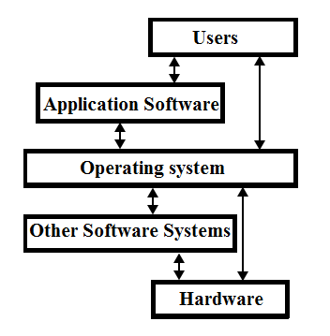
Linux is an operation system
Open source
Built on Linux kernel ( interface to interact with hardware)
Many distributions

Slide 5
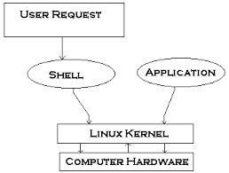
What is the shell

Slide 6
Shell is a program interpreter that runs other program
Shell
The interface to interact with shell is the terminal emulator in a desktop environment
In ubuntu, it is bash (Bourne Again Shell)

Slide 7
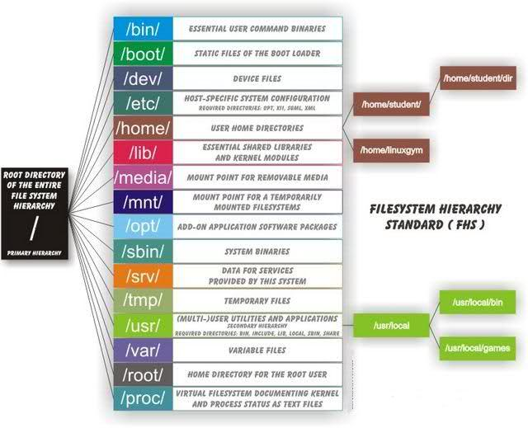
Linux Directory Structure

Slide 8
Command structure:
Command option

Slide 9
Commands to navigate:
1: cd
. current directory
.. parent directory
~ home directory
2: pwd
get current directory you are working on
3 command structure

Slide 10
Hands-on practice
Key shortcut to open the terminal (Ctrl+T)
Check where you are
Go to /usr/bin/ then go back to /usr/
From /usr go back to your home directory

