Slide 1
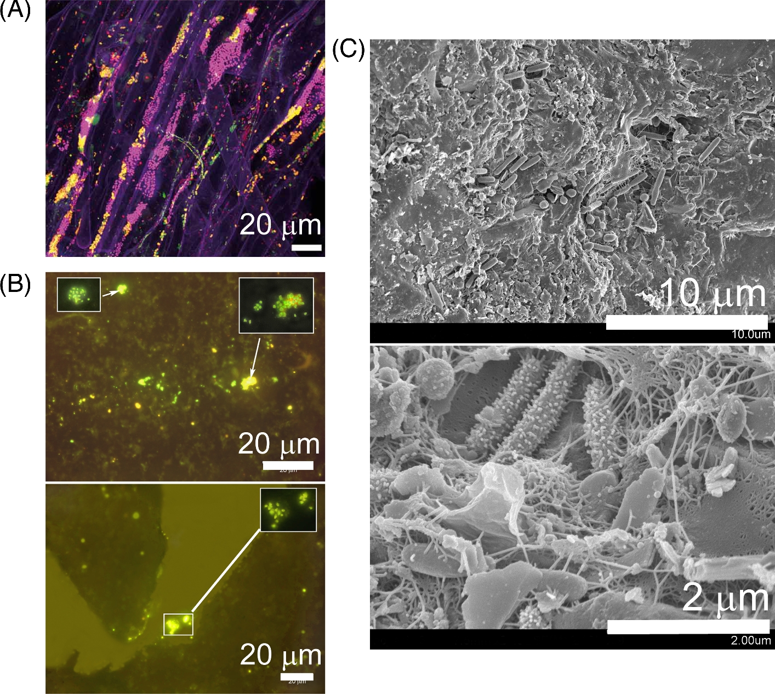

Figure 3. Bacteria colonizing pores and soil surfaces. (A) Fluorescence microscopy images of bacteria in the lettuce ...
Notes:
Figure 3. Bacteria colonizing pores and soil surfaces. (A) Fluorescence microscopy images of bacteria in the lettuce rhizosphere (phylogenetic groups were labeled by fluorescent in situ hybridization and shown with different colors); image adapted from Cardinale (2014). (B) Fluorescence microscopy images of bacteria (labeled by fluorescent in situ hybridization) in a sandy soil; images adapted from Eickhorst and Tippkotter (2008) with permission from Elsevier. [This image is not covered by the terms of the Creative Commons licence of this publication. For permission to reuse, please contact the rights holder.] (C) Scanning electron microscopy images of bacterial cells attached to solid sand surfaces by EPS (seen as a filamentous mesh). Photo credit: Lewis Lab at Northeastern University. Image created by Anthony D’Onofrio, William H. Fowle, Eric J. Stewart and Kim Lewis.
Unless provided in the caption above, the following copyright applies to the content of this slide: © FEMS 2017.This is an Open Access article distributed under the terms of the Creative Commons Attribution Non-Commercial License (http://creativecommons.org/licenses/by-nc/4.0/), which permits non-commercial re-use, distribution, and reproduction in any medium, provided the original work is properly cited. For commercial re-use, please contact journals.permissions@oup.com

