Slide 1
Oculus MP Overview
Gao Song
UCC Software Team

Slide 2
Outline
MP Architecture overview
Component Layers
Made of Channels
Connected by Subscribers
Working as Pipeline
Driven by Data Source
Summary
Debug

Slide 3
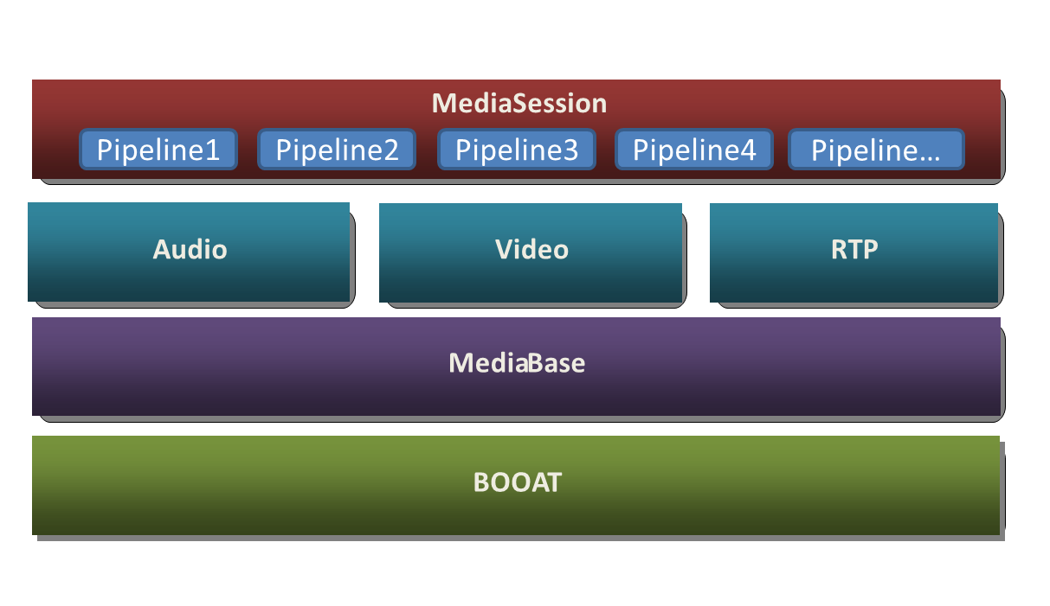
Component Layers
BOOAT: Basic system API wrapper and type definition
Media Base:
Basic data structures related to media processing.
Independent of specific feature or product
Channel, Channel Controller, Channel Composite, Data Source, Pipeline are key modules

Slide 4
Component Layers
RTP:
Network input and output processing
Video:
Provide video processing function: pre-processing, scaling, encoding/decoding, rendering, etc.
Codec APIs are wrapped into this module
Audio:
Provide flow control, encoding/decoding, resample, playback, AEC, mix functions
Pipeline:
Connected Video/Audio, RTP modules
Provide integrated function for stream processing, sending/receiving
Associated with RTCP session

Slide 5
Component Layers
Media Session:
Corresponding to a connected call
Pipeline container
Manage creation and destroy of pipeline
Operate pipeline: start/stop, hold/resume, update
Pipeline can be operated independently in session: audio sending/receiving mute, call hold/resume, video mute…

Slide 6
Made of Channels
Pipeline is made of channels
Channel: a complete function unit (encoder, decoder, RTP, input…)
Two kinds of channels
Composite channel
Controller channel
Composite channel
Run with its connected channel(s) in same thread
Parts of audio channel are composite channel
Controller channel
Own its thread and command/data queue
Exchange data with connected channel(s) by shared buffer

Slide 7
Connected by Subscribers
Channel is connected by other subscriber(s)
The connected subscriber could be channel
Upper channel dispatch shared buffer to all registered subscriber(s)
Subscriber keep input buffer data unchanged, process the data and put data to output buffer, before dispatching to its subscriber(s)
Subscriber will allocate memory, if necessary
Advantages:
Subscribers can always be fed with data (even repeated data) . No channels will be hang for waiting data.
Buffer would be accumulated on condition that downstream subscriber(s) can not handle/return buffer in time. Memory would increase continuously and lead to system overload, which will trigger bug as early as possible.

Slide 8
Working as Pipeline
Connected channels make up pipeline
Video pipeline:
Audio pipeline:

Slide 9
Working as Pipeline
Video pipeline subscription relationship:
Sending:
video_rtp_send subscribe encoder. encoder subscribe resampler
Receving:
jitter subscribe decoder. decoder subscribe video_rtp_recv
Audio pipeline subscription relationship:
Sending:
audio_send_rtp subscribe audio encode. audio encode subscribe AEC . AEC subscribe Input
Receiving:
decode subscribe audio_rtp_recv. FCtrl subscribe decoder. output subscribe FCtrl

Slide 10
Working as Pipeline
Video pipeline thread:
Each channel in video pipeline has its own thread (working thread)
Each channel in video pipeline is created/destroyed in MP main thread.
Audio pipeline thread:
Box with same color share one thread
There is no data flow between output channel and AEC channel, because CSS GW just mute all sending/receiving data.
Input
AEC
Encoder
RTP
Output
Flow Control
Decoder
RTP

Slide 11
Driven by Data Source
Pipeline is driven by data source
Two kinds of data source:
Booat data source: use DataReceiver::onDataReady to drive receiving pipeline
MP data source: use MPAudioDataSource::putData and MPVideoDataSource::putData to drive sending pipeline
Use MPAudioDataSource::getData and MPVideoDataSource::getData to retrieve processed data for playing/rendering from receiving pipeline
For MP external client, use MPDataSourceManager to put/get data to/from pipeline
Need register external client to MPDataSourceManager with source id.

Slide 12
MP Architecture Summary
Code directory structure:
endpoint_common\booat: booat component related code
endpoint_common\media_processor:
algorithm: codec, AEC, FCtrl, LPR, resampler implementation
build: build script folder
include: MP interface for external client
src: pipeline, channel, data source implementation, codec wrapper,
system_test: MP integration test implementation
test: MP unit test implementation
endpoint_common\freerdp: FreeRDP implementation
endpoint_common\script: build scripts for building booat, 3rd parties libs, MP component

Slide 13
MP Architecture Summary
Design:
Buffer management: always allocate buffer, if necessary. Refer to page 7 for its advantages
Support one buffer producer and multi-consumers.
If input buffer will only be used by one subscriber, modifying it is ok. But if not, please not update it, because upper will dispatch data to its consumers/subscribers one by one.
Modification of input data will take effect on subscribers’ sibling(s)
Channel running in different threads own its command/data queue and will be notified to run by event.
RTCP get RTP statistics by copying data from pipeline and no shared data used in this case

Slide 14
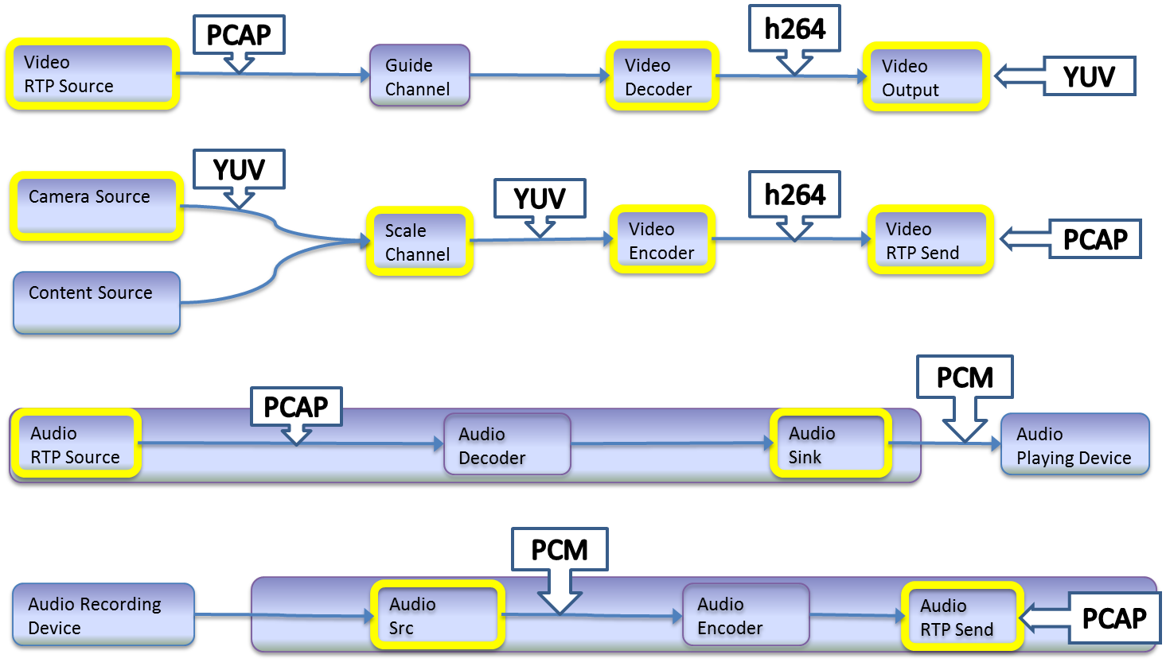
MP Architecture: Thread View for AVC

Slide 15
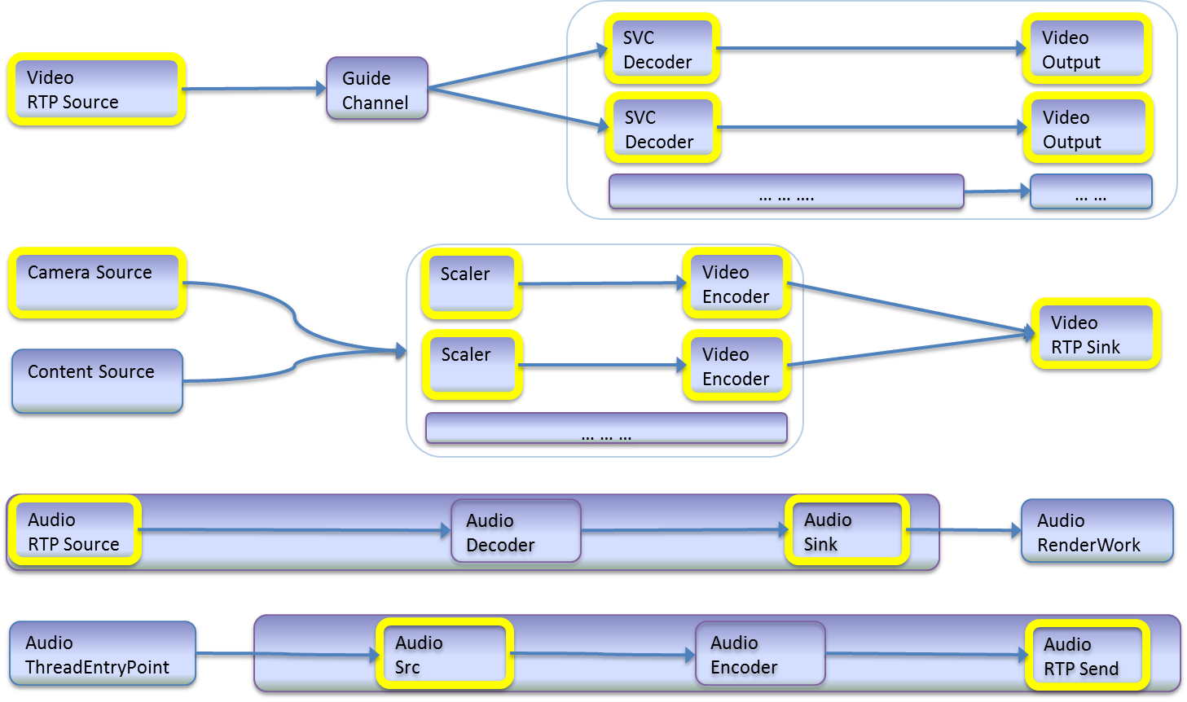
MP Architecture: Thread View for SVC

Slide 16
Q&A

