Slide 1
SIPp
fangpo
Feb 14, 2016

Slide 2
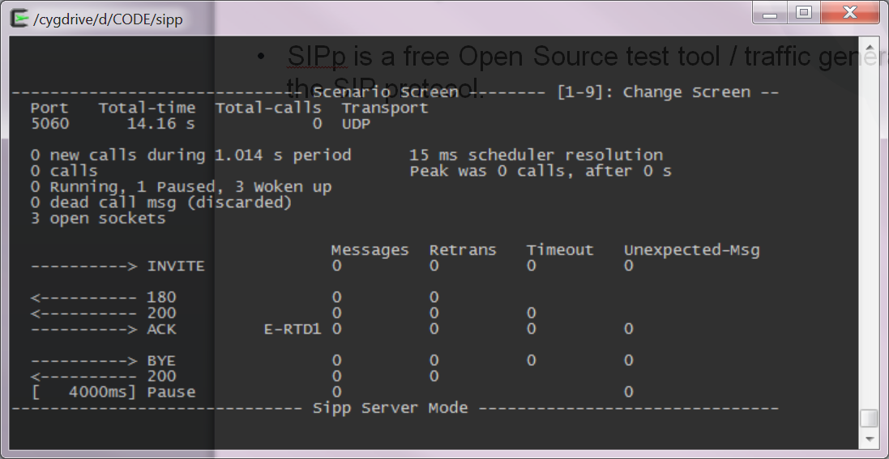
What is SIPp
SIPp is a free Open Source test tool / traffic generator for the SIP protocol.

Slide 3
SIPp features
TCP/UDP/TLS
SIP client/SIP server
Simultaneous call
Send media(audio/video) traffic
RTP echo
RTP pcap
Sip Authentication

Slide 4
How to get SIPp
Download legacy executable
https://sourceforge.net/projects/sipp/files/sipp/3.2/
No latest SIPp executable for download
Download latest source code and build
Install cygwin and build environment
Download SIPp code and build

Slide 5
Install cygwin and build environment
Install https://cygwin.com/setup-x86_64.exe
Select: “Install from internet”
Select root directory: C:\cygwin64
Select local package directory: C:\cygwin_install
Select “Direct connection”
Select one server, such as cygwin.mirrors.hoobly.com
Select following packages
gcc-core gcc-g++ gcc libncurses vim wget
Optional to install: openssl/perl/curl/autoconf/automake/ssh/find

Slide 6
Download SIPp code and build
Refer to http://sipp.sourceforge.net/doc/reference.html#Installing+SIPp
The following is a simplified steps
Open “Cygwin64 Terminal”
cd /cygdrive/d/
mkdir temp; cd temp;
wget https://github.com/SIPp/sipp/archive/v3.4.1.tar.gz
tar xf v3.4.1.tar.gz
There is errors in building 3.5.0
cd sipp-3.4.1
./configure
#Without TLS (Transport Layer Security), SCTP or PCAP support
Please refer to the document above for adding those features
make
make install

Slide 7
Run SIPp command
Open “Cygwin64 Terminal”
Run “sipp” without parameters to see usage

Slide 8
SIPp command Usage
Usage:
sipp remote_host[:remote_port] [options]
Frequently used options:
-sf : Loads an alternate XML scenario file.
To learn more about XML scenario syntax, use the -sd option to dump embedded scenarios. They contain all the necessary help.
-t : Set the transport mode:
- u1: UDP with one socket (default),
- un: UDP with one socket per call,
- t1: TCP with one socket,
- tn: TCP with one socket per call,
-i : Set the local IP address for 'Contact:','Via:', and 'From:' headers. Default is primary host IP address.
-p : Set the local port number. Default is a random free port chosen by the system.
-bind_local : Bind socket to local IP address,
i.e. the local IP address is used as the source IP address. If SIPp runs in server mode it will only listen on the local IP address instead of all IP addresses.
-mi : Set the local media IP address (default: local primary host IP address)
-rtp_echo : Enable RTP echo. RTP/UDP packets received on port defined by -mp are echoed to their sender.
RTP/UDP packets coming on this port + 2 are also echoed to their sender (used for sound and video echo).

Slide 9
Sipp scenarios
Integrated scenarios
sipp -sn uas
sipp -sn uac <remote-ip>
Create your own XML scenarios
UAC example: http://sipp.sourceforge.net/doc/uac.xml.html
UAS example: http://sipp.sourceforge.net/doc/uas.xml.html

Slide 10
Create your own XML scenarios
http://sipp.sourceforge.net/doc/reference.html#Create+your+own+XML+scenarios
In the XML, there are
List of commands with their attributes, Such as
<send> Send message
<recv> Wait specific message
<pause> Pause a while
etc
Keyword list
Keywords are used as variables when send a message, example
<send>
<![CDATA[ INVITE sip:[service]@[remote_ip]:[remote_port] SIP/2.0
Via: SIP/2.0/[transport] [local_ip]:[local_port]
…
</send>
regexp action syntax
Used to extract value from received message, example
<recv request="INVITE" crlf="true" rrs="true">
<action>
<ereg regexp=".*" search_in="hdr" header="Some-New-Header:" assign_to="1" />
<log message="From is [last_From]. Custom header is [$1]"/>
</action>
</recv>

Slide 11
Start SIPp with your XML
Example UAC:
sipp remote_host[:remote_port] -sf uas.xml -t u1
Example UAS:
sipp -sf uas.xml -t u1

Slide 12
Enjoy!

