Slide 1
An NFV Orchestration Framework for Interference-free Policy Enforcement
Xin Li, Chen Qian
University of Kentucky

Slide 2
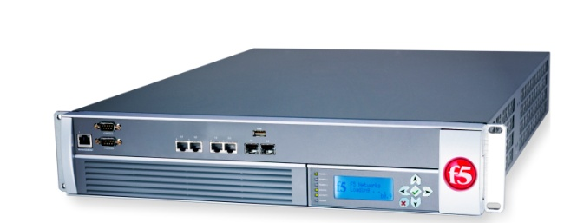
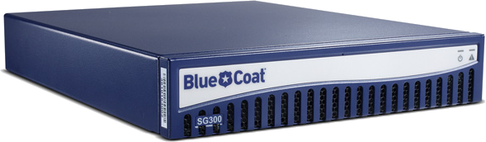
Network Function
Network Function
A.k.a. Middlebox
Networking device that perform functions other than packet forwarding
Build in proprietary hardware

Slide 3
Network Function
Security Network Function
Firewall
IDS
Acceleration Network Function
WAN Optimizer
Proxy

Slide 4
Policy Chain
Correctness: sequential order
Efficiency: not traverse unnecessary ones
Http
Firewall
IDS
Proxy
Non http
Firewall

Slide 5
Network Functions Placement
Policy chain
Placement
not easy to re-deploy
Http
Firewall
IDS
Proxy
Firewall
Proxy
S2
S4
S1
S3

Slide 6
Placement: Hardware Network Functions
Traffic Steering
Simple [Sigcomm’13]
Firewall
IDS
Proxy
Policy Chain:
Http
Firewall
Proxy
IDS
S1
S2
Dst
Image from https://users.ece.cmu.edu/~vsekar/slides/sigcomm13_simple.pptx

Slide 7

Drawbacks of Traffic Steering
Modified routing path
Conflicting with other applications
e.g. Traffic engineering
Additional path length
more latency, bandwidth
Complex routing rules
More forwarding table entries
Loop
Additional mechanism (e.g. tag)

Slide 8



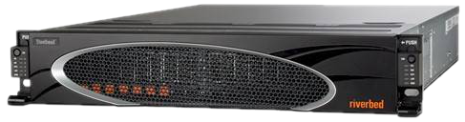

Network Functions Virtualizaiton
IDS
Hardware
Software
WAN Optimizer
More flexible and cheaper
New opportunity: interference-free policy enforcement
Virtual Network Function (VNF)
Proxy

Slide 9
NFV Orchestration Properties
Policy enforcement
Sequence order should be respect
Interference-freedom
Not changing the routing path
Isolation: security and performance
Virtual machine

Slide 10
NFV Orchestration Framework
Core idea
Network Functions are contained in VMs for isolation.
Places the required VNFs on the path of each traffic flow
Not changing routing path

Slide 11
Challenges
Resource-efficient way to place VNFs while enforcing policies.
Optimization problem
Traffic is highly dynamic.
Fast failover
Scale in/out

Slide 12
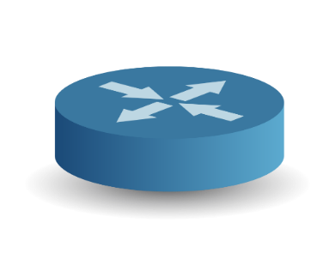






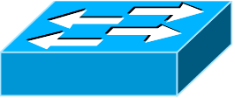
Framework Overview
Traffic
Policy
Path
0.5k
...
1k
1k
http
Proxy
FW
0.5k
SDN controller
Resource
Orchestrator
Optimization Engine
...
App1
App2
Dynamic Handler
Rule Generator
Take Opt Engine output as input
Install VNFs in APPLE hosts
Take outputs from diff apps as input
Generate routing rules (sw & vsw)
Core. Co-exist with other apps
normal app from SDN controller’s view
Inputs to Opt Engine:
Flow spec. & available rsc.
Hosts VNFs
Once overloaded, send ntf. to Dyn. Hdl.
Fast failover if overloaded

Slide 13
Framework Overview
Traffic
Policy
Path
0.5k
...
1k
1k
http
Proxy
FW
0.5k
SDN controller
Resource
Orchestrator
Optimization Engine
...
App1
App2
Dynamic Handler
Rule Generator

Slide 14
Optimization Engine
Input granularity
flows having the same path and policy chain are aggregated into a class
Benefits:
Reduce input size
Wildcard rules instead of exact match: reduce forwarding table entry consumption

Slide 15
Optimization Engine
Spatial Distribution
Load balance
Handle jumbo classes
Firewall
IDS
Policy Chain:

Slide 16
Optimization Engine
Algorithm Objective
Minimize # of VNFs
Algorithm Input
VNF capacity : the max traffic rate it can process
Available Resource & VNF resource consumption
Policy chain
Routing path
Traffic matrix: estimated by other application
Algorithm Output
The place and quantify of each VNF (Placement)
The portion of traffic to be processed in each VNF instance for each class (Rule generation)

Slide 17
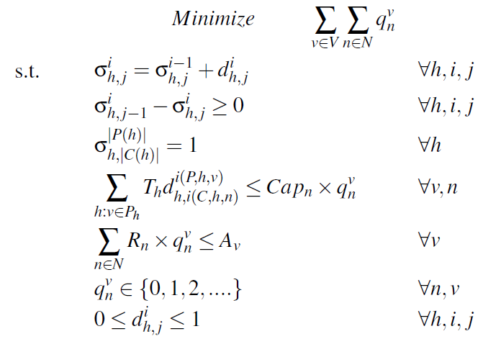

Optimization Engine
Integer Linear Programming (ILP)
CPLEX to solve
NP-hard
Reduced to Set Cover Problem
Approximation algorithm: LP relax
# VNFs
Topology | Nodes | Links | Time
Internet2 | 12 | 15 | 0.08 Sec
GEANT | 23 | 74 | 0.42 Sec
UNIV1 | 23 | 43 | 0.59 Sec
AS-3679 | 79 | 147 | 633.59 Sec
Appr. Algorithm Time
0.029 Sec
0.1 Sec
0.235 Sec
3.013 Sec

Slide 18
Framework Overview
Traffic
Policy
Path
0.5k
...
1k
1k
http
Proxy
FW
0.5k
SDN controller
Resource
Orchestrator
Optimization Engine
...
App1
App2
Dynamic Handler
Rule Generator

Slide 19
Rule generator
Optimization Engine Output
The portion of traffic to be processed in each VNF instance for each class (Rule generation)
Cannot generate rules directly

Slide 20
Rule generator
Sub-class: aggregation of flows within a class that traverse the same VNF instances
The workload assignment to each sub-class is accepted as long as the result of Optimization Engine is preserved
Firewall
IDS
Policy Chain:
FW
FW
IDS
IDS

Slide 21

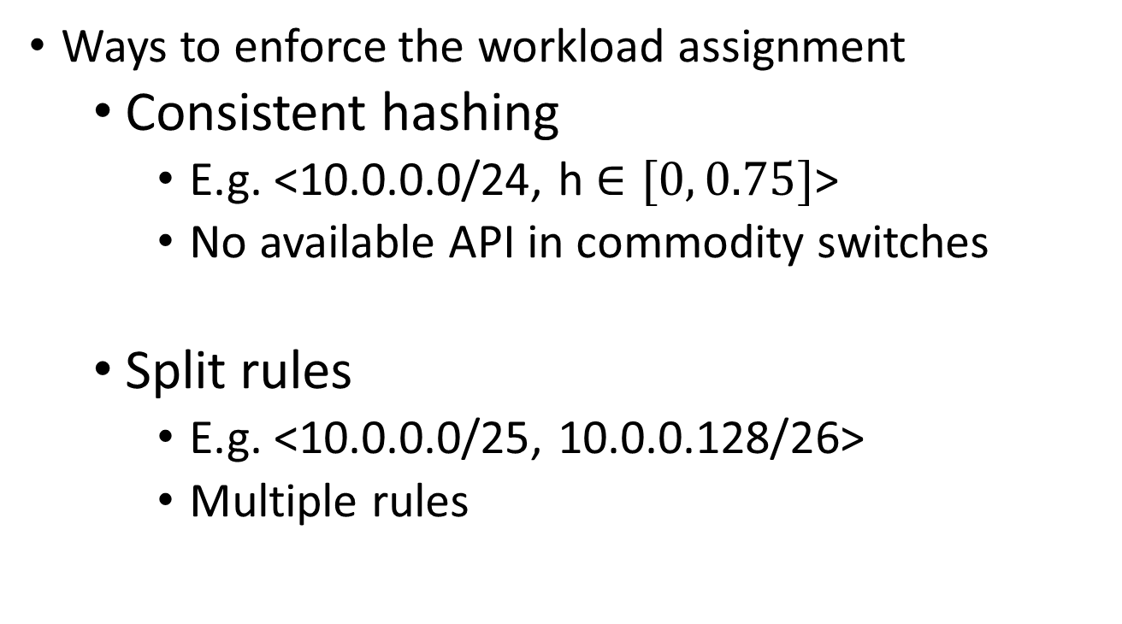
Rule generator
Ways to enforce the workload assignment
Consistent hashing
E.g. <10.0.0.0/24, h $∈[0, 0.75]$>
No available API in commodity switches
Split rules
E.g. <10.0.0.0/25, 10.0.0.128/26>
Multiple rules

Slide 22
Framework Overview
Traffic
Policy
Path
0.5k
...
1k
1k
http
Proxy
FW
0.5k
SDN controller
Resource
Orchestrator
Optimization Engine
...
App1
App2
Dynamic Handler
Rule Generator

Slide 23
Dynamic Handler
Firewall
IDS
Policy Chain:
Overload notification
New FW
Install new forwarding rules
Initiate new VM
Using ClickOS: lightweight

Slide 24
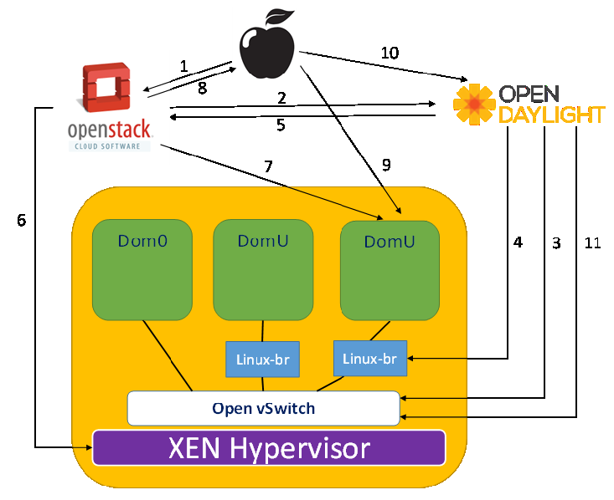
Implementation
Core: Stand-alone
REST API
XEN VMs can’t be connected to OpenVswitch directly
Network Controller
Resource Orchestrator
ClickOS
ClickOS
Linux-br

Slide 25
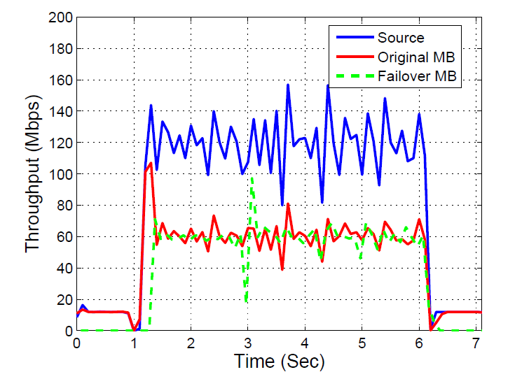
Prototype Emulation
Dynamic Handler
overload
roll back

Slide 26
Simulation Evaluation
Methodology
The input to Optimization Engine is the average traffic matrix.
See the performance of APPLE with time-varying traffic matrix.

Slide 27
Simulation Evaluation
Topologies
Campus network, enterprise network, data center
Network Functions
Each host have 64 cores
4 network functions (FW, IDS, Proxy, IDS)
Different core # requirement and capacity
Policy
Synthesize network policy chains

Slide 28
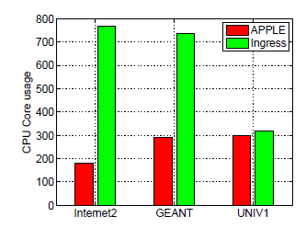
Simulation Evaluation

Slide 29
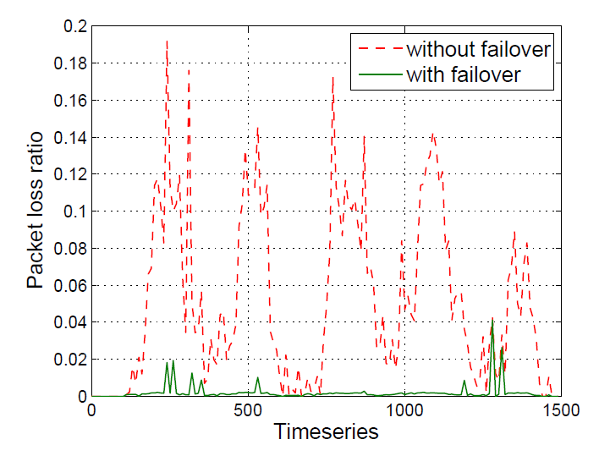
Simulation Evaluation
Less packet loss

Slide 30
Conclusion
We design and implement an interference-free NFV Orchestraton Framework
Resource efficient
Incorporate network dynamics
Integrate ClickOS and OpenStack

Slide 31

Thank you!

Slide 32
Backup slides

Slide 33
Optimization Engine: Policy enforcement
Policy enforcement. To enforce policies, the requirements are two-folded for each flow.
For each network function specified by the policy for a flow, at least one instance is on the network path.
For any VNF instance n, there should be at lease one instance of the VNFs succeeding n on the same switch of n or the downstream switches on the path. (recursive)

