Slide 1

Distributed & Collaborative Monitoring in SDN
﻿An Equal Opportunity University

Slide 2


Motivation
Traditional monitoring is sampling

Slide 3
Motivation
Sampling is coarse-grained
Sample rate is low
Sampling fails short in
Application identification
Anomaly detection
More…

Slide 4
Motivation
Per-flow monitoring

Slide 5
Motivation
Per-flow monitoring
Rule-based
Large memory space
Aggregation-based
False positive
Non-trivial memory space
Match | MonAct
f1 | Sample
f2 | Count
Match | MonAct
10.0.0.0/24 | Sample
10.0.0.1/24 | Count

Slide 6
Distributed & Collaborative Monitoring
Each flow may have its own action requirements.
Millions of flows
Task:
Distribute actions among switches.
Represent rules compactly
Notes:
In a typical network, there may be millions of flows, each of the flows may have its own monitoring action requirement,
So the task of DCM is to distribute the monitor actions among the switches, so that each of the switches is responsible for a certain number of monitoring tasks on a set of flows and work collarboratively.,and , we need to Represent the monitoring rules effiencetly.

Slide 7
Approach: Bloom Filters
Use Bloom Filters to identify flows that should be monitored.
Populated by central controller.
Bloom Filter {f1,f3,f5}→ Counting
Bloom Filter {f1} → Sampling
Notes:
Our approach to provide such memory effienciy ,is to use bloom filters to represent the set of flows that should be monitored by a certain monitoring action.
For example, there are two bmfs installed on this switch, here we let packets of flow f1,f3,f5 goes to heavy hitter detection, and do sampling on flow f1.

Slide 8
DCM Data Plane: Two-stage Bloom Filters
Admission
Bloom Filter
No Monitoring Action
Notes:
For the dataplane of the switch, DCM uses TWO-stage bloom filters to decide which monitoring actions it should carry out.
On Recving a packet, DCM will check the packet using the Adm bloom filter. It selectes the packets that belongs to the flows monitored on this switch. Usually, the majority of the packets will not pass it. Because only a small number of flows is monitored on one single switch. However, the adm bf does not specify which action should be taken on this packet.

Slide 9
DCM Data Plane: Two-stage Bloom Filters
Action Bloom Filters
Actions
Match
BF
1
Match
:
{
f
1
,
f
2
,
…
Admission
}
ActA
BF
2
:
{
f
2
,
f
3
,
…
Bloom Filter
}
ActB
BF
3
:
{
f
4
,
f
5
,
…
}
ActC
…
..
...
No Monitoring Action
Notes:
If a packet passes the adm blm filter , then it will be further checked by the action bloom filters to decide the corresponding monitor actions.
Each of the action bfs represents the set of flows that the specific action should be taken on.
If a packet passes a action bf, the corresponding actions will be taken on this packet.

Slide 10

DCM Overview
controller
New flow notification
Packet miss

Slide 11
Challenges
Flow dynamics
Deletion
False positive in Data Plane
Inaccurate monitoring
Task allocation
Load balance, minimize FP

Slide 12




Flow dynamics
Use CBF in Control Plane
Support addition/deletion
save space multiple times on switches
CBF in Control Plane
Deletion
BF in Data Plane

Slide 13
False positive
Detect FP in Control Plane
Simulate the behavior for new flows
Mitigate FP in report
admBF
actBF1
admBF
actBF2
admBF
actBF1
Match! FP!
actBF1
actBF2
actBF2
No Match
No FP
admBF
actBF1
actBF2

Slide 14




Task allocations
Minimize FP
$$f_{1}$$
$$f_{2}$$
$$f_{3}$$
$$f_{4}$$

Slide 15
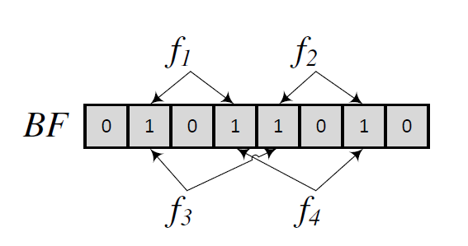
Task allocations
Minimize FP

Slide 16
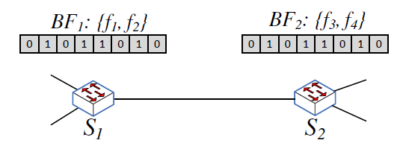
Task allocations
Minimize FP

Slide 17
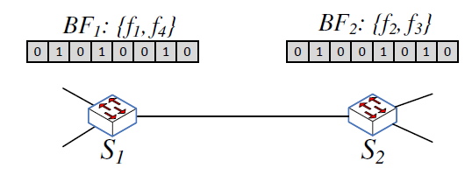
Task allocations
Minimize FP
Intuition: minimize 1s

Slide 18

Task allocations
Is it practical to get minimum number of 1s?
It is NP-hard. (SetCover)

Slide 19

Task allocations (Heuristics)
1
0
0
1
0
0
0
0
One more 1
Two more 1s
Starting from high-volume flows

Slide 20
Task allocations (Heuristics)
Case 1:
Exist complete overlapping.
Choose the overlapping one.
Case 2:
No complete overlapping.
Consider both overlapping and workload.

Slide 21
Task allocations
Real-time online allocation
Periodically offline refinement
Overloading handler

Slide 22
Evaluation
Prototype emulation
Click
Trace-driven simulation
Real topologies + real traces

Slide 23
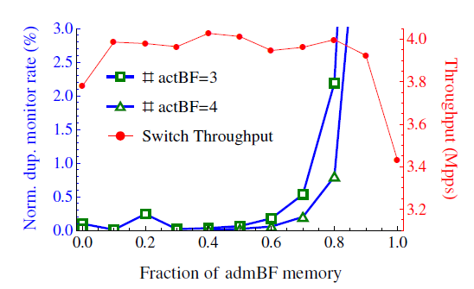
Prototype emulation (single sw)
PF of admBF
Overall false positive

Slide 24
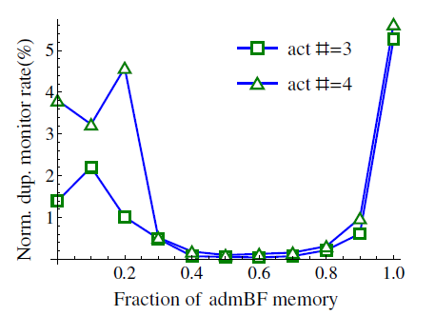
Simulation (network wide)
Optimal range

Slide 25
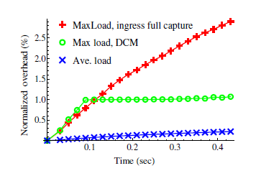
Simulation (Load balance)

Slide 26
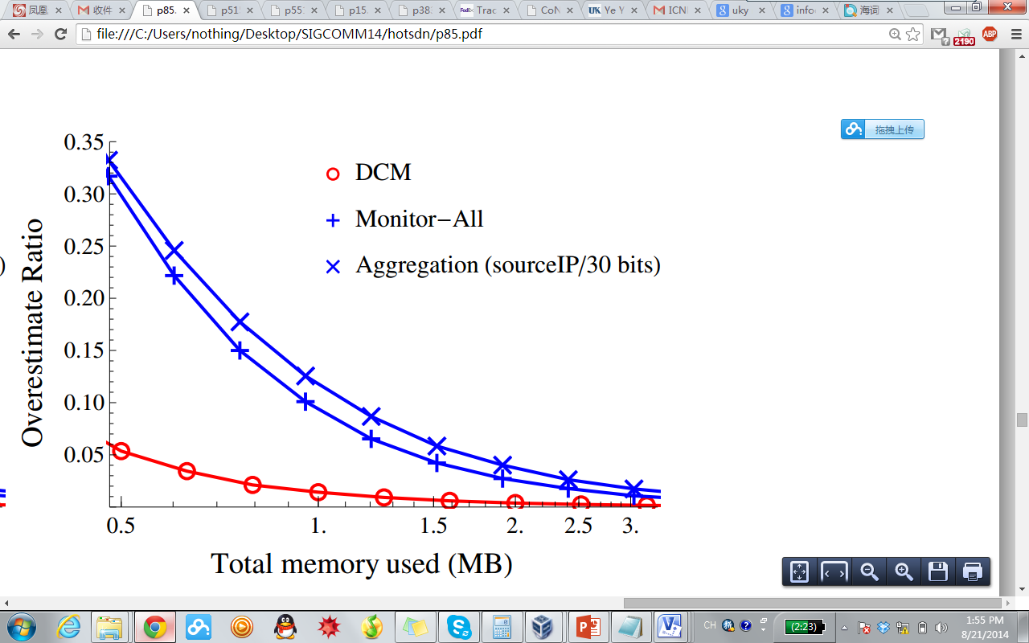
Case Study: Flow Size Counting with Count-Min Sketch
The overestimate ratio reduces significantly.
Notes:
there are two case studies provided in our paper, here we show DCM helps to improve the memory efficiency for couting the flow size using count minium sktch.
Here the x axis indicates the size of total memory used (by the monitor rule table or blfms and the sketch,) the y axis indicates the overestimation under a certain memory limit.
Compared to the other two naïve approaches for per-flow monitoring, (monitor-all where the packets are monitored by all the switches on its path, and aggregation, where the flows are aggregated so that the total number of monitoring rules does not blow up.)
We can see that, when provided the same size of memory space, DCM reduces the overestimate ratio significantly.

Slide 27
Thank you!
Notes:
Thank you.

