Slide 1

An IoT Data Communication Framework for Authenticity and Integrity
Presenter: Xin Li

Slide 2






IoT is ubiquitous

Slide 3




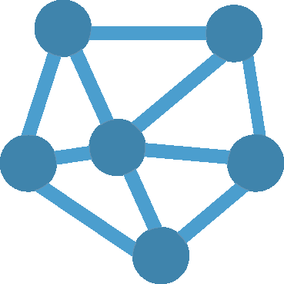
IoT trends
By 2020
Billion
Trillion
Billion
4
4
25+
Trillion
50
Connected People
Revenue
Device
Traffic

Slide 4




IoT hardware platforms
Problem: Resource constrained

Slide 5







IoT Communication Framework

Slide 6


Security threat

Slide 7




Security threat
Scope: Authentication and integrity.
Privacy is orthogonal.

Slide 8
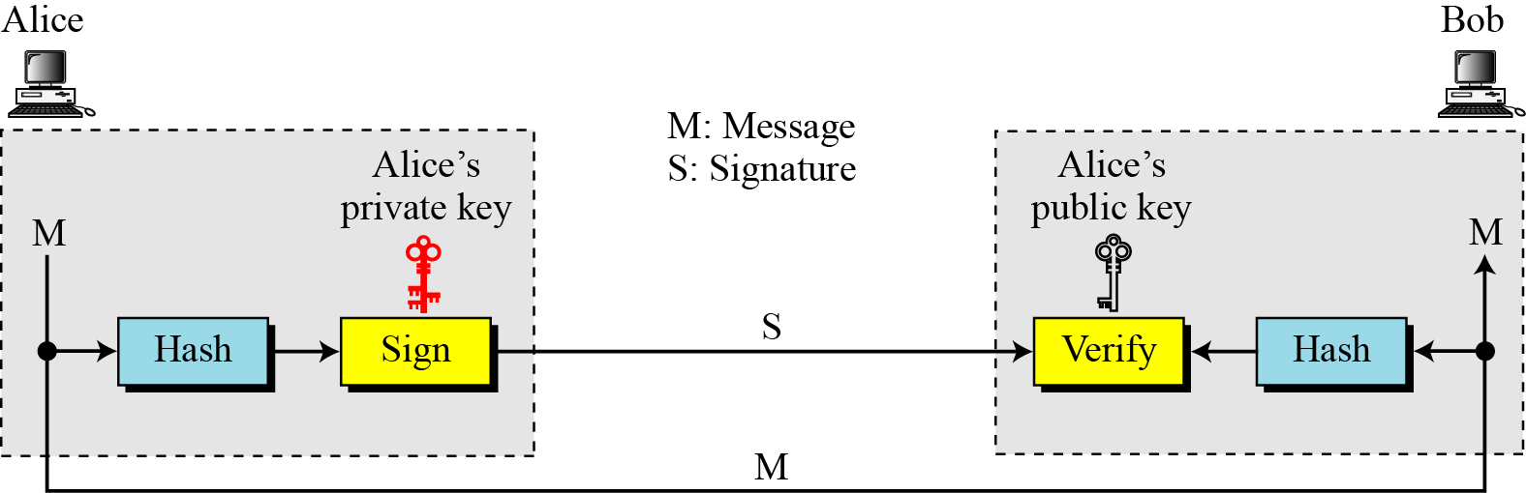
Digital signature preliminary

Slide 9

Digital signature scheme: sign-each
Problem: slow and power-hungry

Slide 10

Digital signature scheme: concatenate
Problem: partial data retrieval
not supported

Slide 11
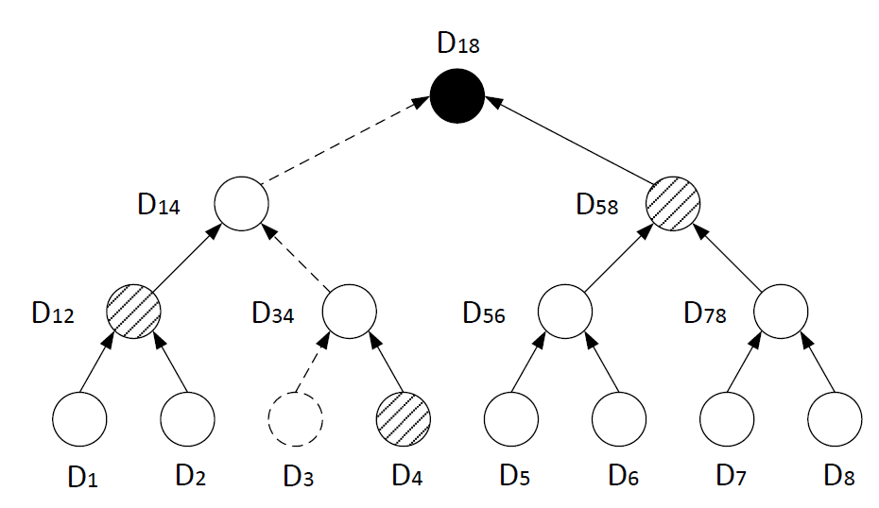

Digital signature scheme: Merkle tree
Space complexity: O(n)
D12 = H(D1||D2)
Any optimization opportunities?

Slide 12
Dynamic Merkle tree

Slide 13
Dynamic Merkle tree

Slide 14
Dynamic Merkle tree

Slide 15
Dynamic Merkle tree

Slide 16
Dynamic Merkle tree
Space complexity: O(log n)
Can we do better?

Slide 17
Geometric star chaining
Intuition: any fraction number can be represented or approximated by a few bits
5/8 = (0.101)₂

Slide 18
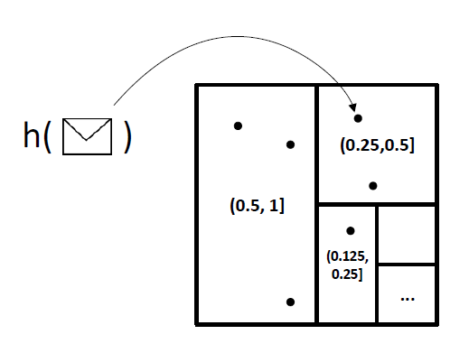
Geometric star chaining
5/8 = (0.101)₂

Slide 19
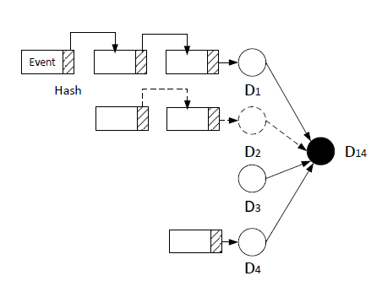
Geometric star chaining
D1 = H(H(e)||D1)
Constant!

Slide 20
Budget limit
Limited storage quota
Limited bandwidth

Slide 21

Distributed stream sampling
Coordinator

Slide 22
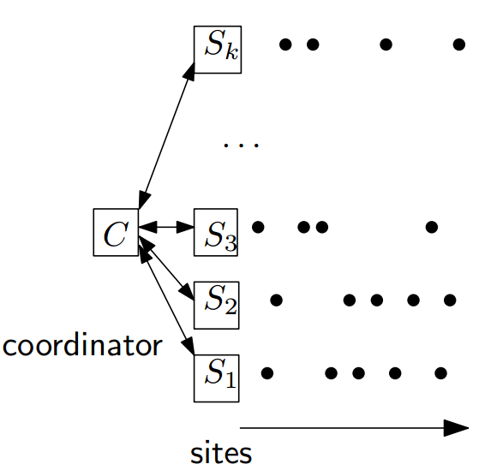
Distributed stream sampling

Slide 23
Min-wise sampling
0.391
0.908
0.291
0.555
0.619
0.273
Communication cost is high!
Broadcast when B-th smallest changes

Slide 24
Evaluation
Simulation and prototype emulation
Real dataset：5 event-based sensing data
Methodology: simulation result feeds prototype emulation
Prototype emulation
DSA
MD5

Slide 25
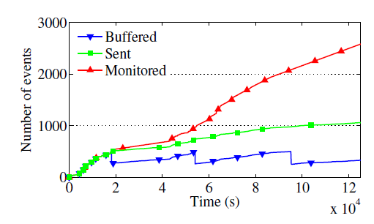
Simulation
Micro-scale experiment

Slide 26
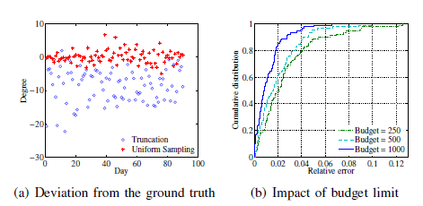
Simulation
Uniformity

Slide 27
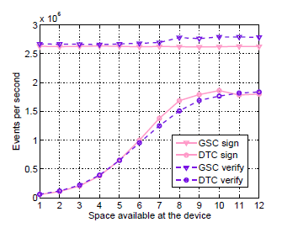
Prototype emulation

Slide 28
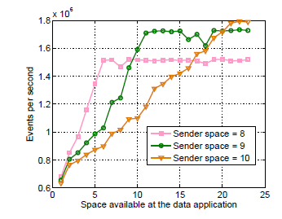
Prototype emulation

Slide 29
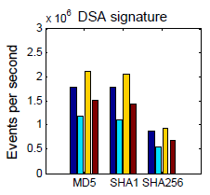
Prototype emulation

Slide 30
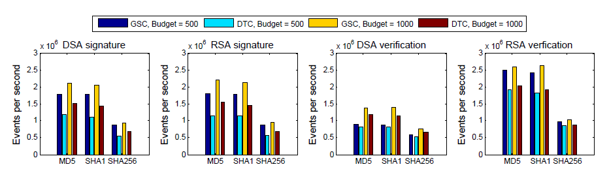
Prototype emulation

Slide 31

Thank you！

