Slide 1
Traffic and Failure Aware VM Placement for Multi-tenant Cloud Computing
Chen Qian, Xin Li
University of Kentucky

Slide 2
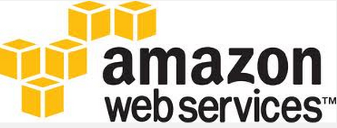
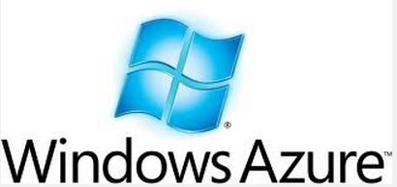


Multi-tenant Cloud
Datacenters with multiple tenants
Provider: Amazon EC2, Windows Azure, etc.
Tenants: Using renting virtual machines (VMs).

Slide 3



VM placement overview
Easy to express tenants’ requests
Abstraction model
#VMs, network performance, availability
Fast to place VMs on physical networks
Optimize network performances
Request
Virtual to
Physical
Cloud Interface
Tenant

Slide 4


Datacenter Networks
Top-of-rack Switch
…
…
….
…
Server 1
Server n
Server 1
Server n
Server 1
Server n
Rack 1
Rack 2
Rack m

Slide 5
In-network traffic
More
Bandwidth&latency
Cross-rack Traffic
In-rack Traffic
…
…
….
…
a
c
d
b
Rack 1
Rack 2
Rack m

Slide 6
Reducing cross-rack traffic
In-rack traffic is more preferred than cross-rack traffic
Switch can forward in-rack packets at line-rate between different ports
Oversubscription is common in current DCNs
Cross-rack traffic is a level of oversubscription. Packet-drop will occur for high cross-rack traffics

Slide 7
Existing work
TMVPP [INFOCOM’10], Oktopus [SIGCOMM’11]
Require for full traffic matrix information
NOT consider fault tolerance
Hose Model [SIGCOMM’99] and Virtual Cluster [SIGCOMM’11]
NOT reflect communication patterns
CloudMirror [SIGCOMM’14]
Fault tolerance is not guaranteed

Slide 8
Function-based Abstraction Model (FAM)
Utilize some application-level knowledge as the hint for traffic-aware and function-aware placement
Tenant networks consists of functions
Each VM serves one function
A function consists of one or more VMs
E.g. load balancer, getway, etc.

Slide 9
Function-based Abstraction Model (FAM)
Inter-function traffic
Vary significantly (e.g. B>>b)
Distribute evenly between VM pairs
DP1
DP2
DP3
B/9
MySQL1
MySQL2
MySQL2

Slide 10
FAM V.S. Hose
Hose Model
Hose Model
Physical Deployment

Slide 11
FAM V.S. Hose
Smaller (compared to 2B)
FAM
FAM capitalizes on tenant communication patterns
Suitable for typical applications
Improved network performance
FAM
Physical Deployment

Slide 12
Network failure
Different levels of failures
We focus on failures within a DCN
Tenants want reliable services
Server/rack failure may cause function disability
If all VMs of “load balancer” function are in a same rack
Rack failure causes the disability of “load balancer”
…
lb1
lb2 lb3

Slide 13
FAM representation
Functions (Vertex)
#VMs
Fault tolerance: max fraction of VMs in a same rack
Bandwidth (Link)
Load
Balancer
b
Dev.
Portal
(3, 0.9)
(3, 0.8)
B
B
KMS
b
MySQL
(3, 0.8)
(3, 0.8)

Slide 14
VM Placement Goal
Reduce the traffic-distance product of a multi-tenant DCN by smart VM placement, while preserving the reliability requirements

Slide 15
VM placement heuristic
This optimization problem is NP-hard
Quadratic Assignment Problem (QAP)
Three steps:
Partition
Place
Virtual Migration

Slide 16
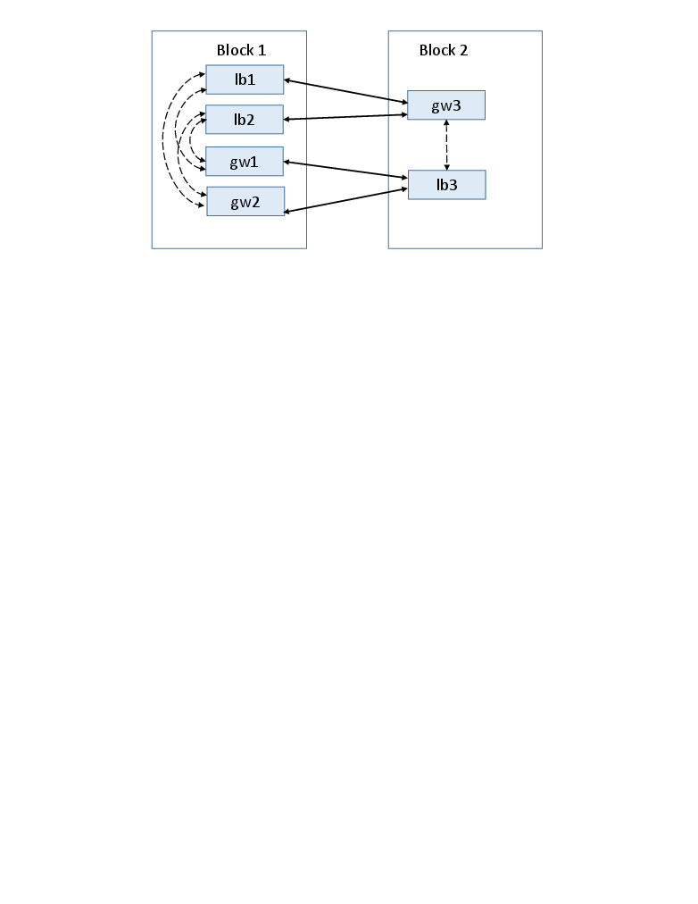
VM placement : partition
Split the set of VMs to multiple components that are placed to different racks
Minimize cross-block traffic, while keeping fault tolerance requirement

Slide 17


VM placement: place
Core
Place blocks onto DCN
…
…
Block1
Block2
Rack1
Rack2

Slide 18
VM placement: place
Core
Place blocks onto DCN
Split blocks if needed
Virtual migration
Fault tolerance requirement violated
Block1
Block2
Rack1
Rack2

Slide 19
Evaluation
Trace: 44 tenant networks, 512 VMs
Physical topology: fattree
8 racks, 32 machines
Each machine can host 16 VMs
Comparison: random, swap, k-cut

Slide 20
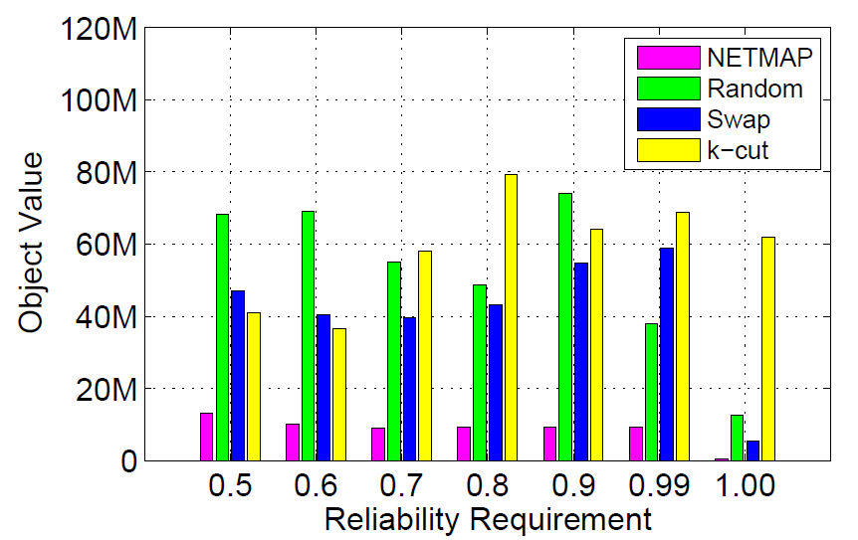
Evaluation
Traffic-network product
Worse
Outperform in all cases
Better
Requirement less strict

Slide 21
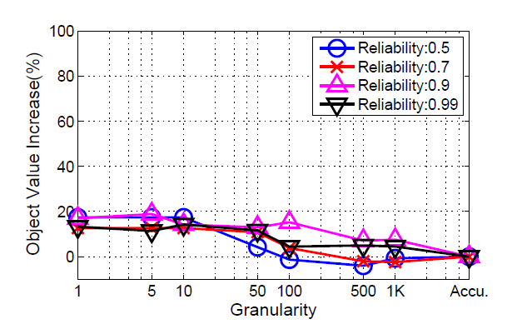
Evaluation
Less than 20%
More accurate

Slide 22
Conclusion
Function-based Abstraction Model
Easy and expressive
VM placement
Low overhead
Good for low-granularity traffic

Slide 23
Q&A
Thank you

